Slide 1
Maths
Position and Direction
Year One
Maths | Year 4 | Position and Direction | Translations | Lesson 3 of 3: 2D Shape Translations

Slide 3
Aim
I can describe the translation of a 2D shape on a coordinate grid.
Success Criteria
I can label the x-axis and y-axis.
I know that translation is a movement from one position to another, without turning.
I can combine translation with coordinates.

Slide 4
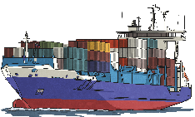
Stormy Seas
Use the vocabulary of position and direction to describe the routes the boats travel across the stormy sea. Click on the boats to see the routes.
North
East
South
West
above
below
between
higher
lower
left
right
Show Route
Show Route
Show Route
North-East
South-East
South-West
North-West
horizontal
vertical
diagonal
row
column
parallel
Hide Route
Hide Route
Hide Route
Show supporting vocabulary word bank
Hide supporting vocabulary word bank

Slide 5
Translating Coordinates
6
In maths, translation means moving an object on a grid.
5
4
The object is moved without changing the size, turning or reflecting it.
3
When translating a 2D shape on a grid we have to make sure that each corner of the shape is moved the same direction and the same number.
2
1
0
1
2
3
4
5
6
Click on the purple triangle to translate it right 3, up 2 on the grid.

Slide 6
Translating Coordinates
6
In maths, translation means moving an object on a grid.
5
4
The object is moved without changing the size, turning or reflecting it.
3
When translating a 2D shape on a grid we have to make sure that each corner of the shape is moved the same direction and the same number.
2
1
0
1
2
3
4
5
6
Click on the blue rectangle to translate it left 2, down 4 on the grid.

Slide 7
Translating Coordinates
6
In maths, translation means moving an object on a grid.
5
4
The object is moved without changing the size, turning or reflecting it.
3
When translating a 2D shape on a grid we have to make sure that each corner of the shape is moved the same direction and the same number.
2
1
0
1
2
3
4
5
6
Click on the green parallelogram to translate it right 1, down 2 on the grid.

Slide 8
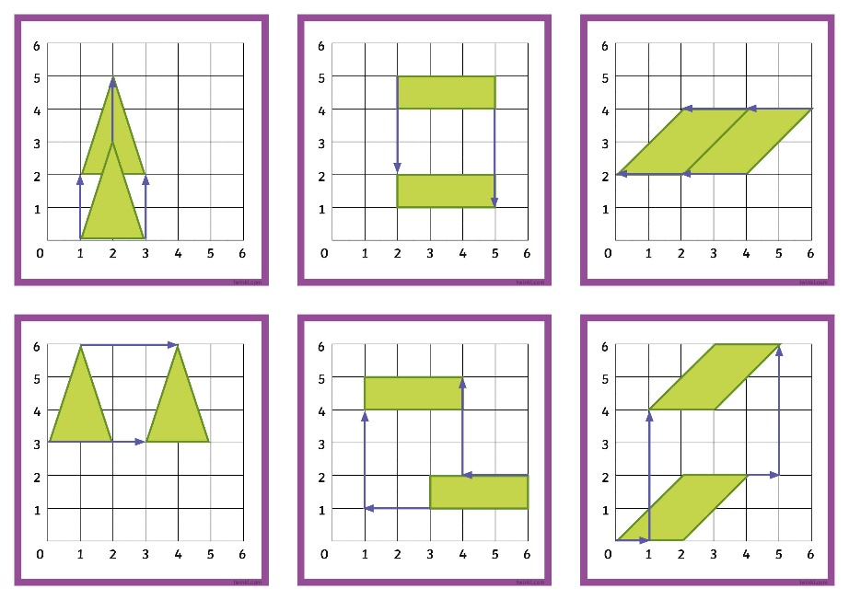
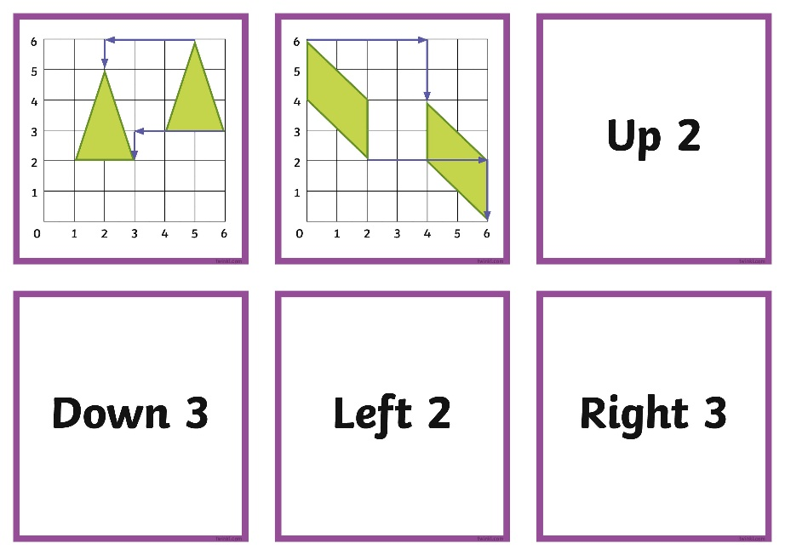
2D Shape Translations
Match Up
Work together in your group to match the translation descriptions to the correct grid.

Slide 9
2D Shape Translations Match Up Answers
Up 2
Down 3
Left 2
Right 3
Left 2, Up 3
Right 1, Up 4
Left 3, Down 1
Right 4, Down 2

Slide 10
Translating 2D Shapes
6
When describing the translation of the purple triangle, we can also include the coordinates of the starting and finishing position:
5
4
Starts at
(1,1), (3,1), (2,4)
3
2
Translates
Right 3, Up 2
1
Finishes at
(4, 3), (6,3), (5,6)
0
1
2
3
4
5
6

Slide 11
Translating 2D Shapes
6
When describing the translation of the blue rectangle, we can also include the coordinates
of the starting and finishing position:
5
4
Starts at
(3,4), (6,4), (6,5), (3,5)
3
2
Translates
Left 2, Down 4
1
Finishes at
(1,0), (4,0), (4,1), (1,1)
0
1
2
3
4
5
6

Slide 12
Translating 2D Shapes
6
When describing the translation of the green parallelogram, we can also include the coordinates of the starting and finishing position:
5
4
Starts at
(1,4), (2,4), (3,5), (2,5)
3
2
Translates
Right 1, Down 2
1
Finishes at
(2,2), (3,2), (4,3), (3,3)
0
1
2
3
4
5
6

Slide 13
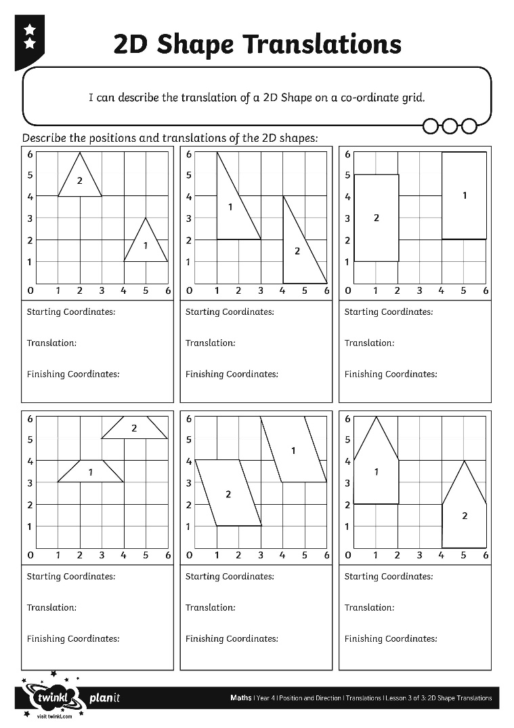
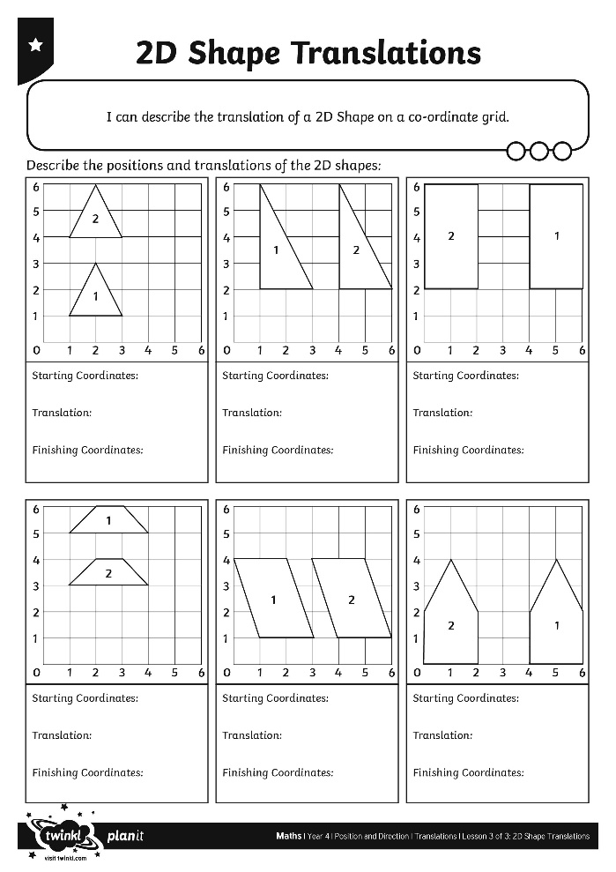
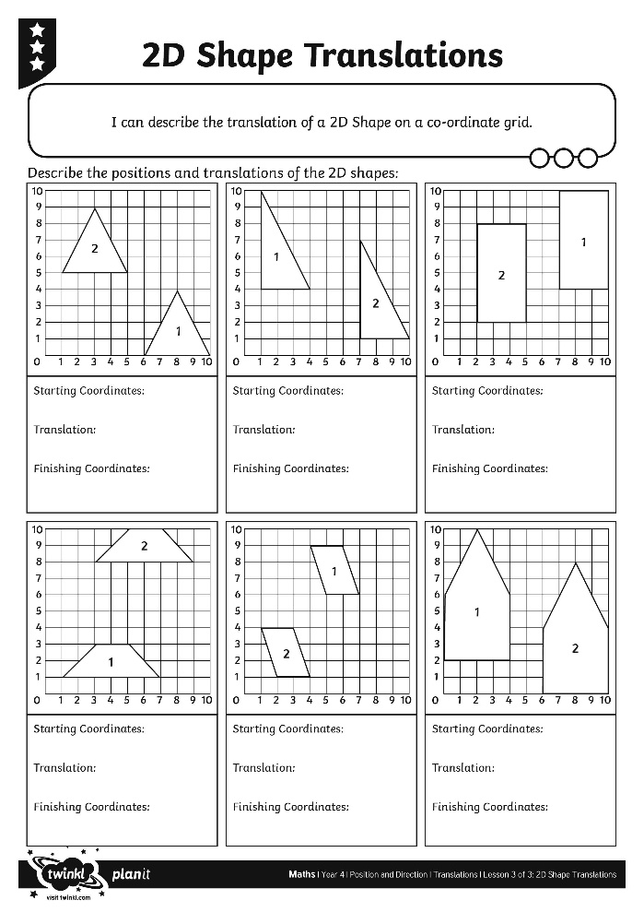
2D Shape Translations

Slide 14
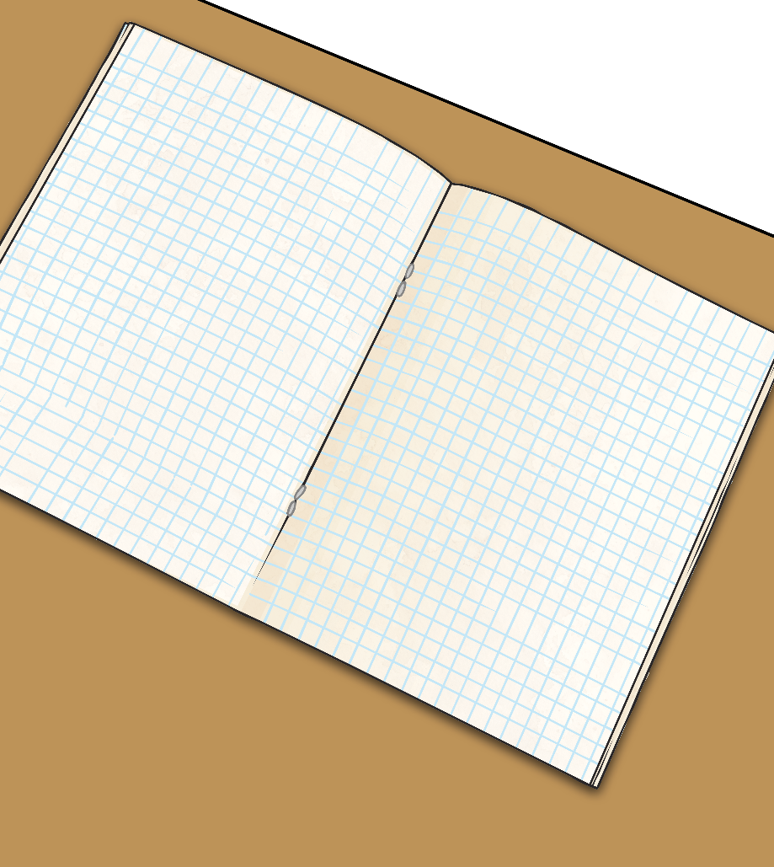
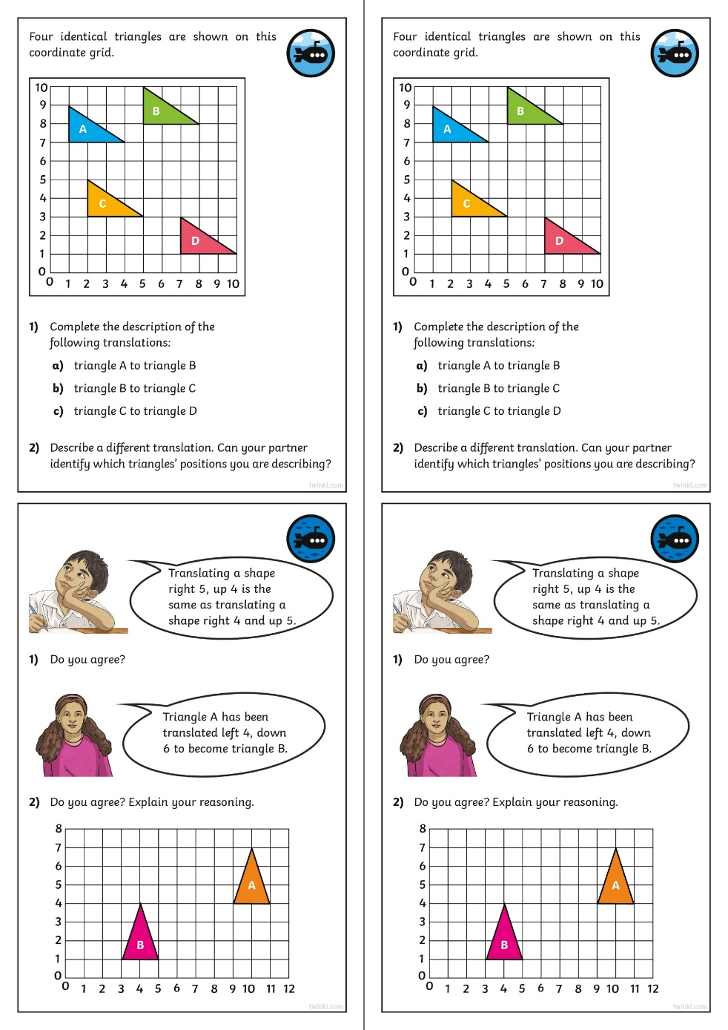
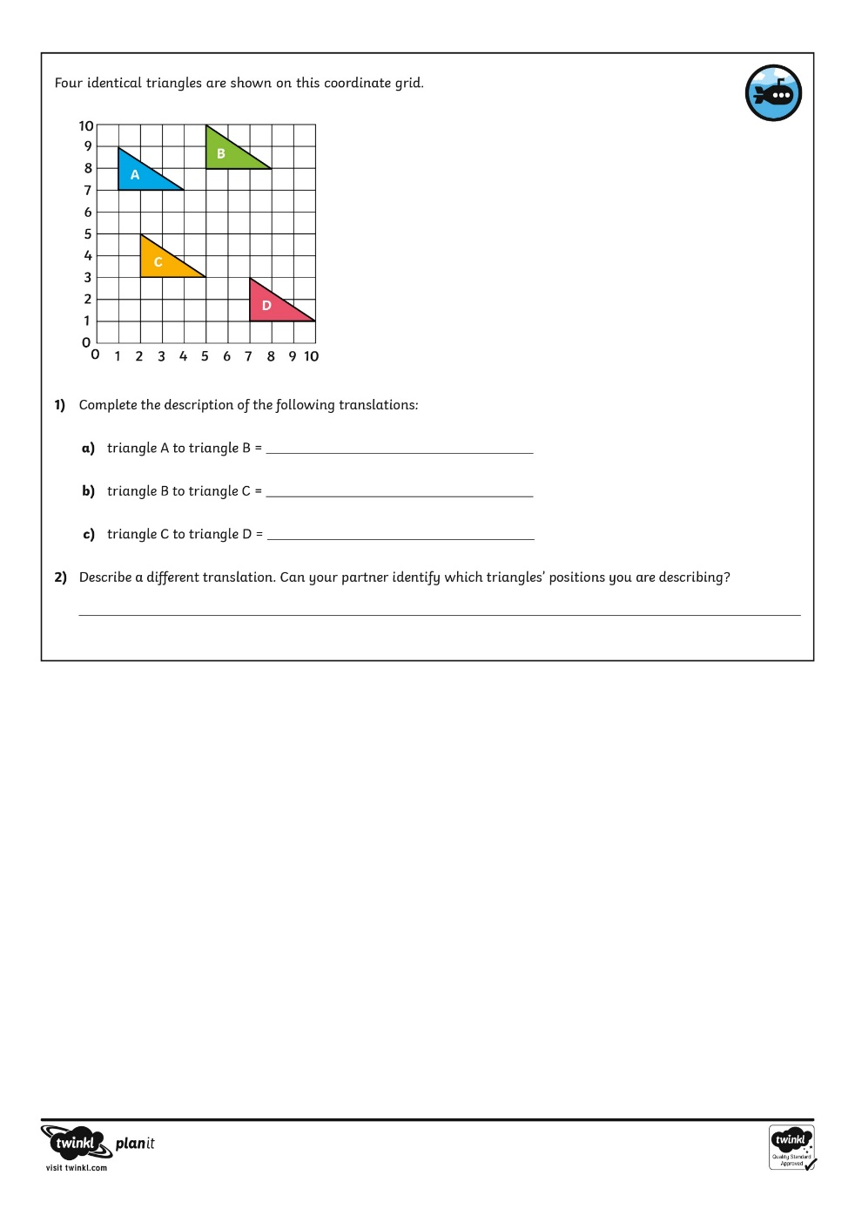
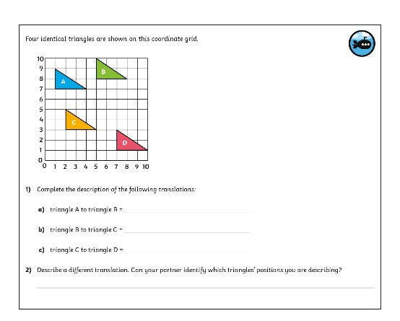
Diving into Mastery
Dive in by completing your own activity!

Slide 15
Translation Quiz Click on the rectangle. How has it been translated?
Up 4
Up 3
Down 4

Slide 16
Translation Quiz Click on the rectangle. How has it been translated?
Left 3
Up 3
Right 3
Up 3
Right 4
Up 4

Slide 17
Translation Quiz Click on the rectangle. How has it been translated?
Right 2
Down 3
Right 3
Down 3
Left 3
Down 2

