Slide 1


Maths
Statistics
Year One
Maths | Year 2 | Statistics | Lesson 5 of 6: At the Farm

Slide 3
Aim
To interpret and construct a pictogram where one picture represents 10.
Success Criteria
I can record data on a pictogram.
I can make a pictogram where one picture represents 10.
I can find the total on a pictogram where one picture represents 10.
I can ask and answer questions about the data.

Slide 4



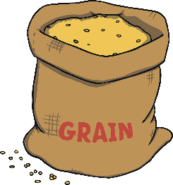


Tens
Each pictures stands for 10.
?
How many of each animal treat is there in the farmer’s barn today? What will half a picture be worth?

Slide 5






Tens
Animal Treat | Frequency
80
55
20
35
70

Slide 6



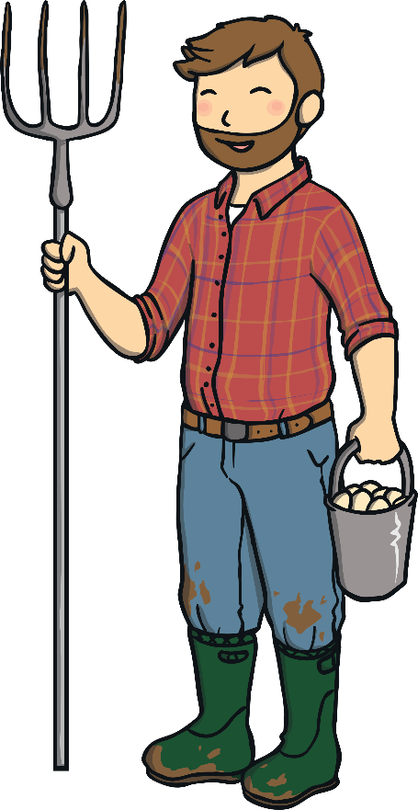
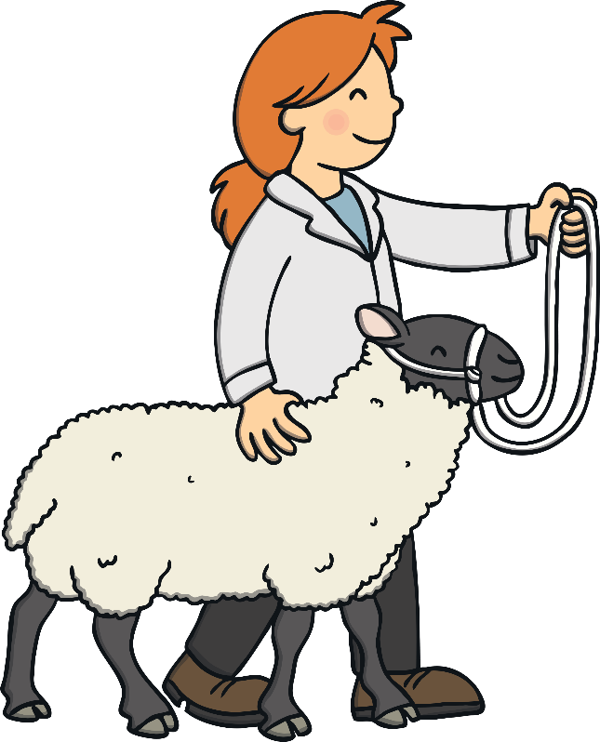
Farmer’s Fall Out
Say hello to Freya, Farid and Frida.
They met at Farmer’s Club.
Farid thinks that his farm has more animals.
Freya thinks that she has the most animals on her farm.
Frida thinks that she has the most animals of all!
?
Can you help them find out who has the most animals?

Slide 7
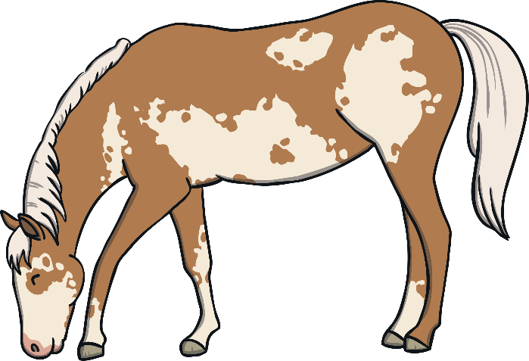
Farmer’s Fall Out
Let’s help the farmers to count their animals on the pictogram.
One picture represents 10 animals. We can write this as 10:1.
= 10
= 5
!
Remember, one animal represents 10 animals so half an animal represents 5 animals.

Slide 8
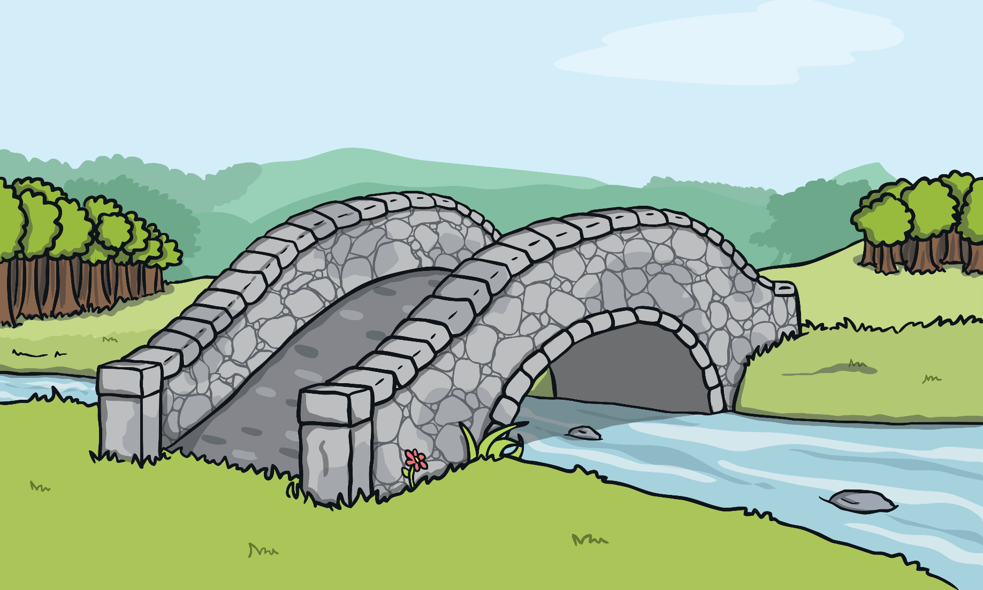


Farmer’s Fall Out
?
Can you help count how many animals there are?
85

Slide 9


Farmer’s Fall Out
?
Can you help count how many animals there are?
45

Slide 10

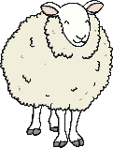
Farmer’s Fall Out
?
Can you help count how many animals there are?
100

Slide 11
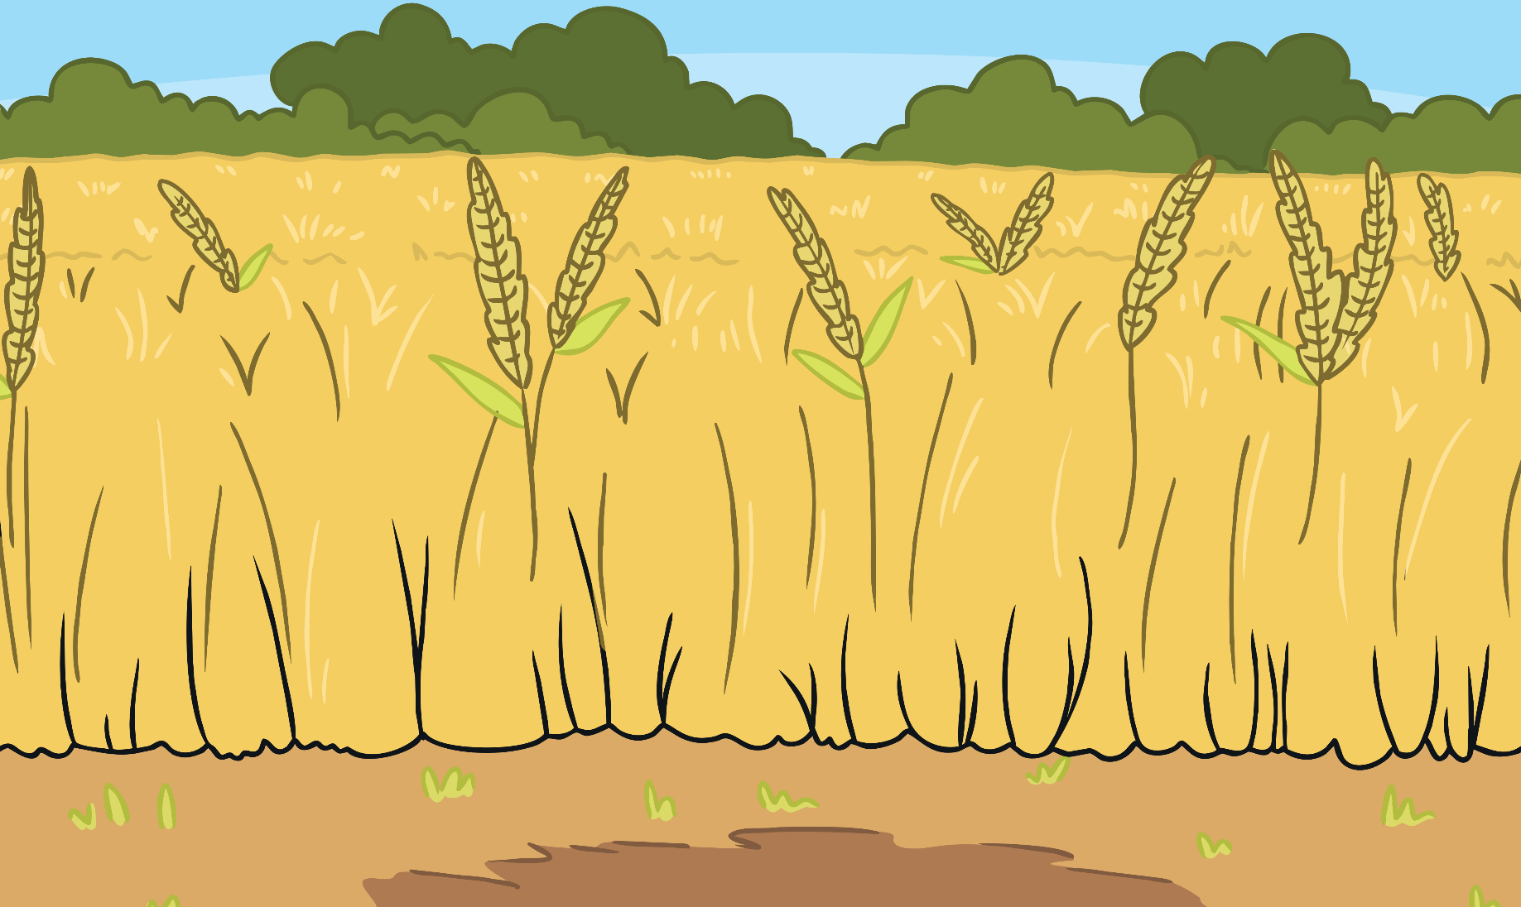
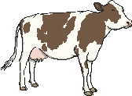
Farmer’s Fall Out
?
Can you help count how many animals there are?
105

Slide 12

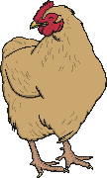
Farmer’s Fall Out
?
Can you help count how many animals there are?
50

Slide 13

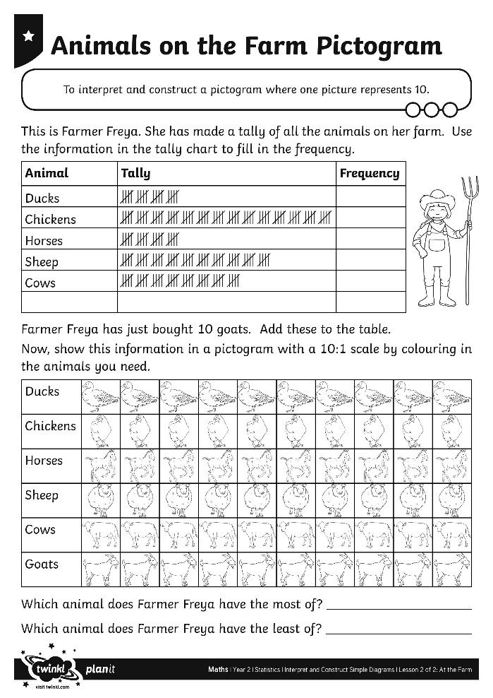

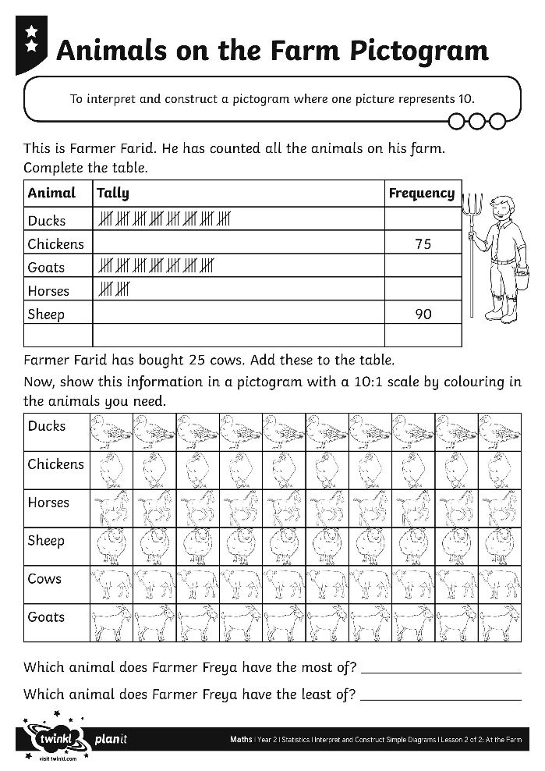
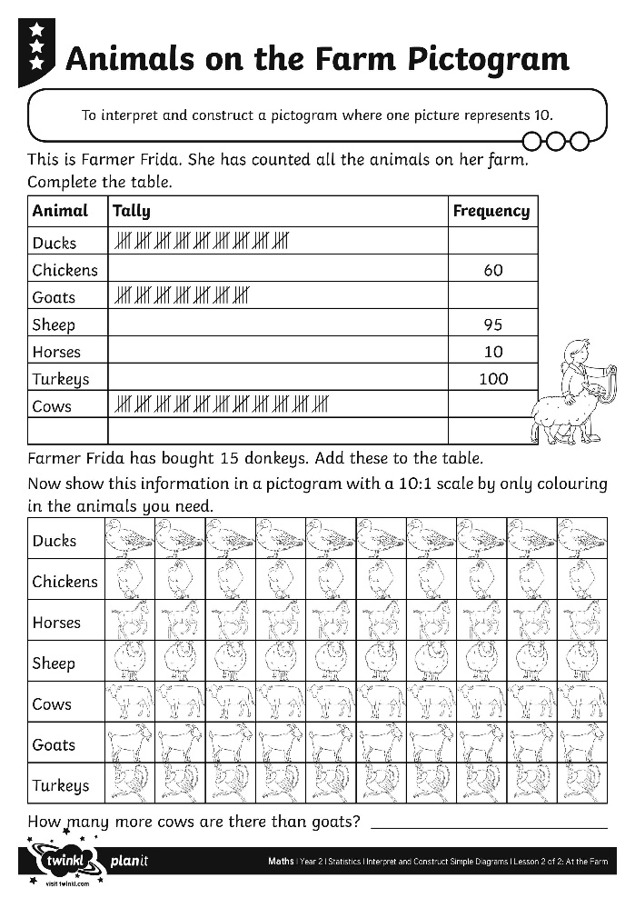
Animals on the Farm

Slide 14
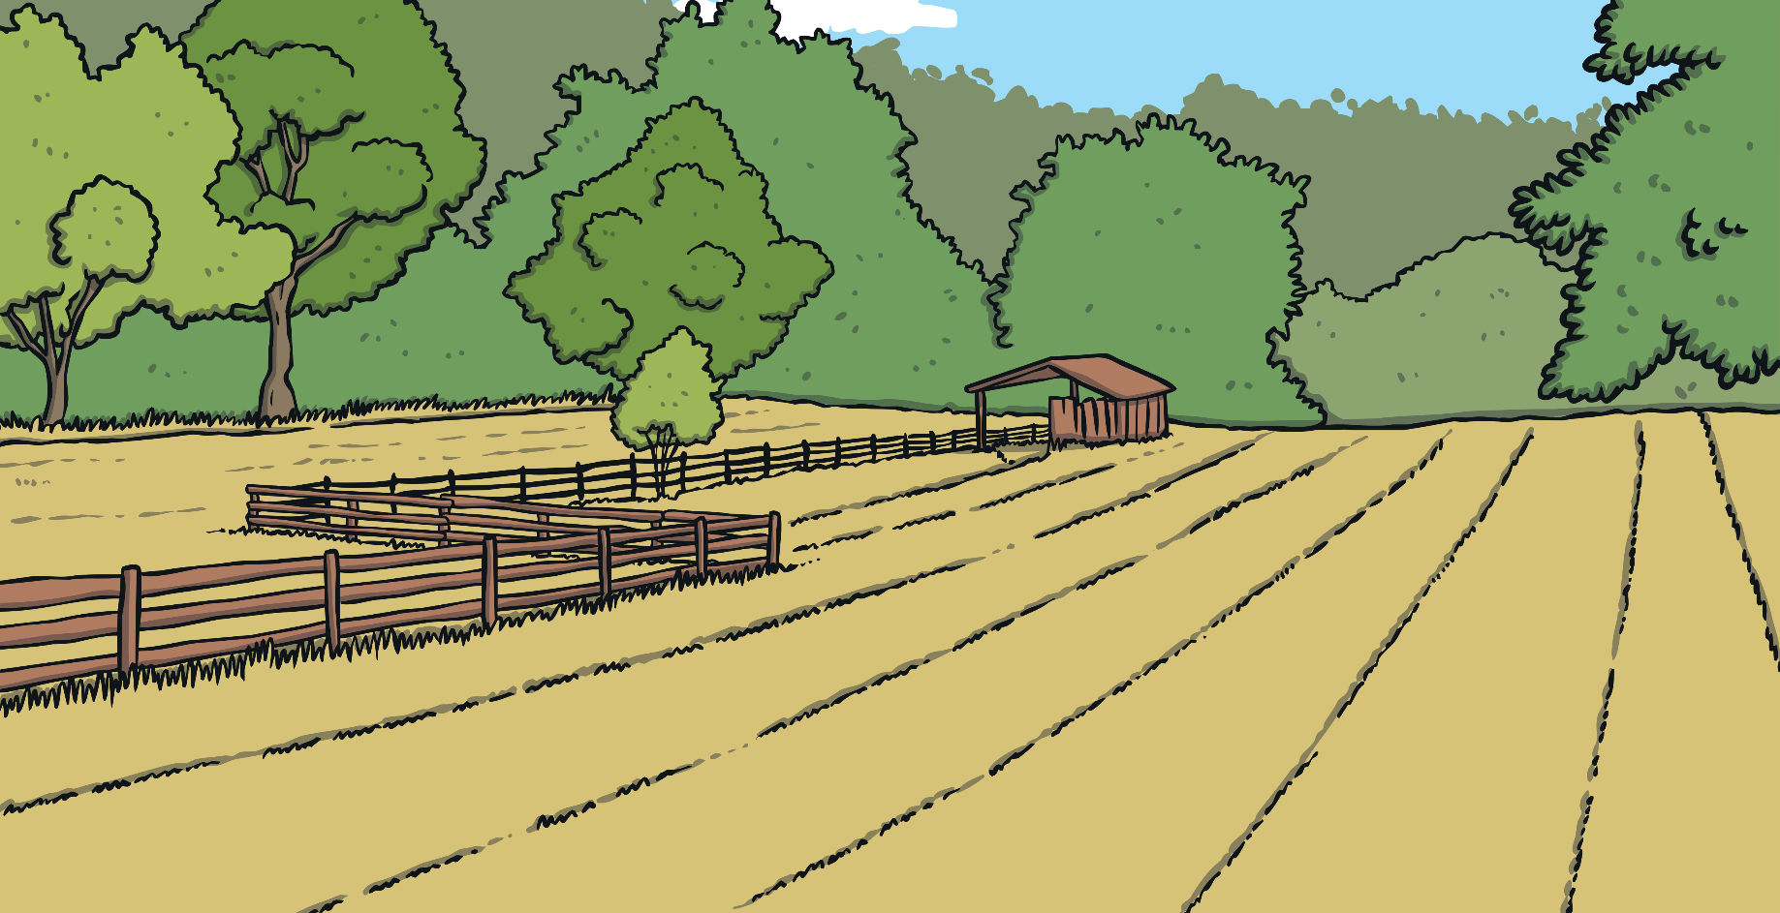
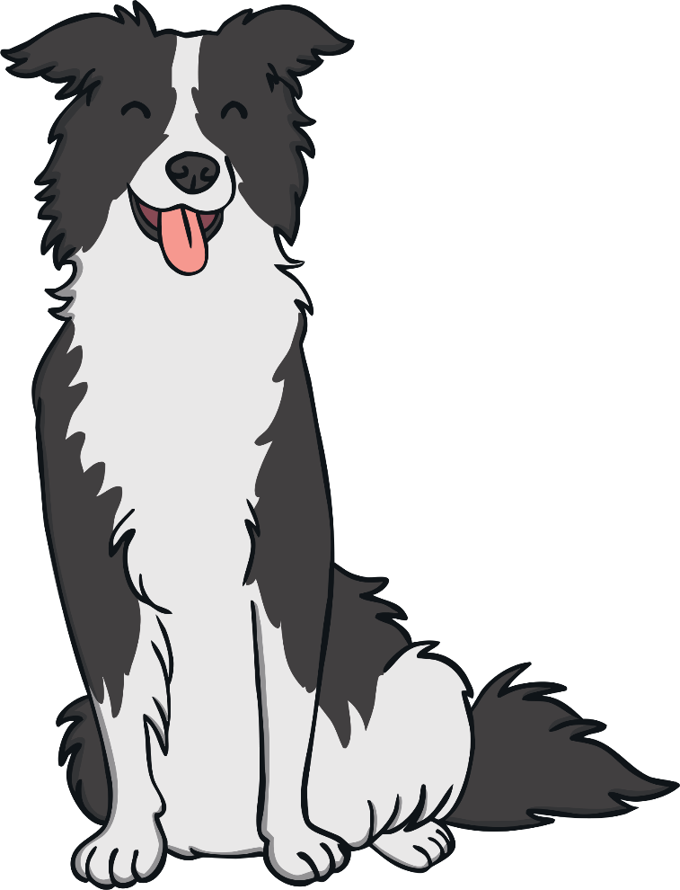
Farm Pictograms
We are going to see how you presented the information from the frequency table on a Pictogram.
Each picture stand for 10 animals.
Why can’t we use 1 picture for each animal?

Slide 15
Farm Pictograms
?
How many pictures did we need to show 30 sheep?
= 30 sheep
10 | 20 | 30 | 40 | 50 | 60 | 70 | 80 | 90 | 100

Slide 16
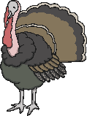
Farm Pictograms
?
How many pictures did we need to show 100 turkeys?
= 100 turkeys
10 | 20 | 30 | 40 | 50 | 60 | 70 | 80 | 90 | 100

Slide 17


Farm Pictograms
?
How many pictures did we need to show 45 chickens?
= 45 chickens
10 | 20 | 30 | 40 | 50 | 60 | 70 | 80 | 90 | 100

Slide 18

Aim
To interpret and construct a pictogram where one picture represents 10.
Success Criteria
I can record data on a pictogram.
I can make a pictogram where one picture represents 10.
I can find the total on a pictogram where one picture represents 10.
I can ask and answer questions about the data.

