Slide 1
Maths
Statistics
Year One
Maths | Year 2 | Statistics | Lesson 1 of 6: Birthdays

Slide 3
Aim
To make and interpret a tally chart.
Success Criteria
I can draw a five bar gate tally.
I can count and write the total.
I can gather information using a tally.

Slide 4
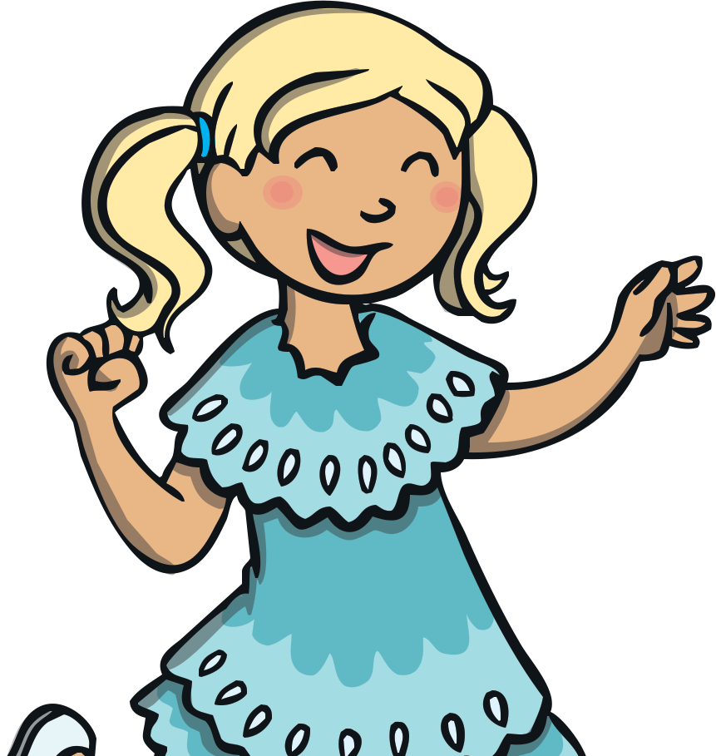
Fives
This is a five bar gate tally. We use it to help us to count. It is easy to count large numbers using a tally by counting in fives.
5
4
3
2
1
Click to watch how we make a five bar gate tally.

Slide 5
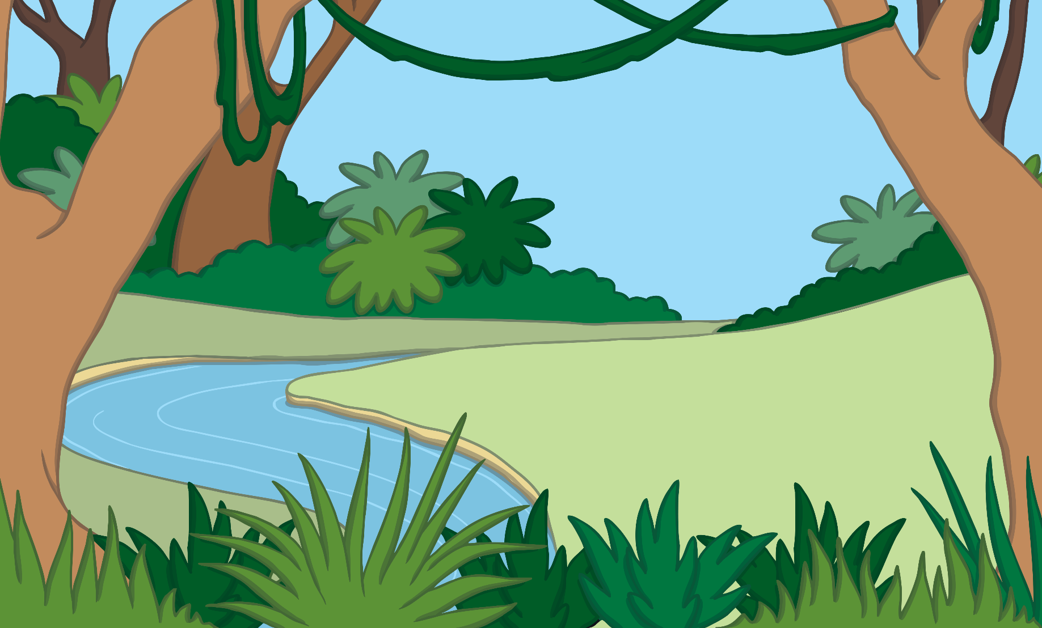
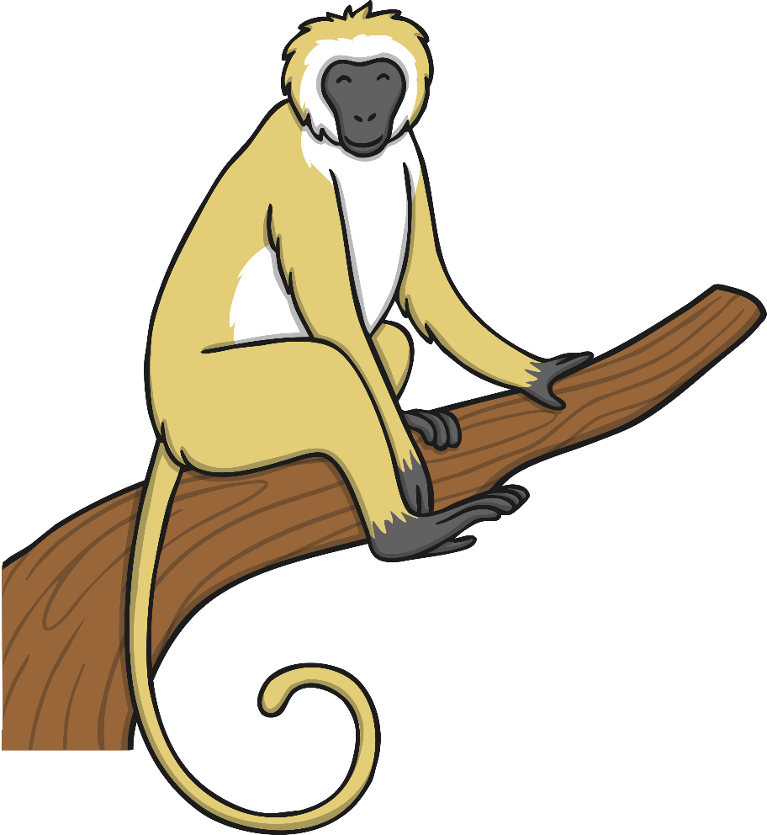
Fives
How many bananas are there?
There are 35 bananas.

Slide 6
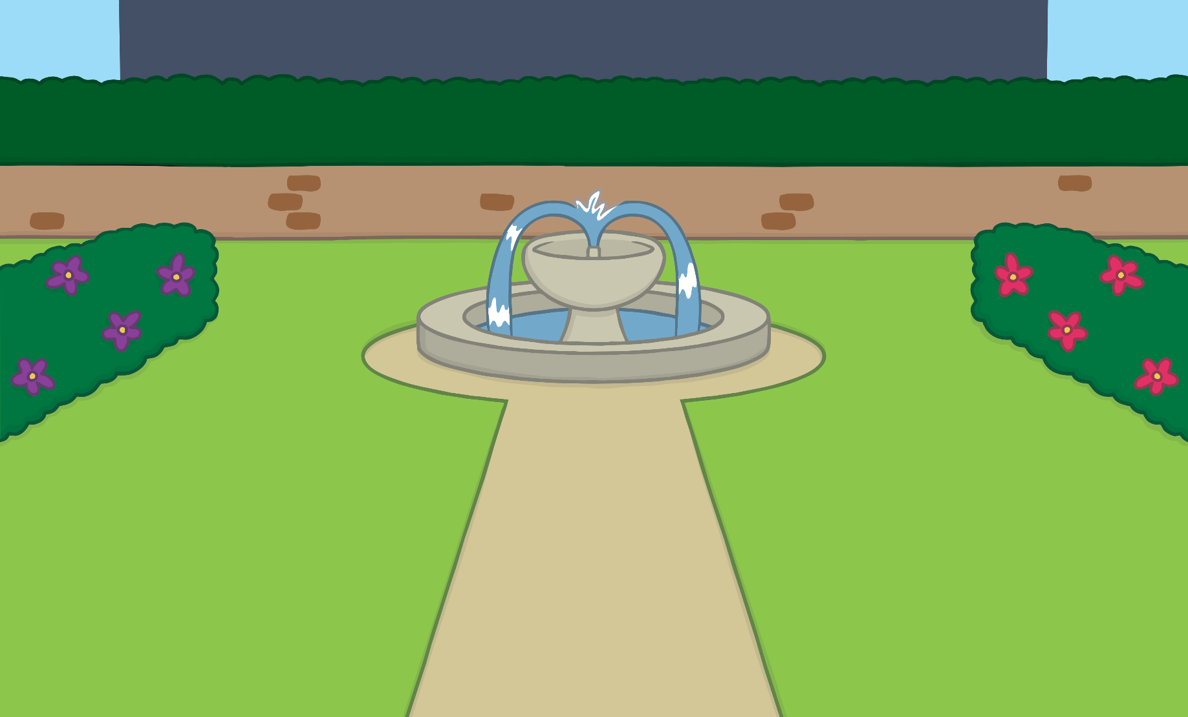
Fives
How many flowers are there?
There are 25 flowers.

Slide 7
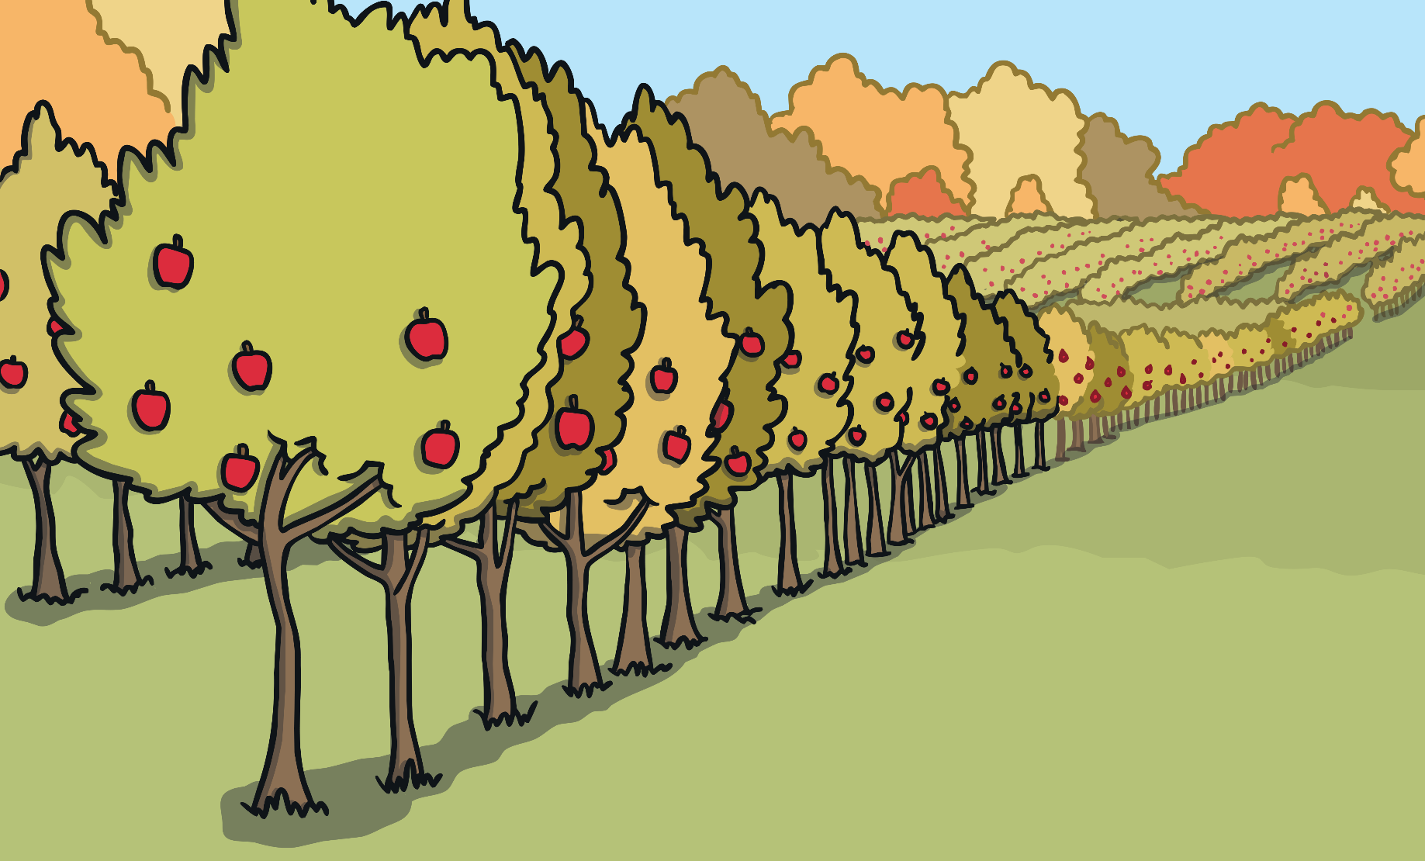
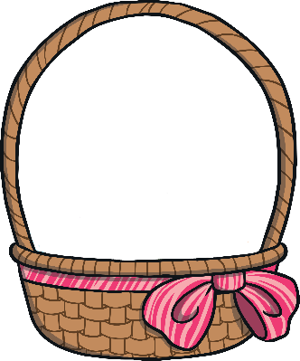
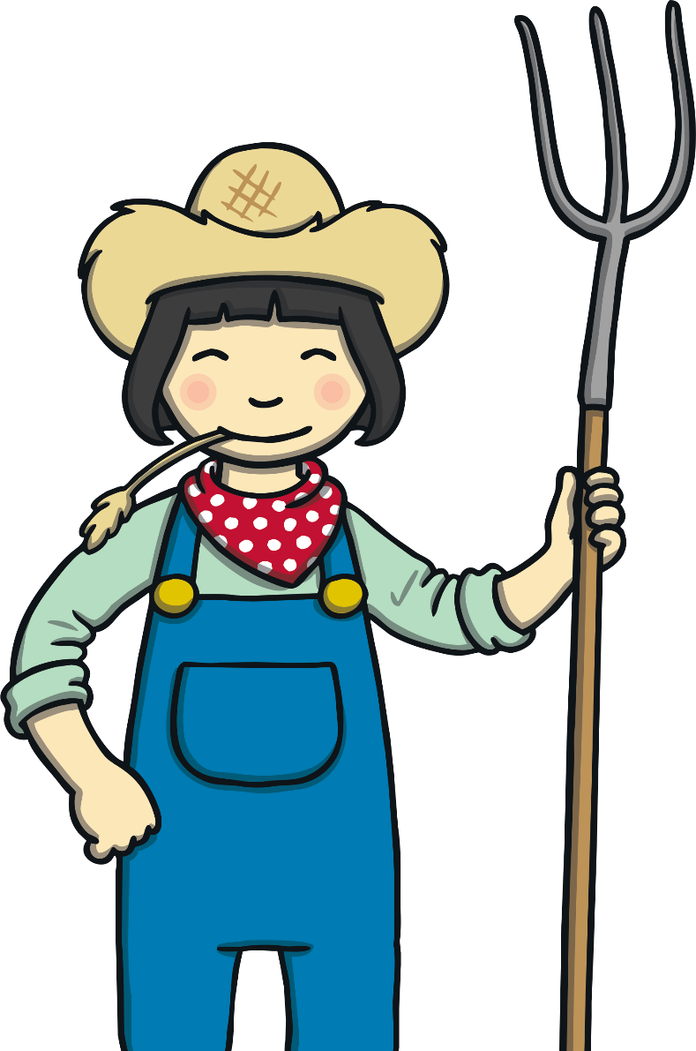
Fives
How many apples are there?
There are 15 apples.

Slide 8
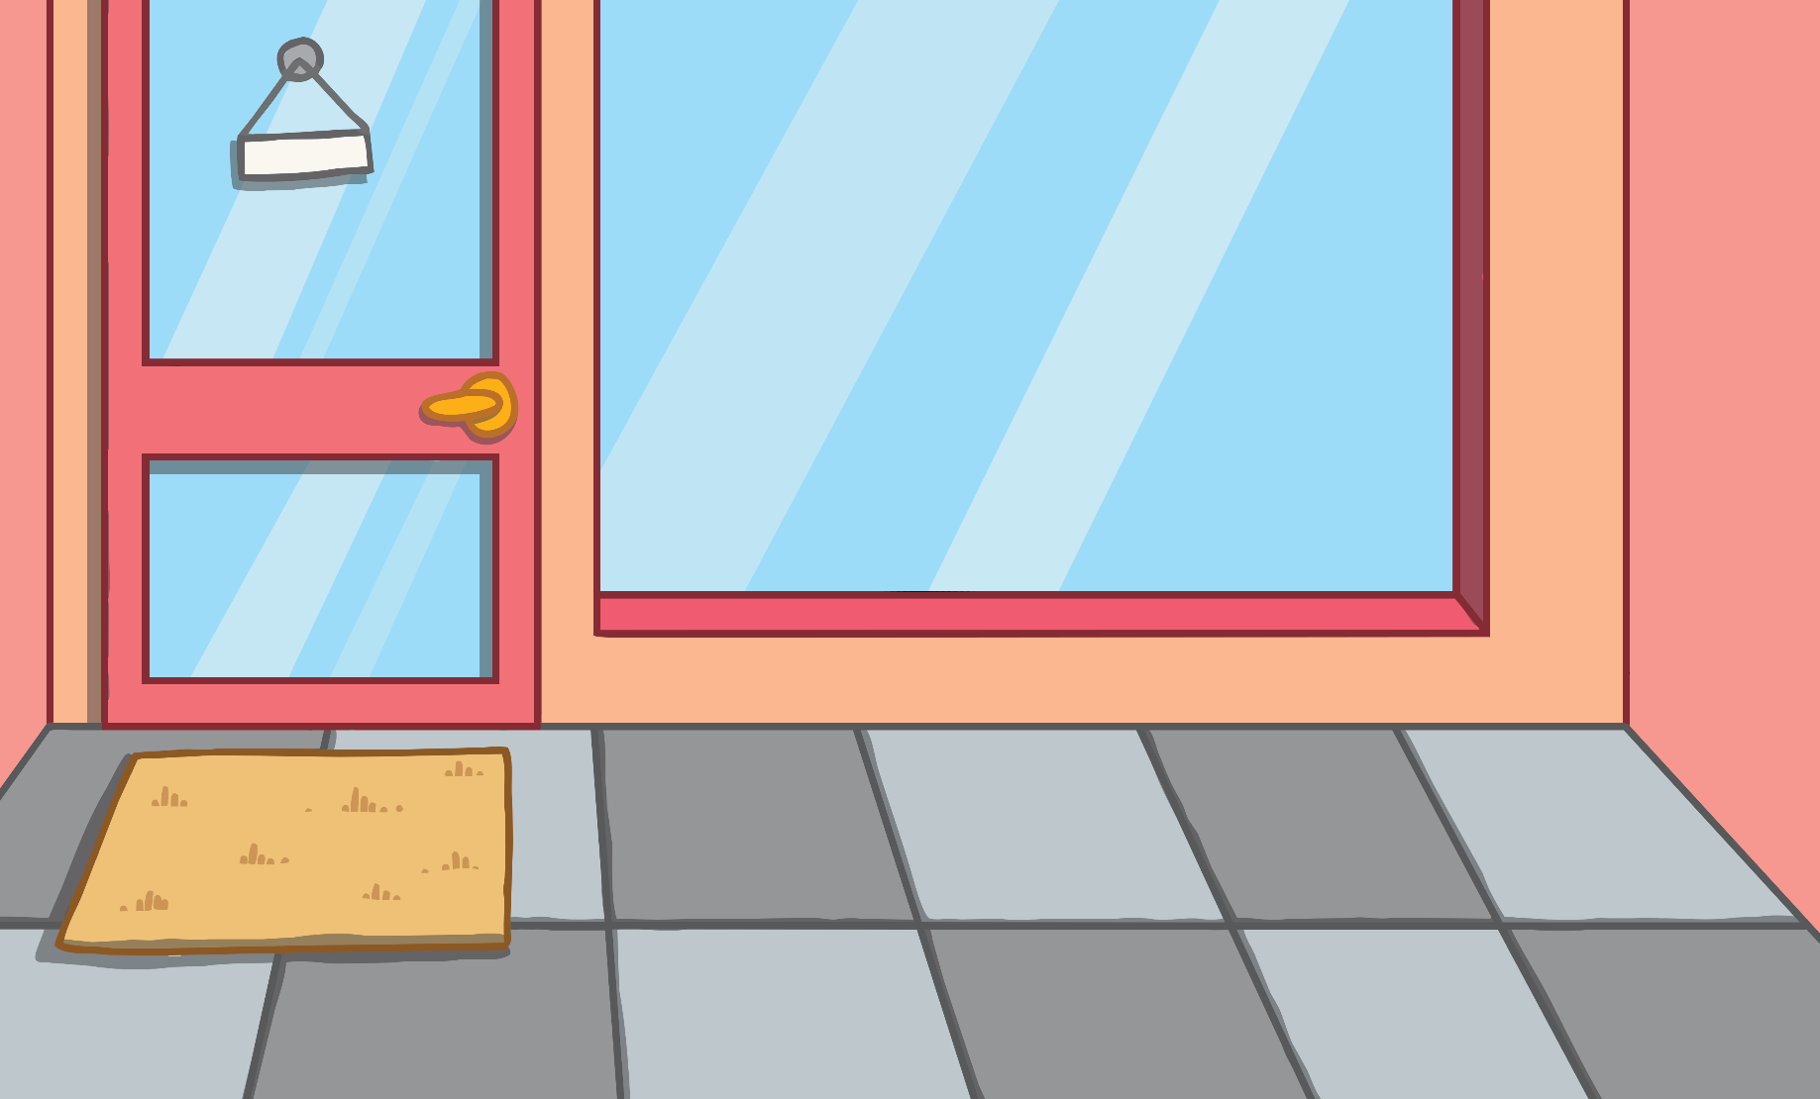
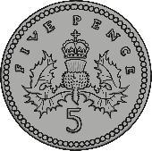
Fives
How much money is there?
There is 30p.

Slide 9
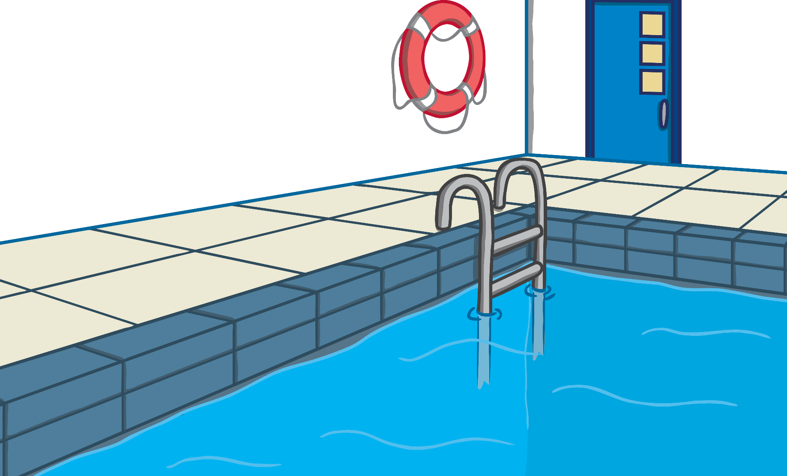
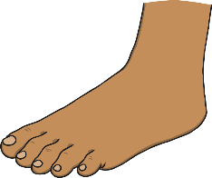
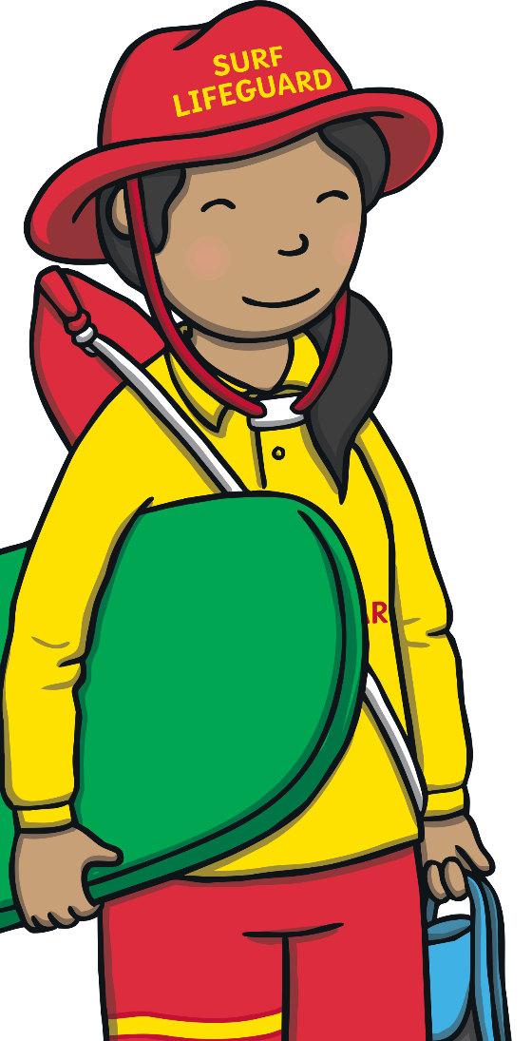
Fives
How many toes are there?
There are 40 toes.

Slide 10
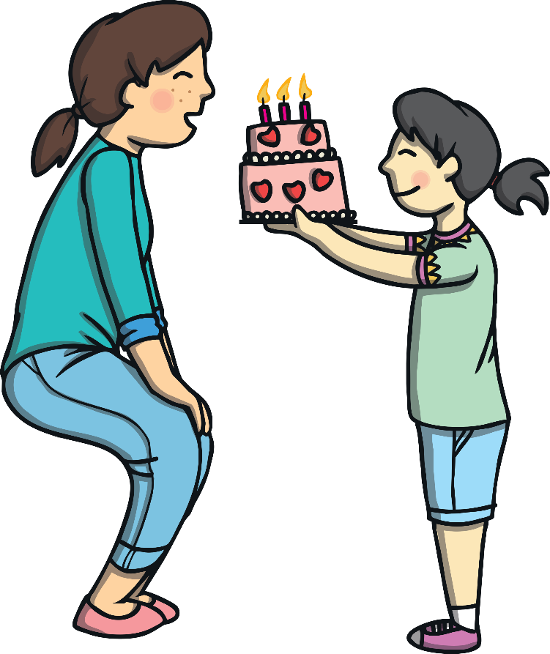
Birthdays
?
What is the most common month to have a birthday in the Year 3 class? (on the sheet provided)
How can we find out the answer to this question?
Most common means the one that happens the most often.

Slide 11
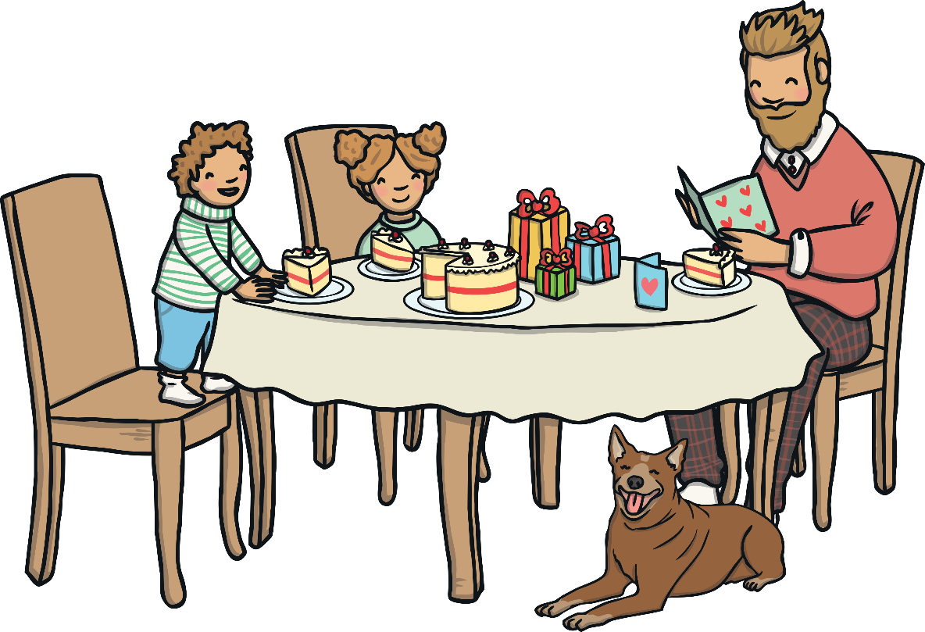
Birthdays
To find out the answer to the question, we need to collect information.
?
You will need to look at the list of children’s names.

Slide 12
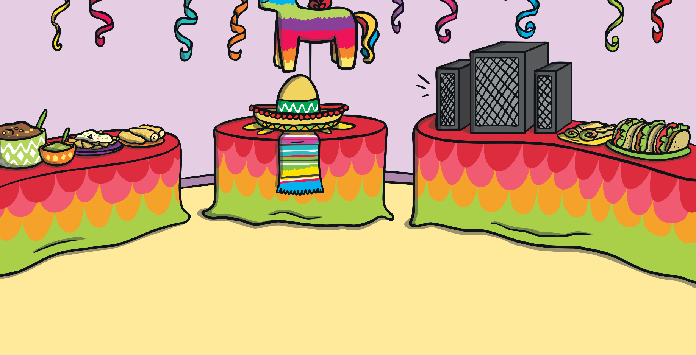
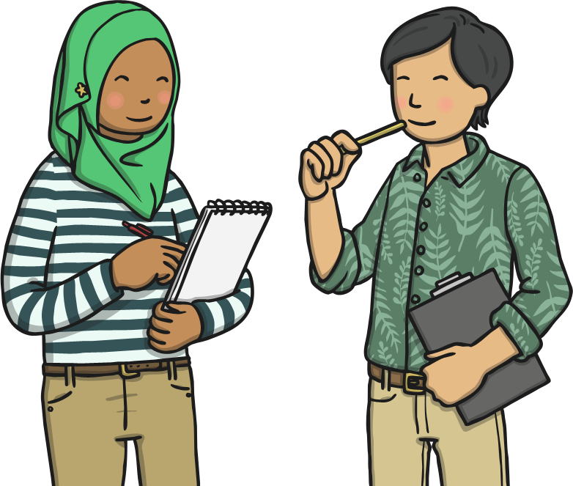
Tally Charts
We are going to use a five bar gate tally to show how many people have their birthday in each month.
This is called a tally chart.

Slide 13
Tally Charts
A tally chart is a way of organising information.
1
3
For each thing we are trying to count, we draw a line.
Then, we carry on making another group of 5.
1
2
3
4
1 |  | 6
2 |  | 7
3 |  | 8
4 |  | 9
5 |  | 10
2
When you reach number 5, draw a line across the first 4.
5

Slide 14
Tally Charts
Month | Tally
January
February
March
April
May
June
July
August
September
October
November
December
+
+
+
+
+
+
+
+
+
+
+
+

Slide 15
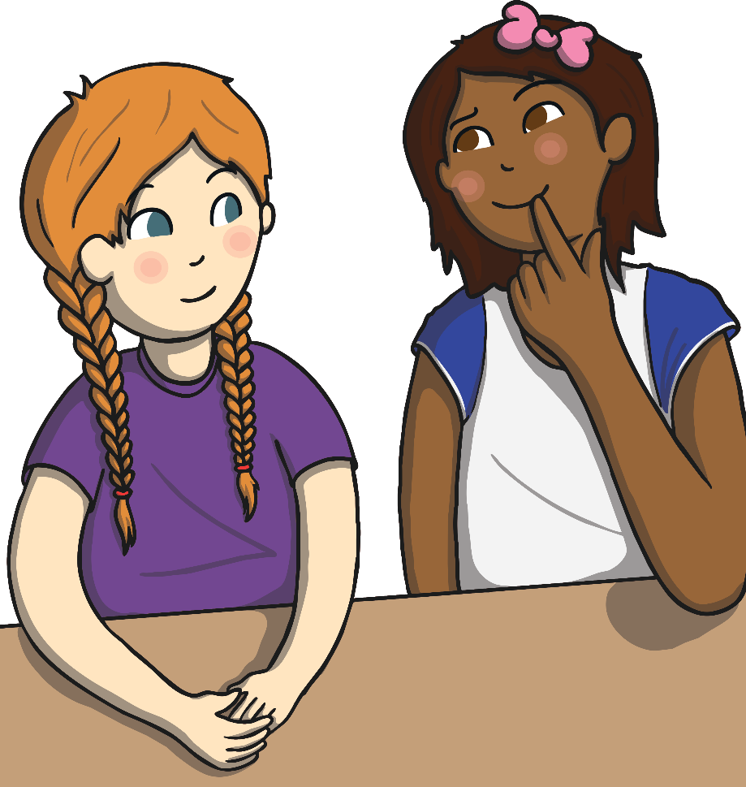
Diving into Mastery
Dive in by completing your own activity!

Slide 16
Aim
To make and interpret a tally chart.
Success Criteria
I can draw a five bar gate tally.
I can count and write the total.
I can gather information using a tally.

