Slide 1
Maths
Statistics
Year One
Maths | Year 2 | Statistics | Lesson 3 of 6: Blocks

Slide 3
Aim
To make and interpret a block diagram.
Success Criteria
I can sort items into groups.
I can record the information on a block diagram.
I can answer questions about my block diagram.

Slide 4
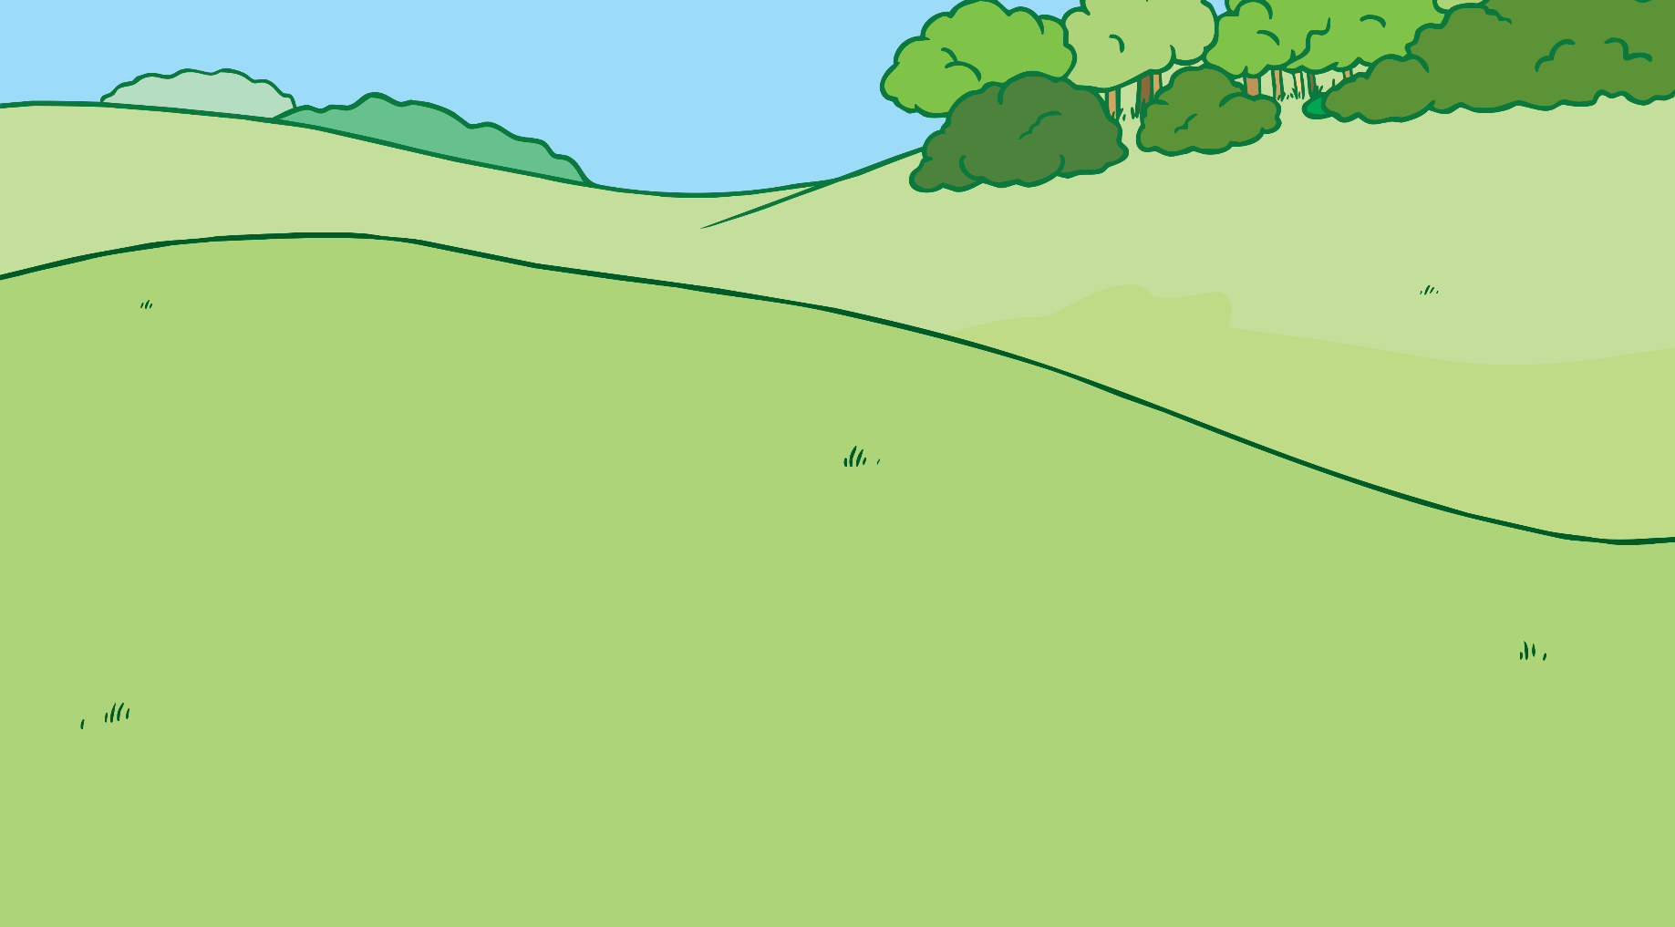
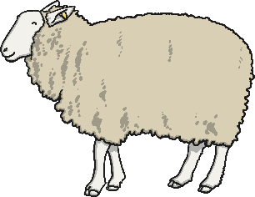
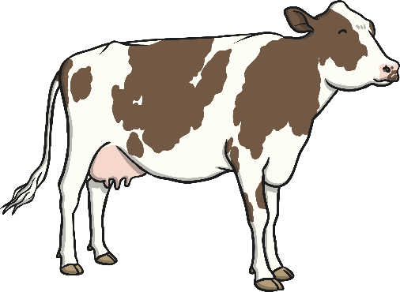
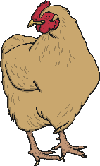
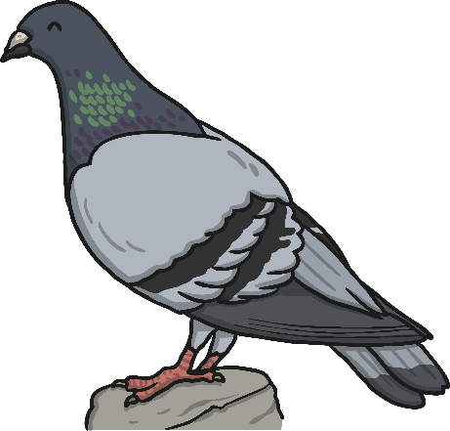
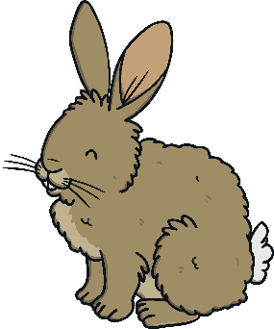
Groups
Sort these animals into groups.
?
?
?
How have you sorted them?
How many animals are in each group?
Can you think of another way to group the animals?

Slide 5
Groups
We could group the animals in many different ways. For example:
Animals with two legs:
Animals with four legs:

Slide 6
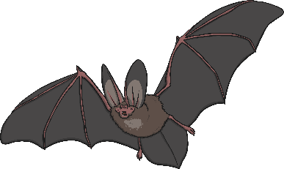
Groups
We could group the animals in many different ways. For example:
Animals that fly:
Animals that don’t fly:

Slide 7
Blocks
Imagine you have a pile of blocks.
We need to find out how many blocks of each colour you have.
How would you arrange these blocks into groups?

Slide 8
Blocks
How did you think you could have arranged your blocks?
?
Which arrangement is best for showing how many blocks there are of each colour? Why?

Slide 9
Tall Towers
One way of arranging the blocks is to sort them into straight lines or towers.
This makes it very easy to see how many there are of each colour.
?
How many red blocks are there?
?
How many blue blocks are there?
?
How many yellow blocks are there?

Slide 10
Block Diagrams
You can easily draw your tall towers on squared paper.
Each square of the paper that you colour in stands for one block.
This is called a block diagram.

Slide 11
Block Diagrams
10
9
8
7
6
5
4
3
2
1
Sometimes, block diagrams have numbers at the side to help you count how many of each kind of block there are.

Slide 12
More Block Diagrams
10
9
8
7
6
5
4
3
2
1
Block diagrams are not only used for drawing blocks. You can use a block diagram to show lots of things.
This block diagram shows the number of boys and girls in a class.
Each green block stands for one boy and each orange block stands for one girl.
Girls
Boys

Slide 13
More Block Diagrams
?
10
9
8
7
6
5
4
3
2
1
How many girls are in this class?
9
?
How many boys are there?
6
?
How many more girls are there than boys?
3
Girls
Boys

Slide 14
More Block Diagrams
20
18
16
14
12
10
8
6
4
2
This block diagram shows the number of animals that were in a pond one day. What do you notice about the scale?

Slide 15
More Block Diagrams
20
18
16
14
12
10
8
6
4
2
?
How many frogs were there?
4
?
How many ducks were there?
2
?
What was the most common animal?
snails
?
What was the least common animal?
ducks
?
How many more fish were there than ducks?
4

Slide 16
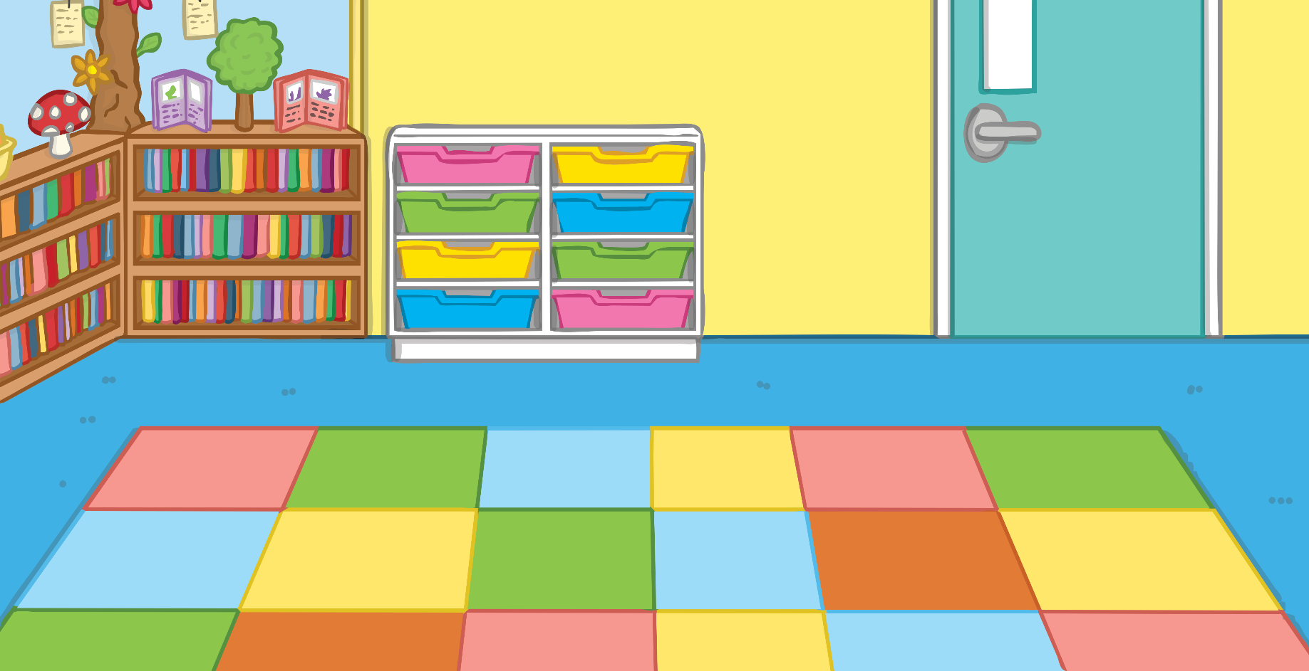
More Block Diagrams
Can you think of anything else you could show on a block diagram?

