Slide 1
Maths
Statistics
Year One
Maths | Year 2 | Statistics | Lesson 2 of 6: Break Time Fruit

Slide 3
Aim
To construct a pictogram from a tally chart.
Success Criteria
I can find information from a tally chart.
I can record the information in a pictogram.
I can use a pictogram to compare the information.

Slide 4
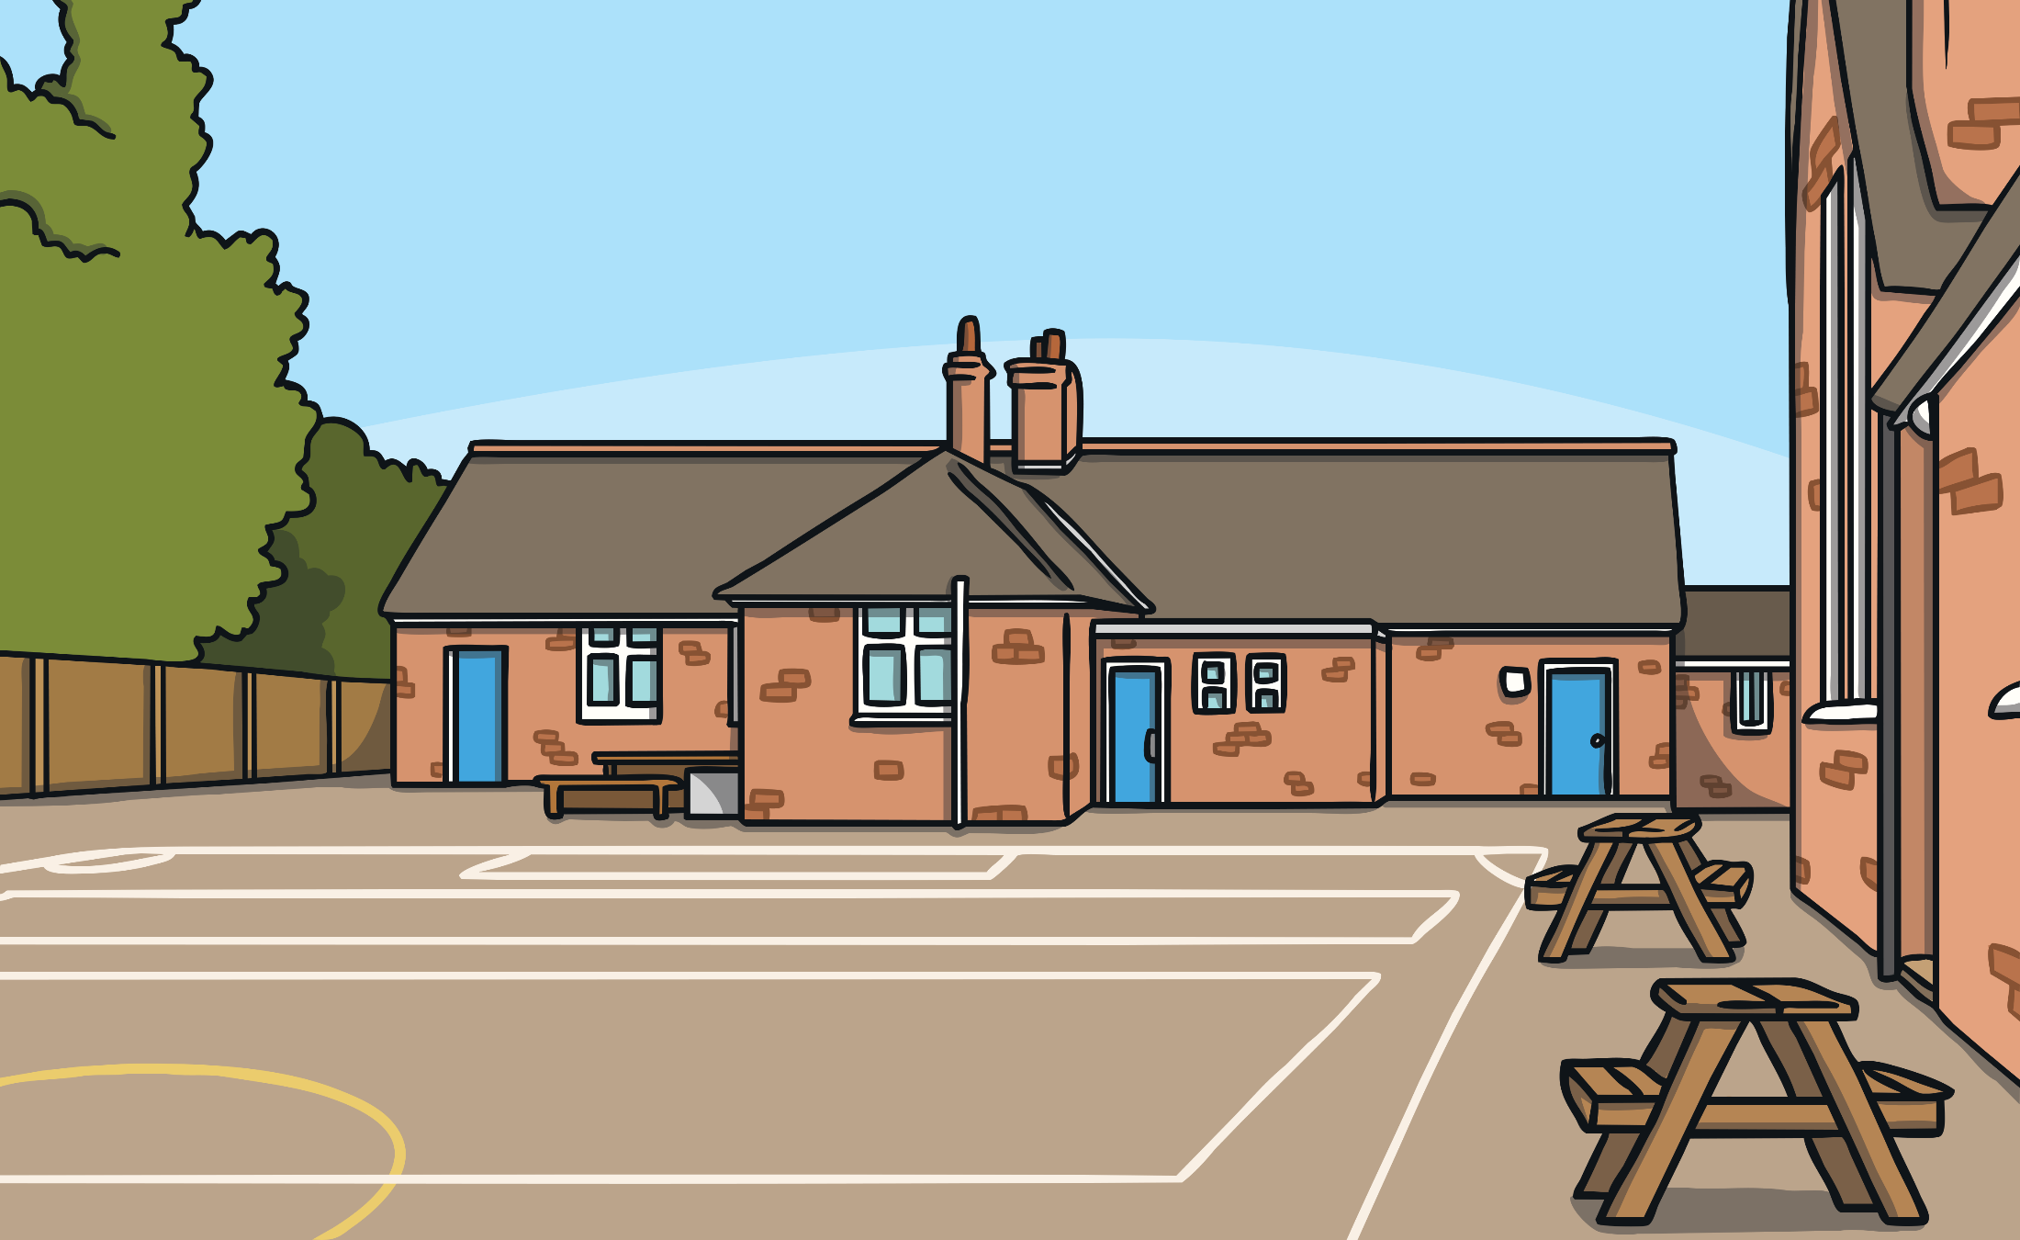
Break Time Fruit
This is Rainbow Primary School.

Slide 5
Break Time Fruit
We are going to find out how many pieces of each fruit the Year 2 classes ate one day at break time. We need to collect some information or data.

Slide 6
Break Time Fruit
A tally chart is a way of organising information.
1
2
Count the fruit that was eaten by the class. Fill in the tally chart for each kind of fruit they ate.
Fruit | Tally | Total
Banana
Orange
apple
4
2
6
We can use this information or data to make a frequency table. Frequency means ‘how many’.
3
Count each tally and fill in the frequency table by writing the total number of each fruit.

Slide 7
Fruit Pictograms
Now, we are going to make a pictogram.

Slide 8
Fruit Pictograms
A pictogram is a chart that uses pictures to show information.
?
What does this pictogram show?
Break Time Fruit
The pictures need to be the same size and lined up very carefully so we can compare them.
Key
= 1 fruit
= 1 fruit
= 1 fruit
= 1 fruit
Fruit

Slide 9
Fruit Pictograms
This pictogram shows the fruit eaten at break time.
Break Time Fruit
?
What was the most popular fruit?
?
How many people ate a banana?
Fruit

Slide 10
Fruit Pictograms
Break Time Fruit
Apple
Banana
Orange
Pear
Fruit
Fruit
?
What is the same and what is different about the two pictograms.
We can use a symbol to represent the fruits.

Slide 11
Fruit Pictograms
Title
Break Time Fruit
Key
= 1 child
Labels
Key
Apple
Banana
Orange
Pear
Fruit

Slide 12
Staff Room Fruit
Here is a tally of the fruit eaten in the staff room this week.
Fruit | Tally | Total
banana
orange
apple
pear
4
6
3
3

Slide 13
Staff Room Fruit
Fruit |  | Total
apples |  | 3
bananas |  | 4
oranges |  | 6
pears |  | 3
Tell me about what you can see.
?
How is this similar to what we have been making?
?
How is it different?

Slide 14
Questions and Answers
?
What is the most popular fruit in the staff room?
?
What was the least popular fruit?
?
How many bananas were eaten?

Slide 15
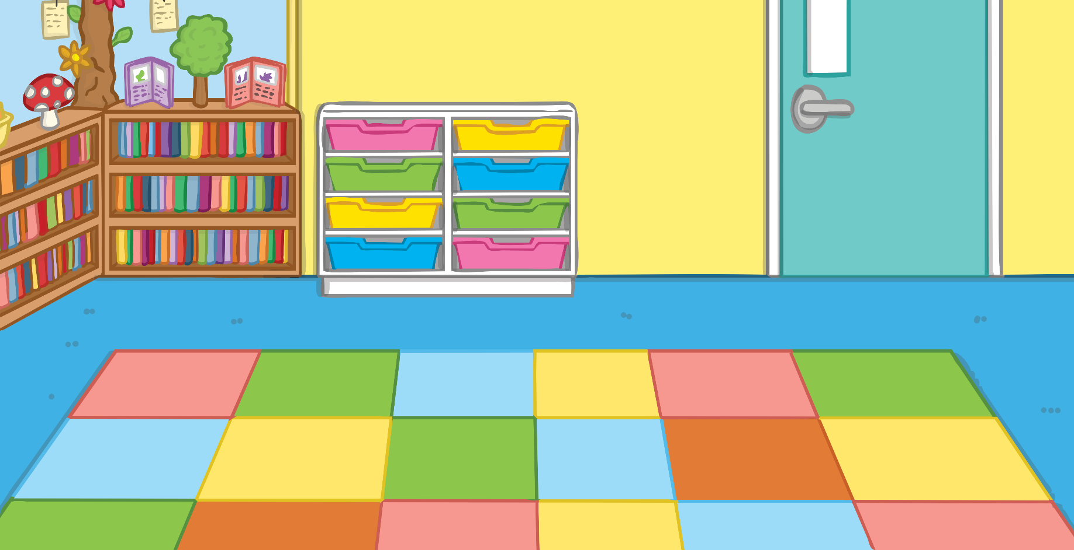
Questions and Answers
Think of a question to ask about your charts and tables.
Ask a friend.

Slide 16
Aim
To construct a pictogram from a tally chart.
Success Criteria
I can find information from a tally chart.
I can record the information in a pictogram.
I can use a pictogram to compare the information.

