Slide 1
Maths
Position and Direction
Year One
Maths | Year 4 | Position and Direction | Coordinates | Lesson 1 of 3: Café Coordinates

Slide 3
Aim
I can read coordinates in the first quadrant.
Success Criteria
I can label the x-axis and y-axis.
I know that a coordinate is represented by two numbers in brackets, separated by a comma.
I can read a coordinate correctly by going along and then up.

Slide 4
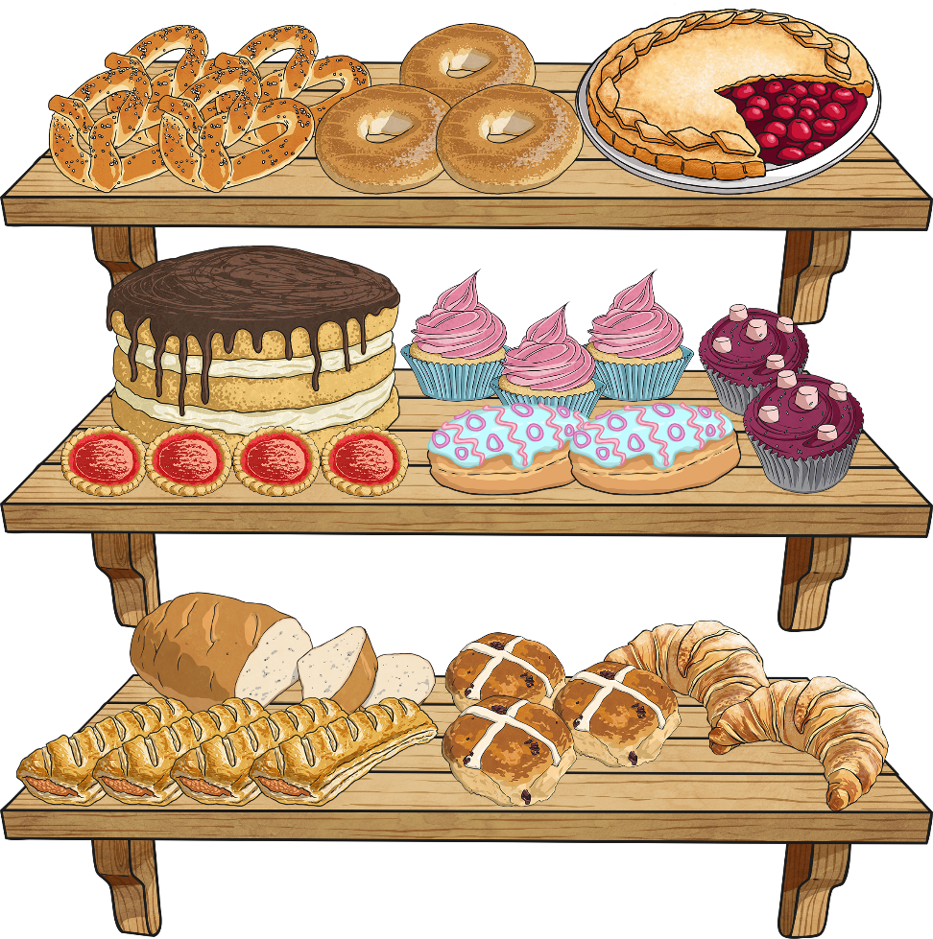
At the Bakery
Use the vocabulary of position and direction to describe the delicious display of the food at the Twinkl bakery.
North
East
South
West
above
below
between
higher
lower
left
right
North-East
South-East
South-West
North-West
horizontal
vertical
diagonal
row
column
parallel
Show supporting vocabulary word bank
Hide supporting vocabulary word bank

Slide 5
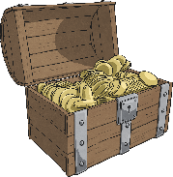
Reading Coordinates
6
Coordinates are a useful way to locate a position on a map or grid.
5
4
Here is a map with a grid on. It shows where to find the treasure. Let’s work together to read the coordinates and locate the position of the gold!
3
2
1
0
1
2
3
4
5
6

Slide 6
Reading Coordinates
6
Look carefully at the numbers across the bottom of the grid and up the side of the grid.
5
4
3
We will use these numbers to give the position of the treasure.
2
1
0
1
2
3
4
5
6

Slide 7
Reading Coordinates
6
The numbers across the bottom of the grid are on the x-axis.
5
4
We always read the number on the x-axis first.
3
2
We can see that the treasure is positioned on line number 2 of the x-axis.
1
0
1
2
3
4
5
6

Slide 8
Reading Coordinates
6
The numbers up the side of the grid are on the y-axis.
5
4
We always read the number on the y-axis after the x-axis.
3
2
We can see that the treasure is positioned on line number 4 of the y-axis.
1
0
1
2
3
4
5
6

Slide 9
Reading Coordinates
6
We have located that the treasure is on line 2 of the x-axis (across) and line 4 of the y-axis (up).
5
4
There is a special way we write this as a coordinate:
3
2
(2,
4)
1
x-axis
y-axis
0
1
2
3
4
5
6

Slide 10
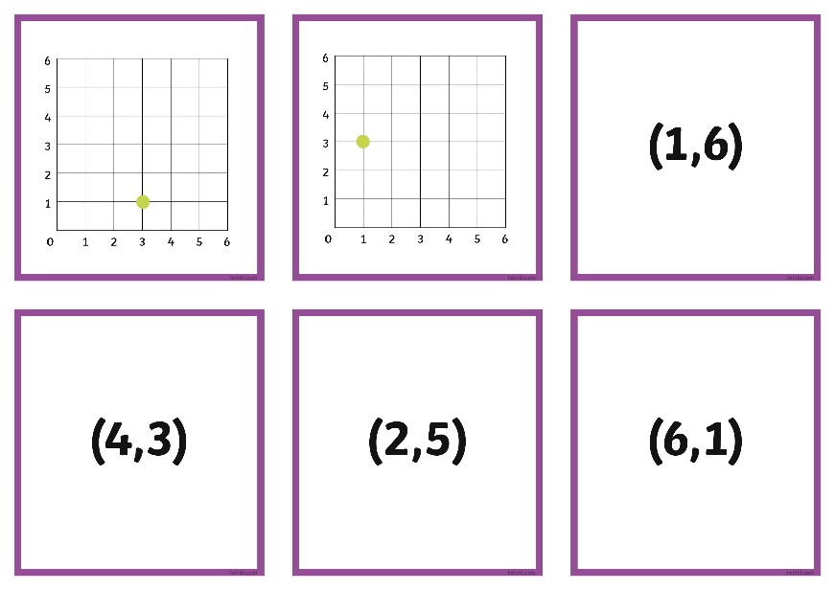
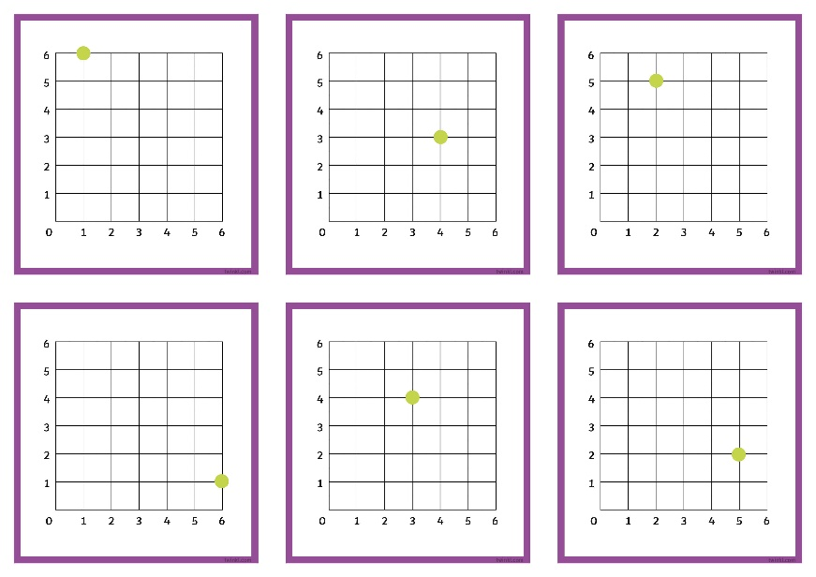
Coordinate Match Up
Work together in your group to match the coordinates with the correct grid.
Remember to:
read across the x-axis first;
read up the y-axis second.
A useful tip!
An easy way to remember is ‘along the corridor and up the stairs’.

Slide 11
Coordinate Match Up
(6,1)
(1,6)
(4,3)
(2,5)
(3,4)
(5,2)
(3,1)
(1,3)

Slide 12
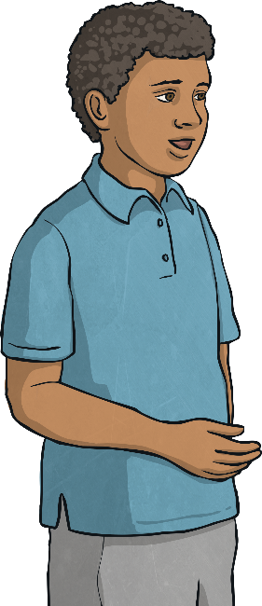
Coordinate Match Up
Click on the child who has read the coordinate correctly.
How has the other child got mixed up?
I think the purple circle is at coordinate (4, 3).
I think the purple circle is at coordinate (3, 4).
I was wrong. You always read the x-axis first!
I was correct. The purple circle is at (3,4).
6
5
4
3
2
1
0
1
2
3
4
5
6

Slide 13
Coordinate Match Up
Click on the child who has read the coordinate correctly.
How has the other child got mixed up?
I think the red circle is at coordinate (5, 2).
I think the red circle is at coordinate (5, 3).
6
I was correct. The red circle is at (5,2).
I was wrong. The orange circle is at (5,3).
5
4
3
2
1
0
1
2
3
4
5
6

Slide 14
Coordinate Match Up
Click on the child who has read the coordinate correctly.
How has the other child got mixed up?
I think the green circle is at coordinate (1, 4).
I think the green circle is at coordinate (2, 4).
6
I was correct. The green circle is at (1,4).
I was wrong. The orange circle is at (2,4).
5
4
3
2
1
0
1
2
3
4
5
6

Slide 15
Coordinate Match Up
Click on the child who has read the coordinate correctly.
How has the other child got mixed up?
I think the blue circle is at coordinate (5, 0).
I think the blue circle is at coordinate (0, 5).
6
I was wrong. You always read the x-axis first!
I was correct. The blue circle is at (0,5).
5
4
3
2
1
0
1
2
3
4
5
6

Slide 16
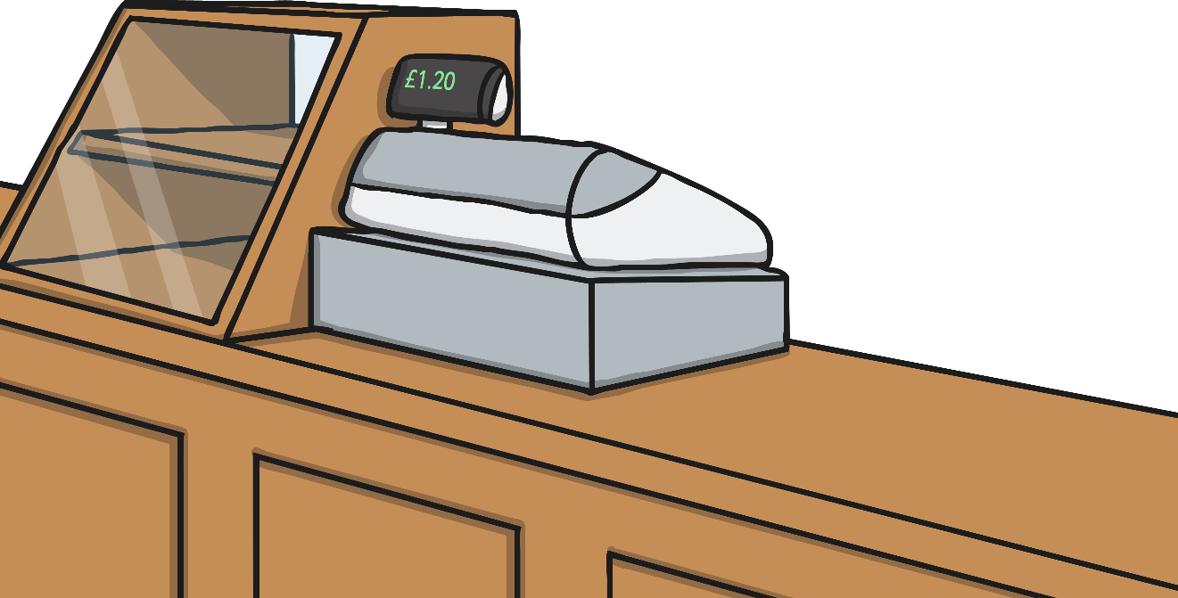
Coordinate Menus
9
8
7
6
Click on the menu items the child is ordering by reading the coordinates correctly.
5
4
3
2
1
0
1
2
3
4
5
6
7
8
9
I would like to order these items please: (7,5), (1, 8), (9,4) and (3,6).

Slide 17
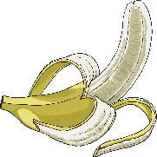
Coordinate Menus
9
8
7
6
Click on the menu items the child is ordering by reading the coordinates correctly.
5
4
3
2
1
0
1
2
3
4
5
6
7
8
9
I would like to order these items please: (6,3), (2, 4), (1,2) and (9,7).

Slide 18
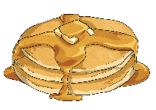
Coordinate Menus
9
8
7
6
Click on the menu items the child is ordering by reading the coordinates correctly.
5
4
3
2
1
0
1
2
3
4
5
6
7
8
9
I would like to order these items please: (7,7), (8,1), (2,9) and (4,8).

Slide 19
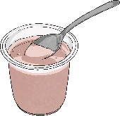
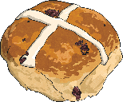
Coordinate Menus
9
8
7
6
Click on the menu items the child is ordering by reading the coordinates correctly.
5
4
3
2
1
0
1
2
3
4
5
6
7
8
9
I would like to order these items please: (3,1), (5,6), (6,1), (1,6) and (6,9).

Slide 20
Aim
I can read coordinates in the first quadrant.
Success Criteria
I can label the x-axis and y-axis.
I know that a coordinate is represented by two numbers in brackets, separated by a comma.
I can read a coordinate correctly by going along and then up.

