Slide 1
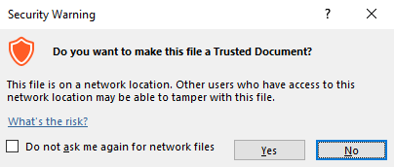
Guidance for Macros in PowerPoints
We use macros within PowerPoints to increase the interactivity of our presentations. Follow this simple process to get the most out of this resource.
What to do:
Open the PowerPoint file and enable editing.
A security warning box may appear. Click yes.
Click enable content.
Enter presentation mode (start the slide show).

Slide 2
Maths
Measurement
Year One
Maths | Year 2 | Measurement | Compare and Sequence | Lesson 3 of 3: Calendar Chaos

Slide 4
Aim
To solve a problem involving comparing and sequencing intervals of time.
Success Criteria
I can sequence the months of the year.
I know the months of the year have different numbers of days.
I can work with a partner to solve a problem.

Slide 5
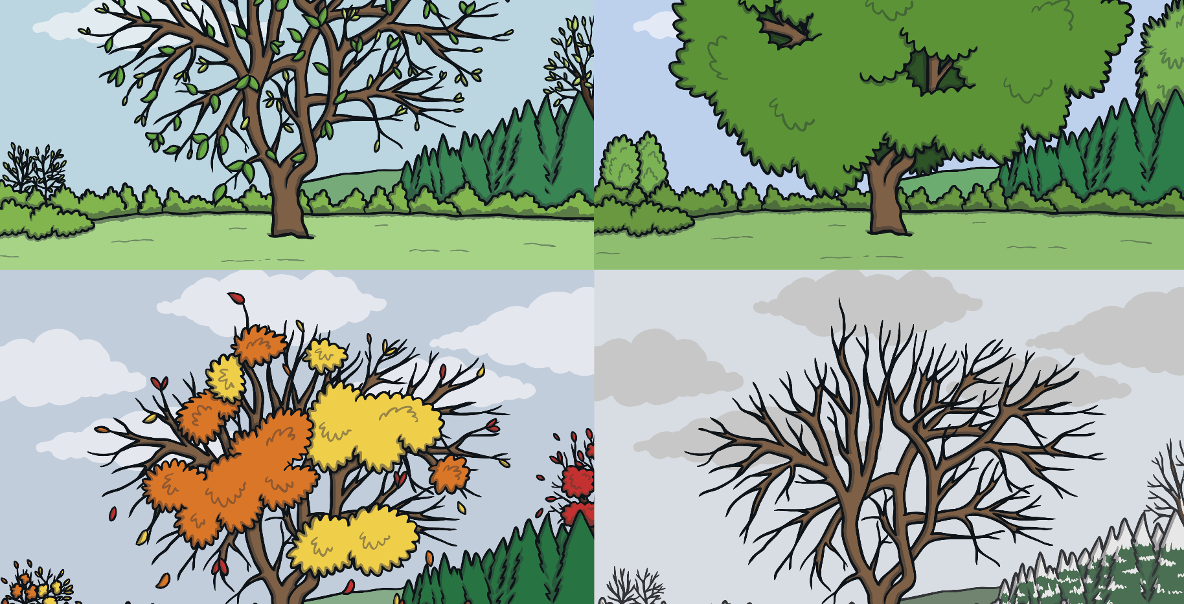
Months of the Year
?
Can you read this rhyme to a partner?
Why do you think this rhyme is useful?
30 days has September,
April, June and November.
All the rest have 31,
Excepting February alone,
Which only has 28 days clear,
And 29 in each leap year.

Slide 6
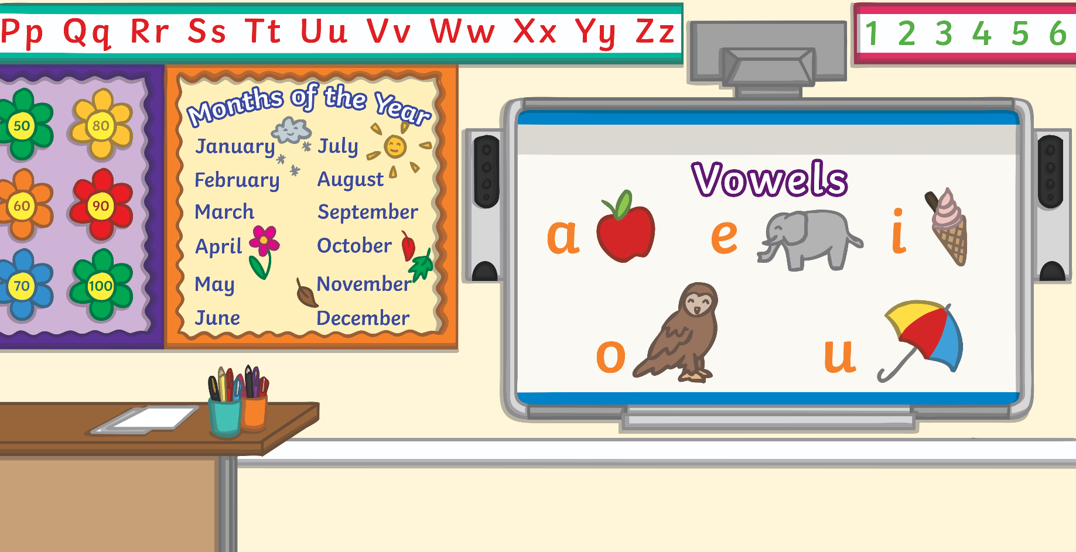
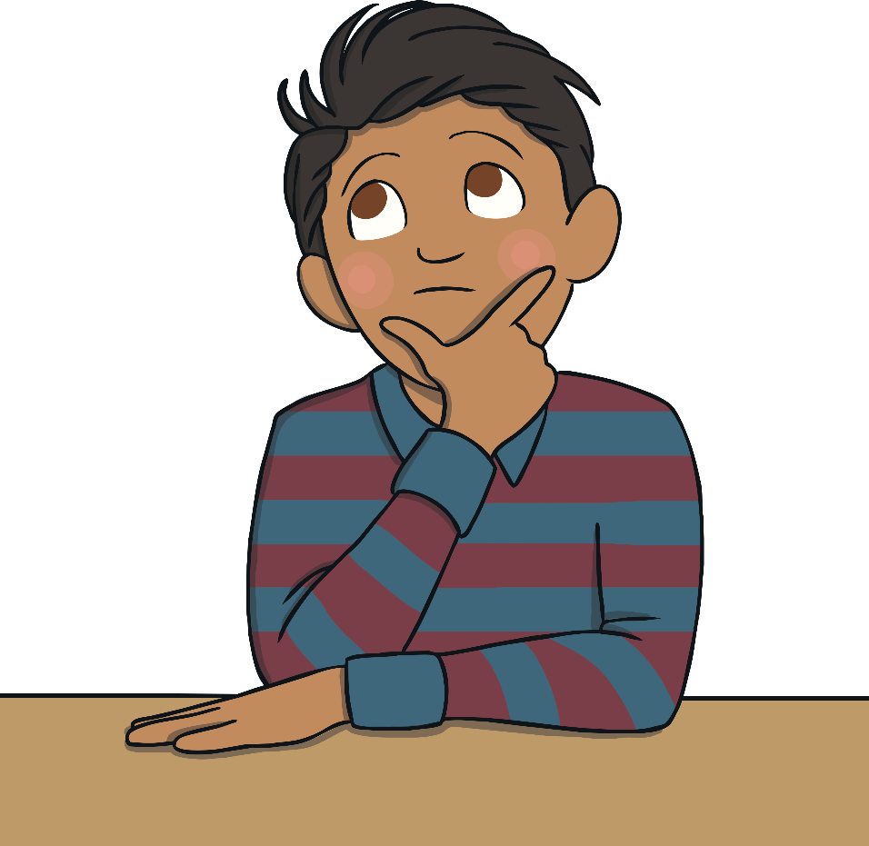
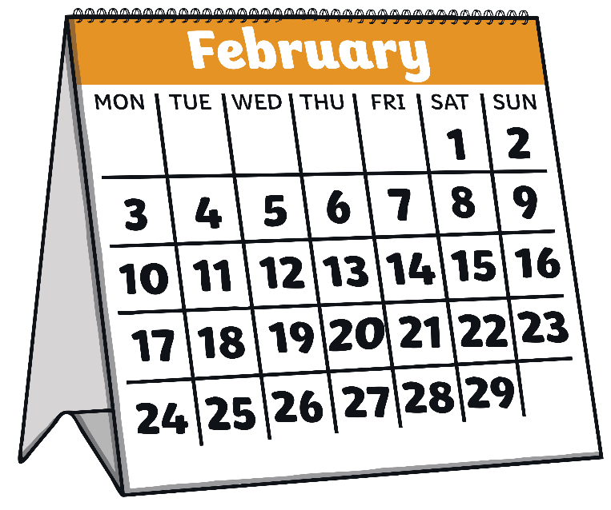
What Is a leap year?
A year is how long it takes for the Earth to go around the sun once (an orbit). This takes approximately 365 ¼ days.
In our calendars, we have 365 days making up one year but what happens to the extra ¼ of a day?
Is this year a leap year? How could you find out?
Every 4 years the four quarters add together to make an extra day. This day is the 29th February. When this happens it is called a leap year.

Slide 7
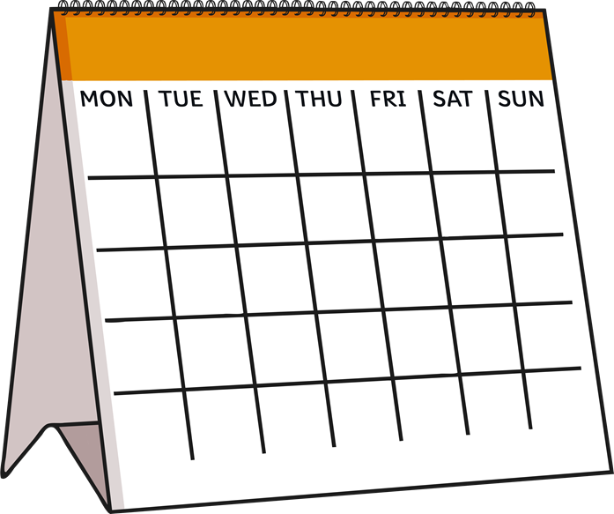
Calendar Chaos
There has been chaos in the calendar factory and all the months have been mixed up.
Can you help to put the months of the calendar back in the correct order?
Do you know which month this could be?
1
2
3
4
5
6
7
8
9
10
11
12
14
15
16
17
18
19
How could we work it out?
13
21
22
23
24
25
26
20
27
28

Slide 8
Calendar Chaos
We can see that this month has 28 days.
?
Which month do you know that has 28 days? Remember, you could use the rhyme to help you.
M | T | W | T | F | S | S
 |  | 1 | 2 | 3 | 4 | 5
6 | 7 | 8 | 9 | 10 | 11 | 12
13 | 14 | 15 | 16 | 17 | 18 | 19
20 | 21 | 22 | 23 | 24 | 25 | 26
27 | 28

Slide 9
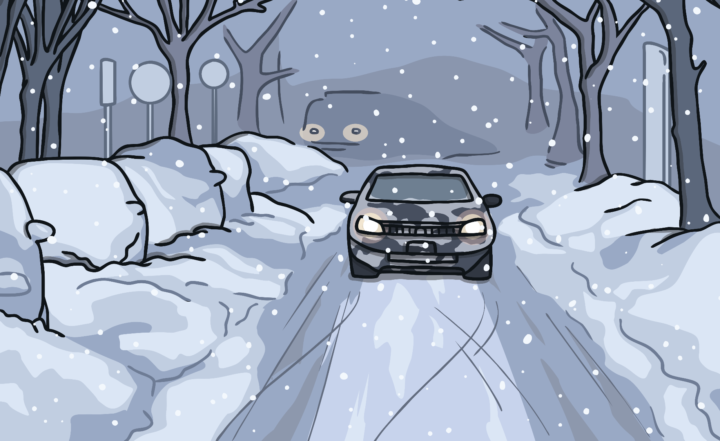
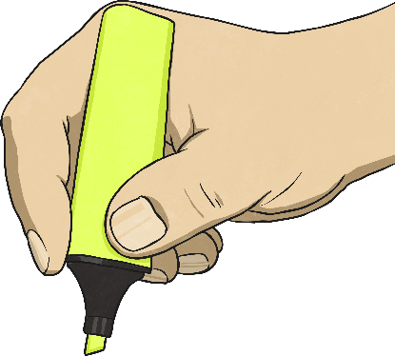
Calendar Chaos
30 days has September,
April, June and November.
All the rest have 31,
Excepting February alone,
Which only has 28 days clear,
And 29 in each leap year.

Slide 10
Calendar Chaos
February is the only month which has 28 days so this must be February.
?
What else does this calendar tell us?
M | T | W | T | F | S | S
 |  | 1 | 2 | 3 | 4 | 5
6 | 7 | 8 | 9 | 10 | 11 | 12
13 | 14 | 15 | 16 | 17 | 18 | 19
20 | 21 | 22 | 23 | 24 | 25 | 26
27 | 28
The 1st day of February is on a Wednesday.
The last day of February is on a Tuesday.
?
What day of the week will March start on? How do you know?

Slide 11
Calendar Chaos
The last day of February is a Tuesday.
M | T | W | T | F | S | S
 |  | 1 | 2 | 3 | 4 | 5
6 | 7 | 8 | 9 | 10 | 11 | 12
13 | 14 | 15 | 16 | 17 | 18 | 19
20 | 21 | 22 | 23 | 24 | 25 | 26
27 | 28
March comes after February so it must start on a Wednesday.

Slide 12
Calendar Chaos
?
Which of these months could be March? How do you know?
M | T | W | T | F | S | S
 |  |  |  |  | 1 | 2
3 | 4 | 5 | 6 | 7 | 8 | 9
10 | 11 | 12 | 13 | 14 | 15 | 16
17 | 18 | 19 | 20 | 21 | 22 | 23
24 | 25 | 26 | 27 | 28 | 29 | 30
M | T | W | T | F | S | S
 |  | 1 | 2 | 3 | 4 | 5
6 | 7 | 8 | 9 | 10 | 11 | 12
13 | 14 | 15 | 16 | 17 | 18 | 19
20 | 21 | 22 | 23 | 24 | 25 | 26
27 | 28 | 29 | 30 | 31
M | T | W | T | F | S | S
1 | 2 | 3 | 4 | 5 | 6 | 7
8 | 9 | 10 | 11 | 12 | 13 | 14
15 | 16 | 17 | 18 | 19 | 20 | 21
22 | 23 | 24 | 25 | 26 | 27 | 28
29 | 30 | 31
M | T | W | T | F | S | S
 |  |  | 1 | 2 | 3 | 4
5 | 6 | 7 | 8 | 9 | 10 | 11
12 | 13 | 14 | 15 | 16 | 17 | 18
19 | 20 | 21 | 22 | 23 | 24 | 25
26 | 27 | 28 | 29 | 30
M | T | W | T | F | S | S
 |  |  |  | 1 | 2 | 3
4 | 5 | 6 | 7 | 8 | 9 | 10
11 | 12 | 13 | 14 | 15 | 16 | 17
18 | 19 | 20 | 21 | 22 | 23 | 24
25 | 26 | 27 | 28 | 29 | 30
M | T | W | T | F | S | S
 | 1 | 2 | 3 | 4 | 5 | 6
7 | 8 | 9 | 10 | 11 | 12 | 13
14 | 15 | 16 | 17 | 18 | 19 | 20
21 | 22 | 23 | 24 | 25 | 26 | 27
28 | 29 | 30 | 31

Slide 13
Calendar Chaos
I know that September starts on a Friday.
?
Which one of these months could it be? How could I check?
M | T | W | T | F | S | S
 |  |  |  | 1 | 2 | 3
4 | 5 | 6 | 7 | 8 | 9 | 10
11 | 12 | 13 | 14 | 15 | 16 | 17
18 | 19 | 20 | 21 | 22 | 23 | 24
25 | 26 | 27 | 28 | 29 | 30
M | T | W | T | F | S | S
 |  |  |  | 1 | 2 | 3
4 | 5 | 6 | 7 | 8 | 9 | 10
11 | 12 | 13 | 14 | 15 | 16 | 17
18 | 19 | 20 | 21 | 22 | 23 | 24
25 | 26 | 27 | 28 | 29 | 30 | 31
I know that September has 30 days so this must be September. I could say the rhyme to help me.

Slide 14
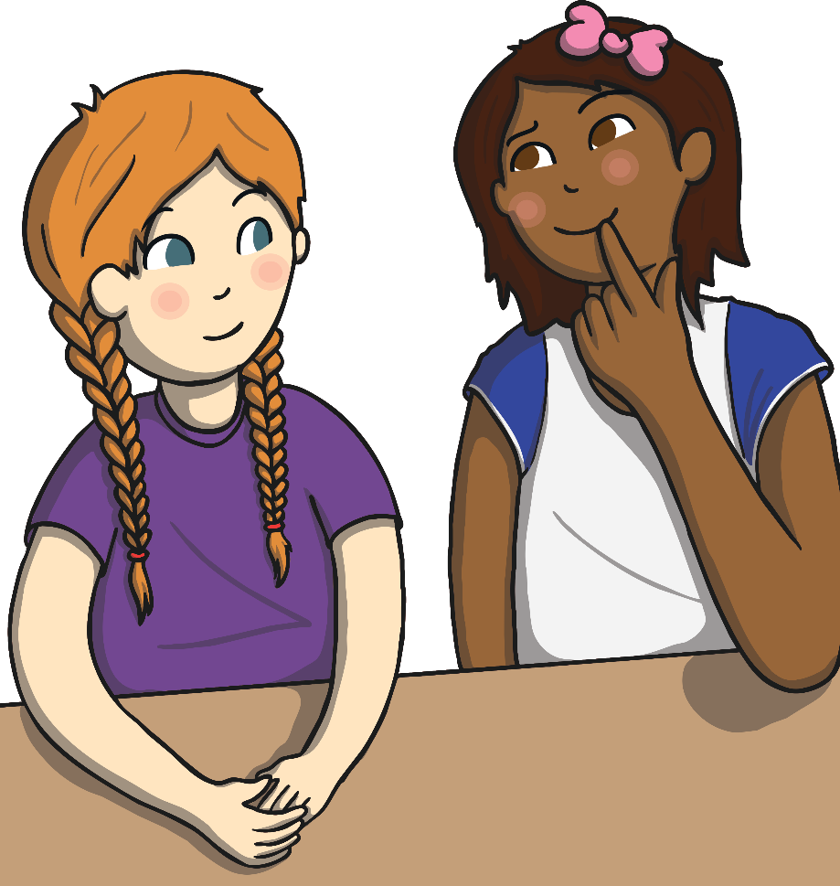
Diving into Mastery
Dive in by completing your own activity!

