Slide 2
SAFETY FIRST!!!!
DO NOT try and do any experiments with electricity at home!! It can be very dangerous. Even batteries can actually be dangerous if they are not used correctly.
DO NOT EVER play/experiment with electricity that comes from a plug. It is extremely dangerous.
Stay safe and I hope you enjoy my demonstration today ☺

Slide 3
Electrical Conductors and Insulators
An electrical conductor is a material that allows electricity to pass through it (for example, the inside of a wire)
An electrical insulator does not allow electricity to pass through it (like the outside of a wire)

Slide 4
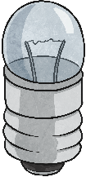
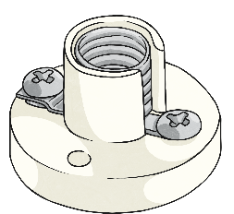
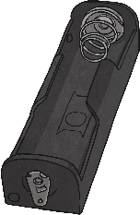
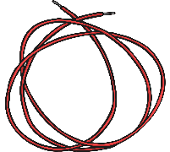
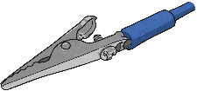
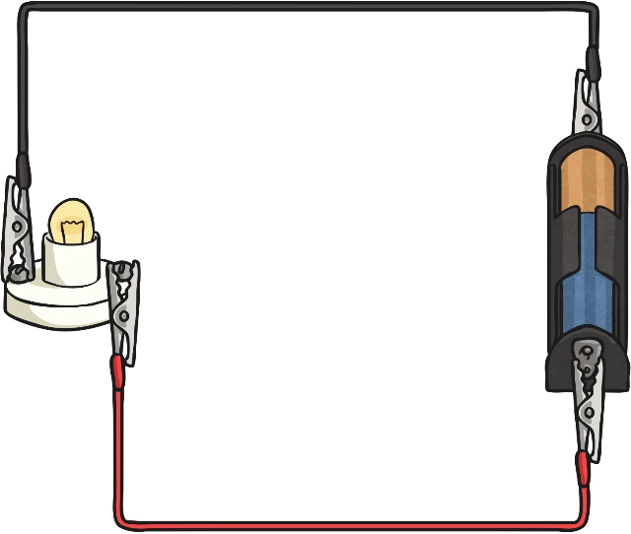
Testing Materials
Before I start the investigation I need to make sure I’ve actually got all of the equipment I need and that it all works.
3 wires and crocodile clips
bulb
bulb holder
battery (cell)
battery holder
The circuit should look like the one on the right when complete.
N.B. check that it works and the bulb lights. If the bulb is dim in this circuit, change either the bulb or the battery.

Slide 5
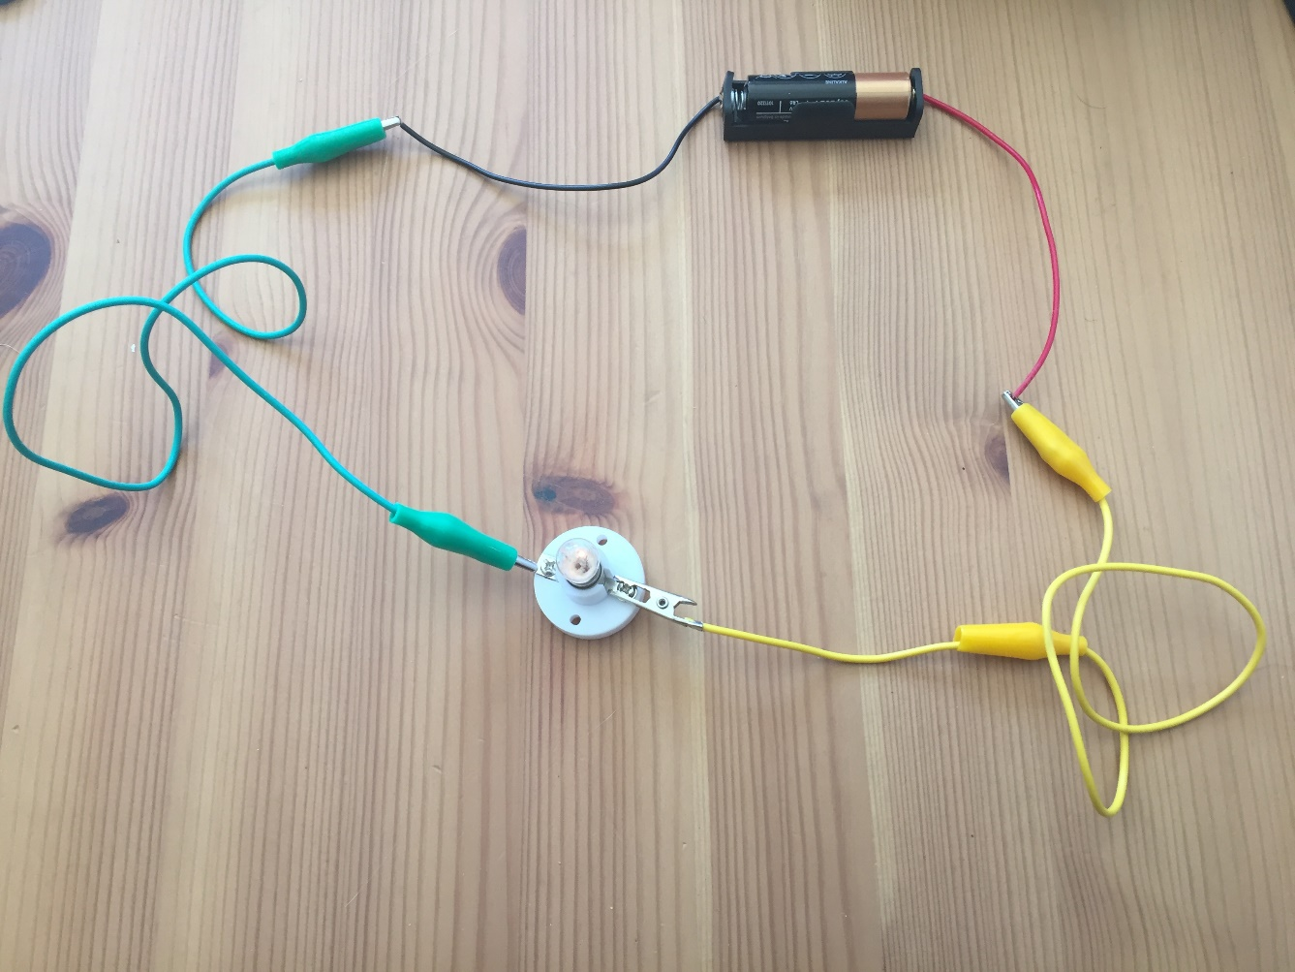
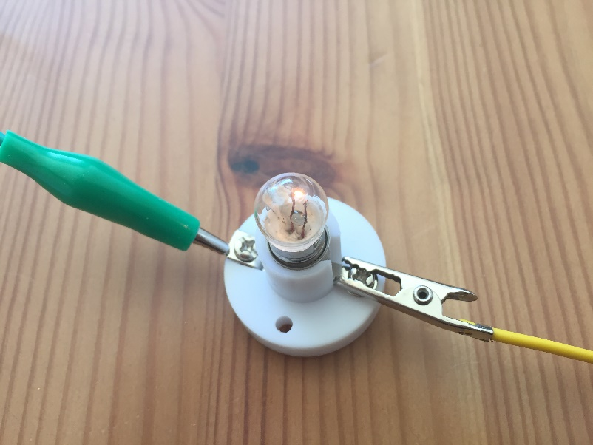
I tested all the components and the circuit works ☺

Slide 6
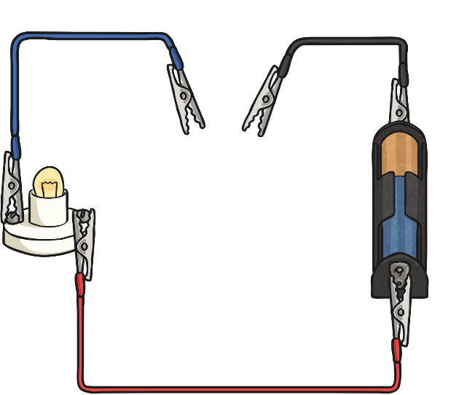
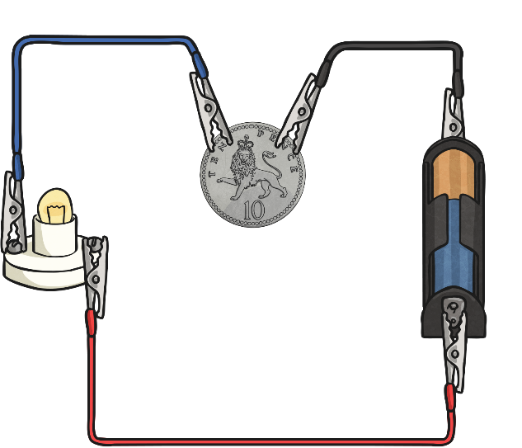
Testing Materials
Then I’m going to get an extra wire and set up my circuit like this:
Connect it to your circuit so it now looks like this:
Choose a material and add it to the circuit so it looks like this:
If the bulb lights, then the material is an electrical conductor.
If the bulb remains unlit, the material is an electrical insulator.
N.B. Check that all parts of the circuit are connected properly.

Slide 7
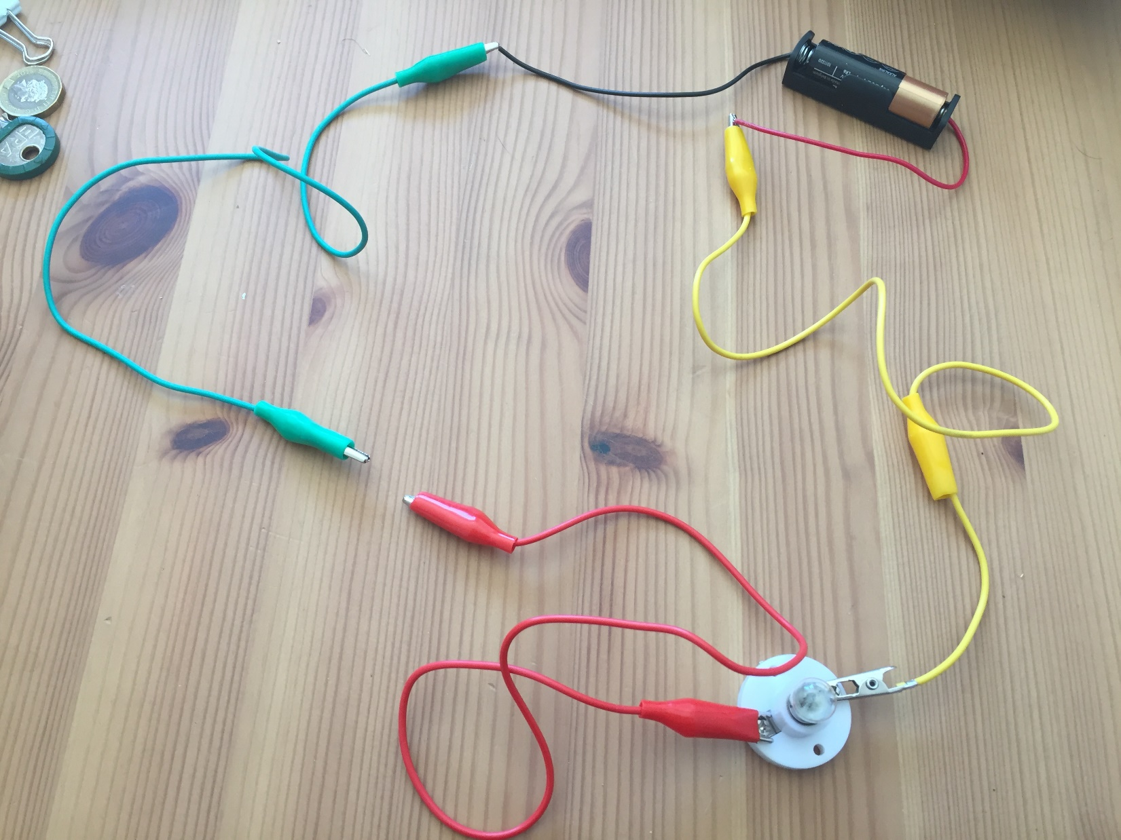
Here’s what my circuit looks like. It’s ready to go!

Slide 8
On the next slide are photos of the materials that I’m going to test to see whether they will be conductors or insulators.
Look closely at the pictures and decide for yourself what you think they are going to be.
Draw a table in your book that looks like this:
Prediction:
Conductors | Insulators
Write the name of each material/object in the column that you think it will fit into.

Slide 9
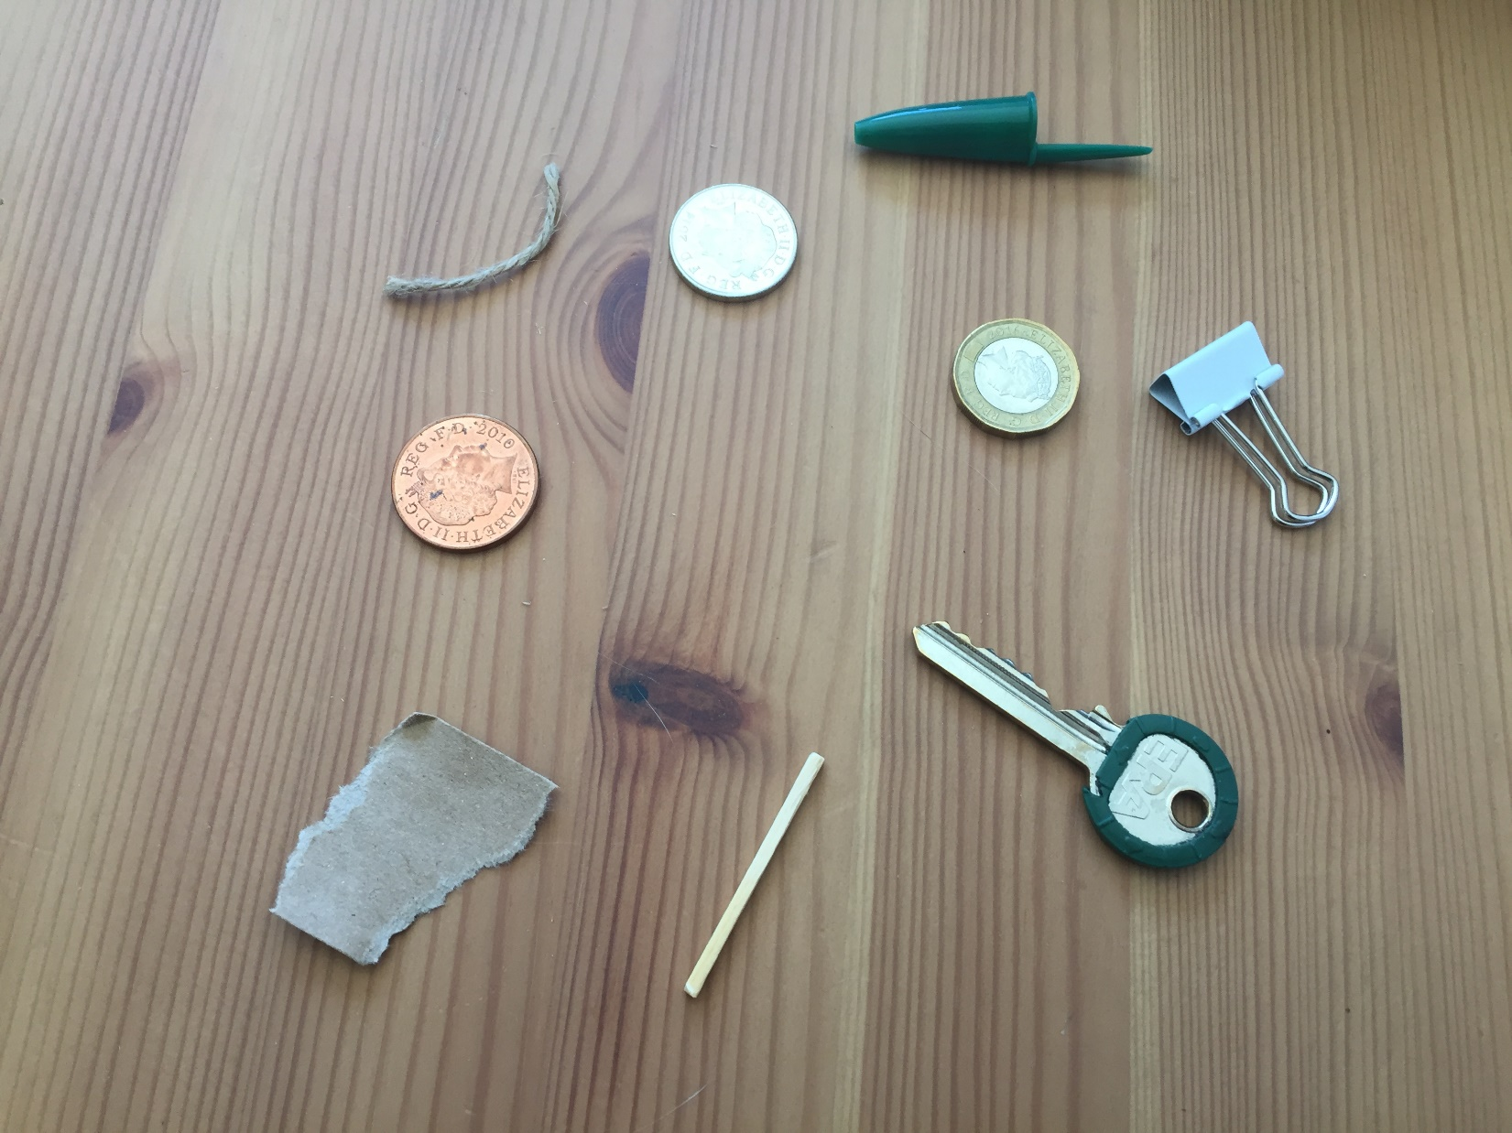
Plastic pen lid
string
Bulldog clip
10p coin
2p Coin
£1 coin
key
paper
Wooden matchstick

Slide 10
First up… paper!
Did you think it would be a conductor or an insulator?

Slide 11
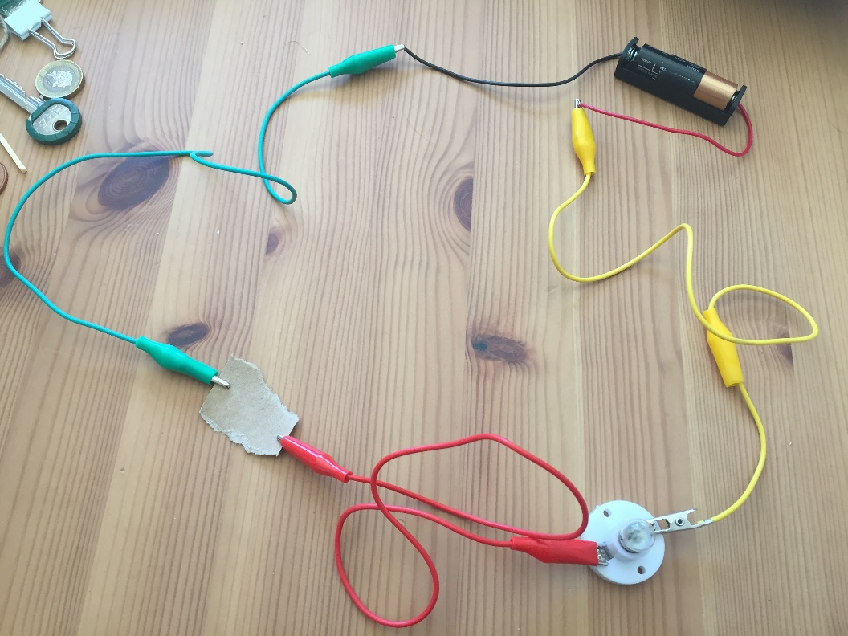
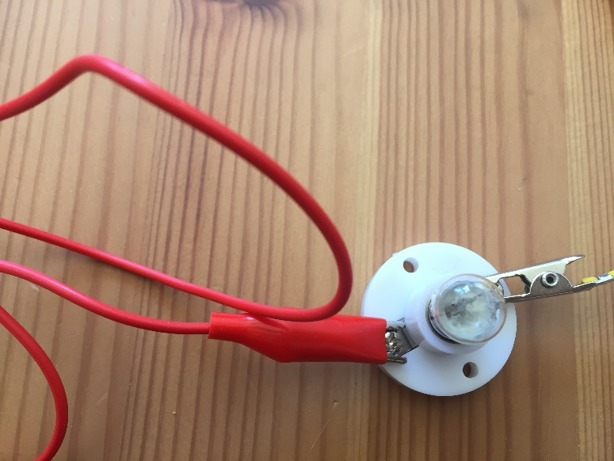
The bulb is not lit, the circuit is incomplete so paper is an electrical insulator.
Did you get it right?

Slide 12
Next, the 2p coin.
Did you think it would be a conductor or an insulator?

Slide 13
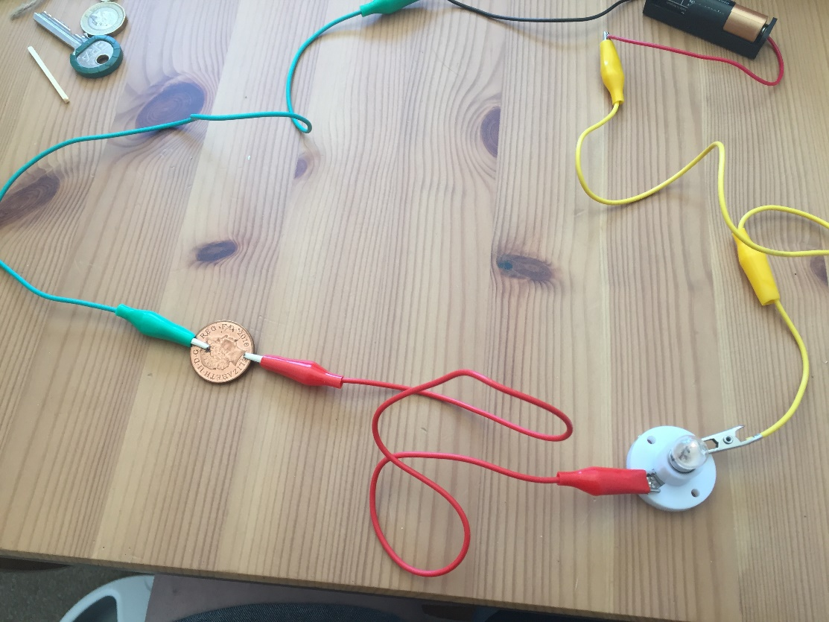
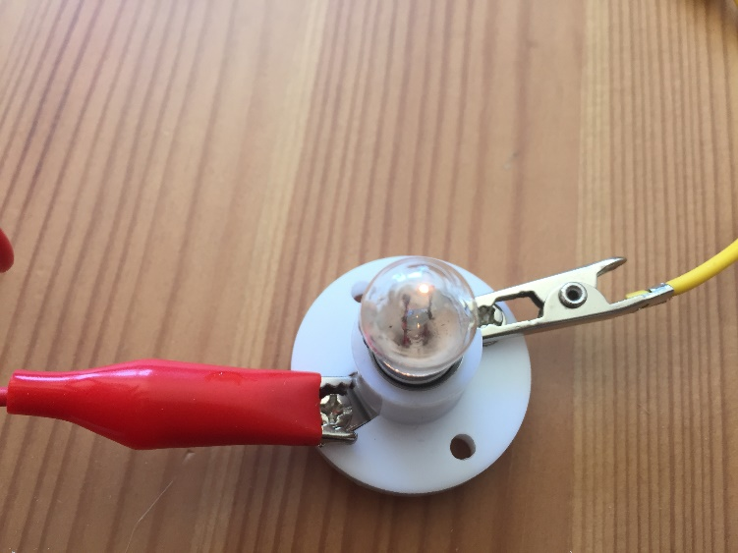
The bulb is lit, the circuit s complete so the 2p coin is an electrical conductor.
Were you correct?

Slide 14
Now, the matchstick
Did you think it would be a conductor or an insulator?

Slide 15
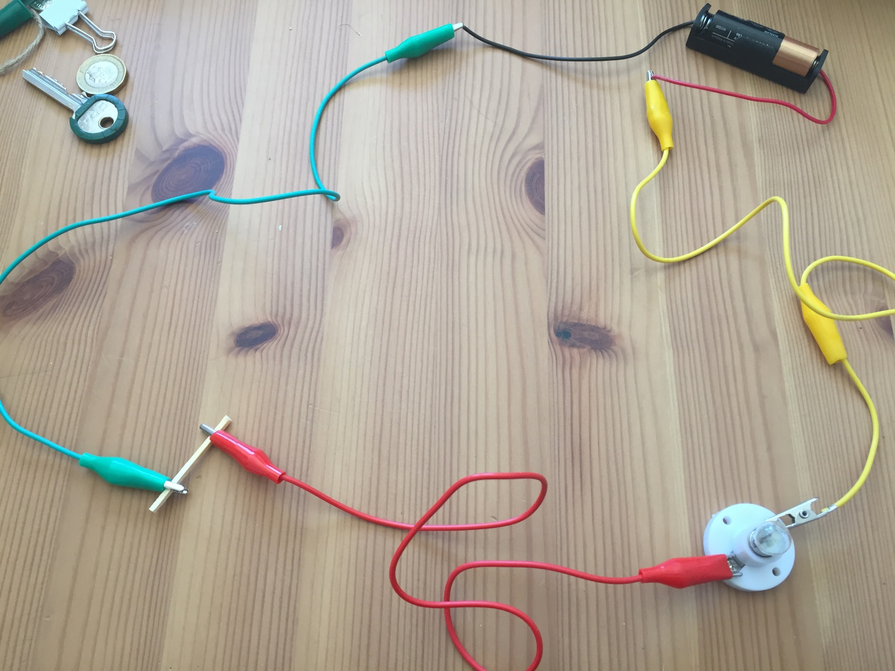
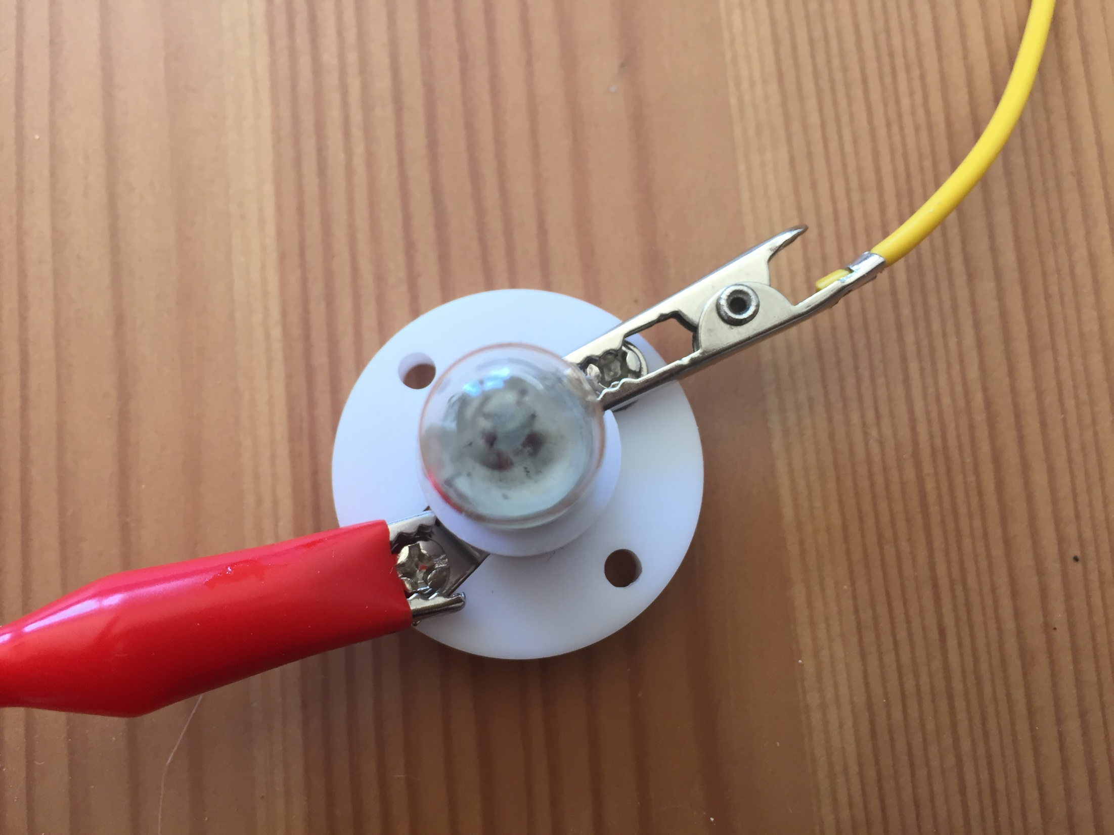
The bulb is not lit, the circuit is incomplete so the matchstick is an electrical insulator.
Were you correct?

Slide 16
It’s the pen lid now
Did you think it would be a conductor or an insulator?

Slide 17
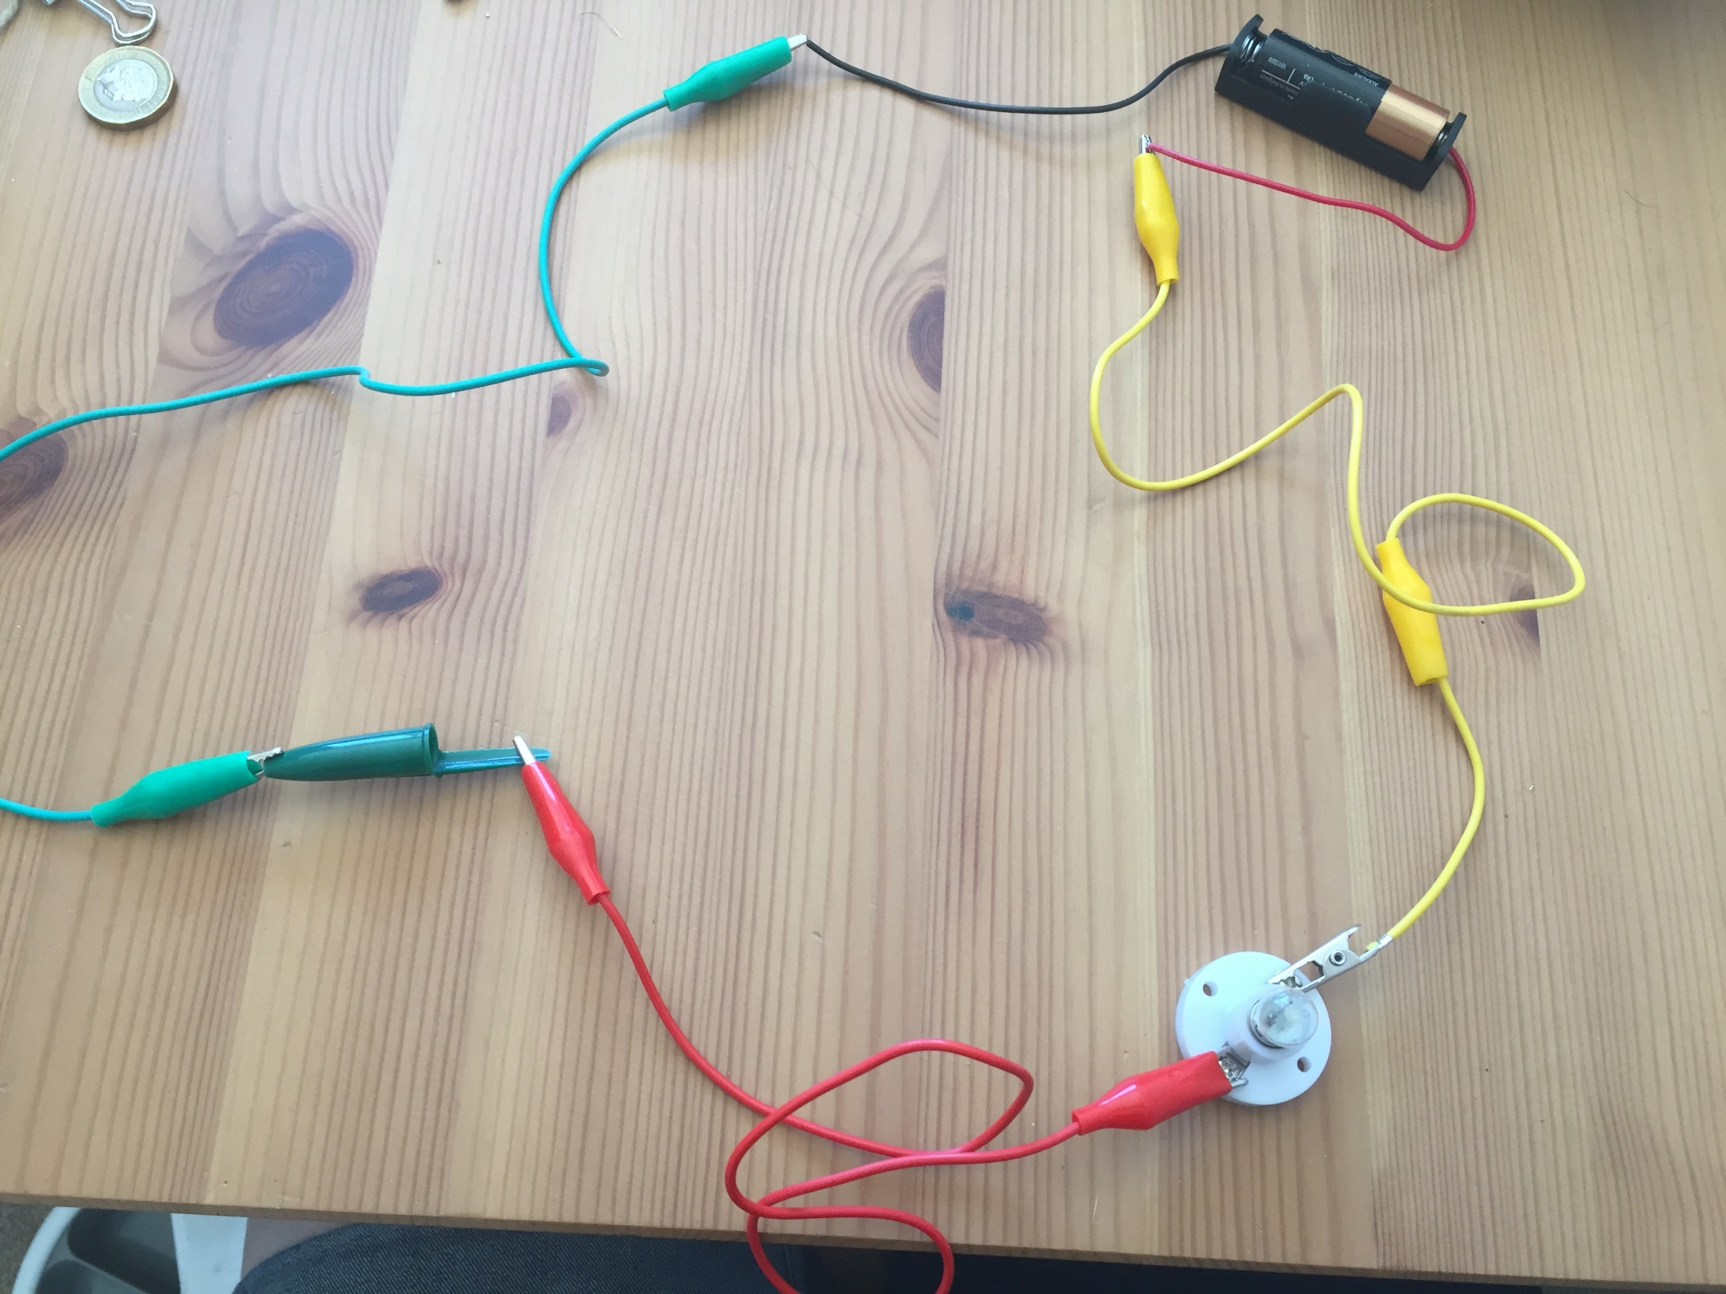
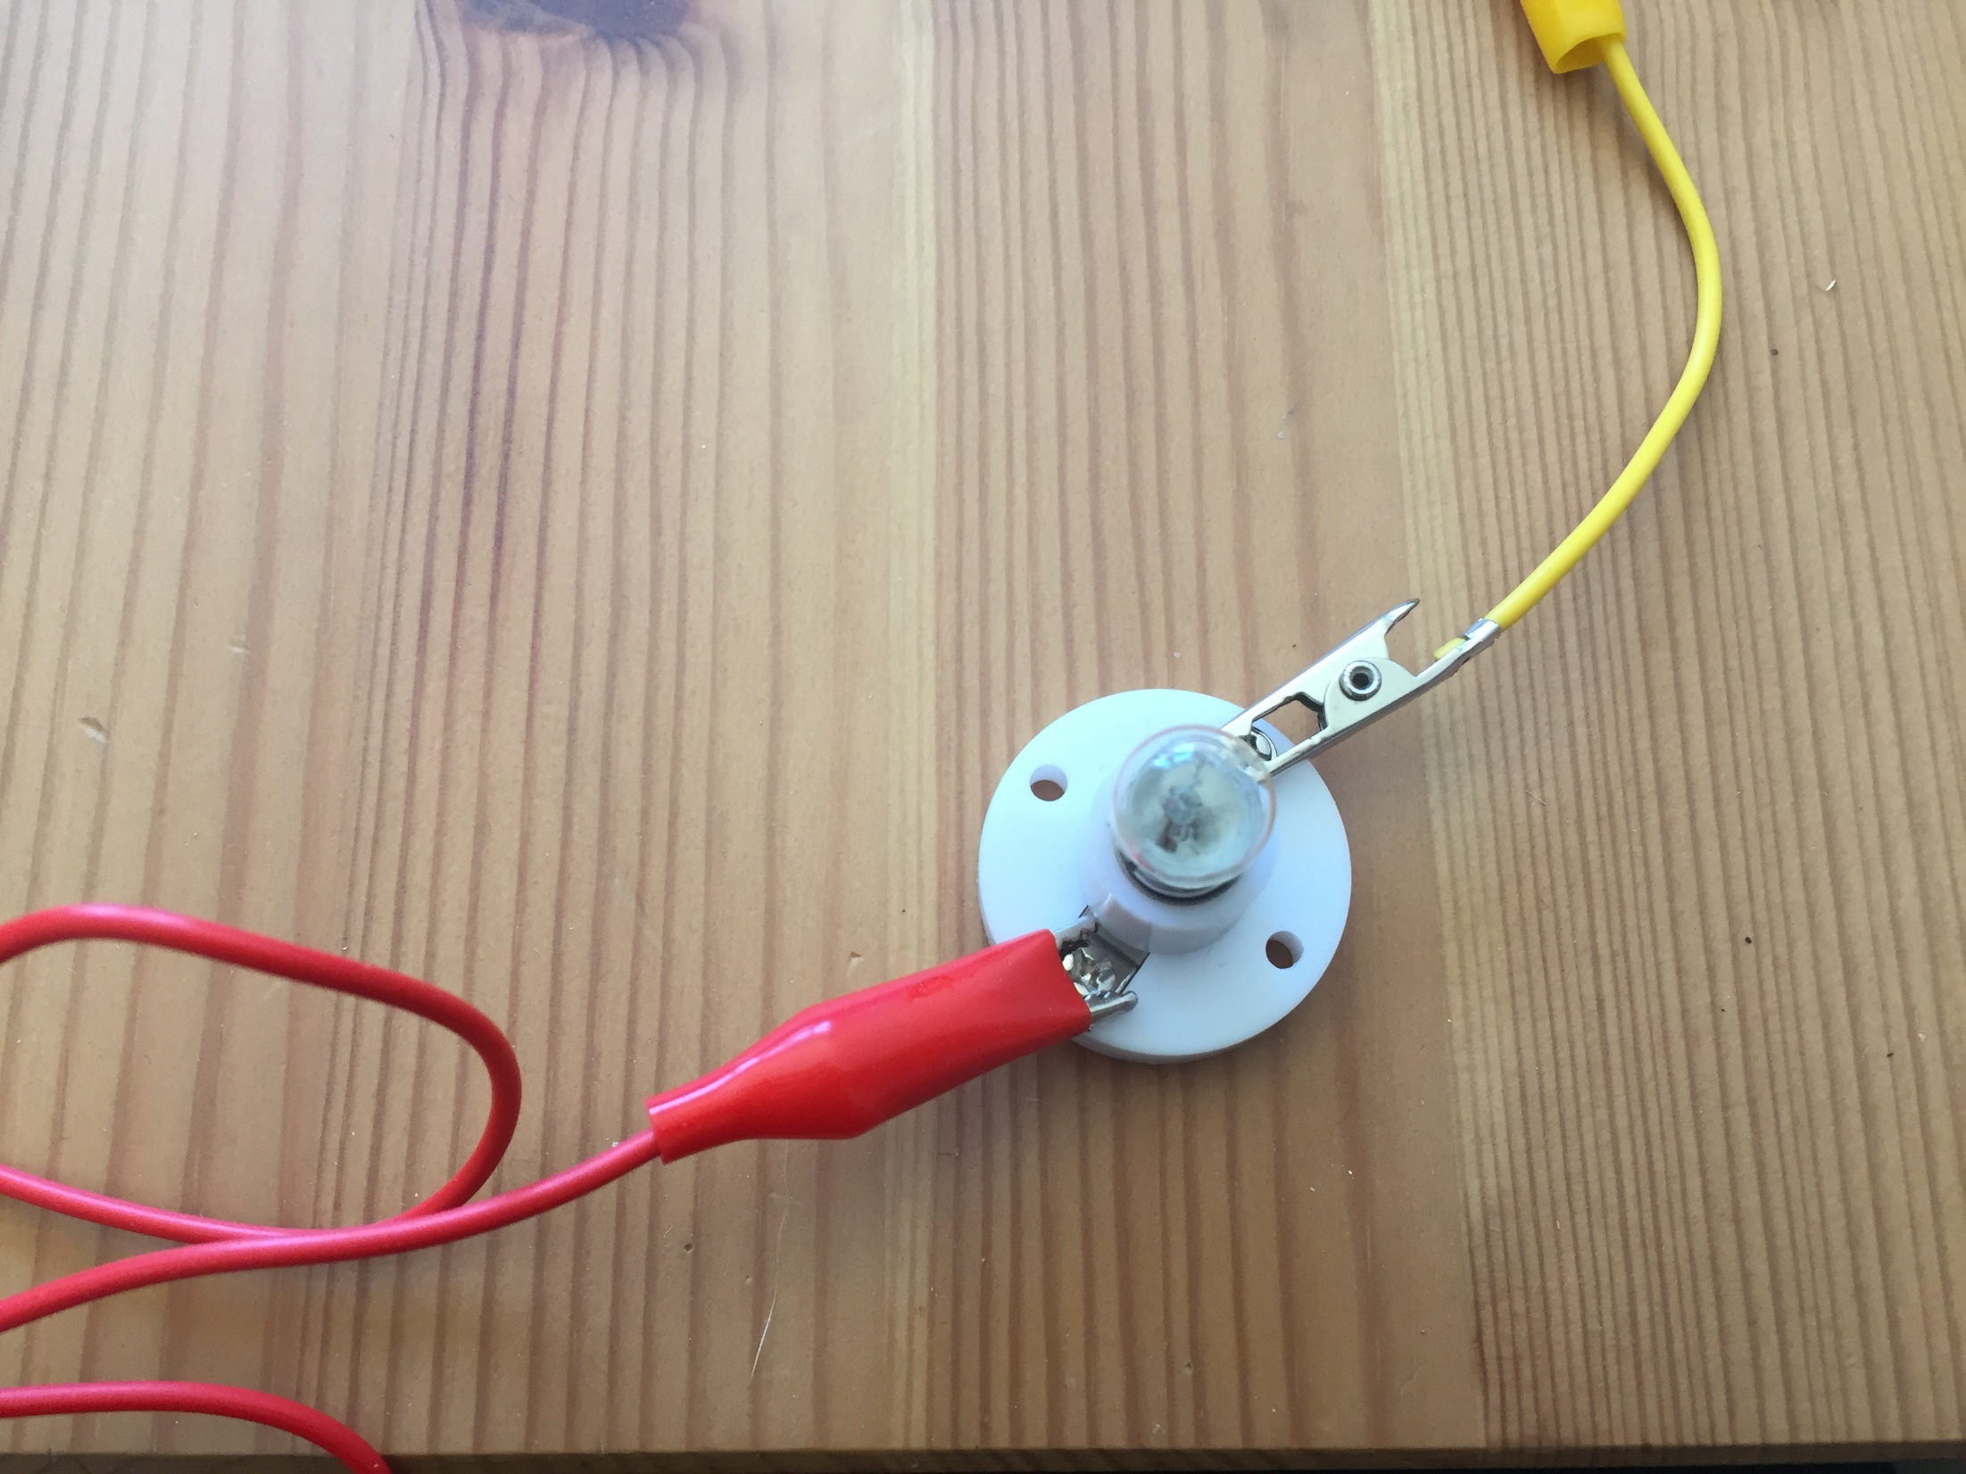
The bulb is not lit, the circuit is incomplete so the pen lid is an electrical insulator.
Were you correct?

Slide 18
Next, the £1 coin.
Did you think it would be a conductor or an insulator?

Slide 19
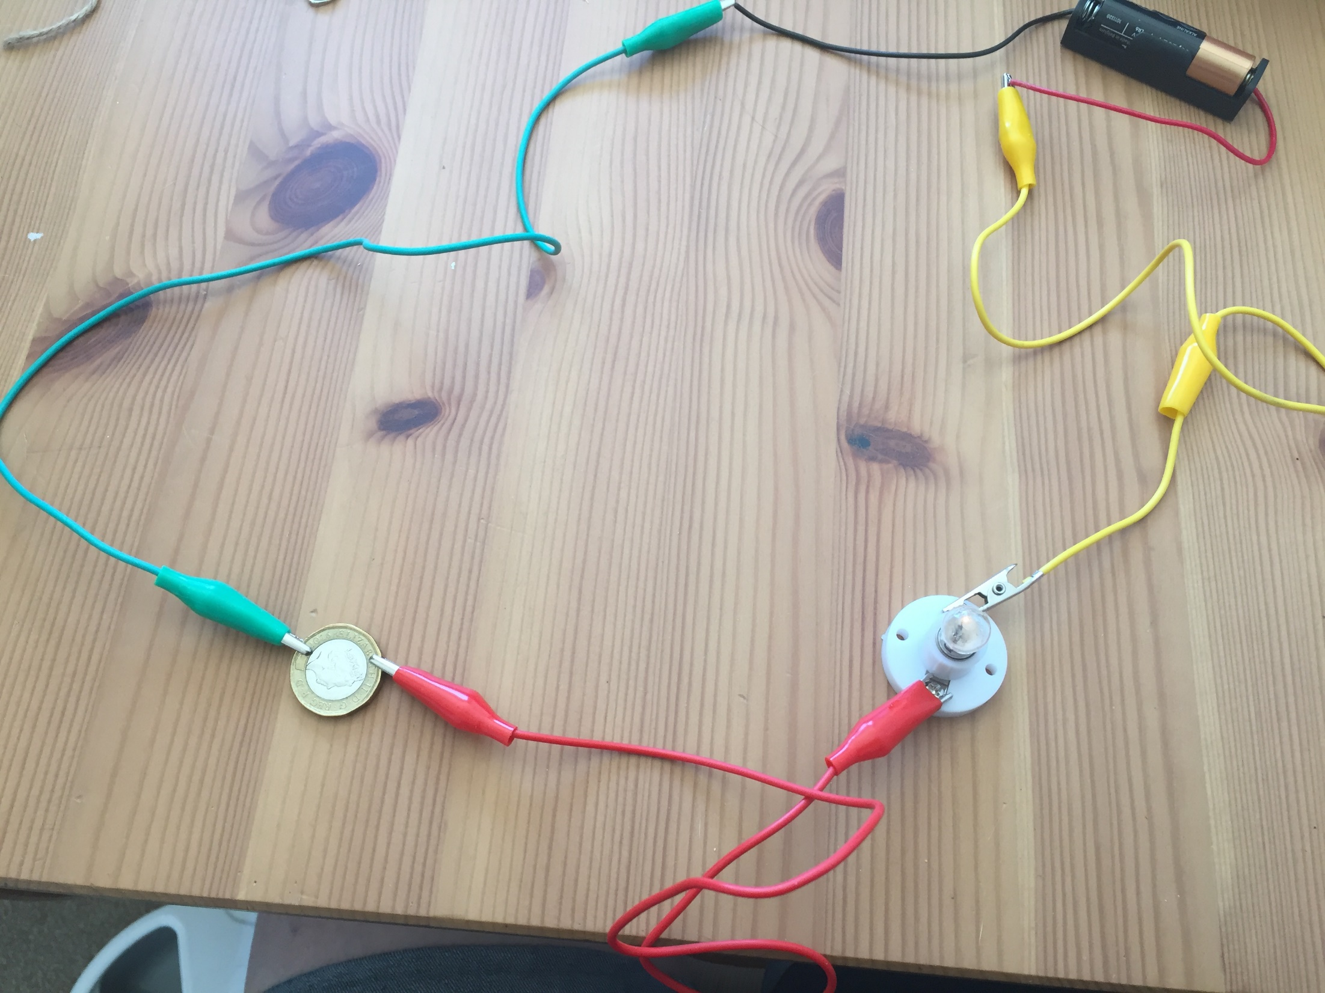
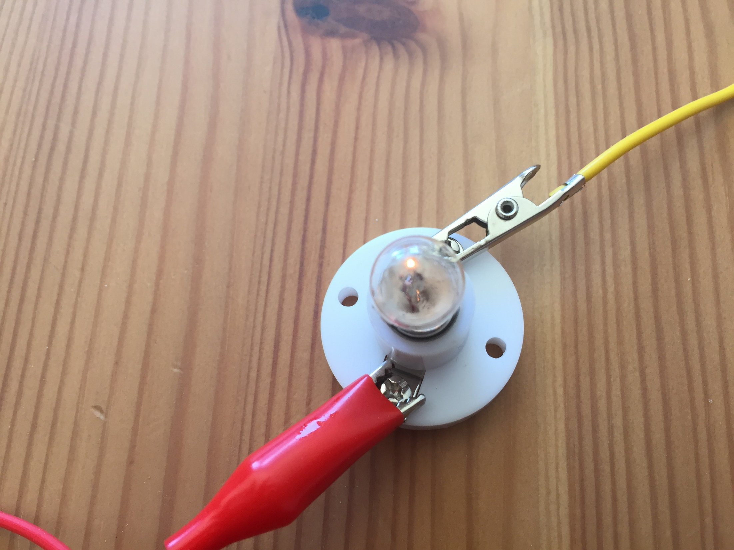
The bulb is lit, the circuit is complete so the £1 coin is an electrical conductor.
Were you correct?

Slide 20
The piece of string is next.
Did you think it would be a conductor or an insulator?

Slide 21
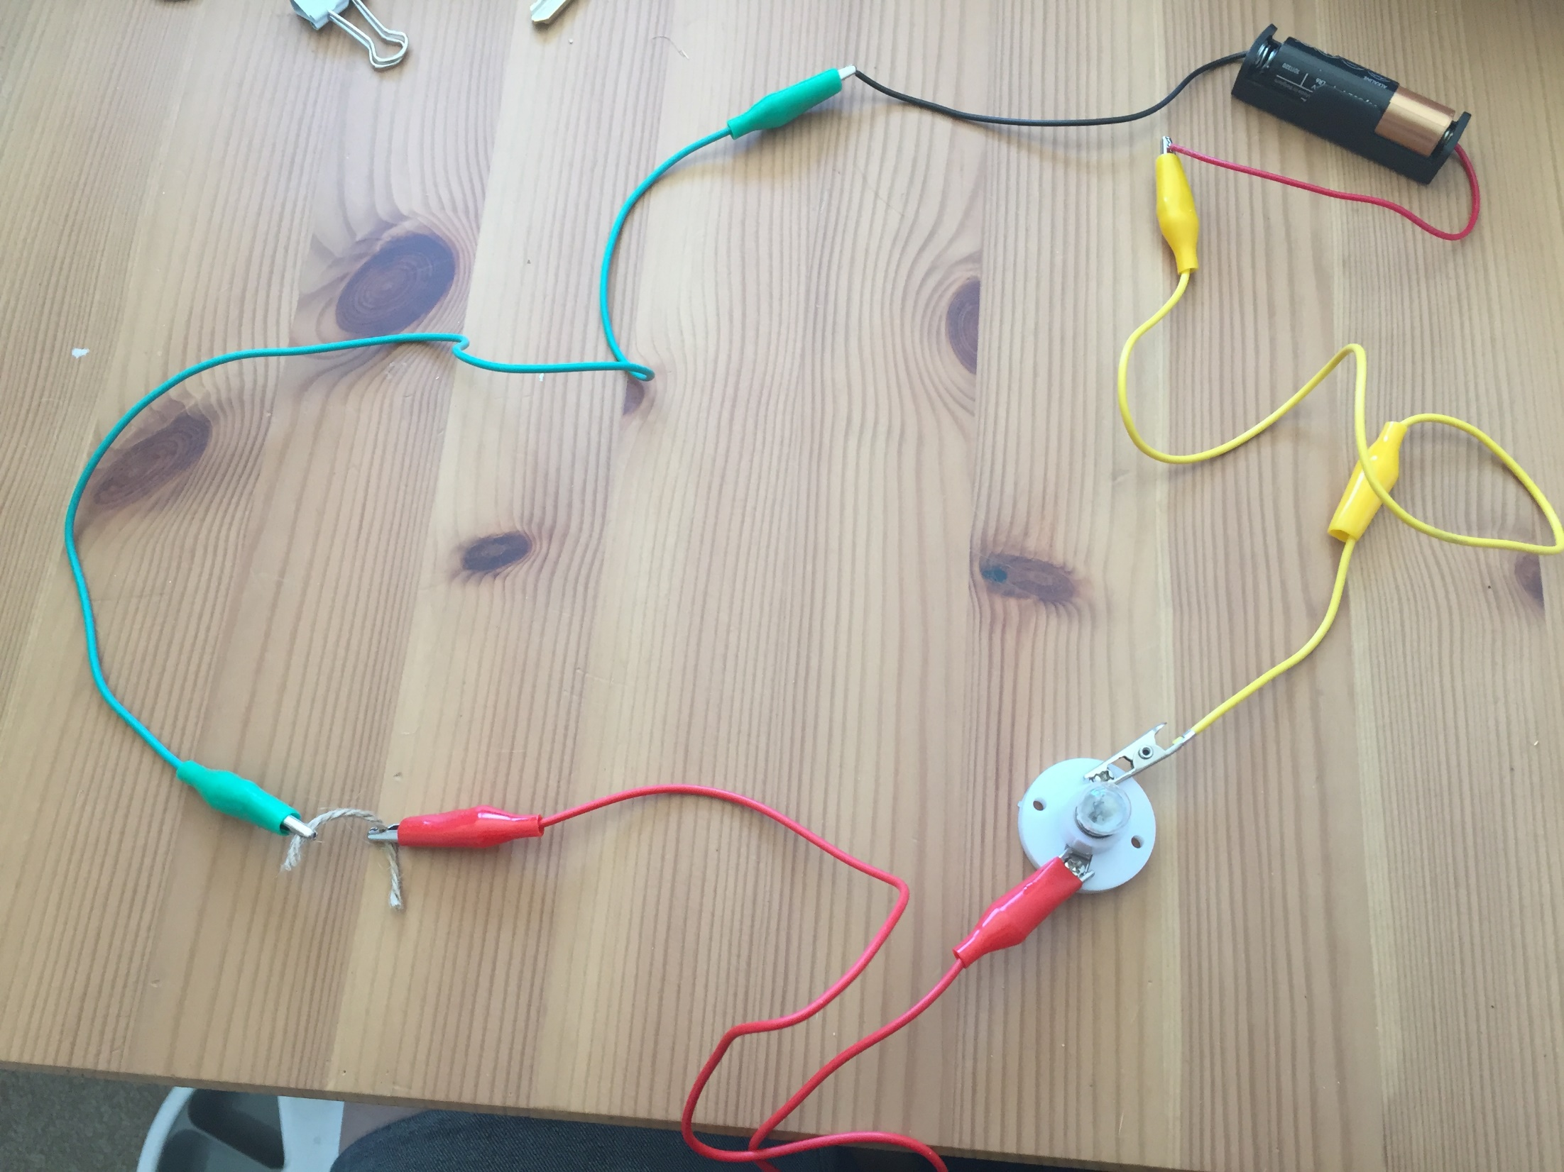
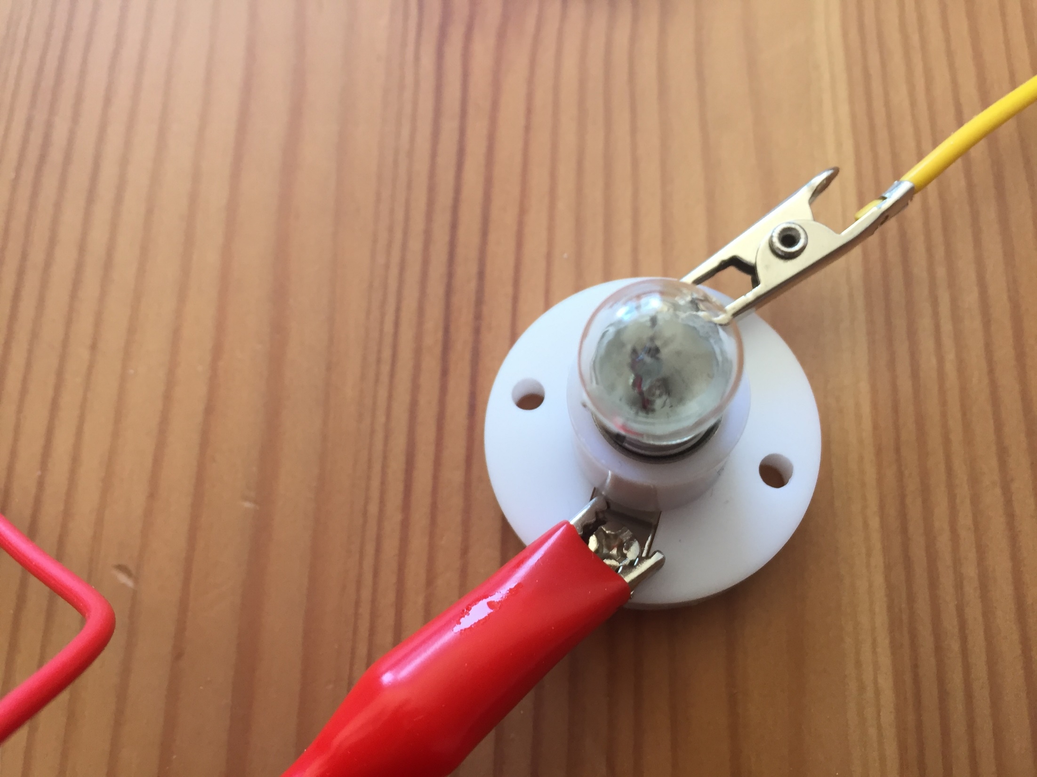
The bulb is not lit, the circuit is incomplete so the string must be an electrical insulator.
Were you correct?

Slide 22
Now is the bulldog clip
Did you think it would be a conductor or an insulator?

Slide 23
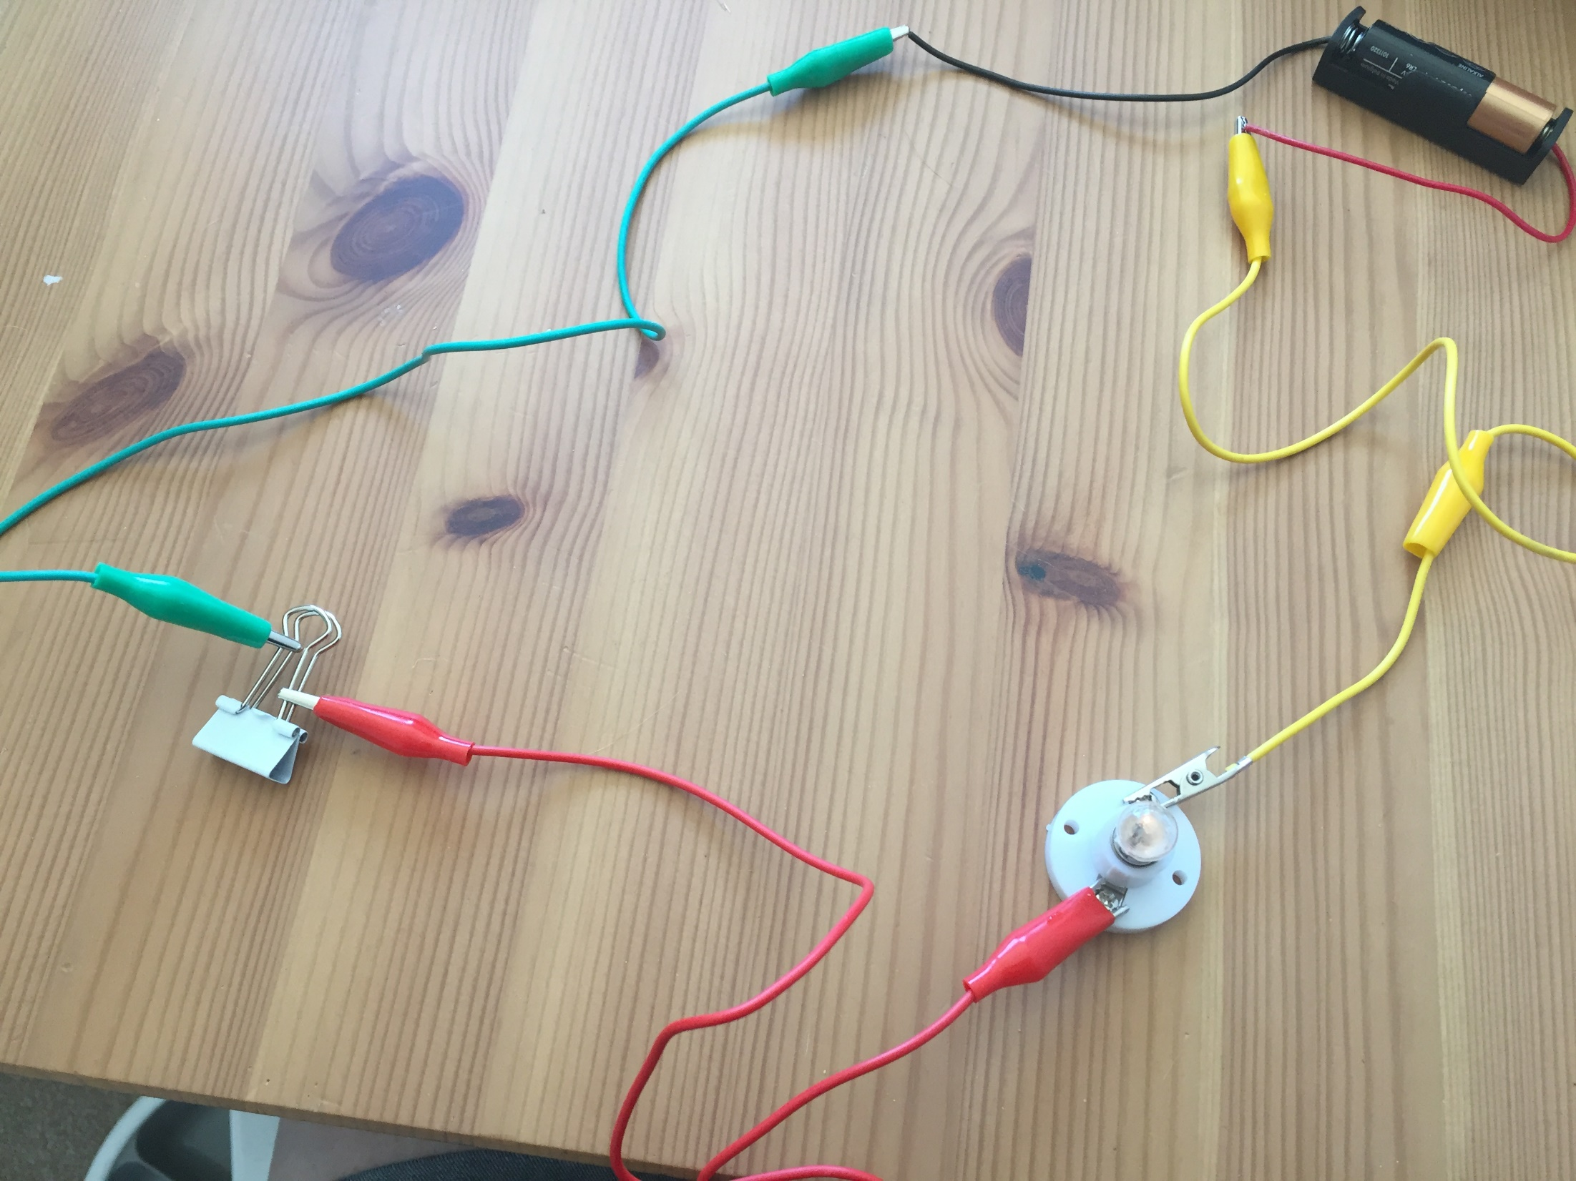
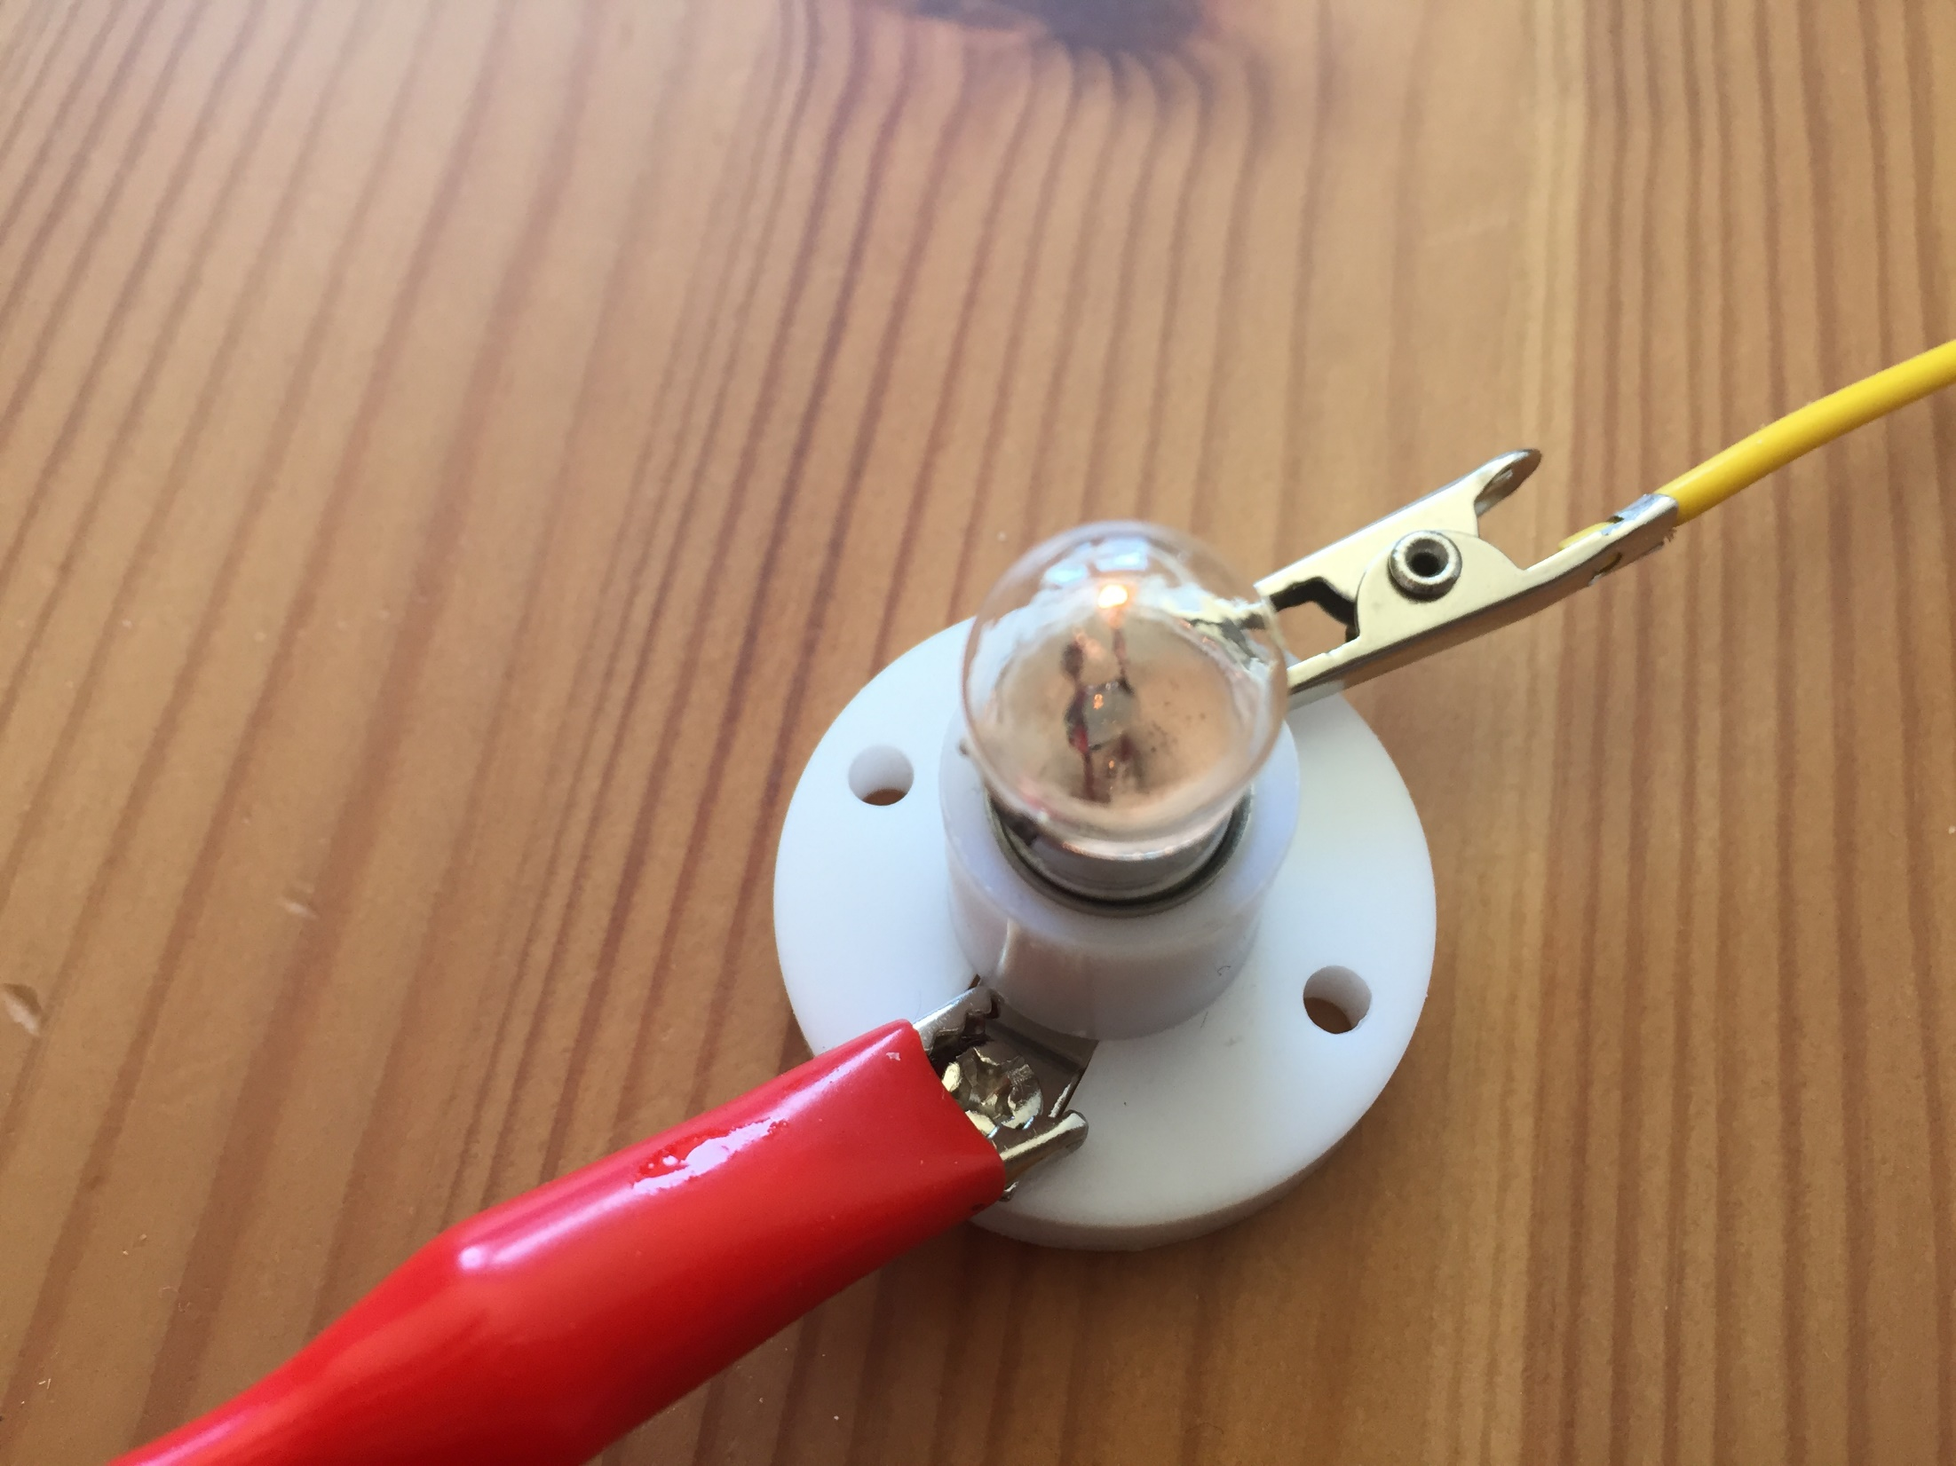
The bulb is lit, the circuit is complete so the bulldog clip must be an electrical conductor.
Were you correct?

Slide 24
Next is the 10p coin.
Did you think it would be a conductor or an insulator?

Slide 25
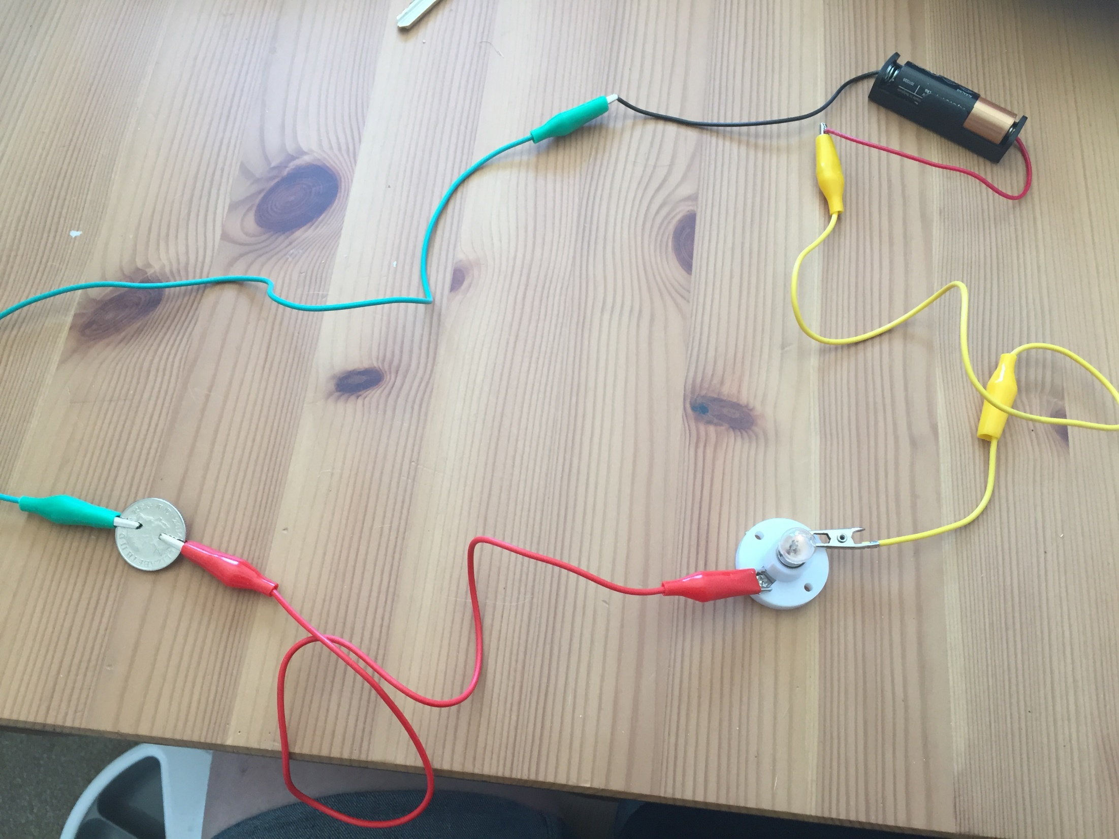
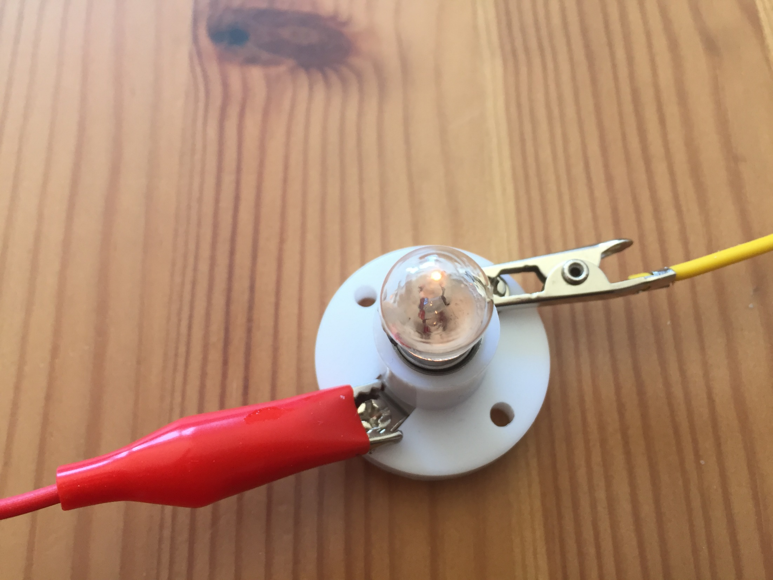
The bulb is lit, the circuit is complete so the 10p coin must be an electrical conductor.
Were you correct?

Slide 26
Finally is the key.
Did you think it would be a conductor or an insulator?

Slide 27
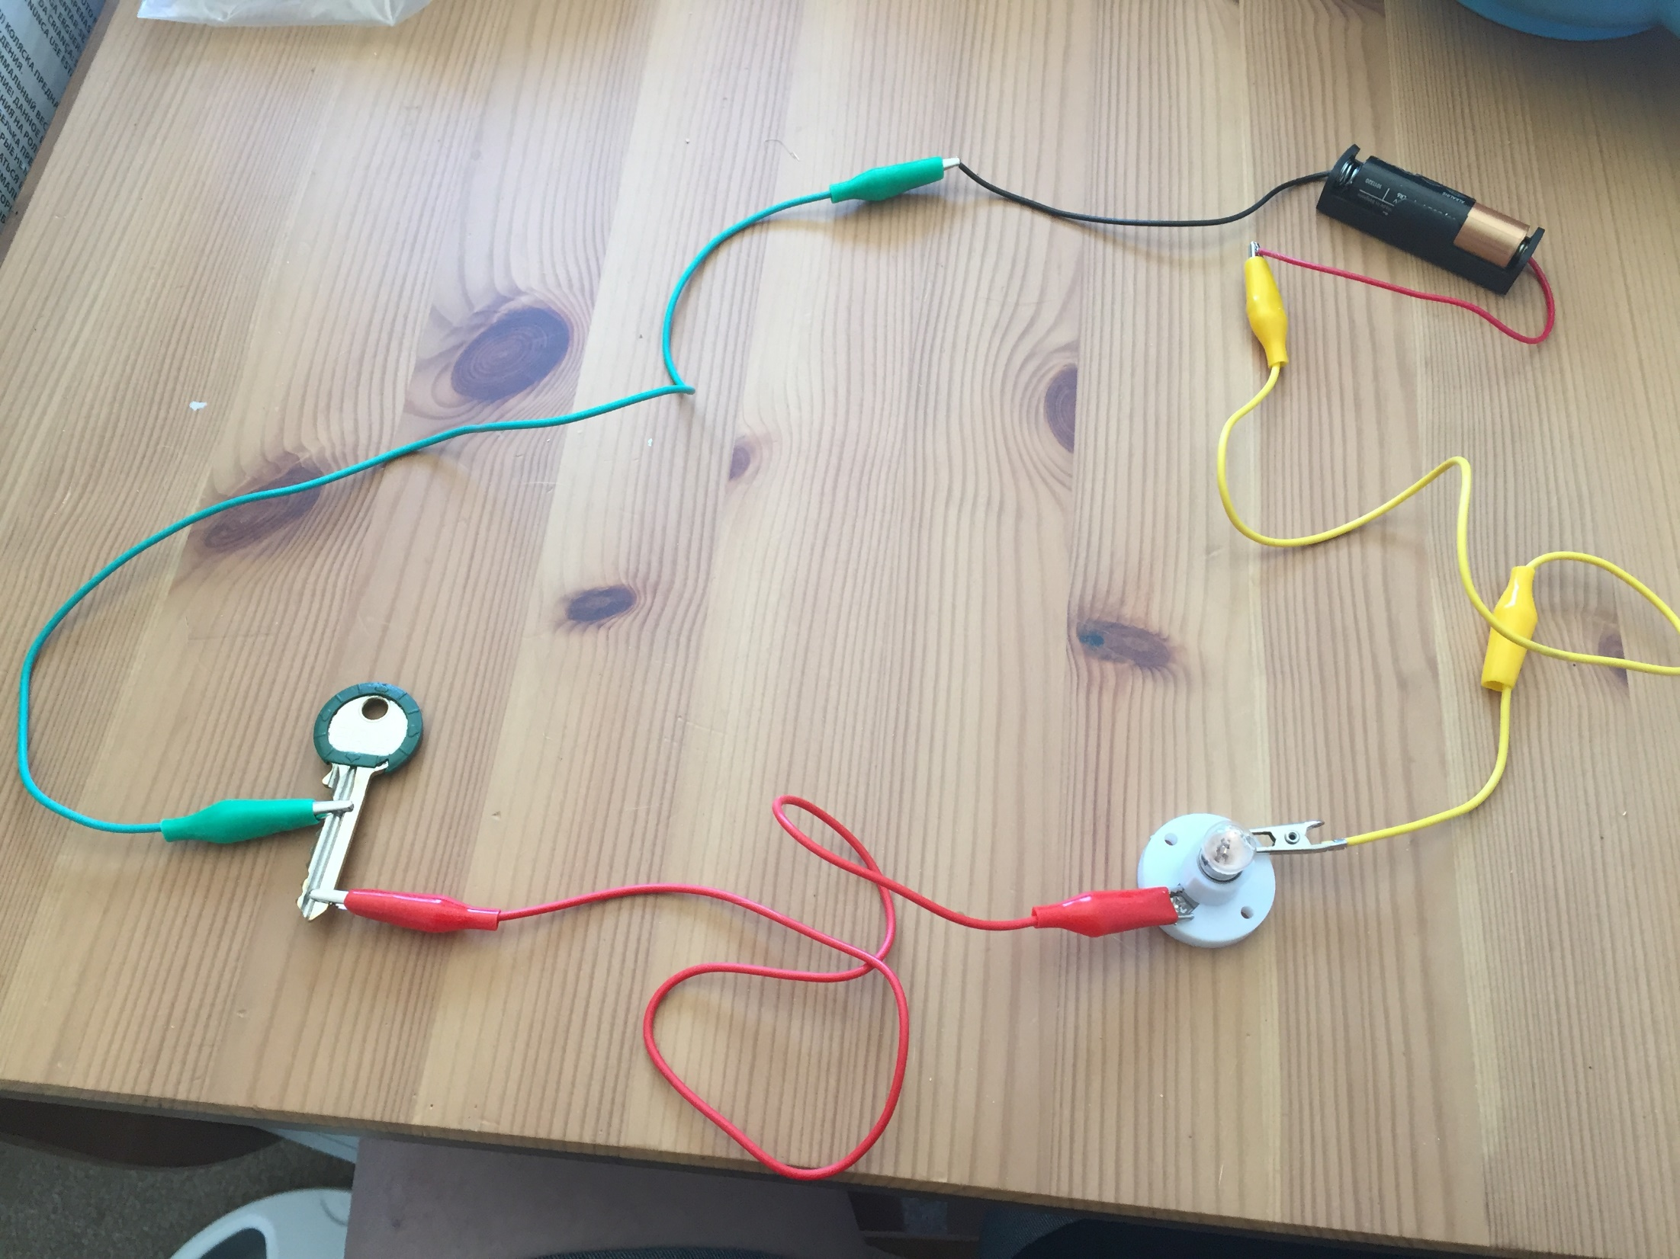
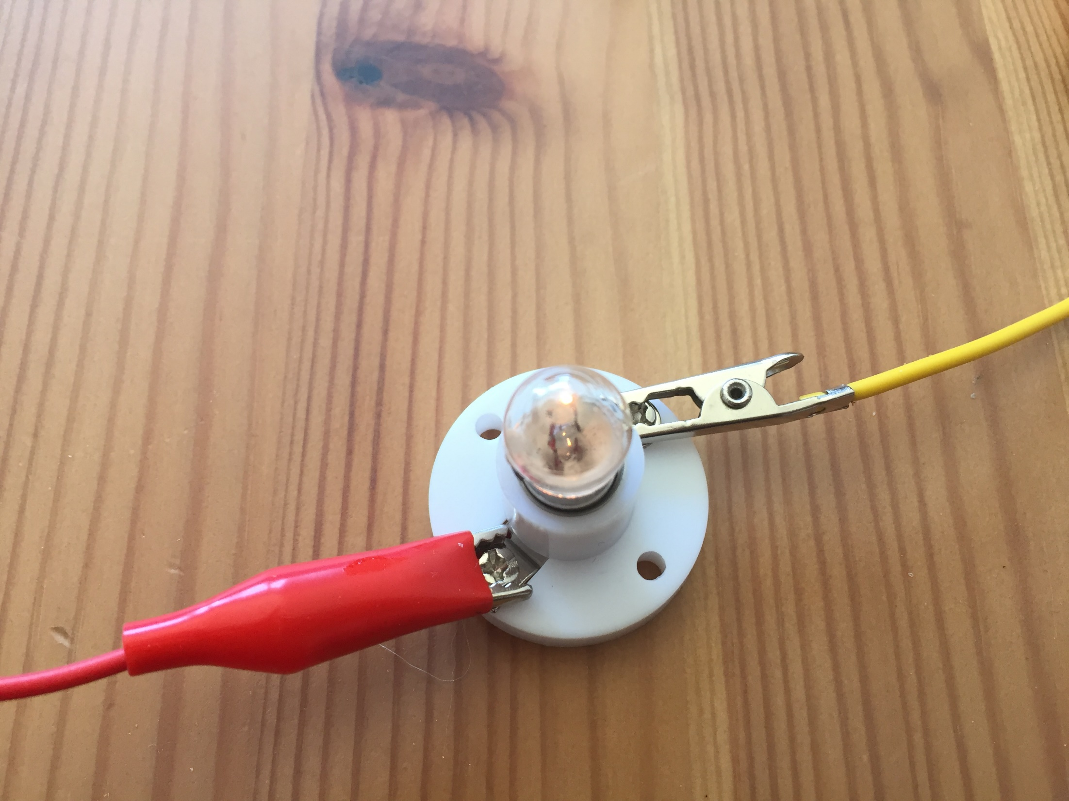
The bulb is lit, the circuit is complete so the key must be an electrical conductor.
Were you correct?

Slide 28
Testing Materials: Results
Conductors | Insulators
key bulldog clip 10p coin £1 coin 2p coin | matchstick paper string pen lid

Slide 29
What have you noticed about electrical conductors and insulators?
The 5 things that conducted electricity were the coins, the bulldog clip and the key. What are all of those things made from?
Metal!
They aren’t all the same type of metal though. Any metal will conduct electricity but some of them are better than others. Copper is a really good electrical conductor which is why it is used inside wires.
One other excellent conductor of electricity is water. That is why you should never turn on a switch with wet hands or use electrical items in the bathroom!

Slide 30
The 4 things that didn’t conduct electricity were the plastic lid, the wooden matchstick, the string and the paper.
Non of these objects have metal in them. They are all non-metals. Non-metals are insulators of electricity.
Some insulators are much better than others though – plastic is a good insulator and that is why it is used to cover electrical wires and partly why it is used to make the outside of so many electrical appliances.
Although paper, wood and string didn’t complete our circuit today, they would not prevent you from getting an electric shock off a stronger electrical current. They would also most likely set on fire!

Slide 31
Now that you know all about conductors and insulators, look at the sheet with the pictures of objects.
Draw another table in your book like this one:
Conductors | Insulators
Write the names of the objects in the correct column. After you’ve finished, add some more objects of your own to the table.
Remember: DO NOT actually test them!

