Slide 1
Maths
Position and Direction
Year One
Maths | Year 4 | Position and Direction | Translations | Lesson 2 of 3: Coordinate Translations

Slide 3
Aim
I can describe the translation of an object on a coordinate.
Success Criteria
I can label the x-axis and y-axis.
I know that a translation is a movement from one position to another, without turning.
I can combine translation with coordinates.

Slide 4
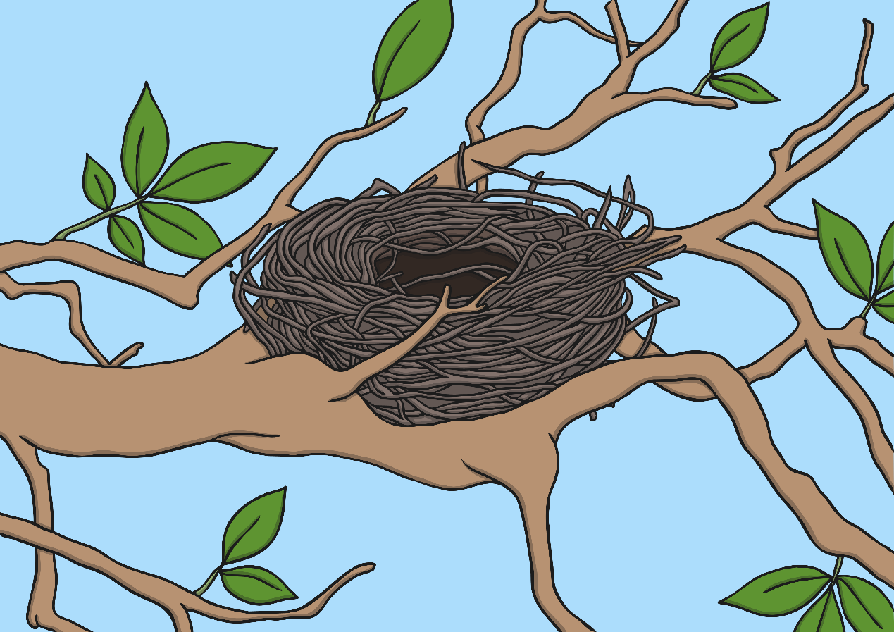
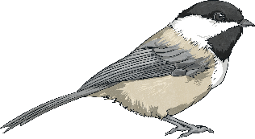
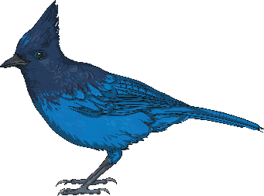
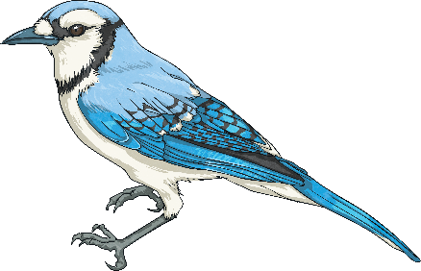
Flying Birds
Use the vocabulary of position and direction to describe the routes the birds fly to the nest.
North
East
South
West
above
below
between
higher
lower
left
right
Show Route
Show Route
North-East
South-East
South-West
North-West
horizontal
vertical
diagonal
row
column
parallel
Hide Route
Hide Route
Show Route
Hide Route
Show supporting vocabulary word bank
Hide supporting vocabulary word bank

Slide 5
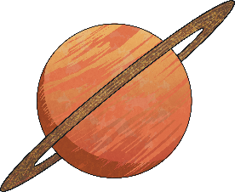
Translating Coordinates
6
In maths, translation means moving an object on a grid.
5
The object is moved without changing the size, turning or reflecting it.
4
3
When translating an object on a grid, it can slide up or down, left or right.
2
1
Click on the planet to translate it up 4 on the grid.
0
1
2
3
4
5
6

Slide 6
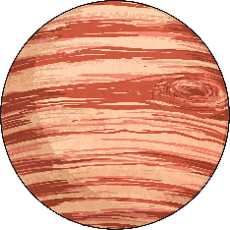
Translating Coordinates
6
In maths, translation means moving an object on a grid.
5
The object is moved without changing the size, turning or reflecting it.
4
3
When translating an object on a grid, it can slide up or down, left or right.
2
1
Click on the planet to translate it left 3 on the grid.
0
1
2
3
4
5
6

Slide 7
Translating Coordinates
6
In maths, translation means moving an object on a grid.
5
The object is moved without changing the size, turning or reflecting it.
4
3
When translating an object on a grid, it can slide up or down, left or right.
2
1
Click on the planet to translate it right 4, up 2 on the grid.
0
1
2
3
4
5
6

Slide 8
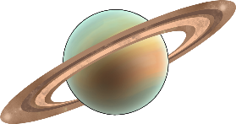
Missing Translations
6
Click on the planet to see it translated.
5
Part of the translation describing the movement of the planet is missing.
Work with your partner to work out the missing part of the translation.
4
3
2
Right
?
3
1
Down
3
Click on the question mark to see the answer.
0
1
2
3
4
5
6

Slide 9
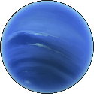
Missing Translations
6
Click on the planet to see it translated.
5
Part of the translation describing the movement of the planet is missing.
Work with your partner to work out the missing part of the translation.
4
3
2
Left
3
?
1
Up
6
Click on the question mark to see the answer.
0
1
2
3
4
5
6

Slide 10
Missing Translations
6
Click on the planet to see it translated.
5
Part of the translation describing the movement of the planet is missing.
Work with your partner to work out the missing part of the translation.
4
3
2
Left
?
1
1
Down
4
?
Click on the question mark to see the answer.
0
1
2
3
4
5
6

Slide 11
Translations New Position
Click on the football to translate it up 4 on the grid.
6
When describing the translation, we can also include the position of the football using coordinates:
5
4
3
Starts at (1,2)
2
Translates Up 4
1
Finishes at (1, 6)
0
1
2
3
4
5
6

Slide 12
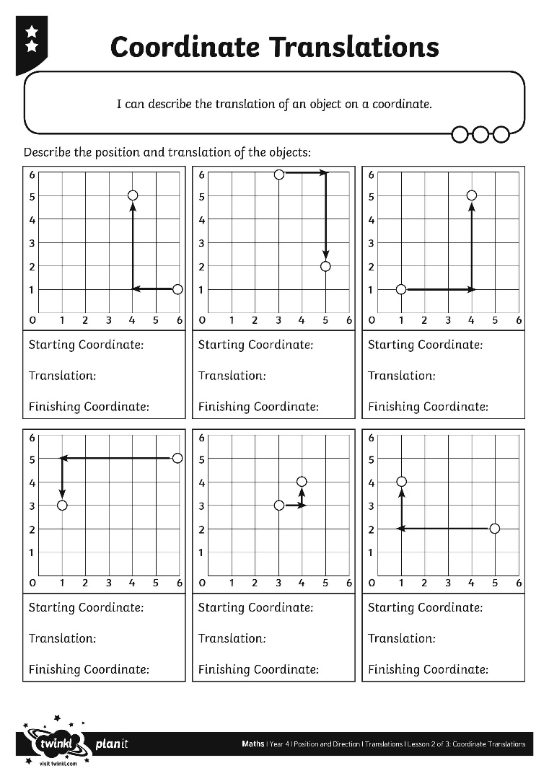
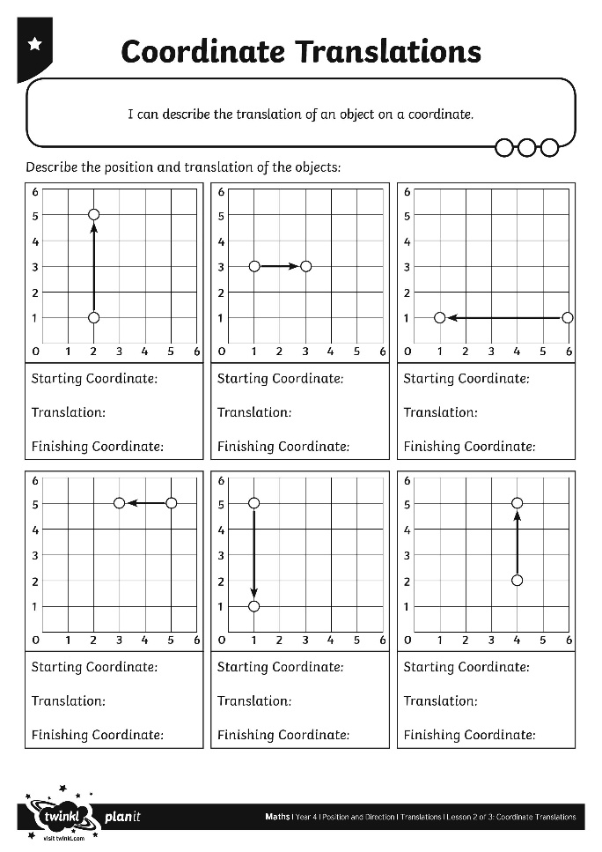
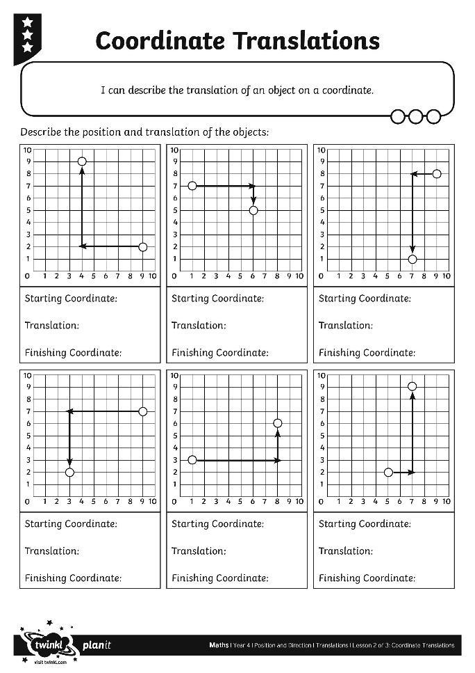
Coordinate Translations

Slide 13
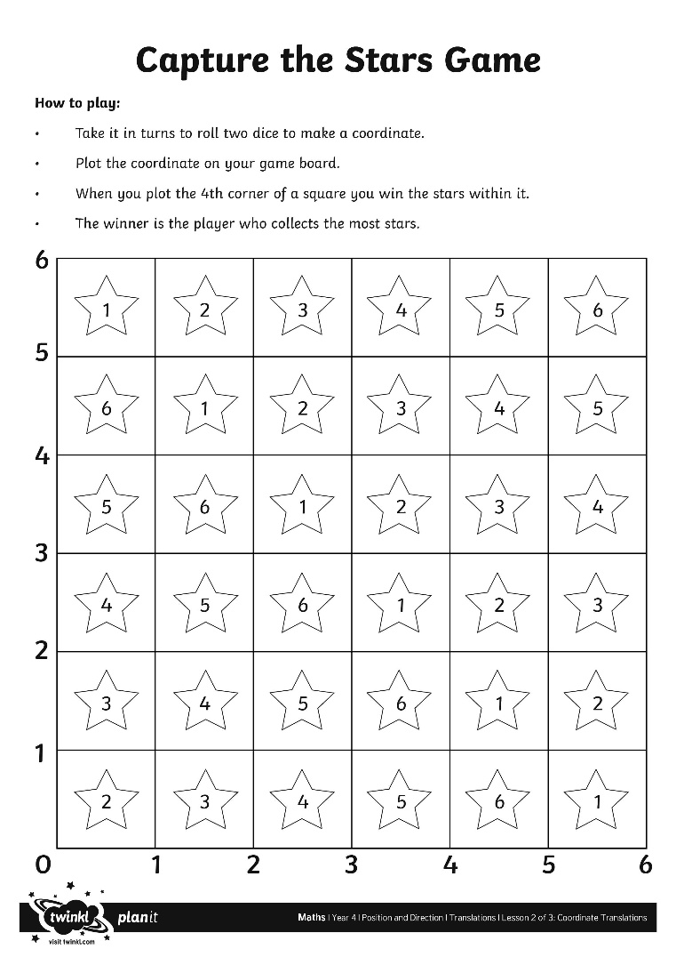
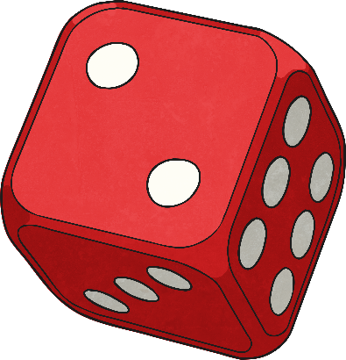
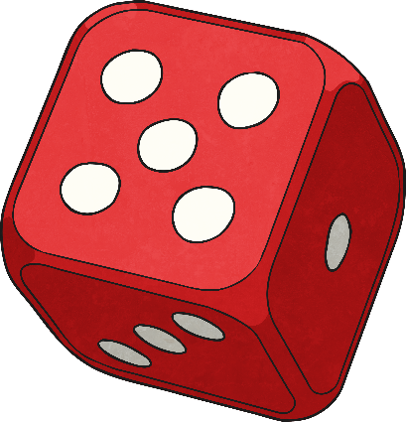
Capture the Stars
How to play:
Take it in turns to roll two dice to make a coordinate.
Plot the coordinate on your game board.
When you plot the 4th corner of a square you win the stars within it.
The winner is the player who collects the most stars.

