Slide 1
Maths
Number and Place Value
Year One
Maths | Year 2 | Number and Place Value | Solve Problems | Lesson 2 of 3: Cycle Spins

Slide 3
Aim
I can use place value and number facts to solve problems.
Success Criteria
I can use place value to compare numbers.
I can compare numbers using >,< and =.

Slide 4
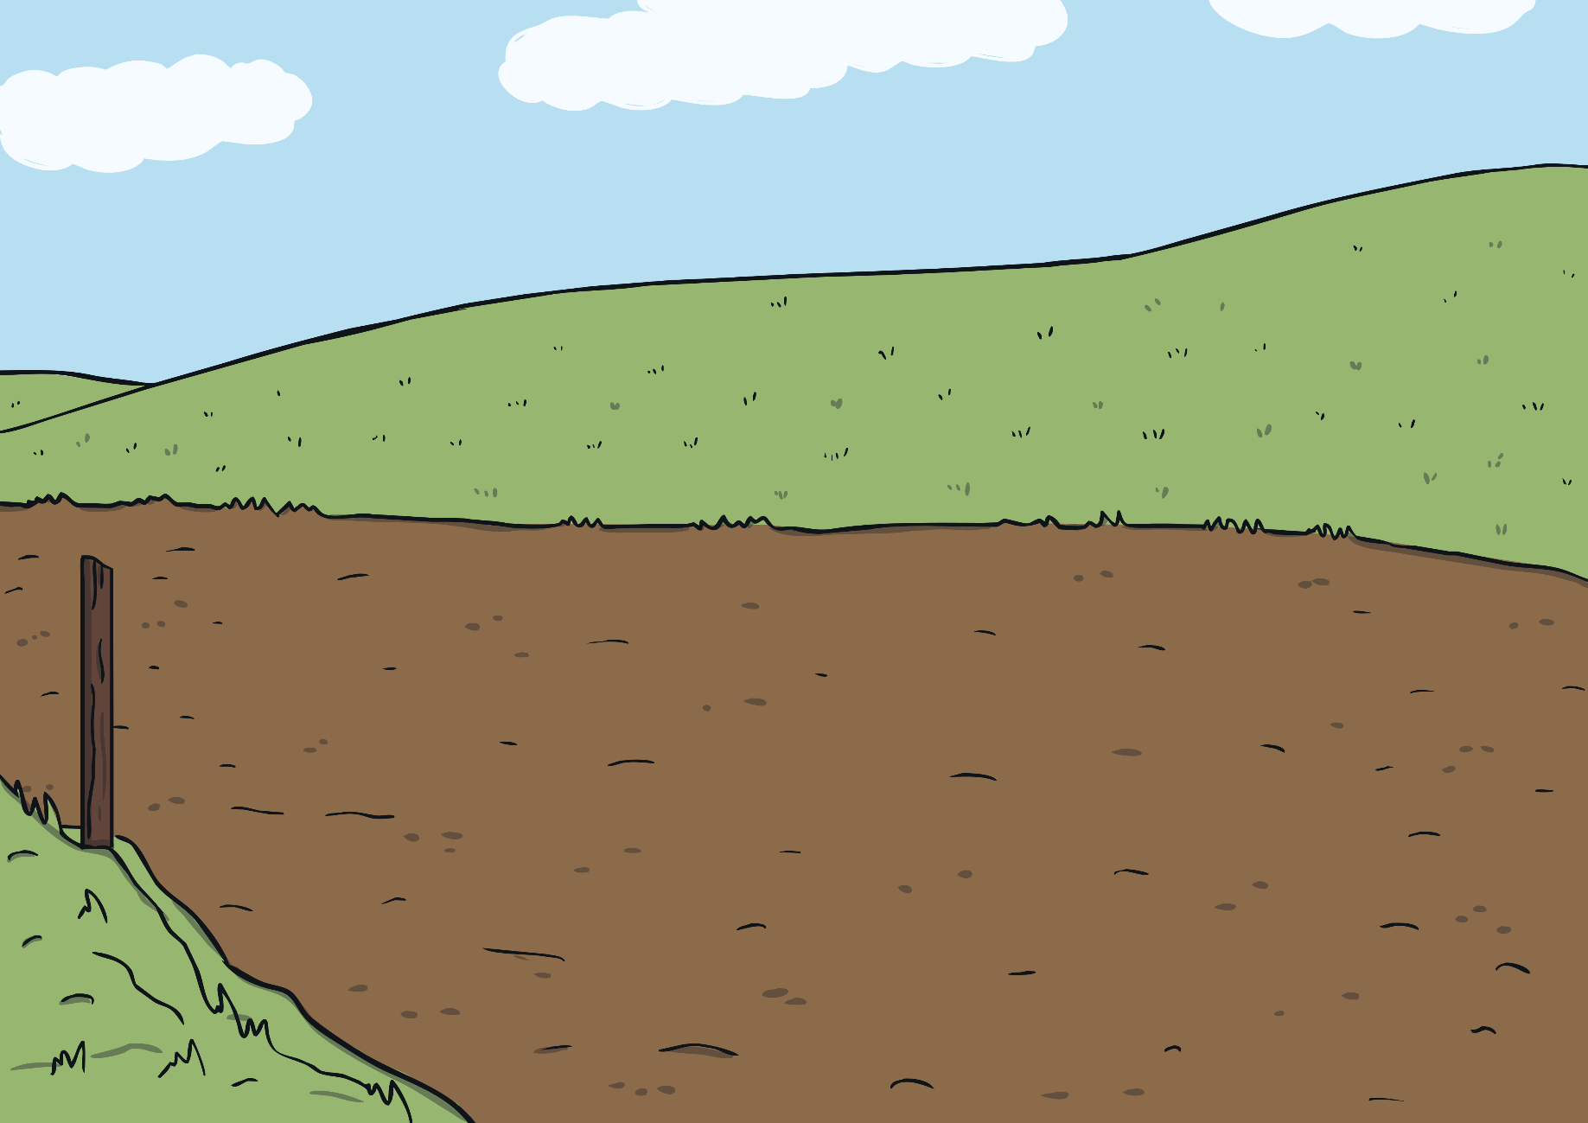
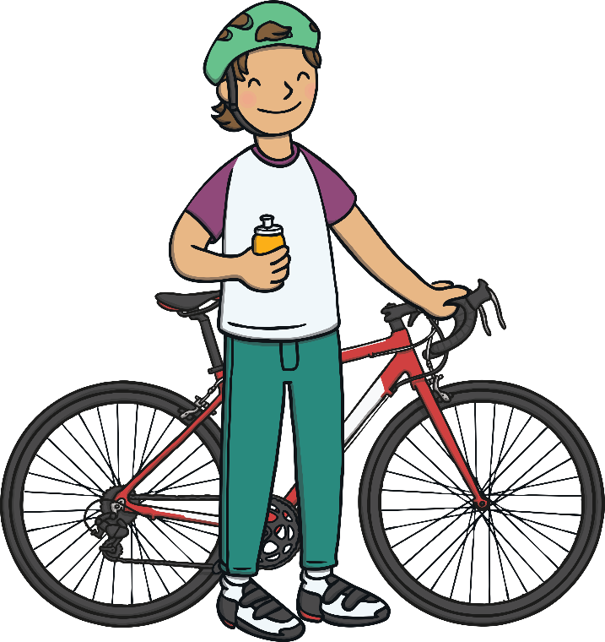
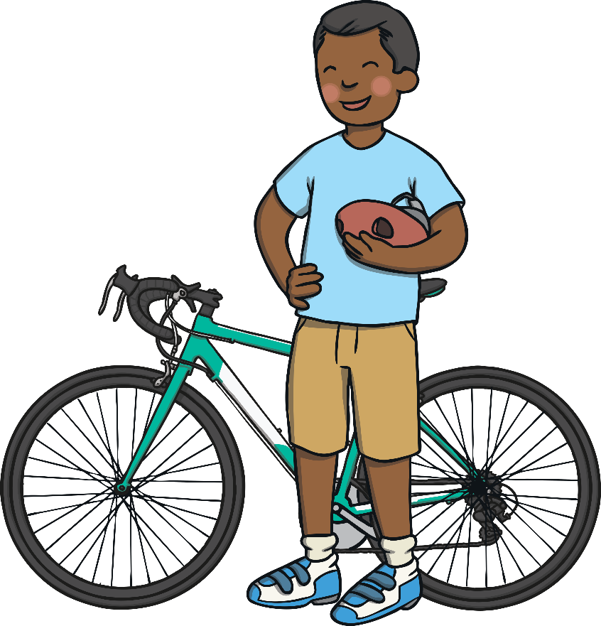
Take Your Place
Marcel and Klaudia are enjoying a bike ride.
They stop for a break. Marcel suggests they play a number game.

Slide 5
Take Your Place
Marcel thinks of a number.
My number has two tens. The ones digit is double the tens digit.
Which arrow is pointing to his number on the number line?
A
B
C
0
10
20
30
40
50
24

Slide 6
Take Your Place
Klaudia thinks of a number.
My number is a two-digit number. When added together, the digits total 10. They have a difference of 4. My number is lower than 50.
Which arrow is pointing to her number on the number line?
A
B
C
0
10
20
30
40
50
37

Slide 7
Take Your Place
Marcel thinks of a number.
My number is an odd number. It is greater than 40 but less than 43.
Which arrow is pointing to his number on the number line?
A
B
C
0
10
20
30
40
50
41

Slide 8
Take Your Place
Klaudia thinks of a number. Her number is one of these below.
Can you think of some clues for these numbers?
A
B
C
0
100

Slide 9
Take Your Place
Klaudia’s number is a multiple of ten.
Which number is it?
30 and 90 are both multiples of ten.
55 is not.
Her number can’t be 55.
A
B
C
0
100

Slide 10
Take Your Place
Klaudia’s number is ten less than 100.
Which one is her number?
A
C
0
90
100

Slide 11
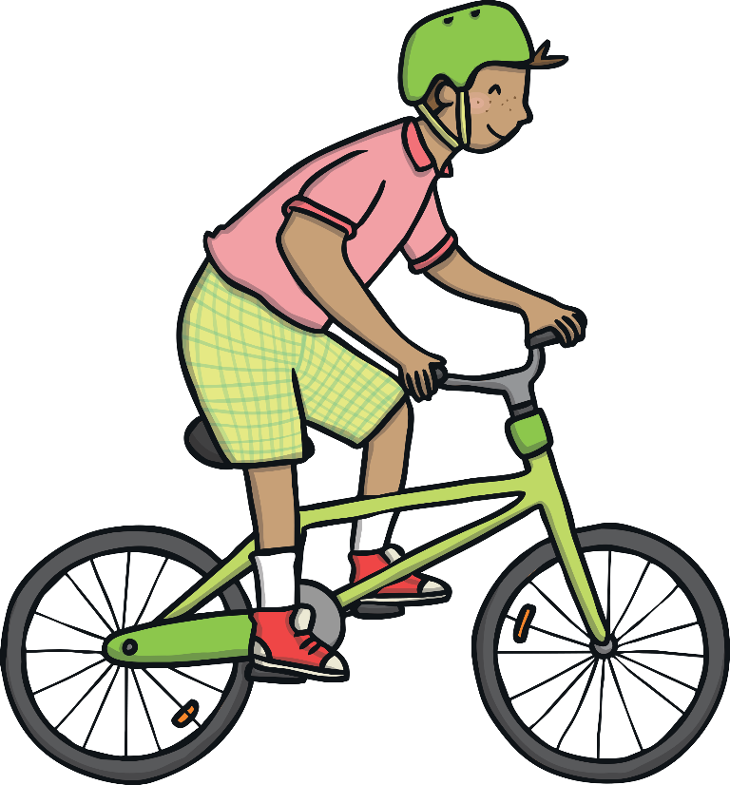
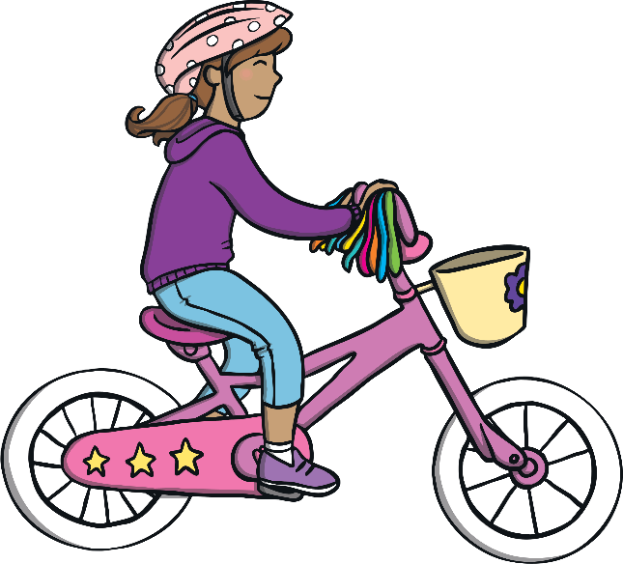
Comparing Numbers
Sam and Emma always argue over who has cycled farthest.
Can you use place value to help them compare numbers?

Slide 12
Comparing Numbers
Is this true or false?
Explain why to your partner.
two tens
=
20
True!

Slide 13
Comparing Numbers
Is this true or false?
Explain why to your partner.
one less than 53
>
five tens and four ones
False!

Slide 14
Comparing Numbers
Is this true or false?
Explain why to your partner.
<
one more than 44
False!

Slide 15
Comparing Numbers
Is this true or false?
Explain why to your partner.
one less than 100
=
True!

Slide 16
Comparing Numbers
Is this true or false?
Explain why to your partner.
ten less than 33
>
two tens and four ones
False!

Slide 17
Comparing Numbers
Is this true or false?
Explain why to your partner.
<
ten more than 57
True!

Slide 18
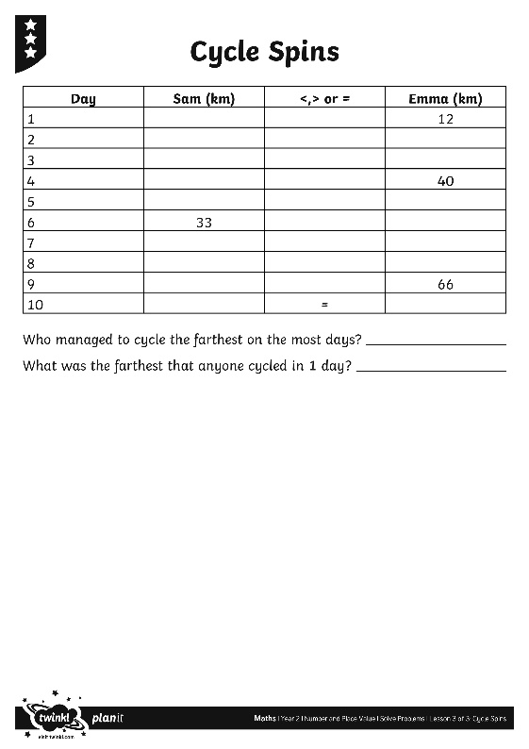
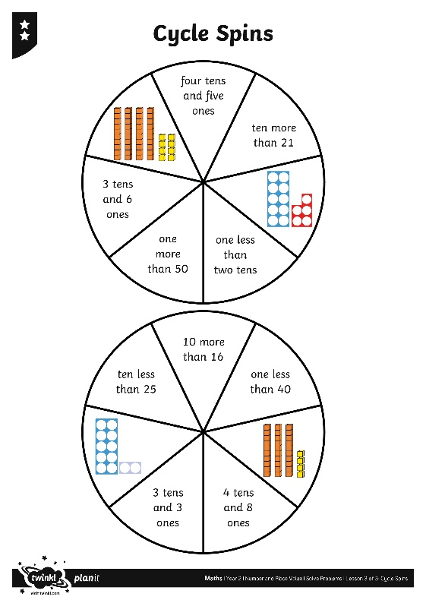
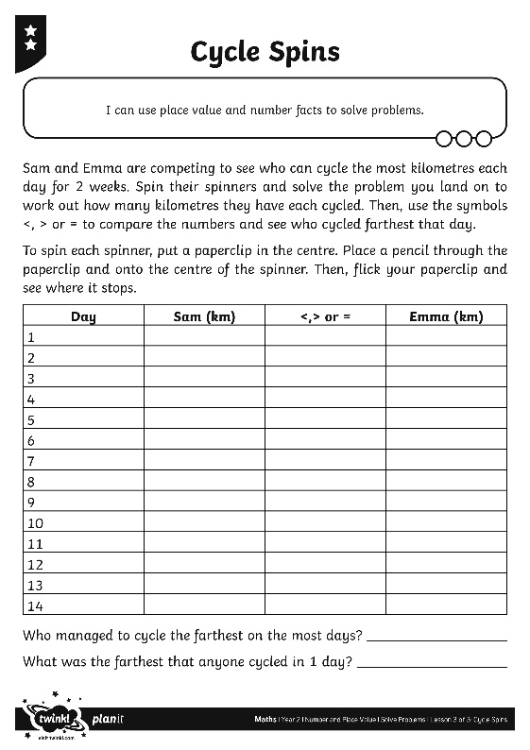
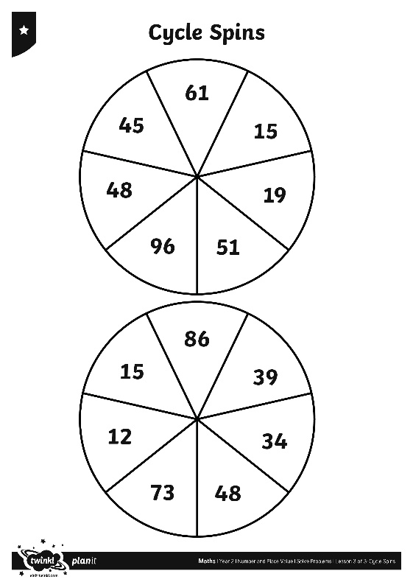
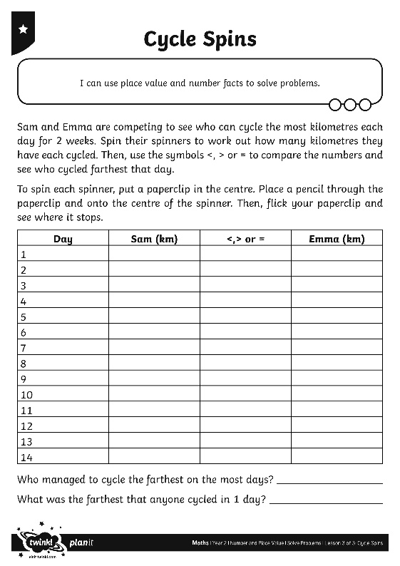
Bicycle Challenge
Can you work out who has cycled farthest each day?
Use <, > or = to compare numbers.

Slide 19
Aim
I can use place value and number facts to solve problems.
Success Criteria
I can use place value to compare numbers.
I can compare numbers using >,< and =.

