Slide 1
Maths
Measurement
Year One
Maths | Year 3 | Measurement | Measure, Compare, Add and Subtract Units of Measurement | Lesson 2 of 5: Measuring in Litres and Millilitres

Slide 2
Measuring in Litres and Millilitres

Slide 3
Aim
I can measure volume in litres and millilitres.
Success Criteria
I can calculate the intervals on a scale.
I can read scales to measure in litres and millilitres.

Slide 4
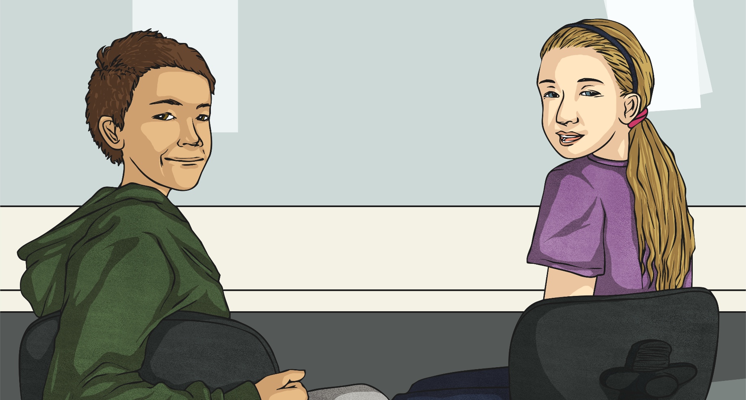
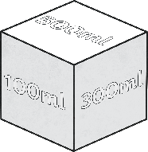
Make a Litre
In pairs, take turns to roll the Millilitres Dice. Keep a running total of
your score. The first person to reach exactly 1l wins 1 point.
I have rolled exactly one litre so I win a point!
I rolled 300ml
Then 200ml which totals 500ml
Then 400ml which totals 900ml
Then 100ml which totals 1000ml
I have gone over 1l so I have to start again!
I rolled 200ml
Then 100ml which totals 300ml
Then 500ml which totals 800ml
Then 100ml which totals 900ml
Then 300ml which totals 1200ml
The first person to reach exactly 1l wins 1 point. If your total goes over 1l (1000ml) then you have to start from zero again!
The person who scores the most points in three minutes wins!

Slide 5
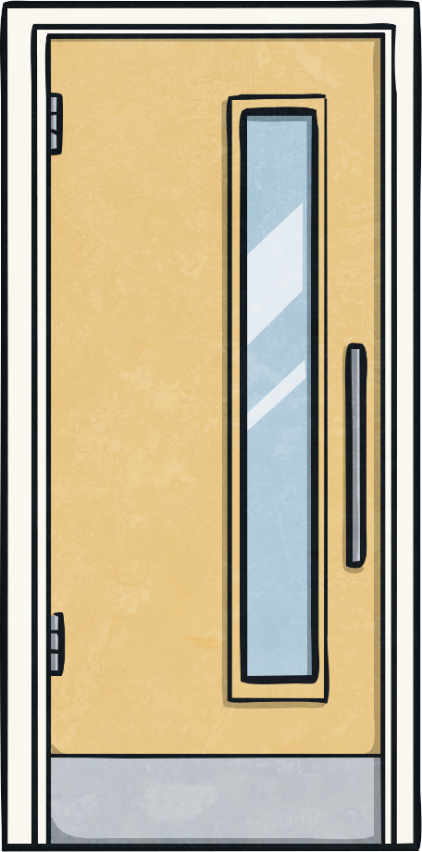
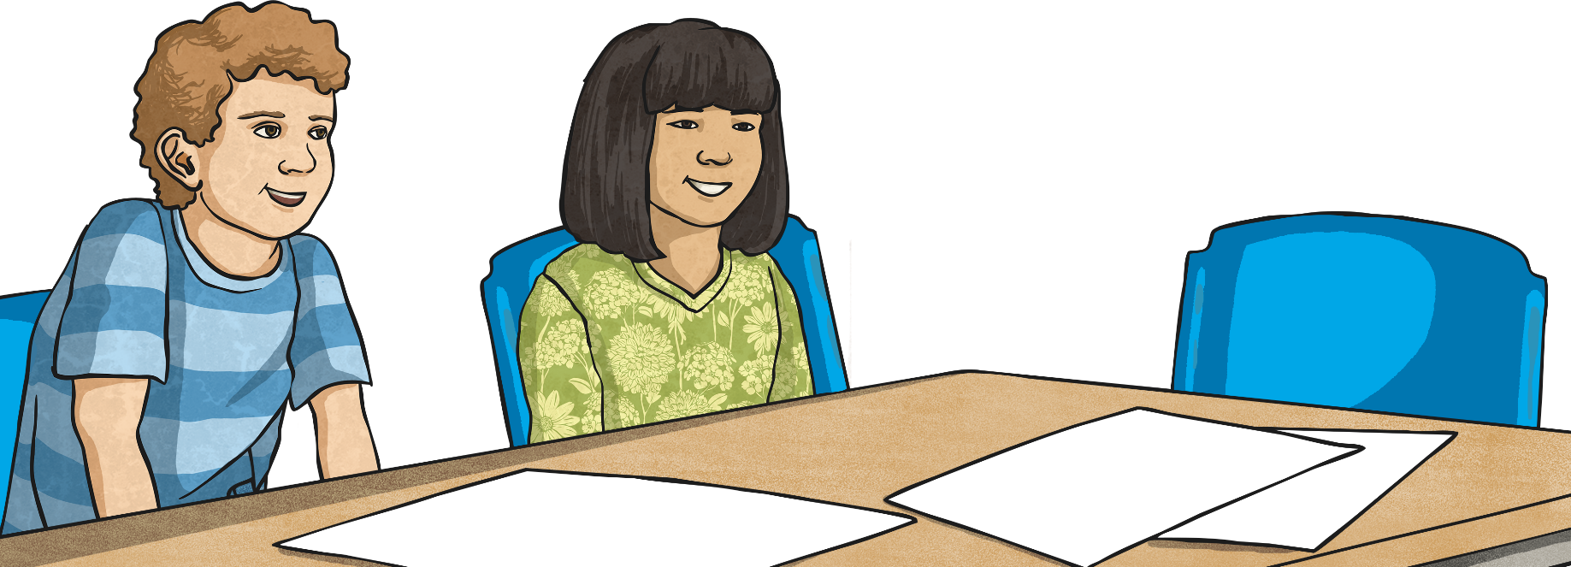
Measuring Volume in
Litres and Millilitres
We are going to measure volume in litres and millilitres.
If you look where the liquid comes up to it is 2l plus four intervals, so this measures:
2l + 400ml = 2l 400ml.
To work out what each interval is worth we divide 1000 by 10.
1000 ÷ 10 = 100, so each interval is worth 100ml.
We need to calculate what the small intervals on the scale on the measuring cylinder are worth.
First, we need to convert litres to millilitres.
1 litre = 1000 millilitres.

Slide 6
Measuring Volume in
Litres and Millilitres
This is the same scale, how much liquid is in the measuring cylinder?
If you look where the liquid comes up to it is 4l plus eight intervals, so this measures:
4l + 800ml = 4l 800ml.

Slide 7
Measuring Volume in
Litres and Millilitres
We are going to measure volume in litres and millilitres.
If you look where the liquid comes up to it is 4l plus one interval, so this measures:
4l + 500ml = 4l 500ml.
To work out what each interval is worth we divide 1000 by 2.
1000 ÷ 2 = 500, so each interval is worth 500ml.

Slide 8
Measuring Volume in
Litres and Millilitres
This is the same scale, how much liquid is in the measuring cylinder?
If you look where the liquid comes up to, it is 2l plus one interval, so this measures:
2l + 500ml = 2l 500ml.

Slide 9
Measuring Volume in
Litres and Millilitres
We are going to measure volume in litres and millilitres.
If you look where the liquid comes up to, it is 2l plus one interval, so this measures:
2l + 250ml = 2l 250ml.
To work out what each interval is worth, we divide 1000 by 4.
1000 ÷ 4 = 250, so each interval is worth 250ml.

Slide 10
Measuring Volume in
Litres and Millilitres
This is the same scale, how much liquid is in the measuring cylinder?
If you look where the liquid comes up to, it is 4l plus three intervals, so this measures:
4l + 750ml = 4l 750ml.

Slide 11
Measuring Volume in
Litres and Millilitres
We are going to measure volume in litres and millilitres.
If you look where the liquid comes up to, it is 2l plus two intervals, so this measures:
2l + 400ml = 2l 400ml.
To work out what each interval is worth, we divide 1000 by 5.
1000 ÷ 5 = 200, so each interval is worth 200ml.

Slide 12
Measuring Volume in
Litres and Millilitres
This is the same scale, how much liquid is in the measuring cylinder?
If you look where the liquid comes up to, it is 3l plus three intervals, so this measures: 3l + 600ml = 3l 600ml.

Slide 13
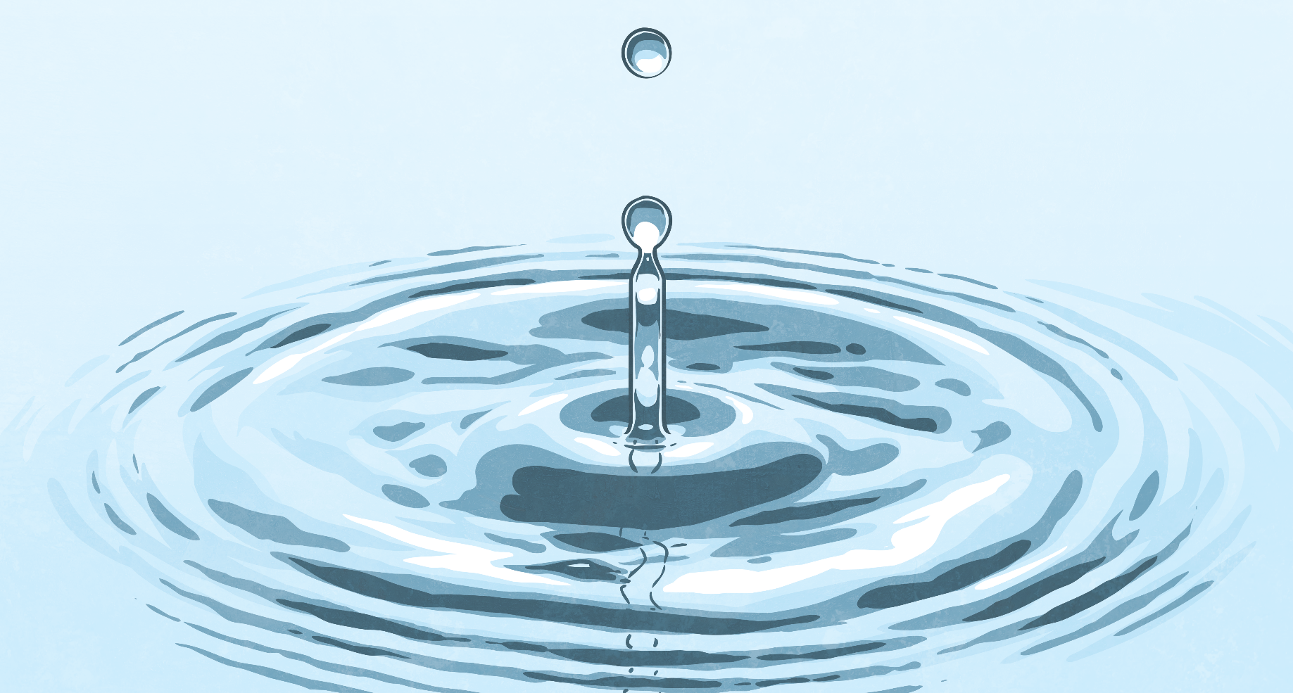
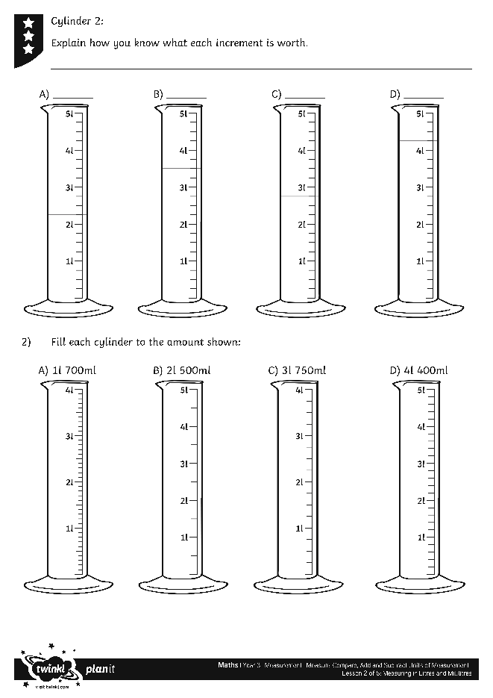
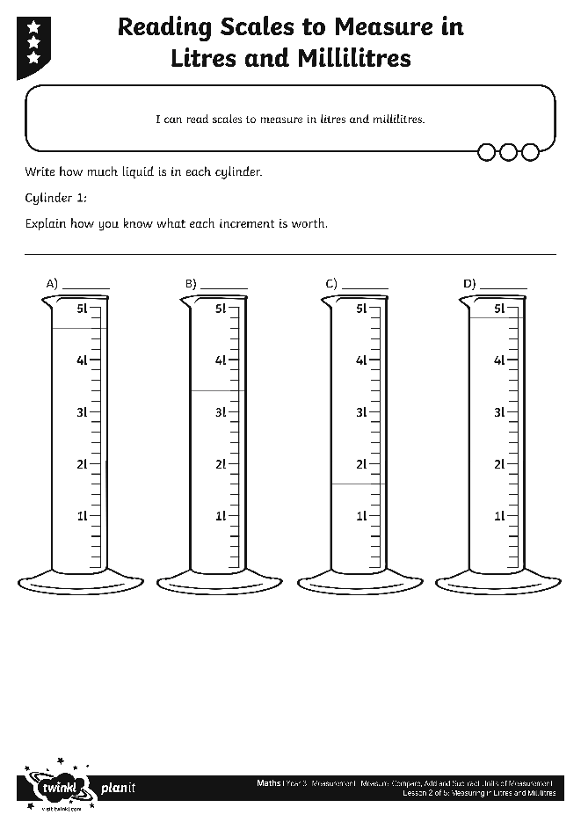
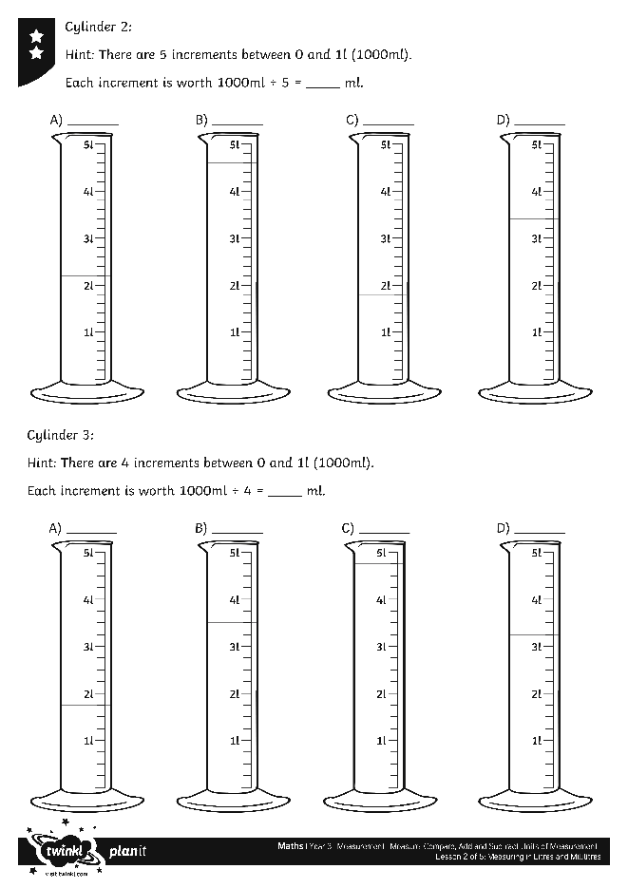
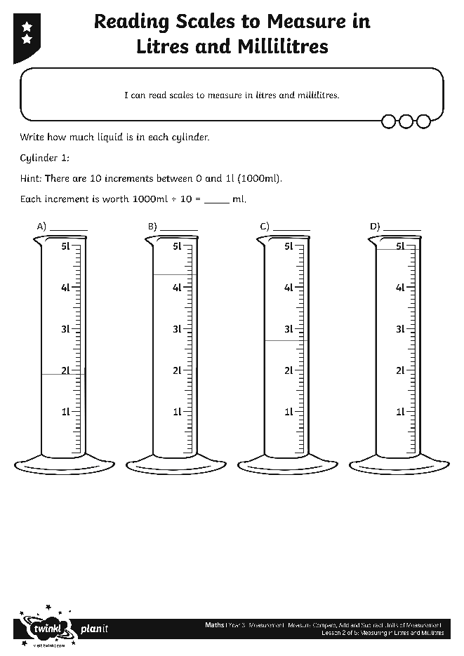
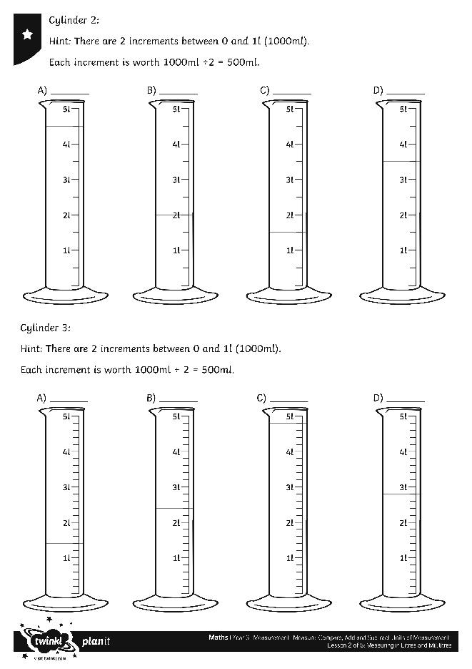
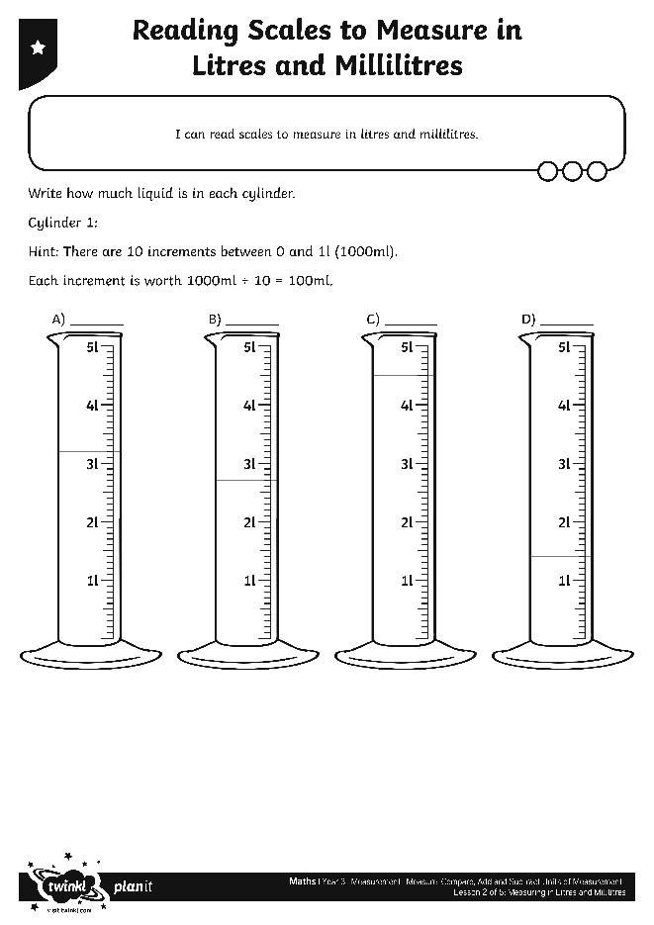
Reading Scales
Use your marvellous measuring skills to complete these activity sheets:

Slide 14
Aim
I can measure volume in litres and millilitres.
Success Criteria
I can calculate the intervals on a scale.
I can read scales to measure in litres and millilitres.

