Slide 1
Maths
Statistics
Year One
Maths | Year 2 | Statistics | Lesson 6 of 6: Seaside Shop

Slide 3
Aim
To interpret and construct a block diagram where one block represents 5.
Success Criteria
I can count in fives.
I can make a block diagram where one picture represents 5.
I can ask and answer questions about the data.

Slide 4
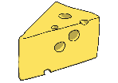
Odd One Out
?
What are these tables and diagrams called?
Which one is the odd one out?
Cheese
Jam
Egg
Ham
Type of Sandwich
Ham | 3
Egg | 4
Cheese | 6
Jam | 8

Slide 5
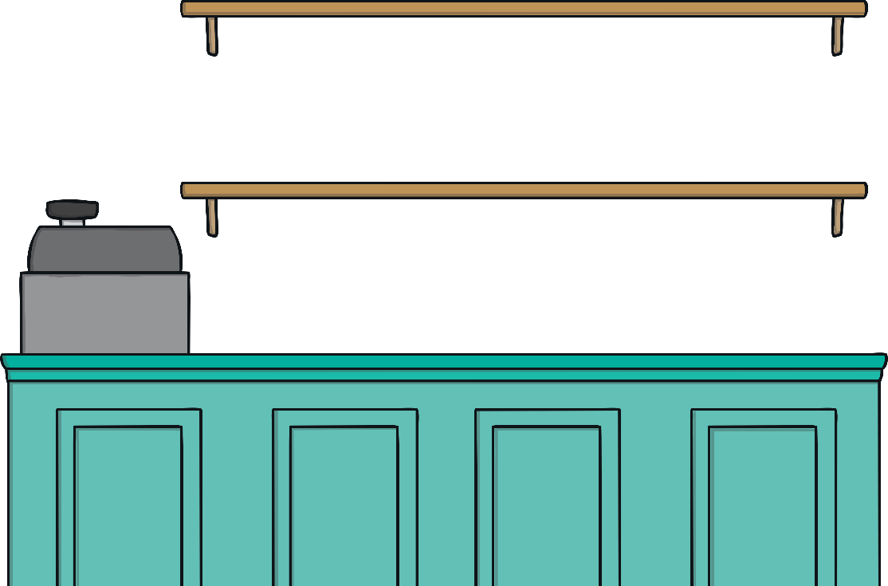
Samir’s Shop
?
Can you help Samir?
Samir runs a seaside shop in Skegness. He is collecting information about how many toys he sold last week so he knows how many to order next week. He is not sure how he should organise his information to make it easy to understand.
?
What ways can you think of to show Samir’s information?

Slide 6
Samir’s Shop
Samir has created a frequency chart to show how many of each toy he sold.
Toy | Frequency
 | 20
 | 30
 | 15
 | 10

Slide 7
Samir’s Shop
?
How else could Samir have collected and organised his data?
Bucket
Beach ball
Windmill
Rubber ring
40
35
30
25
20
15
10
5
Each toy = 5

Slide 8
Samir’s Shop
We are going to create a block diagram to show how many of each type of toy Samir sold.
Toy | Frequency
 | 20
 | 30
 | 15
 | 10
What could the block diagram count in steps of?

Slide 9
Seaside Shop
A Block Diagram to Show the Number of Toys Sold in Samir’s Shop
35
30
25
20
15
10
5
Number of Toys
Type of Toy

Slide 10
Seaside Shop
?
How many balls did Samir sell?
30
Toy | Frequency
 | 20
 | 30
 | 15
 | 10
?
How many inflatables did Samir sell?
10
?
How many more windmills than inflatables did Samir sell?
5
?
What toy was the most popular?
bucket
?
What toy was the least popular?
inflatable

Slide 11
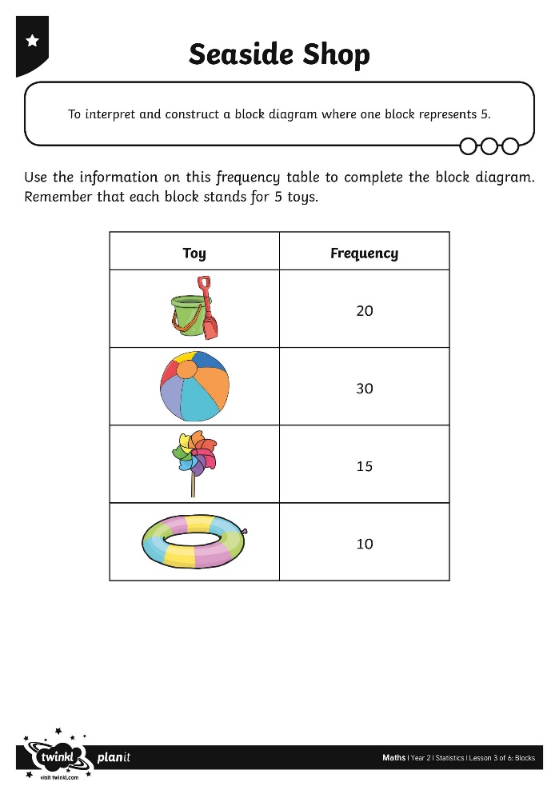
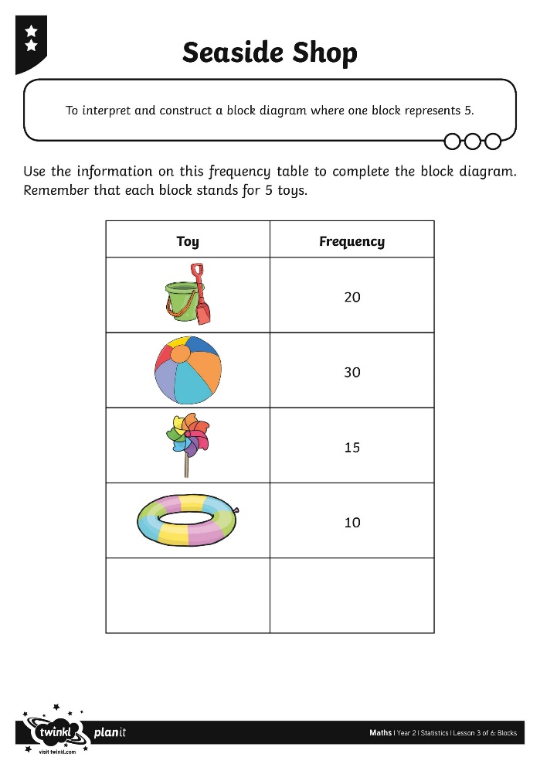
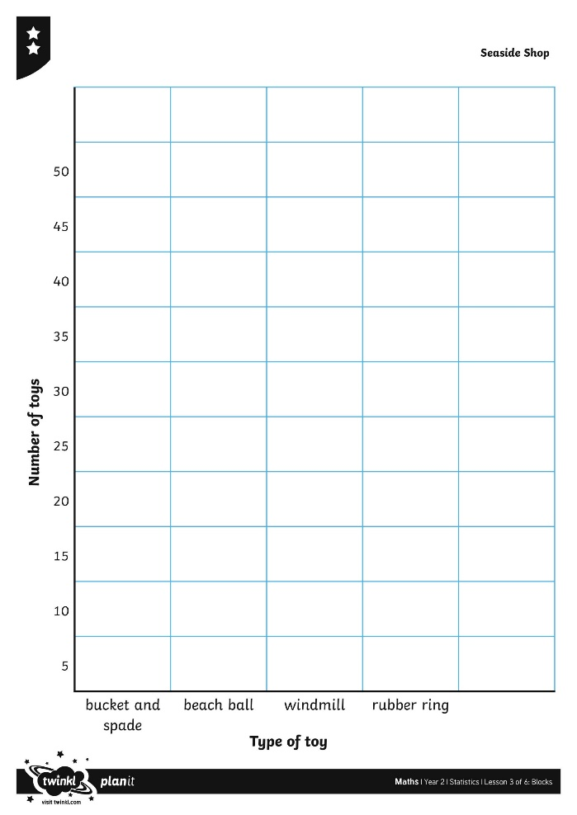
Seaside Shop

Slide 12
You Choose
Samir is not sure how he should organise his information to make it easy to understand. Can you help Samir?
?
Which diagram do you think is best for showing this information?
I think Samir’s pictogram is easy to count the pictures.
I think the frequency table is best because it shows the most toys.
I think the block diagram is best because it is easy to see which toy has sold the most.
?
Do you agree or disagree? Which diagram would you choose?

Slide 13
Aim
To interpret and construct a block diagram where one block represents 5.
Success Criteria
I can count in fives.
I can make a block diagram where one picture represents 5.
I can ask and answer questions about the data.

