Slide 2
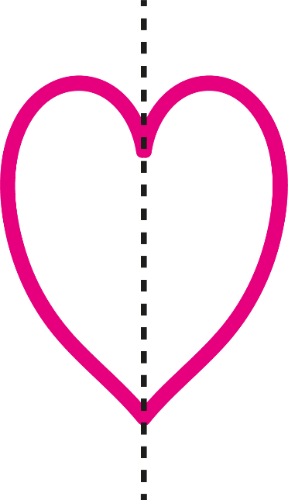
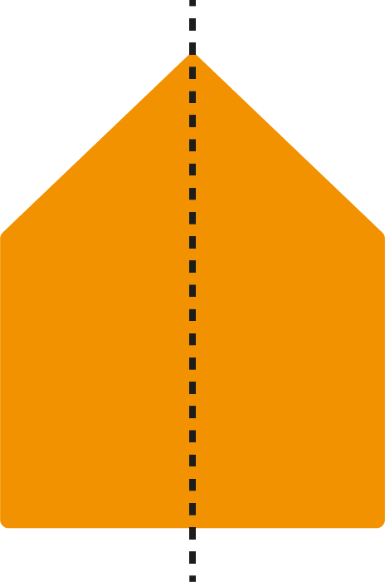
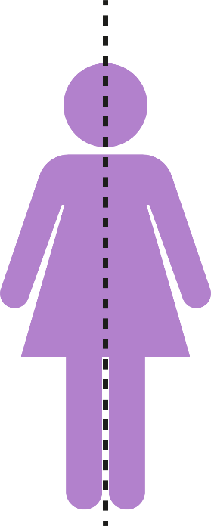
Symmetry
Reflective Symmetry
Reflection symmetry is where one half of the image is the reflection of the other half. You could fold the image and have both halves match exactly.

Slide 3
Symmetry
Reflective Symmetry
Reflection symmetry can be in different orientations.

Slide 4
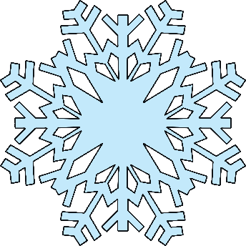
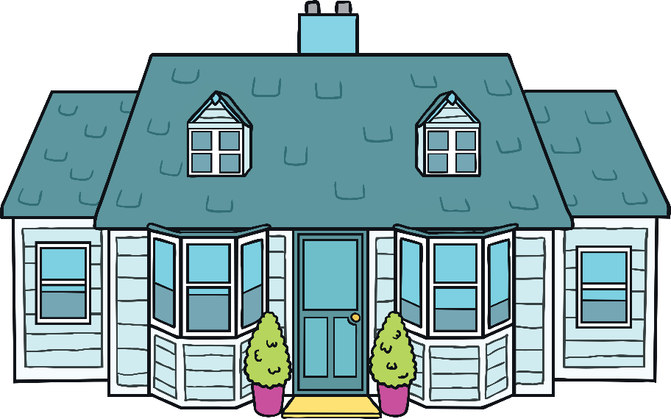
Symmetry
Lots of real life objects are symmetrical.

Slide 5
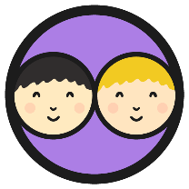
Butterfly Patterns
Divide your whiteboard in half with a line and pretend the two halves are butterfly wings. Make a symmetrical pattern with a partner.
One person draws a 2D shape on one wing and the other person draws the same shape in the correct position on the other wing. Take turns to draw on each wing. Click on the butterfly to generate a 2D shape to use in your design.

