Slide 1
Maths
Measurement
Year One
Maths | Year 4 | Measurement | Solving Time Problems | Lesson 1 of 4: Time Problems Involving Hours and Minutes

Slide 3
In order to do the work today, you need to know:
1 hour = 60 minutes
60 seconds = 1 minute
There are 60 minutes in 1 hour!
It’s really important to remember that because you’re used to things being in 100s.

Slide 4
So, if there are 60 minutes in 1 hour, how many minutes are there in 3 hours?
To work that out, you need to do 3 x 60
(remember, you can do 3 x 6 which is 18 and then add the 0 back on
So 3 hours = 180 minutes

Slide 5
Answer these questions on a whiteboard or piece of paper:
How many minutes are there in
2 hours?
4 hours?
8 hours?
120 minutes
240 minutes
480 minutes

Slide 6
What about if the question is set out like this:
How many minutes are there in 3 hours and 47 minutes?
The first thing to do is work out how many minutes are in three hours so that is 3 x 6 = 18, add the 0 and you get 180 minutes.
Then we need to add the 47 minutes on.
180 + 47 = 227 minutes

Slide 7
Try these on your board or piece of paper:
How many minutes are in 1 hour 38 minutes?
How many minutes are in 4 hours 42 minutes?
98 minutes
282 minutes

Slide 8
It is the exact same when you’re dealing with minutes and seconds.
1 minute 43 seconds would be 103 seconds because there are 60 seconds in a minute then you add on the 43 seconds.
How many seconds is 2 minutes 35 seconds?
2 x 60 = 120 seconds
120 + 35 = 155 seconds

Slide 9
Comparing Time Units
Use the correct symbol (<, > or =) to compare these times:
>
<
=
125 seconds
>
1 minute 50 seconds

Slide 10
Comparing Time Units
Use the correct symbol (<, > or =) to compare these times:
>
<
=
2 minutes
20 seconds
<
150 seconds

Slide 11
Comparing Time Units
Use the correct symbol (<, > or =) to compare these times:
>
<
=
1 hour 15 minutes
=
75 minutes

Slide 12
Comparing Time Units
Use the correct symbol (<, > or =) to compare these times:
>
<
=
500 seconds
<
9 minutes

Slide 13
Comparing Time Units
Use the correct symbol (<, > or =) to compare these times:
>
<
=
1000 seconds
<
20 minutes

Slide 14
Comparing Time Units
Use the correct symbol (<, > or =) to compare these times:
>
<
=
2 hours
10 minutes
>
100 minutes
=
1 hour 40 minutes

Slide 15
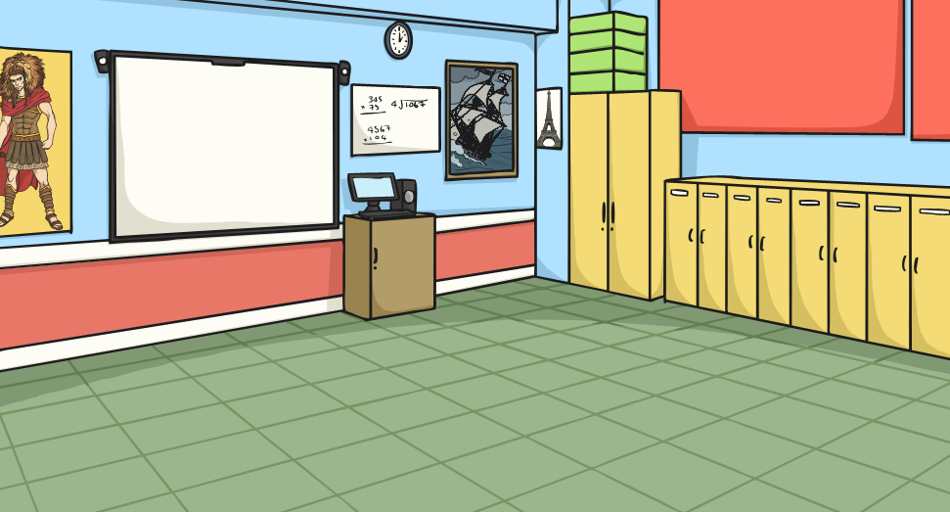
Comparing Time Units
Order these times from the longest time to the shortest time:
500 seconds
3 minutes
50 seconds
1 hour 5 minutes
30 minutes
2 hours
25 minutes
395 seconds
1
2 hours
25 minutes
2
1 hour 5 minutes
3
30 minutes
4
500 seconds
5
395 seconds
6
3 minutes
50 seconds

