Slide 1


Maths
Measurement
Year One
Maths | Year 4 | Measurement | Solving Time Problems | Lesson 4 of 4: Time Problems Involving Weeks and Days

Slide 3
Aim
I can solve problems that involve converting units of time (weeks
and days).
Success Criteria
I can convert from weeks to days.
I can convert from days to weeks.
I can solve problems that involve converting from weeks to days and days to weeks.

Slide 4



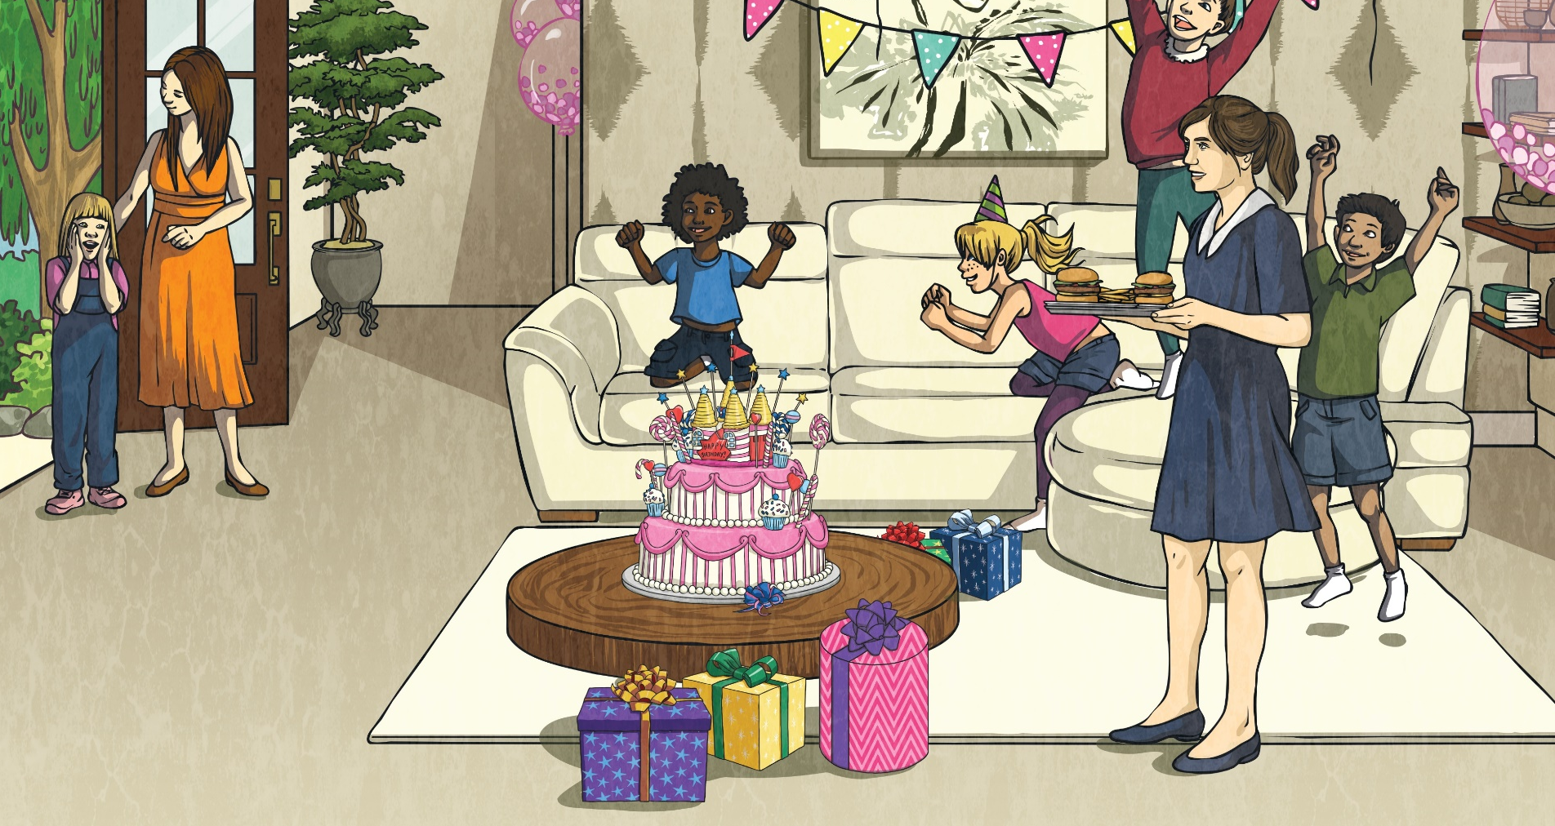




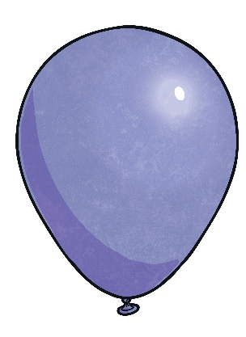


Order It
Here are a variety of units of time. Order them from least to greatest.
1
year
200
seconds
90
minutes
5
hours
4
minutes
2
hours
4
months
least to greatest
1
year
90
minutes
2
hours
4
minutes
200
seconds
4
months
5
hours

Slide 5

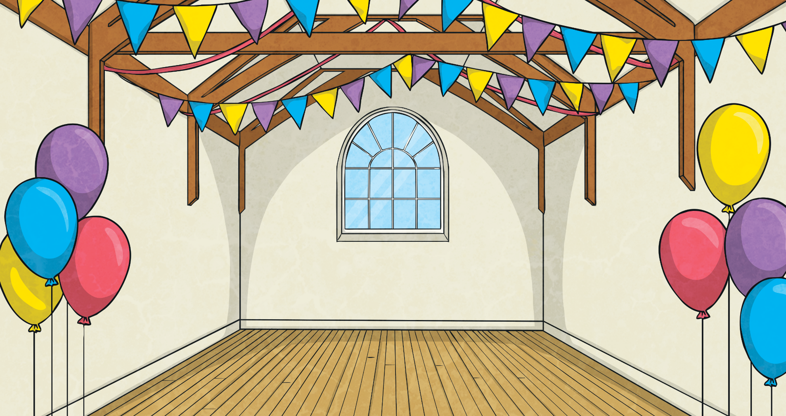
Weeks to Days
Write how many days there are in the number of weeks shown.
7 days
in 1 week
49 days
in 7 weeks
28 days
in 4 weeks
1 week
7 weeks
4 weeks
56 days
in 8 weeks
14 days
in 2 weeks
63 days
in 9 weeks
8 weeks
2 weeks
9 weeks
5 weeks
6 weeks
3 weeks
35 days
in 5 weeks
42 days
in 6 weeks
21 days
in 3 weeks

Slide 6
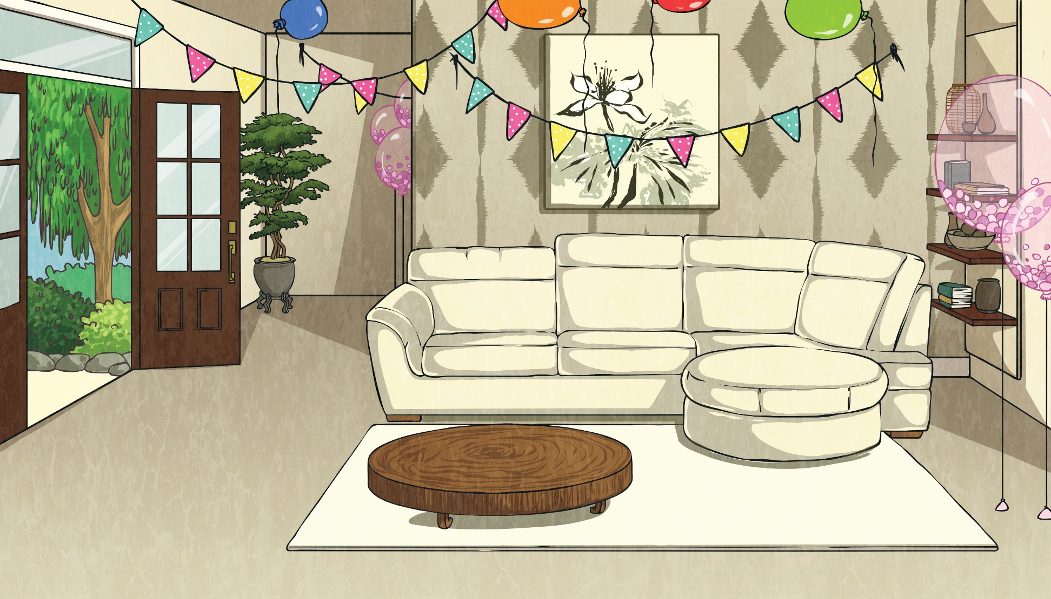


Weeks to Days
How many days are there in 3 weeks and 4 days?
3 × 7 =
21
+ 4 =
25 days
How many days are there in:
a.
b.
2 weeks 3 days?
5 weeks 6 days?
17 days
41 days
c.
d.
4 weeks 2 days?
6 weeks 3 days?
30 days
45 days

Slide 7
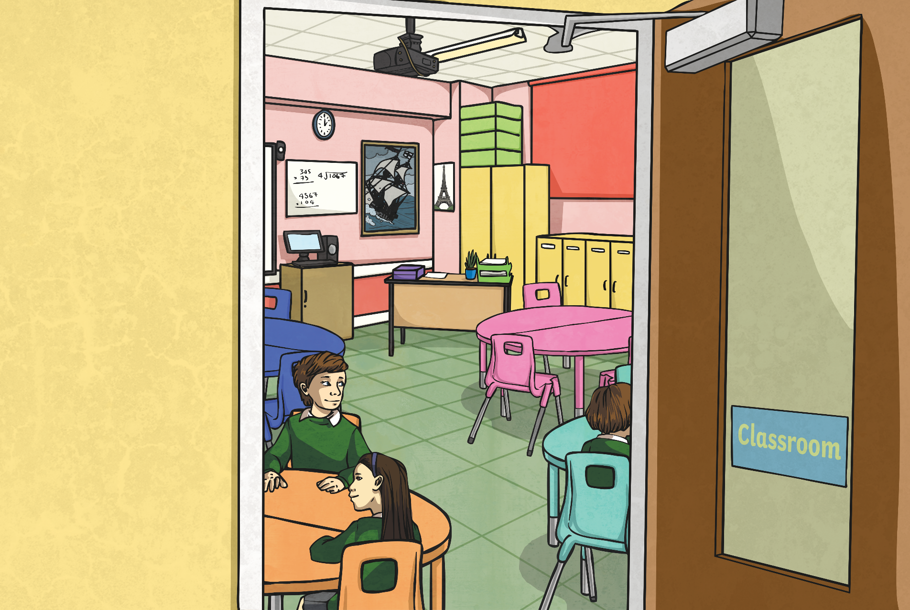
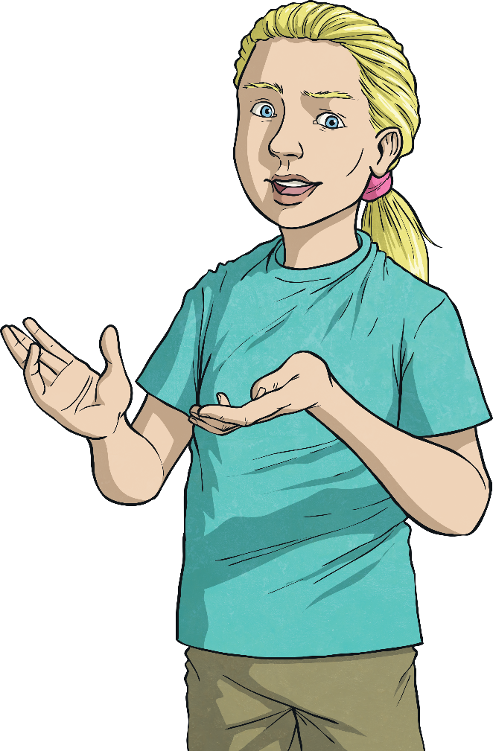
Days to Weeks
To calculate how many weeks there are in a number of days, divide the number by 7:
If there is a remainder, this becomes days.
e.g. 42 days = 42 ÷ 7 = 6
There are
6 weeks in 42 days.
e.g. 50 days = 50 ÷ 7 = 7 remainder 1
There are 7 weeks 1 day in 50 days.

Slide 8
Days to Weeks
How many weeks are there in:
a.
28 days?
b.
35 days?
4 weeks
5 weeks
c.
d.
29 days?
44 days?
4 weeks 1 day
6 weeks 2 days
e.
61 days?
8 weeks 5 days

Slide 9


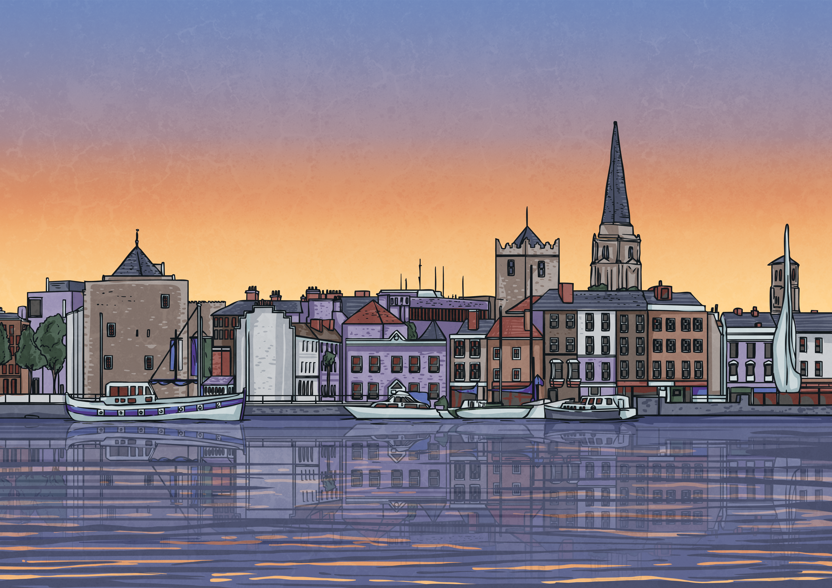
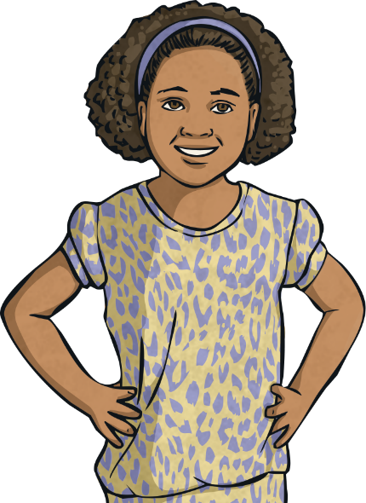
Calendar Problem
Mo | Tu | We | Th | Fr | Sa | Su
 |  |  | 1 | 2 | 3 | 4
5 | 6 | 7 | 8 | 9 | 10 | 11
12 | 13 | 14 | 15 | 16 | 17 | 18
19 | 20 | 21 | 22 | 23 | 24 | 25
26 | 27 | 28 | 29 | 30 | 31
Mo | Tu | We | Th | Fr | Sa | Su
 |  |  |  |  |  | 1
2 | 3 | 4 | 5 | 6 | 7 | 8
9 | 10 | 11 | 12 | 13 | 14 | 15
16 | 17 | 18 | 19 | 20 | 21 | 22
23 | 24 | 25 | 26 | 27 | 28 | 29
30
Today is Tuesday 13th May.
I am going on holiday on Friday 20th June.
How long is it until I go on holiday? Write your answer in both days and in weeks and days.
Answer:
38 days or 5 weeks 3 days

Slide 10

Aim
I can solve problems that involve converting units of time (weeks
and days).
Success Criteria
I can convert from weeks to days.
I can convert from days to weeks.
I can solve problems that involve converting from weeks to days and days to weeks.

