Slide 1
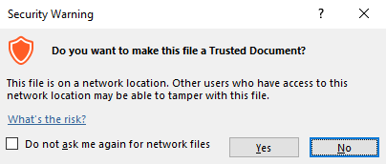
Guidance for Macros in PowerPoints
We use macros within PowerPoints to increase the interactivity of our presentations. Follow this simple process to get the most out of this resource.
What to do:
Open the PowerPoint file and enable editing.
A security warning box may appear. Click yes.
Click enable content.
Enter presentation mode (start the slide show).

Slide 2
Maths
Measurement
Year One
Maths | Year 2 | Measurement | Minutes, Hours and Days | Lesson 1 of 1: Time Tales

Slide 4
Aim
To know the number of minutes in an hour and the number of hours in a day.
Success Criteria
I can measure intervals of time on a clock.
I can estimate intervals of time.
I can say how long different events would take using different measurements of time.

Slide 5
Just a Minute
?
Can you estimate 1 minute?
Click on the button to start the timer. Close your eyes and raise your hand when you think a minute has passed.
START
Time’s up!
?
Was your estimate too early, too late or exactly on time?

Slide 6
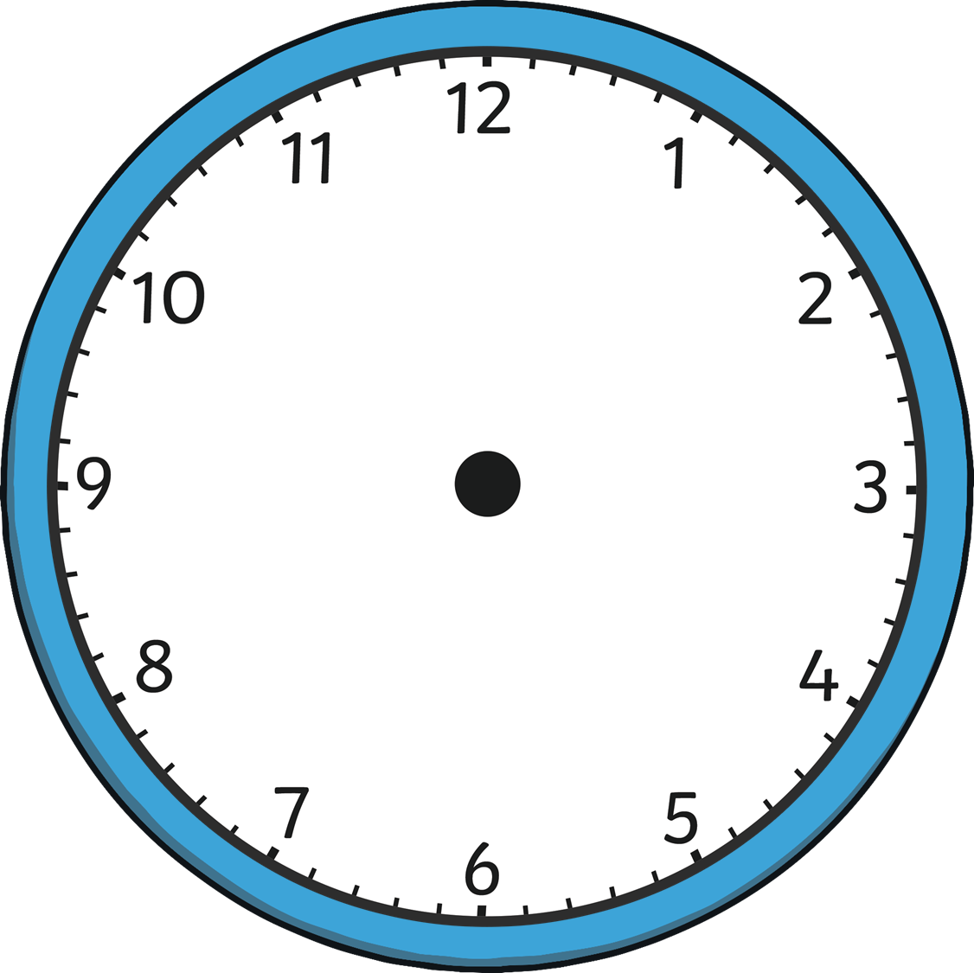
Just a Minute
You can use words to help count a minute without using a stopwatch. Watch the second hand of the clock as it passes through 1 minute and say ‘1 elephant, 2 elephants, 3 elephants’ and so on as each second passes.
START
?
Can you think of any other words you could use to help you to count a minute?

Slide 7
Just a Minute
Now have another try at estimating 1 minute. Try counting using the word ‘elephant’ or a different word of your own to help you.
Press start to activate the minute timer. Close your eyes and raise your hand when you think a minute has passed.
START
Time’s up!
?
Was your estimate more accurate than the first time? Can you explain why?

Slide 8
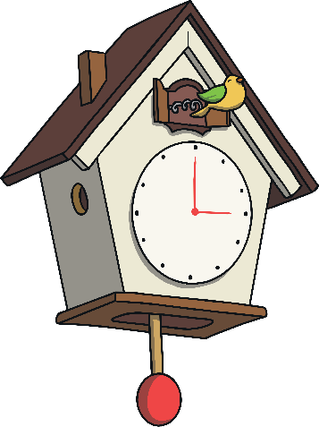
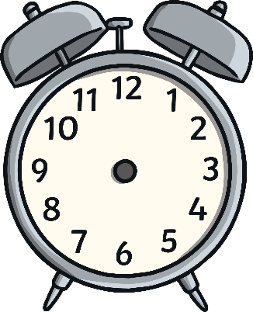
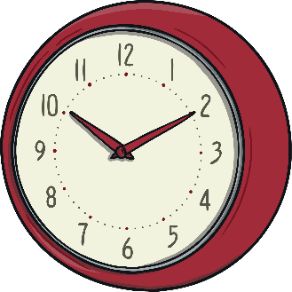
Spending Time
Time is a unit that can be measured.
Time is measured in different units.
It can be measured in:
seconds
years
days
weeks
minutes
hours
months

Slide 9
Spending Time
One way we can measure time is with clocks.
We use seconds, minutes and hours to measure time on a clock.
second hand
minute hand
Which of these hands takes the most time to go the whole way around the clock?
Which takes the least time?
hour hand

Slide 10
Spending Time
?
Can you see the minute interval markings around the clock?
How many can you count?

Slide 11
Spending Time
The second hand takes one second to move one interval on the clock. Can you help count how many seconds there are in a minute? Click ‘start’ to begin.
START
There are 60 seconds in a minute. It takes 1 minute for the second hand to travel around the clock.

Slide 12
Spending Time
Let’s count the 1 hour interval markings together!
How many can you count?
START
The hour hand travels around the clock twice in 1 day. This means that there are 24 hours in 1 day.
12 hours + 12 hours = 24 hours

Slide 13
Spending Time
How many minutes are in…
…a quarter of an hour?
…three quarters of an hour?
…half an hour?
15 minutes
30 minutes
45 minutes

Slide 14
Spending Time
Match the times.
1 day
1 hour
1 minute
60 seconds
24 hours
60 minutes

Slide 15
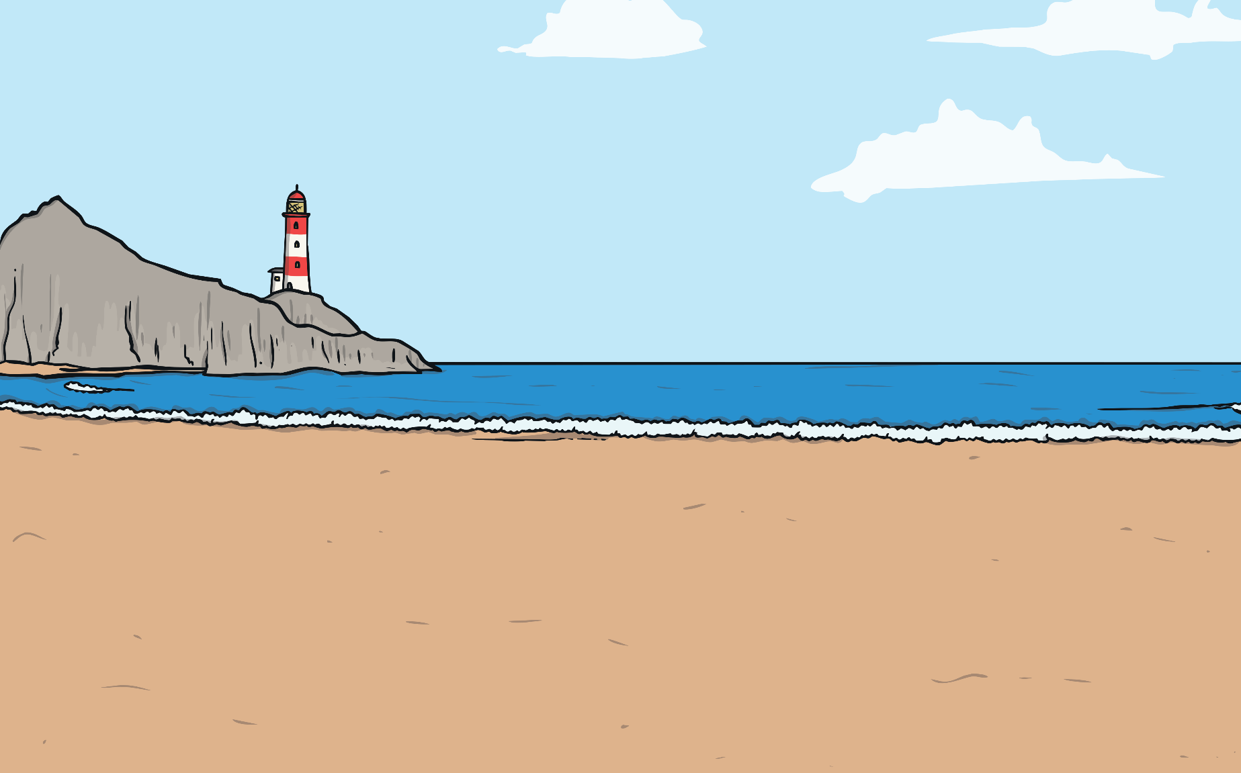
Time Flies
Chloe and Tim have been at the beach having fun. They’ve been swimming, collecting shells and building castles in the sand.
Time really flies when you’re having fun!
It’s almost time to go home!
We just got here a few minutes ago.
?
What do you think this means?
Is it possible that they were only there for a few minutes?

