Slide 1
Maths
Measurement
Year One
Maths | Year 2 | Measurement | Compare and Sequence | Lesson 2 of 3: What’s the Time Mr Wolf?

Slide 3
Aim
To sequence and compare different times of the day.
Success Criteria
I can use vocabulary to describe different intervals of time.
I can say whether everyday activities usually take place before noon or after noon.
I can compare how long different events take in a day.

Slide 4
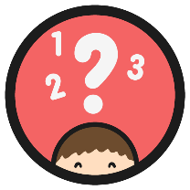
Mr Wolf
There are 24 hours in one day.
1
2
3
4
5
6
7
8
9
10
11
12
13
14
15
16
17
18
19
20
21
22
23
24
?
Can you count the 24 sections of the diagram?

Slide 5
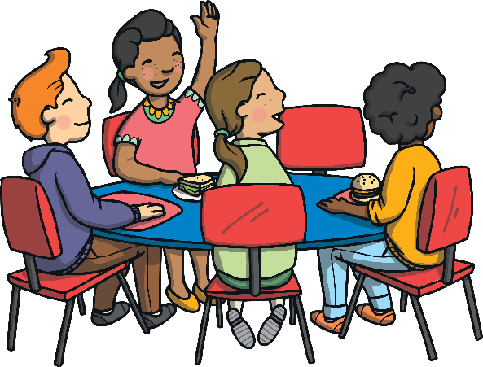
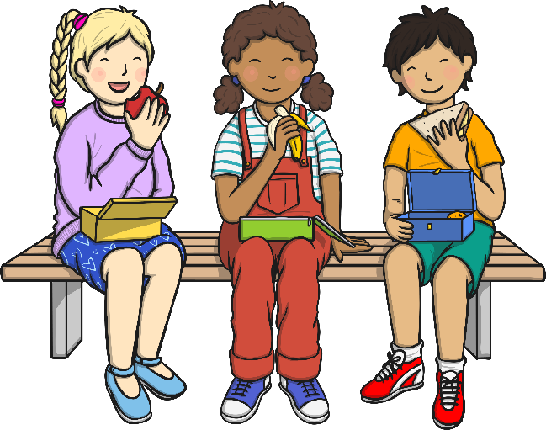
Mr Wolf
The middle part of a day in known as noon.
?
What time is this?
noon

Slide 6
Mr Wolf
Noon is at 12 o’clock. This can also be known as midday.
24 hours
noon
before noon
after noon

Slide 7
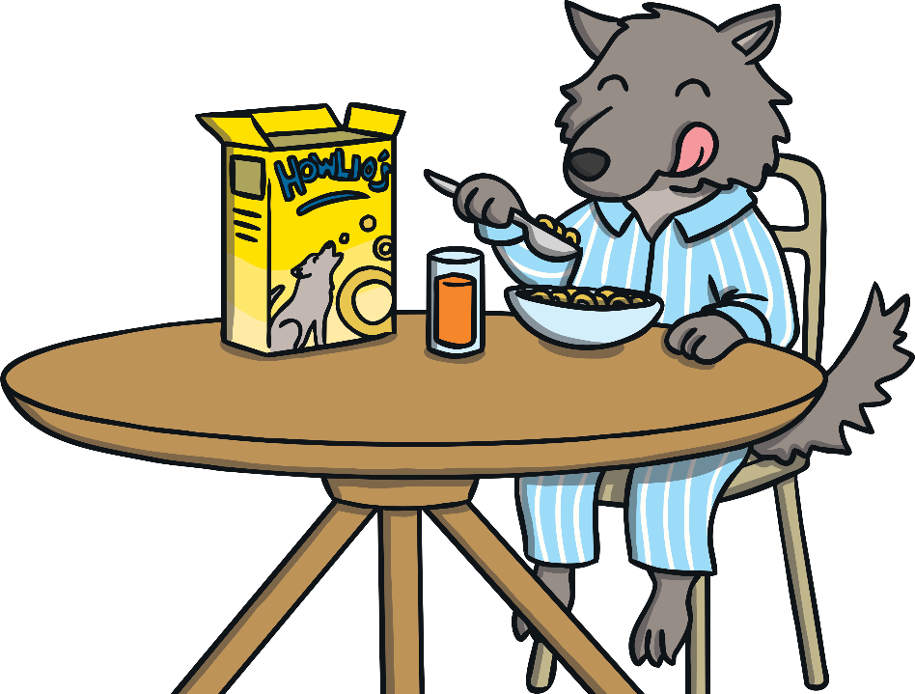
Mr Wolf
Sort the activities into things that you would normally do before noon and things you would normally do after noon.
?
Which do you do at both times of the day?

Slide 8
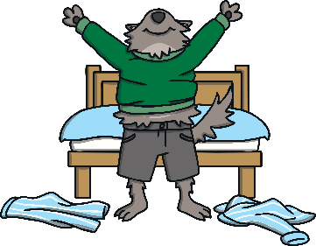
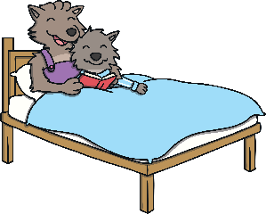
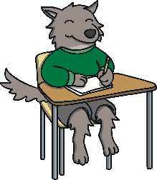
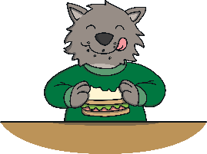
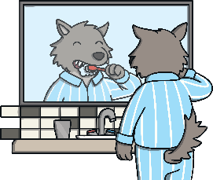
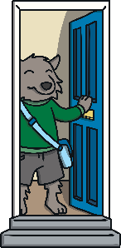
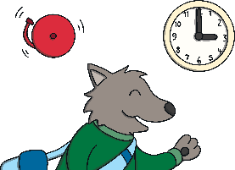
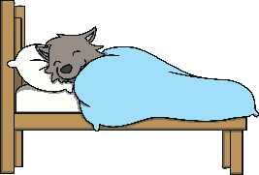
before noon
after noon
Answer

Slide 9
A Day in the Life of…
This is a block graph to show how you spend your day.
Click to select how your time is spent.
1 block = 1 hour
sleeping
eating
playing
learning
washing
relaxing
?
What do you spend the most and least time doing?

Slide 10
Compound Time
Put two time words together to make some compound words.
set
bed
some
line
stop
day
after
time
end
watch
noon
week
time
sun
table
dead
time
birth
Click to see if you matched them correctly.

Slide 11
Compound Time
Put two time words together to make some compound words.
sun
set
dead
line
bed
time
stop
watch
some
time
after
noon
birth
day
week
end
time
table
?
What do each of these words mean?
Which words measure time? Which words describe time?

Slide 12
Aim
To sequence and compare different times of the day.
Success Criteria
I can use vocabulary to describe different intervals of time.
I can say whether everyday activities usually take place before noon or after noon.
I can compare how long different events take in a day.

