Slide 1
Maths
Number and Place Value
Year One
Maths | Year 2 | Number and Place Value | Solve Problems | Lesson 1 of 3: Winning Problems

Slide 3
Aim
I can use place value and number facts to solve problems.
Success Criteria
I can identify and change the value of each digit in a number.
I can represent numbers on an abacus.
I can identify and explain a number pattern.
I can use a pattern to help me solve a problem.
I can find all possible solutions to a problem.

Slide 4
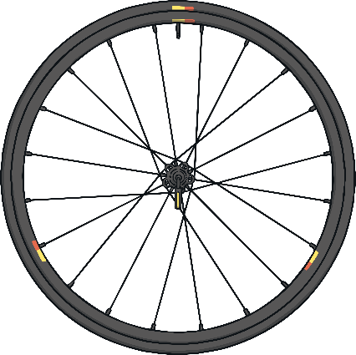
Take Your Place
Let’s spin the wheels to generate two numbers.
What is the greatest two-digit number you can make from the numbers?
Tens | Ones
0
8
2
4
1
9
0
1
0
3
8
9
1
5
8
0
5
2
7
4
Spin
Where should the digit from the first wheel go - in the tens or the ones column? Why?
How do you know that you’ve made the greatest two-digit number you can possibly make?
Next

Slide 5
Take Your Place
Let’s spin the wheels to generate two numbers.
What is the smallest two-digit number you can make from the numbers?
Tens | Ones
0
8
2
4
1
9
0
1
0
3
8
9
1
5
8
0
5
2
7
4
Spin
Where should the digit from the first wheel go - in the tens or the ones column? Why?
How do you know that you’ve made the smallest two-digit number you can possibly make?
Next

Slide 6
Take Your Place
Let’s spin the wheels to generate two numbers.
How many different numbers can you make with these digits?
Tens | Ones
0
8
2
4
1
9
0
1
0
3
8
9
1
5
8
0
5
2
7
4
Spin
Can you make more numbers by only using one digit?
Next

Slide 7
Abacus Athletics
Tia is counting how many points Team Twinkl have won at the Epic Athletics Day.
She is using an abacus to help her count.
7
8
4
10
9
5
6
1
2
3
Tens Ones
What do you think happens after Tia gets to 9?
After 9, Tia needs to use the tens column to show one ten.

Slide 8
Abacus Athletics
What do you think Tia will do to show 11?
18
17
19
15
11
14
12
13
16
Tens Ones
To keep counting after ten, Tia uses the tens and the ones columns.

Slide 9
Abacus Athletics
What do you think Tia will do to show 20?
20
Tens Ones
Why do you think that?

Slide 10
Abacus Athletics
Help me count to 30.
27
28
30
29
26
25
24
22
20
21
23
Tens Ones

Slide 11
Abacus Athletics
How many points do Team Twinkl have?
Explain how you know.
Tens Ones
There are 2 tens and 3 ones.
The number is 23.

Slide 12
Abacus Athletics
How many points do the other teams have?
12
43
57
Tens Ones
Tens Ones
Tens Ones
Speedy Superstars
Fast Friends
Golden Gang
Show answers

Slide 13
Abacus Athletics
How many points do the other teams have?
33
4
20
Tens Ones
Tens Ones
Tens Ones
Happy Heroes
Quick Kings
Sporty Squad
Show answers

Slide 14
Abacus Athletics
How many points do the Speedy Superstars have now?
24
Write a calculation to show the number on the abacus.
42
14
Tens Ones

Slide 15
Abacus Athletics
How many points do the Golden Gang have now?
36
Write a calculation to show the number on the abacus.
63
73
Tens Ones

Slide 16
Abacus Athletics
How many points do the Fast Friends have now?
41
Write a calculation to show the number on the abacus.
4
14
Tens Ones

Slide 17
Abacus Athletics
How many points do the Sporty Squad have now?
7
17
70
Tens Ones

Slide 18
Abacus Athletics
How many points do the Happy Heroes have now?
1
10
100
Tens Ones

Slide 19
Winning Problems
Tia gives her teammates a clue so they can work out how many points they have so far.
Tia says, “There are 3 beads on my abacus.”
What might Team Twinkl’s score be?
How can you be sure you have found all the possibilities?
Tens Ones
Tens Ones
Tens Ones
Tens Ones
They might have 3 points.
They might have 12 points.
They might have 21 points.
They might have 30 points.

Slide 20
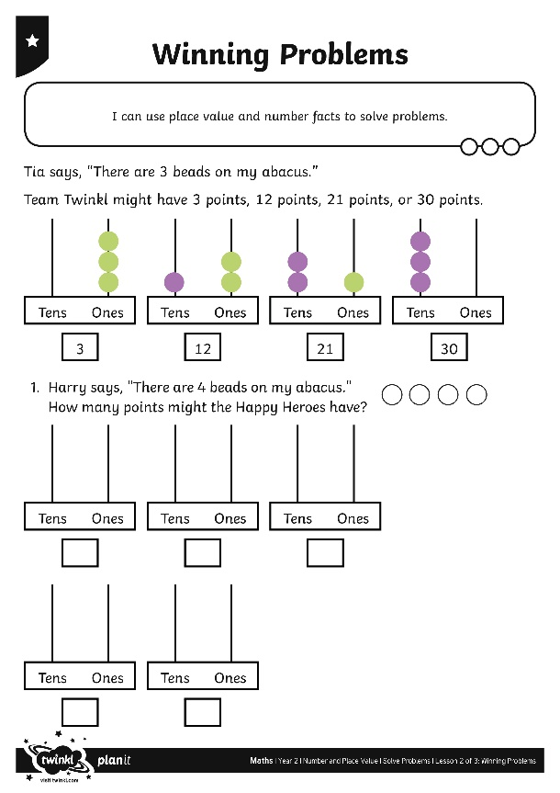
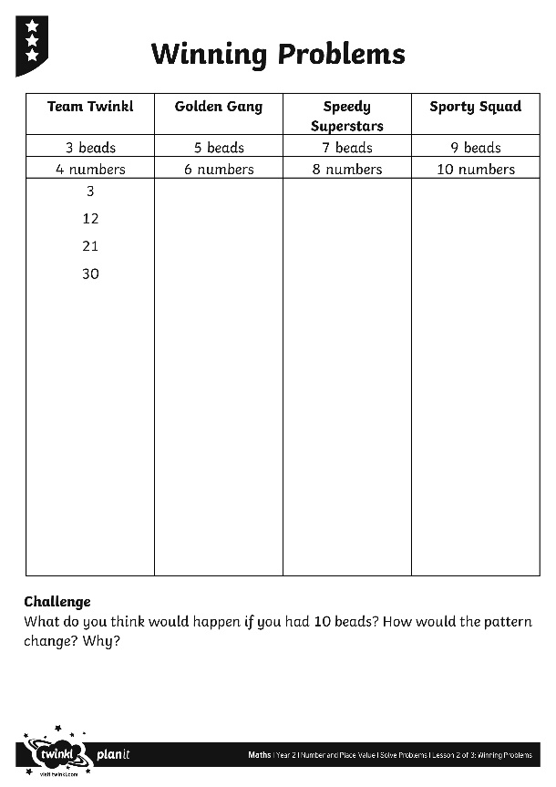
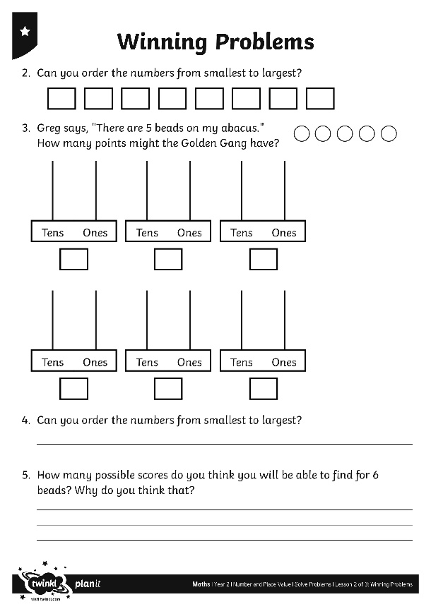
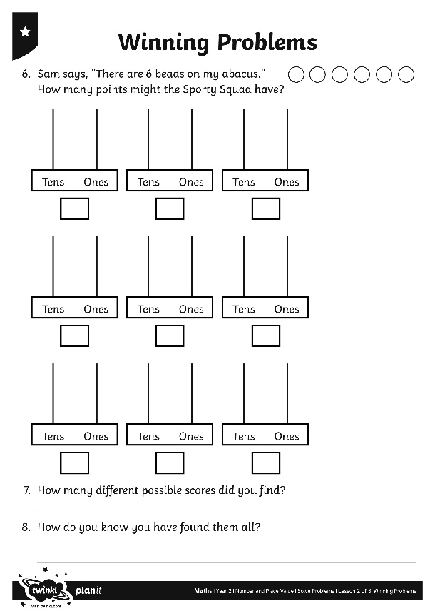
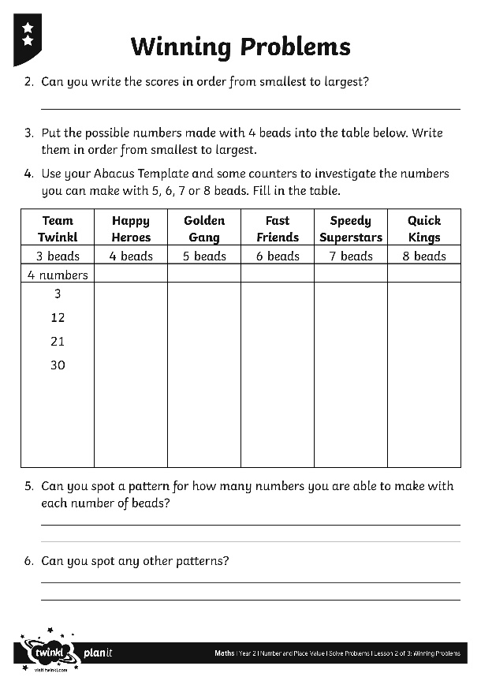
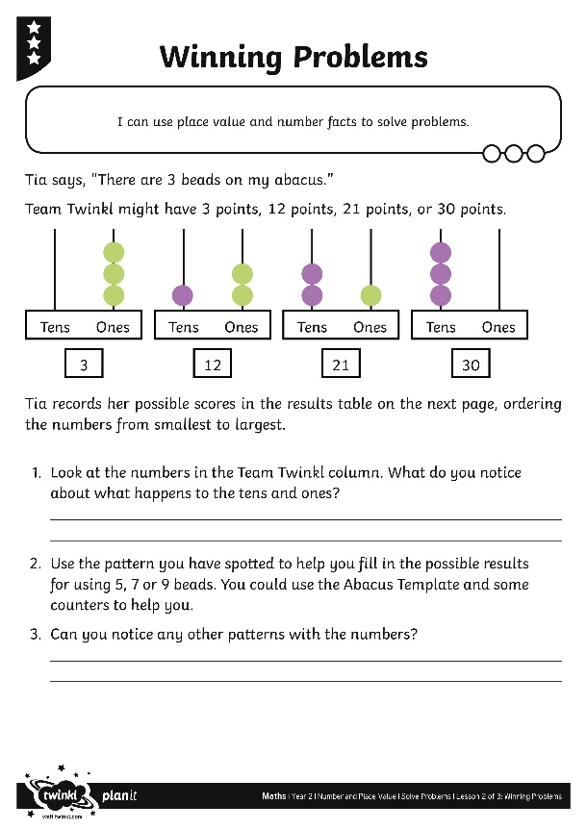
Winning Problems Activity
Can you work out how many points the other teams might have?
Can you spot any patterns?

