Slide 1


Spelling, Punctuation and Grammar
Word Families
Year One
SPaG | Word Families

Slide 2

Word Families

Slide 3
Aim
I can identify word families.
Success Criteria
I can describe what a word family is.
I can use prefixes and suffixes to create different words for a family.
I can identify different words in a word family.

Slide 4
Introductory Activity

Slide 5

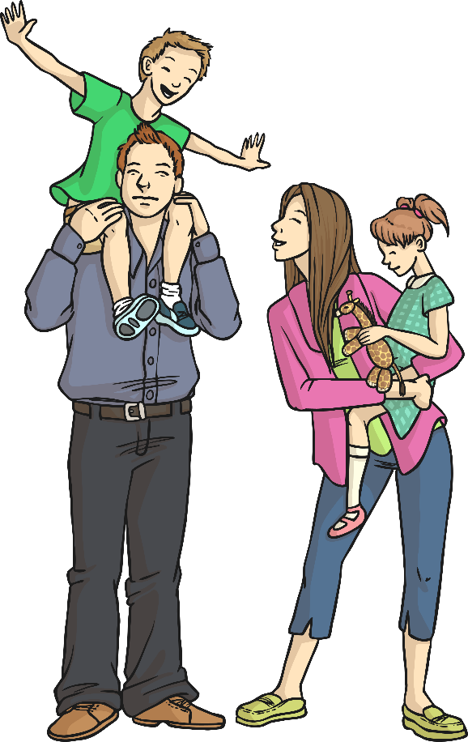
Meet the Family
Look at the words around the Help family.
Can you sort them into groups? Decide how to group the words together.
helper
helpful
helpless
unhelpful
helping
The Help Family
help
helped

Slide 6
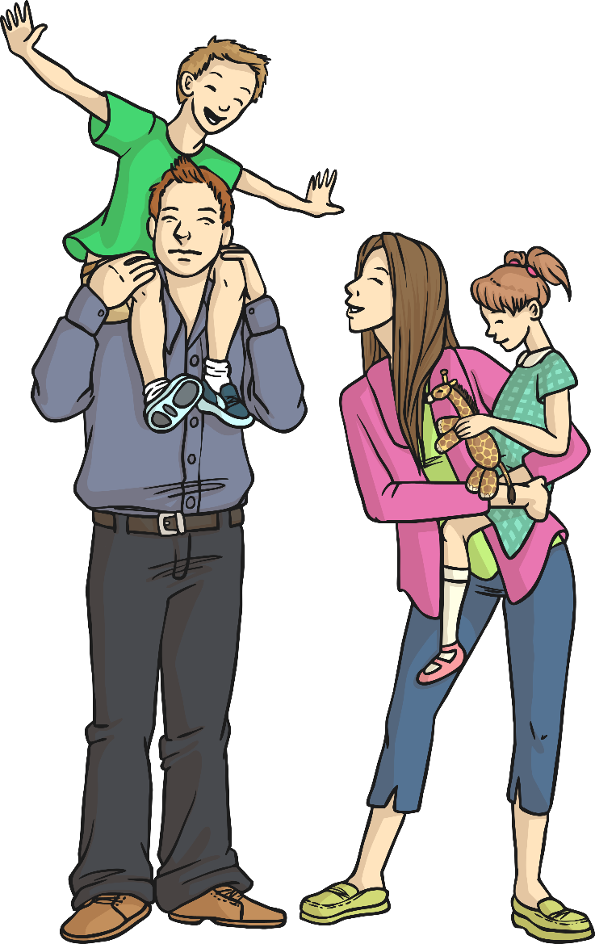
Meet the Family
How did you group the words?
One way could be…
Root Word
help
Prefix before the root
unhelpful
Suffix after the root
helper
helping
helped
helpful
Helpless

Slide 7
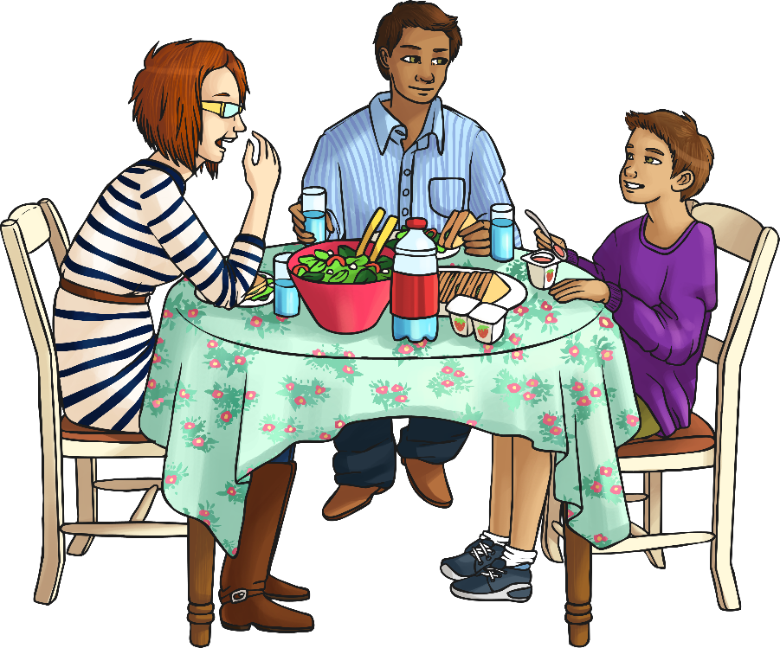
Meet the Family
Here is another word family, the Write family.
Can you sort these words into groups also?
writer
write
written
writing
underwrite
The Write Family
rewrite
writes

Slide 8

Meet the Family
How did you sort the ‘write’ family words?
What are word families?
Word families are groups of
words that link together through
their meaning, grammar or morphology (roots, prefixes and suffixes).
These words…
rewrite written underwrite
…all come from the root ‘write’.

Slide 9
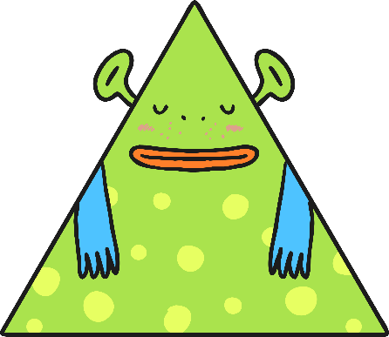
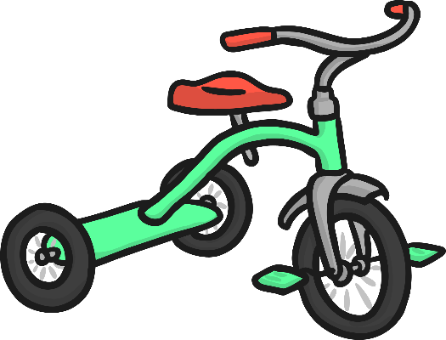

Meet the Family
These words…
triangle
tricycle
tripod
…all come from the root ‘tri’, which means three in Latin.
Can you see why these words might need a ‘three’ in them?
This is a partial root word, because it does not make sense in English on its own, but it is a Latin root word.

Slide 10

Meet the Family
Word Families
Word families sometimes use prefixes and suffixes or change spelling in the word family.
rewrite
written
underwrite

Slide 11

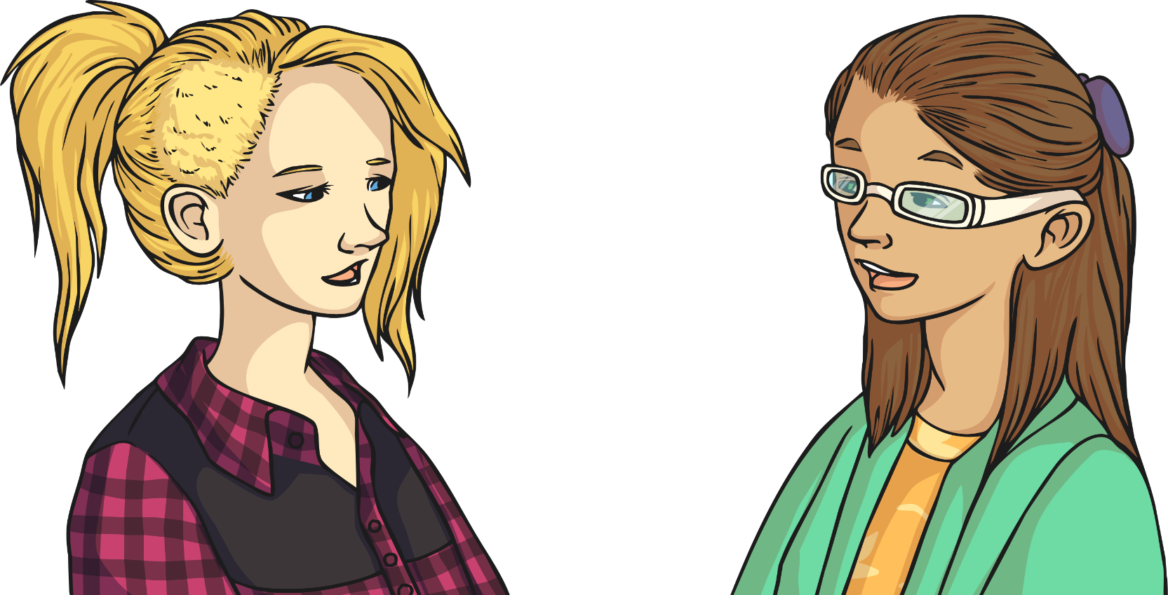
Word Relays
root word
Talk
talked talking talks
Can you find any more in a dictionary?

Slide 12
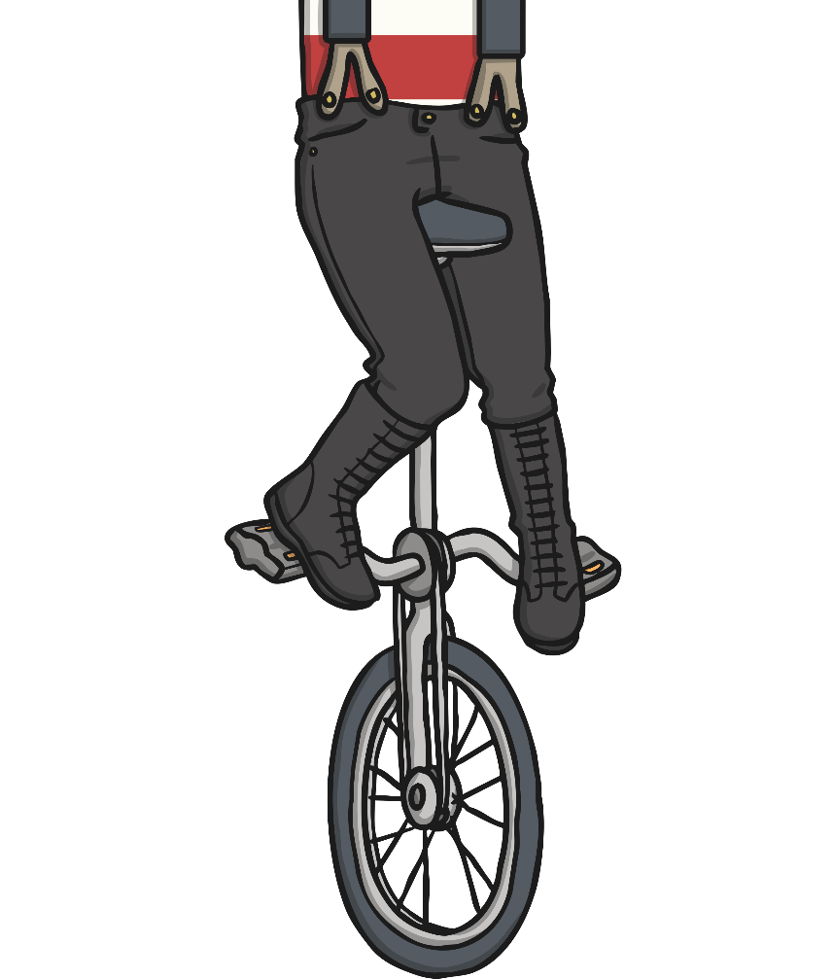
Word Relays
root word
(partial root word or Latin root word)
Uni
unite uniform unify unicorn universal university
Can you find any more in a dictionary?

Slide 13
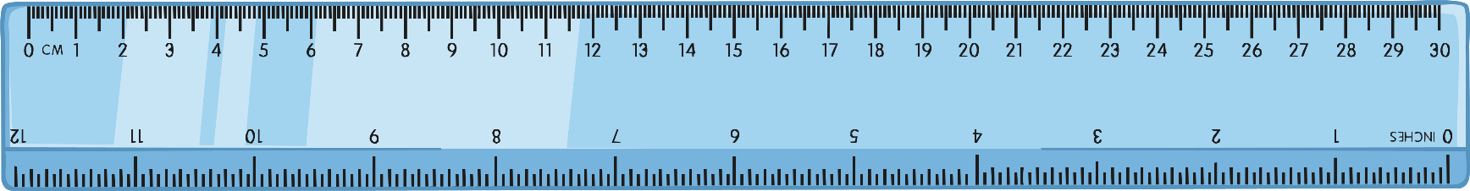
Word Relays
root word
Cent
century centipede centimetre percent
Can you find any more in a dictionary?

Slide 14
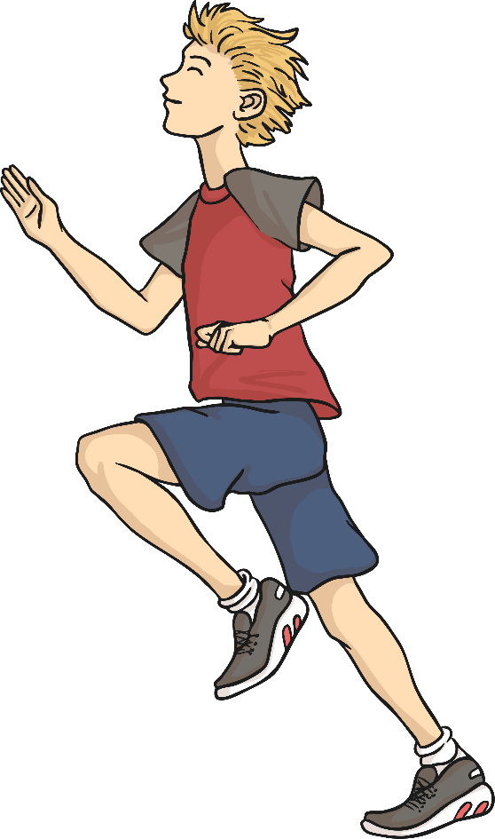
Word Relays
root word
Run
running runner runs rerun reruns rerunning
Can you find any more in a dictionary?

Slide 15

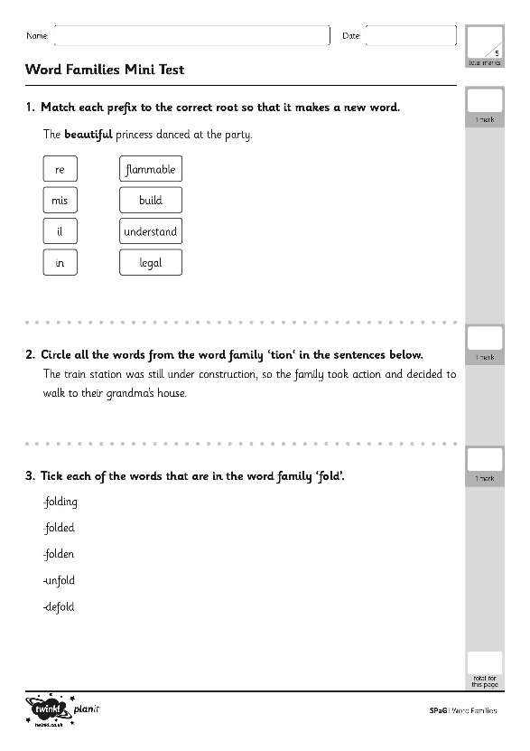
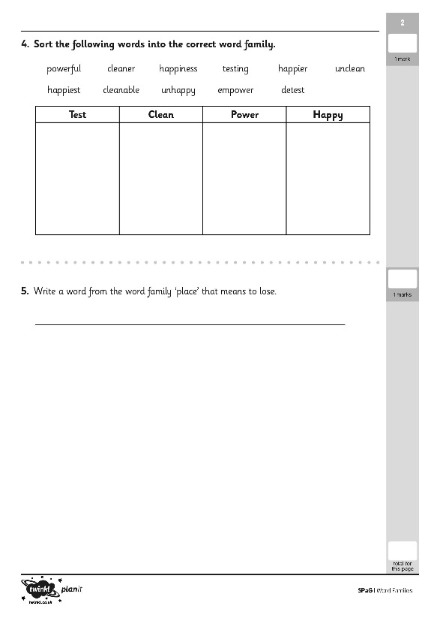
Word Families
Use all of the information your have learnt and practiced about word families.
Work on your own to complete the Assessment Activity Sheet.

Slide 16
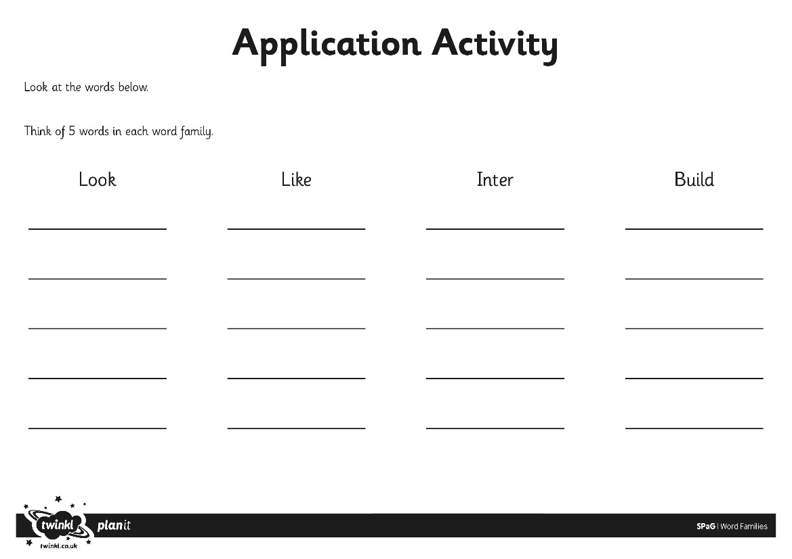
Word Families
Use all of the information your have learnt and practiced about word families.
Work on your own to complete the Assessment Activity Sheet.

Slide 17
Aim
I can identify word families.
Success Criteria
I can describe what a word family is.
I can use prefixes and suffixes to create different words for a family.
I can identify different words in a word family.

