Slide 1
Science
Living Things and Their Habitats
Year One
Science | Year 2 | Living Things and Their Habitats | Working Together, Staying Alive | Lesson 5

Slide 2
Title slide (themed) here

Slide 3
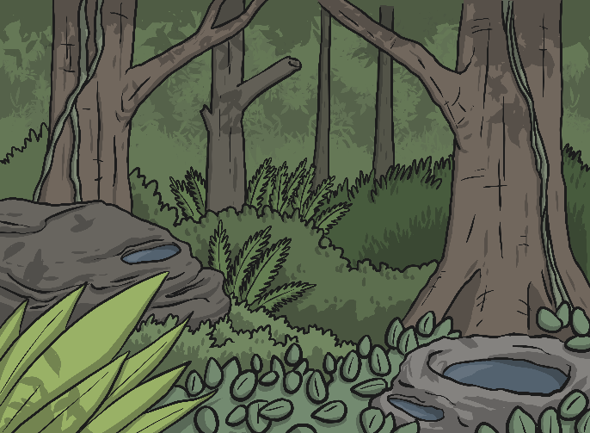
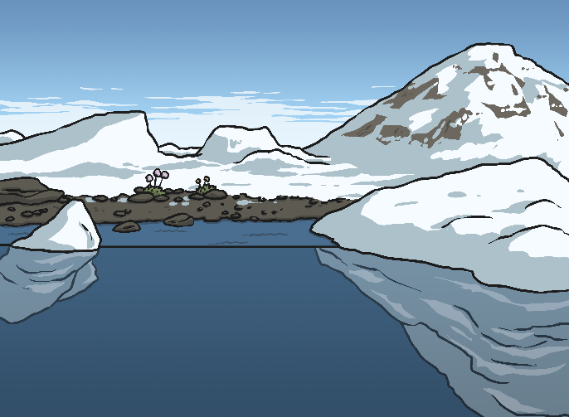
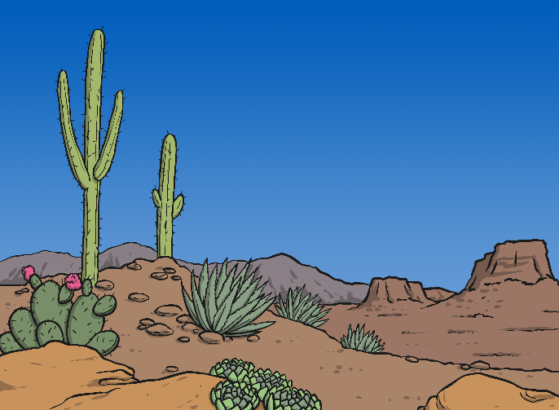
World Habitats
Rainforest
Arctic
Do you remember the world habitats we researched a few lessons ago?
Ocean
Desert

Slide 4
World Habitats
Can you remember some plants or animals that live here?
What are ocean habitats like?
Oceans

Slide 5
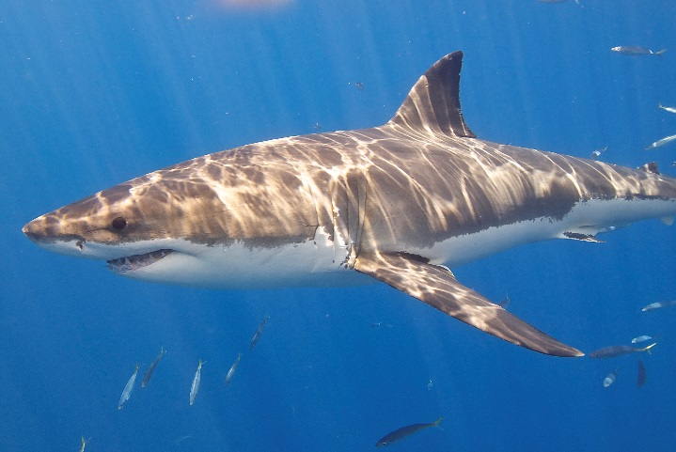
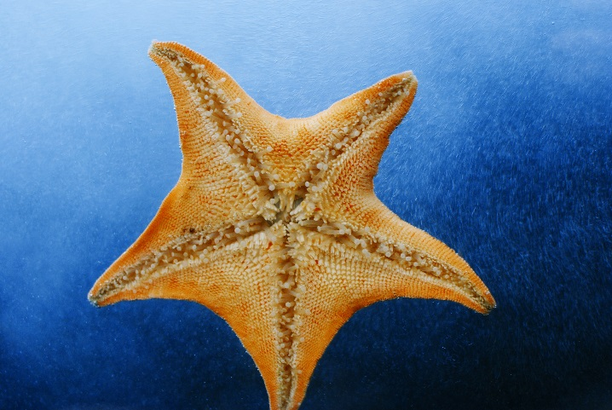
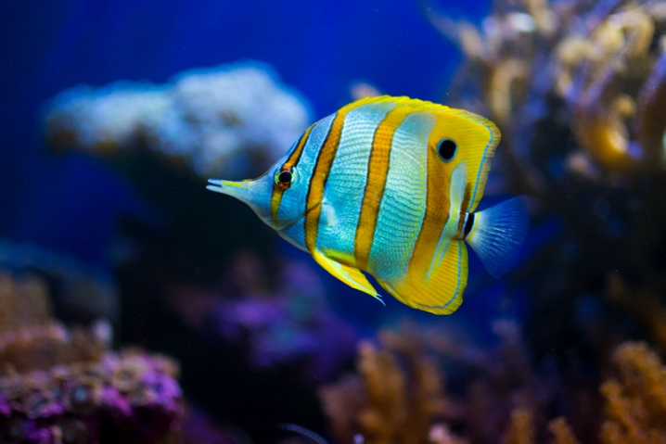
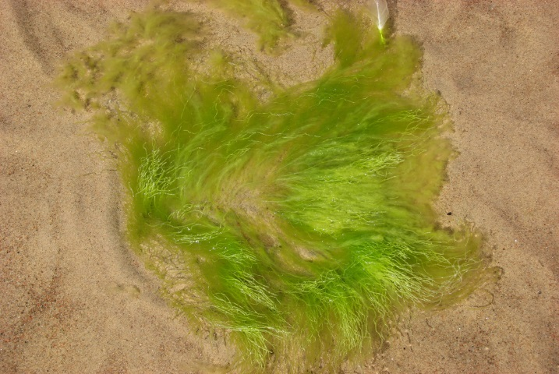
Animals of the Oceans
Photos courtesy of Elias Levy, Lisa Williams, Patrik Nygen and qorize (@flickr.com) - granted under creative commons licence - attribution

Slide 6
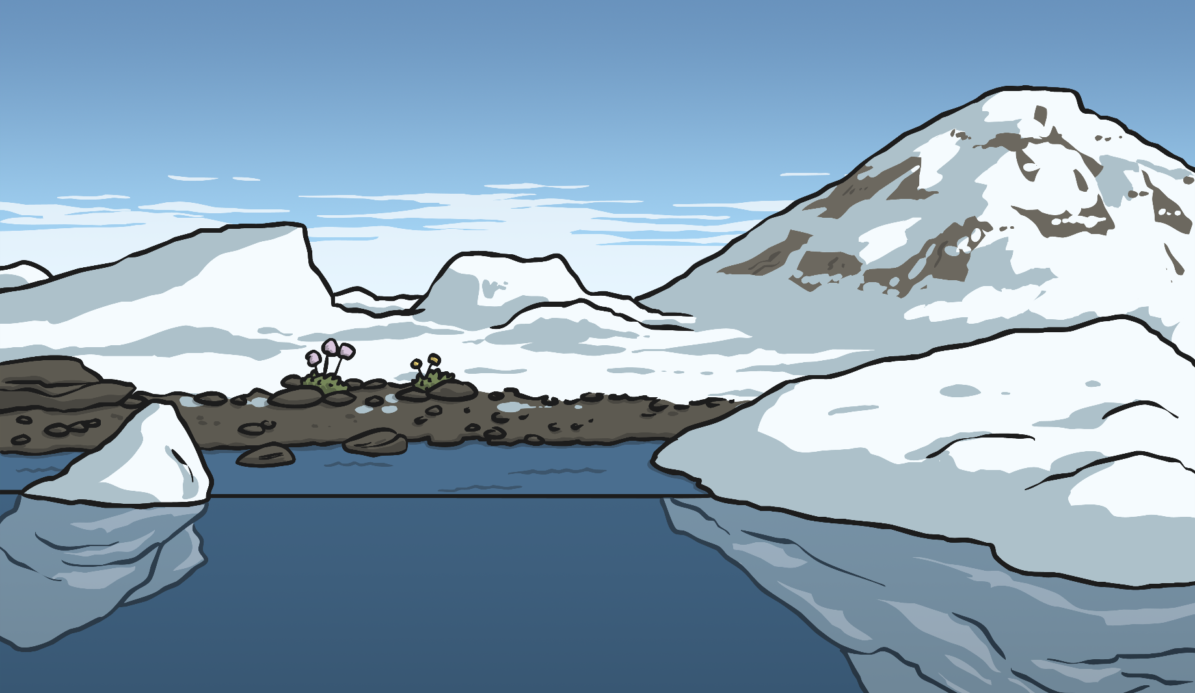
World Habitats
Can you remember some plants or animals that live here?
What is the Arctic habitat like?
The Arctic

Slide 7
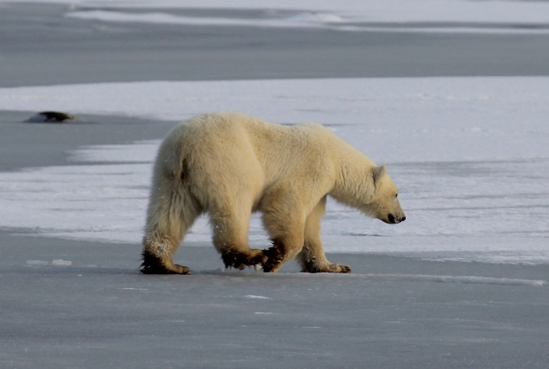
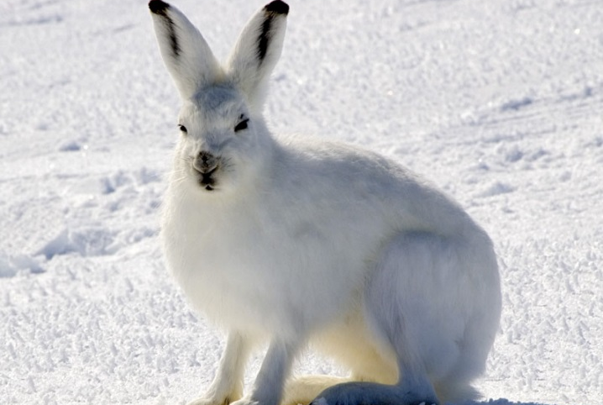
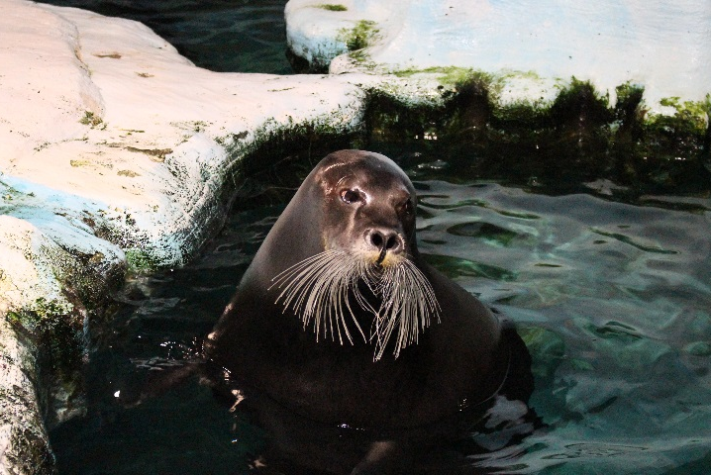
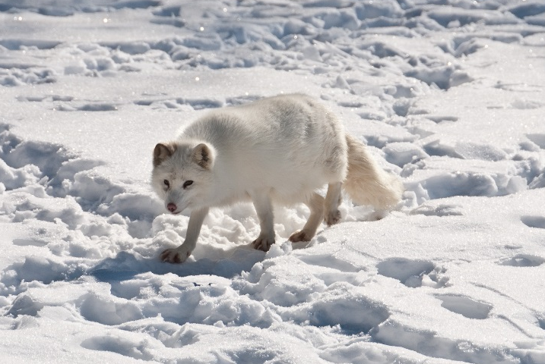
Animals of the Arctic
Photos courtesy of Emma, Steve Sayles, Lee Dyer and Bering Land Bridge National Preserve (@flickr.com) - granted under creative commons licence - attribution

Slide 8
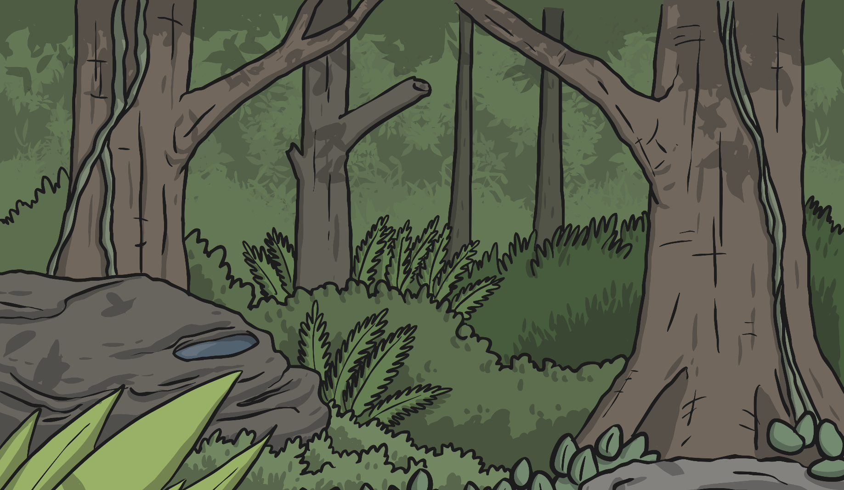
World Habitats
Can you remember some plants or animals that live here?
What are tropical rainforest habitats like?
Tropical Rainforests

Slide 9
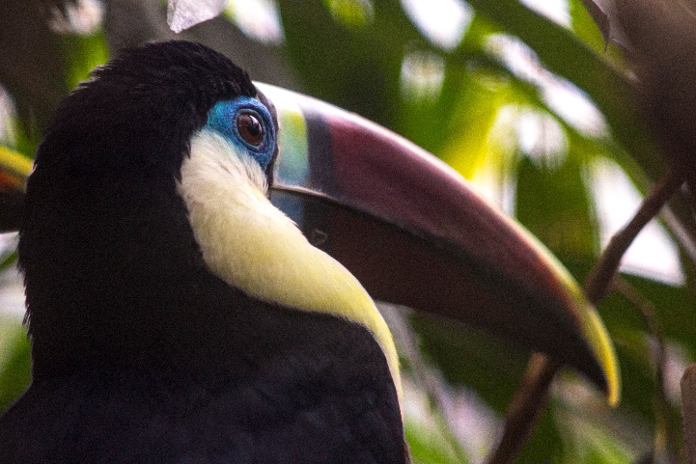
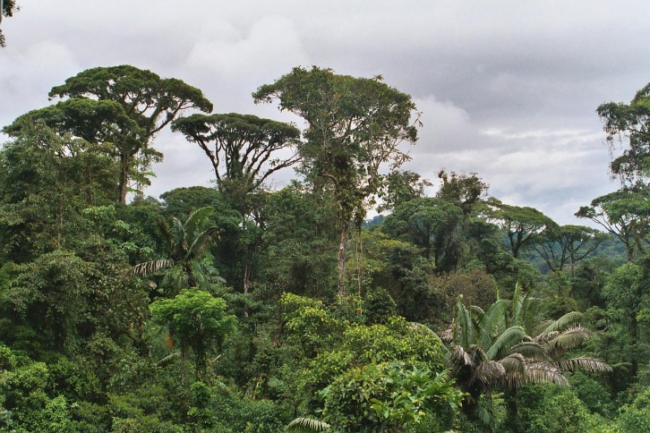
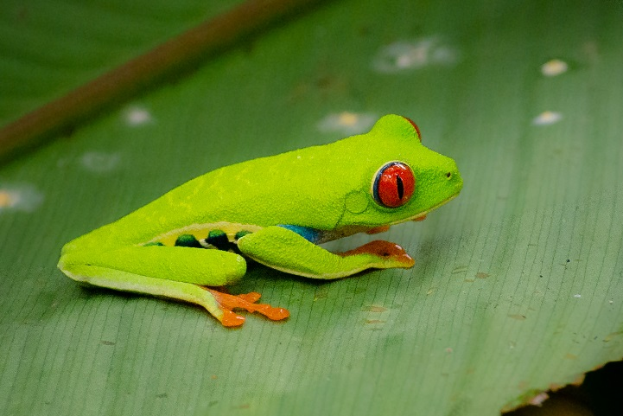
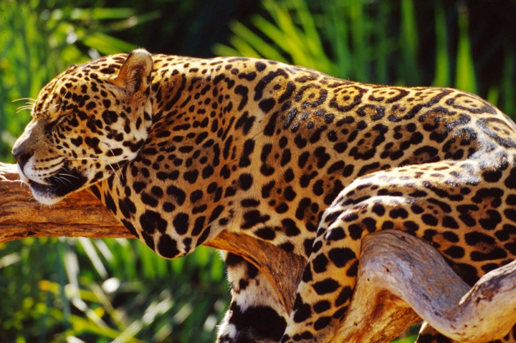
Animals of Tropical Rainforests
Photos courtesy of Endangered_Human, Bayucca, Kurt Bauschardt and Land Rover Our Planet (@flickr.com) - granted under creative commons licence - attribution

Slide 10
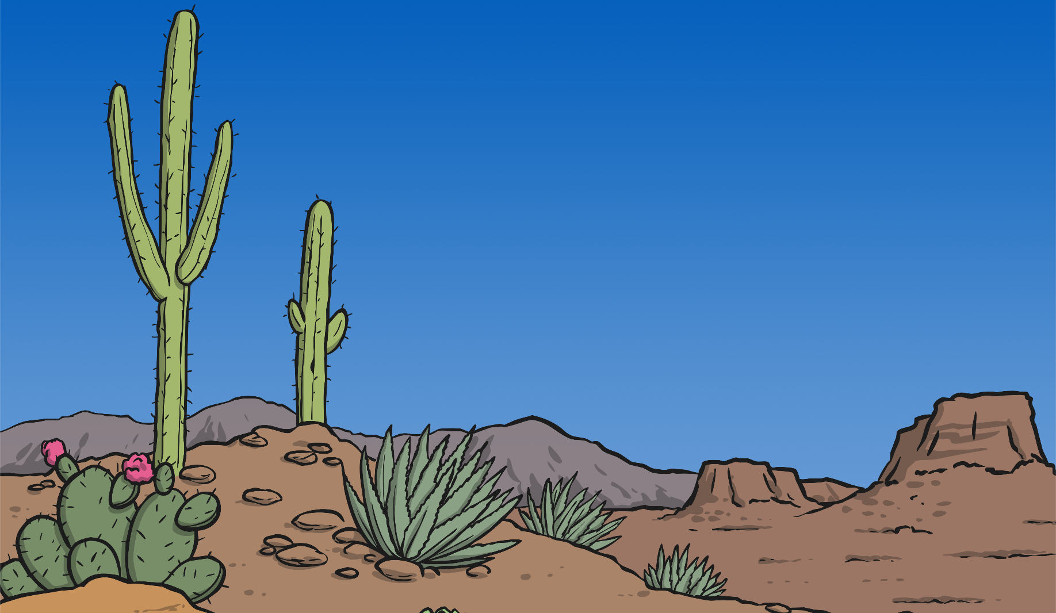
World Habitats
Can you remember some plants or animals that live here?
What are desert habitats like?
Deserts

Slide 11
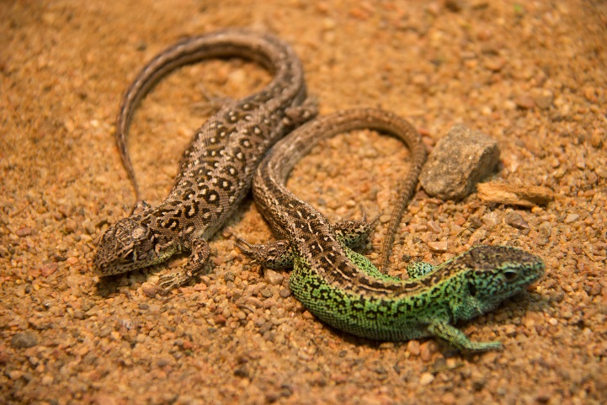
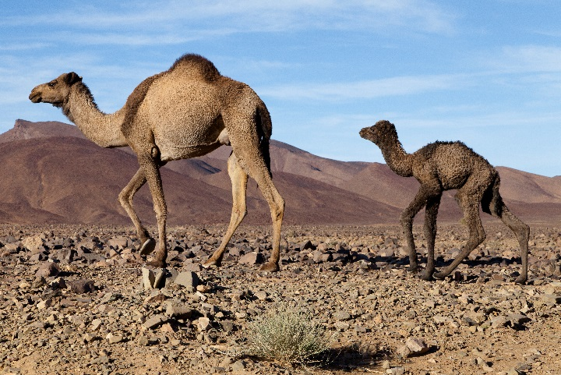
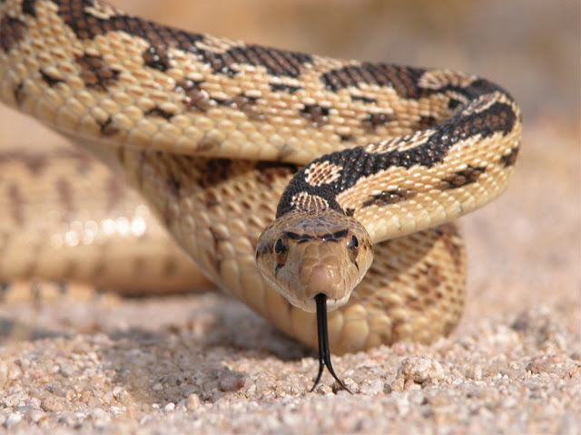
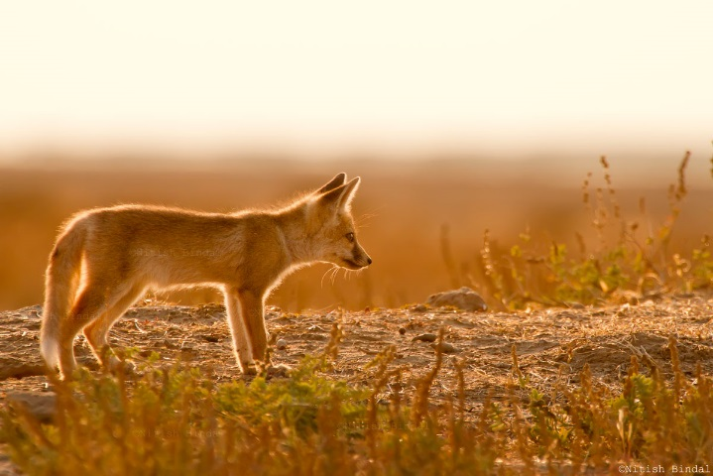
Animals the Desert
Photos courtesy of Susanne Nilsson, SuperCar-RoadTrip, Bryan Adams and Nitish Bindal Agrawal (@flickr.com) - granted under creative commons licence - attribution

Slide 12
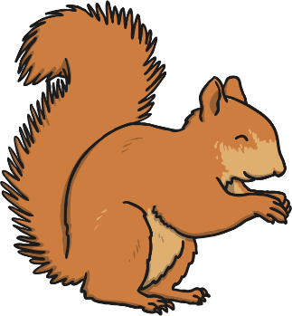
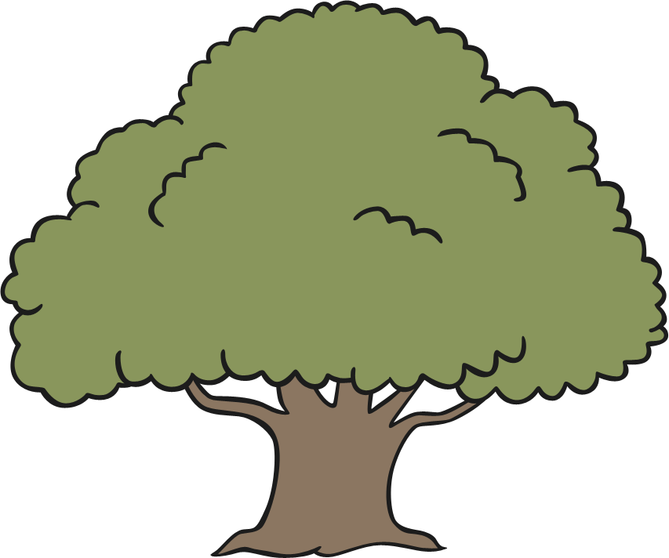
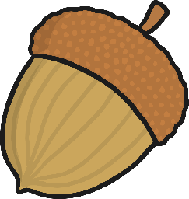
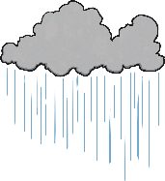
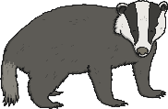
Dependency
Living things in a habitat depend on each other. This means they need each other to stay alive.
Squirrels and oak trees are part of a woodland habitat.
Why might this squirrel need an oak tree to stay alive?
Food: Acorns are a squirrels favourite food.
Safety: Living high in an oak tree gives squirrels protection from foxes and badgers, and gives them a safe place to have babies.
Shelter: The oak tree protects the squirrel from the wind, cold and rain, and bigger animals.

Slide 13
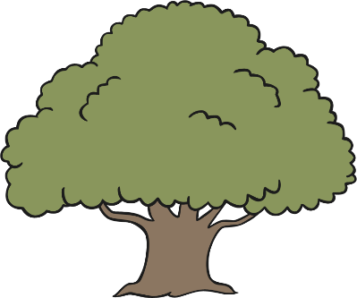
Dependency
Why does an oak tree need a squirrel?
The oak tree needs the squirrel to spread its seeds.
The squirrel collects lots of acorns, and buries some to save for later.
Food: Acorns are a squirrels favourite food.
Safety: Living high in an oak tree gives squirrels protection from foxes and badgers, and gives them a safe place to have babies.
Shelter: The oak tree protects the squirrel from the wind, cold and rain, and bigger animals.
Sometimes the squirrels forget to go and dig them up again.
These acorns grow into new oak trees.
It carries them far away from the tree and hides them under the ground, away from other animals.

Slide 14
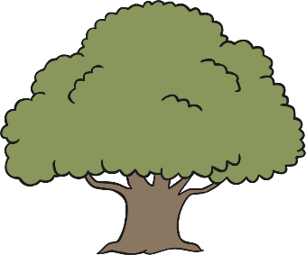
Dependency
The squirrel needs the oak tree for food and shelter.
The oak tree needs the squirrel to spread seeds so new trees can grow.
Food: Acorns are a squirrels favourite food.
Safety: Living high in an oak tree gives squirrels protection from foxes and badgers, and gives them a safe place to have babies.
Shelter: The oak tree protects the squirrel from the wind, cold and rain, and bigger animals.
The oak tree and the squirrel depend on each other. This means they need each other to stay alive.

Slide 15
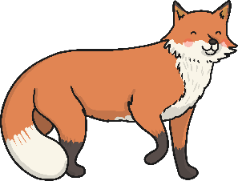
Dependency
Why do foxes need squirrels?
Foxes eat squirrels.
Why do foxes need oak trees?
Food: Acorns are a squirrels favourite food.
Safety: Living high in an oak tree gives squirrels protection from foxes and badgers, and gives them a safe place to have babies.
Shelter: The oak tree protects the squirrel from the wind, cold and rain, and bigger animals.
If there were no oak trees, there would be fewer squirrels, so there would be less food for the foxes.

Slide 16
Dependency
Can anyone think how the foxes are helping the oak trees?
If there were no foxes, there would be more squirrels.
The squirrels might eat all of the acorns and then no new oak trees could grow.
Food: Acorns are a squirrels favourite food.
Safety: Living high in an oak tree gives squirrels protection from foxes and badgers, and gives them a safe place to have babies.
Shelter: The oak tree protects the squirrel from the wind, cold and rain, and bigger animals.
All of the living things in this habitat depend on each other to survive.

Slide 17
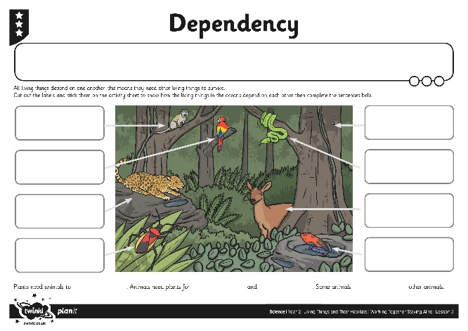
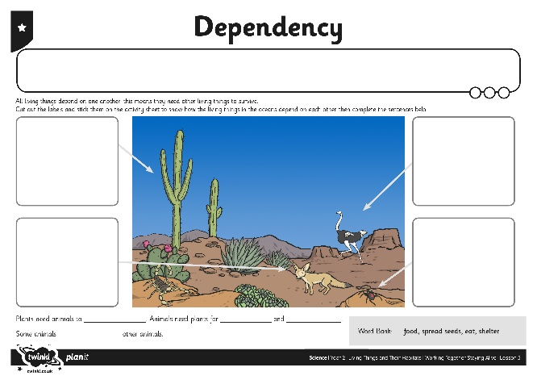
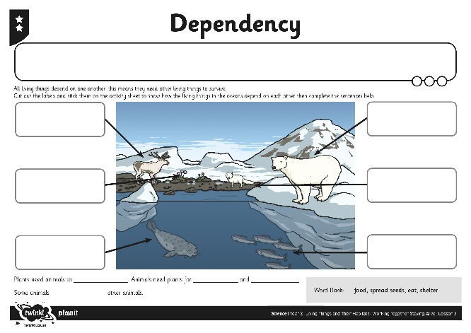
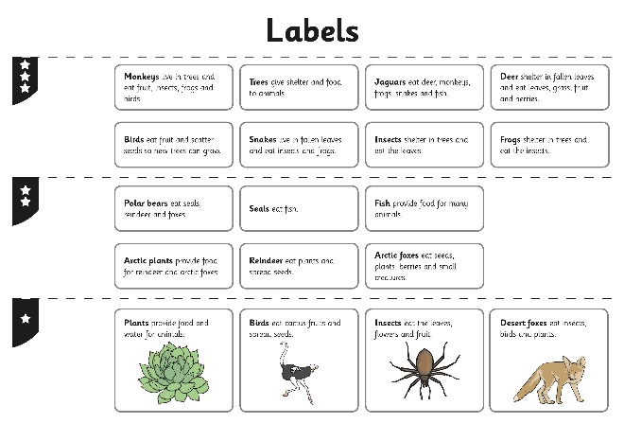
Dependency Activity
Look at the habitat on your activity sheet.
Read the labels, then stick them onto the habitat to show how the living things in the habitat work together.
Complete the sentences to say how animals and plants depend on each other to stay alive.
Food: Acorns are a squirrels favourite food.
Safety: Living high in an oak tree gives squirrels protection from foxes and badgers, and gives them a safe place to have babies.
Shelter: The oak tree protects the squirrel from the wind, cold and rain, and bigger animals.

Slide 18
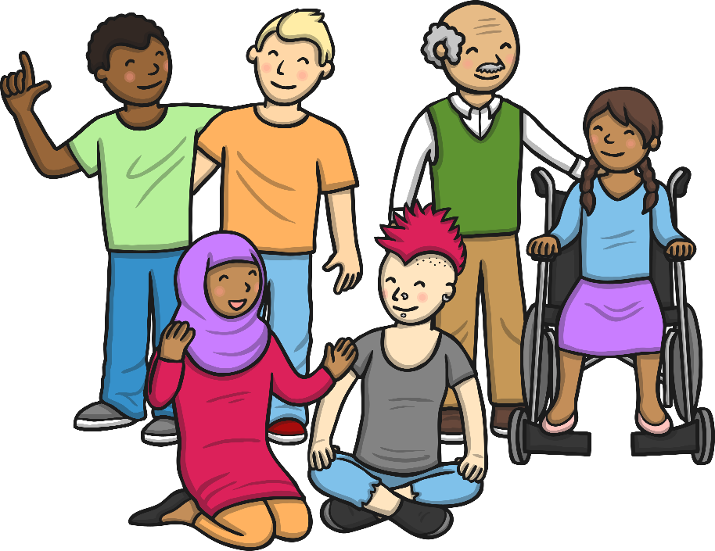
What about Us?
How do humans depend on other living things to stay alive?
What living things depend on us for survival?
Food: Acorns are a squirrels favourite food.
Safety: Living high in an oak tree gives squirrels protection from foxes and badgers, and gives them a safe place to have babies.
Shelter: The oak tree protects the squirrel from the wind, cold and rain, and bigger animals.

Slide 19
Aim
I can identify how an animal is suited to its habitat.
I can explain how living things in a habitat depend on each other.
Success Criteria
I can describe the features of some animals.
I can identify the needs of different plants and animals.
I can suggest how an animal survives in its habitat.
I can explain why the plants in a habitat need the animals.
I can explain why the animals in a habitat need the plants.

