Slide 1
Maths
Measurement
Year One
Maths | Year 2 | Measurement | Standard Units | Lesson 2 of 5: Messy Mixtures

Slide 2
Aim
To estimate and measure mass in grams and kilograms.
Success Criteria
I can use language related to mass.
I can estimate the weight of objects by handling them.
I can use scales to measure in grams and kilograms.

Slide 3
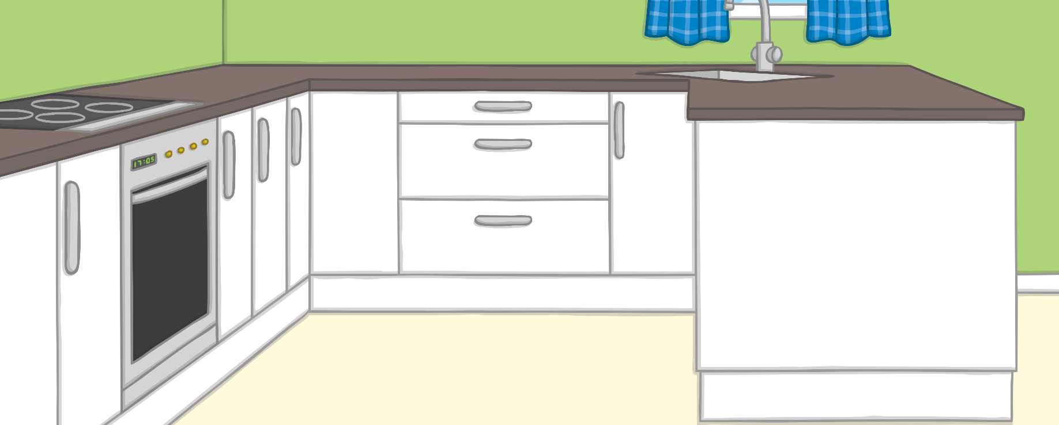
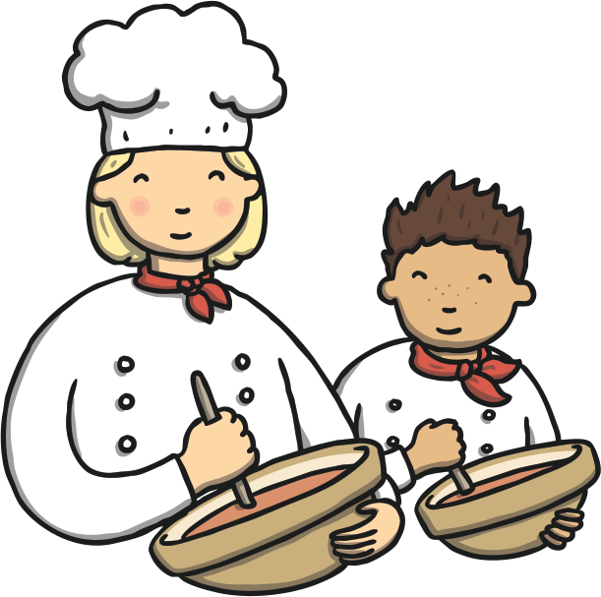
Standard Unit Snap
?
Can you match the units of measurement?
Click on a red card and blue card to turn them over. Shout ‘Snap!’ when you find a pair.
Click here to play the game!

Slide 4
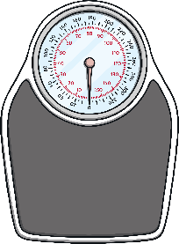
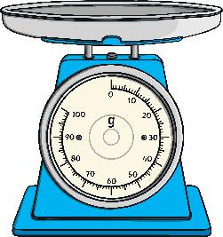
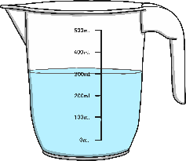
centimetre
kilogram
kg
m
?
?
?
?
metre
gram
l
ml
?
?
?
?
millilitre
litre
g
cm
?
?
?
?
No Match
Found a match? Tick the matching box.
Exit Game

Slide 5
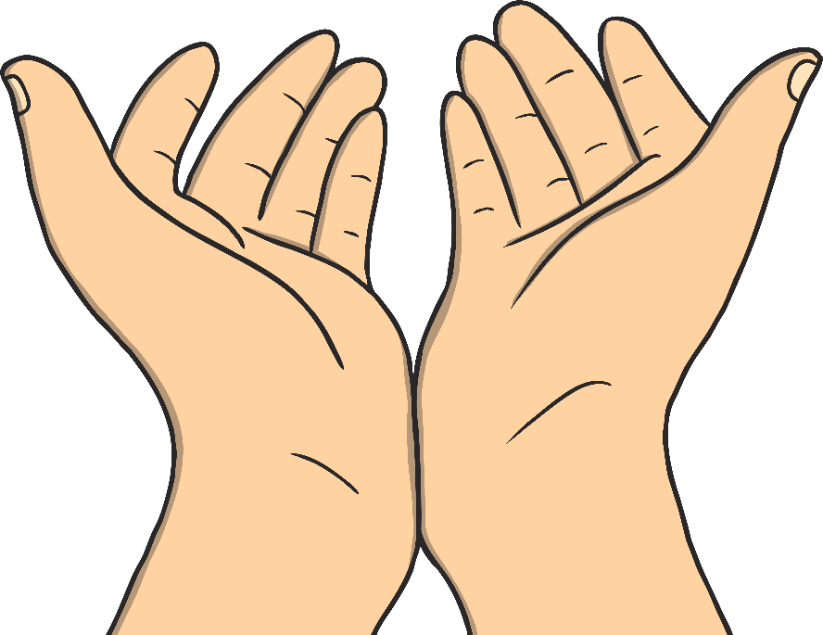
Heavier and Lighter
Than a Kilogram
There are 1000 grams in 1 kilogram.
We can write g for gram.
We can write kg for kilogram.
Spend some time finding objects in your home which are heavier and lighter than a kilogram or even exactly a kilogram! Hold the object in your hands first to estimate.
?
Did you find any objects which were roughly equal to a kilogram?

Slide 6
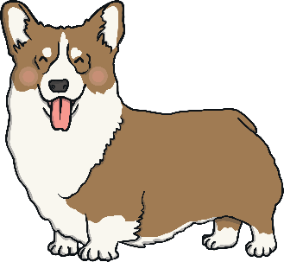
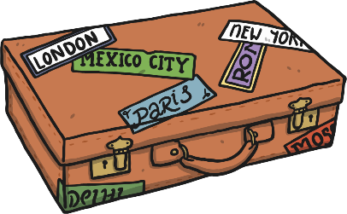
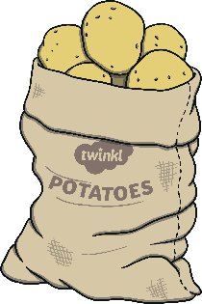
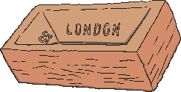
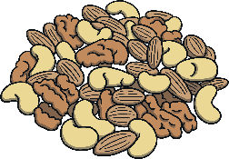
Grams or Kilograms?
Sort these pictures into two groups:
Objects you would measure in grams:
Objects you would measure in kilograms:
Click the pictures to reveal the answers.

Slide 7
Grams or Kilograms?
?
Which of these objects could you sensibly measure in both grams or kilograms?
Objects you would measure in grams:
Objects you would measure in kilograms:

Slide 8
Aim
To estimate and measure mass in grams and kilograms.
Success Criteria
I can use language related to mass.
I can estimate the weight of objects by handling them.
I can use scales to measure in grams and kilograms.

