Slide 1
Maths
Measurement
Year One
Maths | Year 2 | Measurement | Standard Units | Lesson 2 of 5: Messy Mixtures

Slide 2
Aim
To estimate and measure mass in grams and kilograms.
Success Criteria
I can use language related to mass.
I can read scales to measure in grams and kilograms.

Slide 3
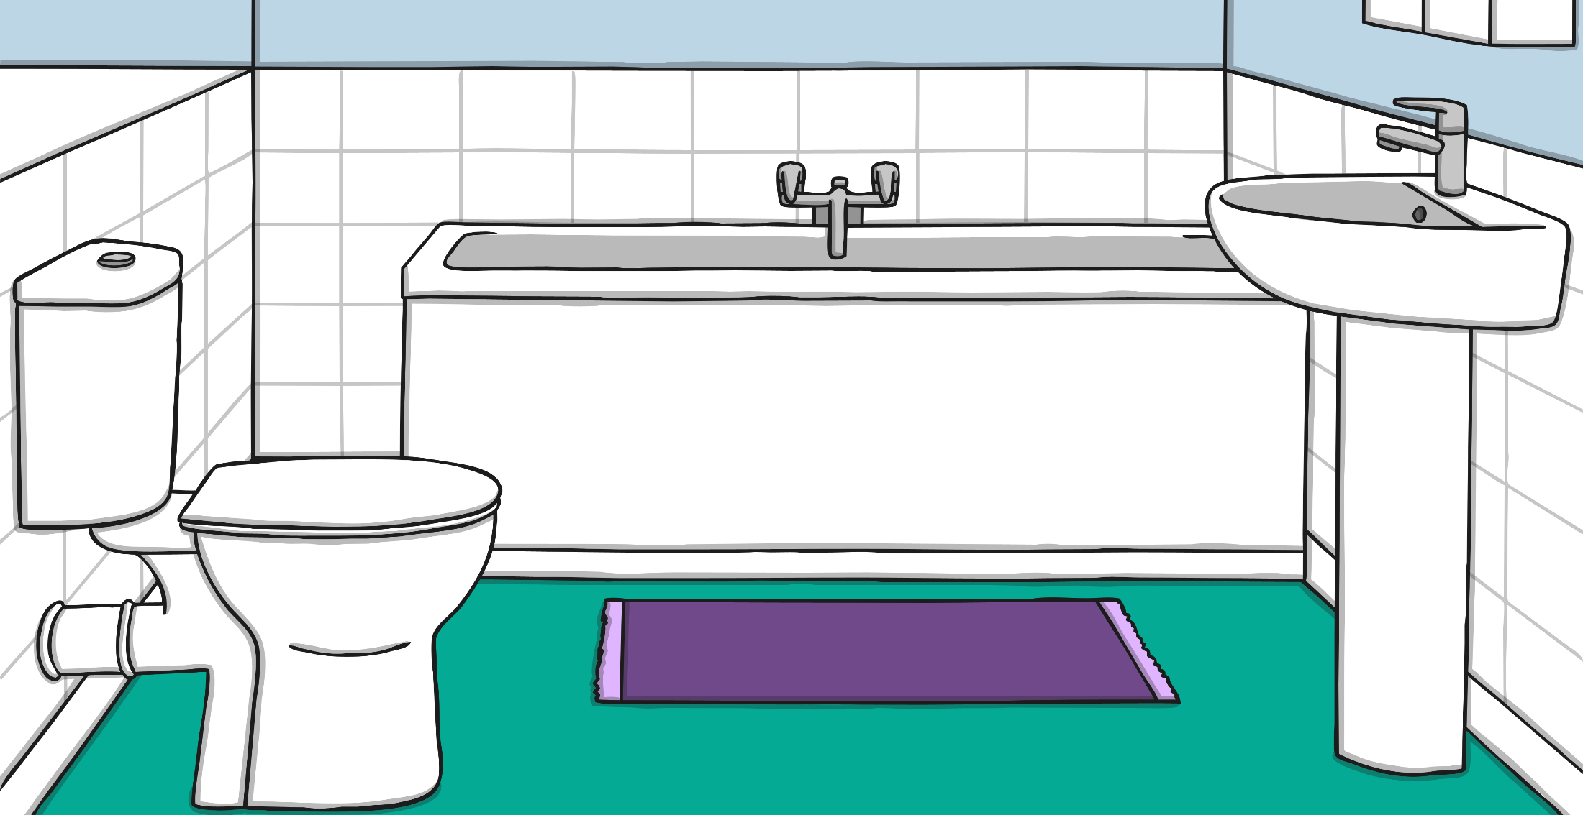
Reading Scales
Here are some bathroom scales. They measure kilograms.
40kg
Can you count in 10s along the scale?
20
30
10
40
0
50
kg
?
Where is the arrow pointing to on the scale?
How many kilograms are the scales measuring?

Slide 4
Reading Scales
Here are some bathroom scales. They measure kilograms.
10kg
20
30
10
40
0
50
kg
?
Where is the arrow pointing to on the scale?
How many kilograms are the scales measuring?

Slide 5
Reading Scales
Here are some bathroom scales. They measure kilograms.
15kg
The dial is between 10 and 20.
What number is half way between?
20
30
10
40
0
50
kg
?
Where is the arrow pointing to on the scale?
How many kilograms are the scales measuring?

Slide 6
Reading Scales
Here are some bathroom scales. They measure kilograms.
25kg
The dial is between 20 and 30.
What number is half way between?
20
30
10
40
0
50
kg
?
Where is the arrow pointing to on the scale?
How many kilograms are the scales measuring?

Slide 7
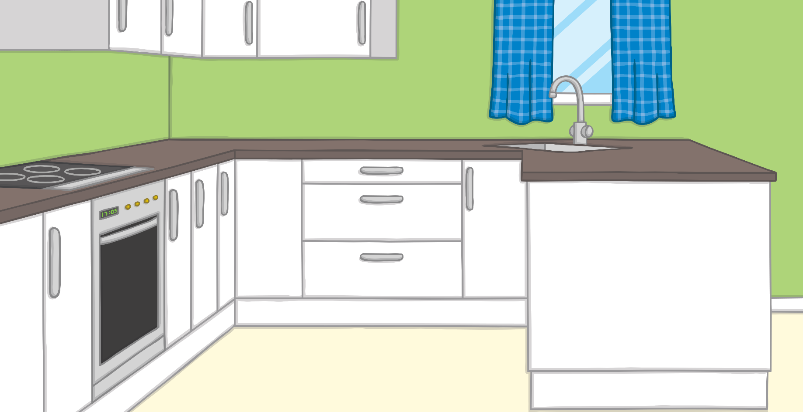
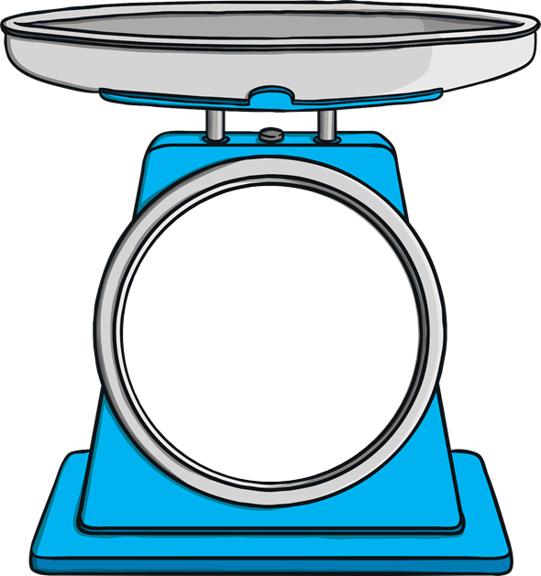
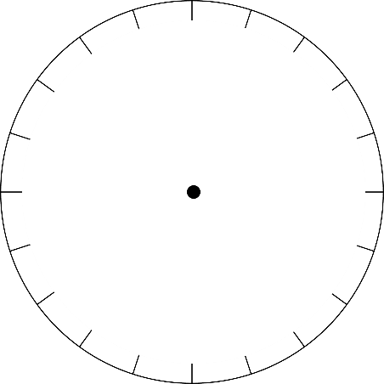
Reading Scales
Here are some kitchen scales. They measure grams.
10g
Can you count in 5s along the scale?
90
100
10
80
20
70
g
30
60
50
40
?
Where is the arrow pointing to on the scale?
How many grams are the scales measuring?

Slide 8
Reading Scales
Here are some kitchen scales. They measure grams.
75g
90
100
10
80
20
70
g
30
60
50
40
?
Where is the arrow pointing to on the scale?
How many grams are the scales measuring?

Slide 9
Reading Scales
Here are some kitchen scales. They measure grams.
50g
What is the maximum weight the scales can measure?
90
100
10
80
20
70
g
30
60
50
40
?
Where is the arrow pointing to on the scale?
How many grams are the scales measuring?

Slide 10
Reading Scales
Here are some kitchen scales. They measure grams.
97g
The arrow has just moved past 95g. Is it closer to 95g or 1000g?
90
100
10
80
20
70
g
30
60
50
40
?
Where is the arrow pointing to on the scale?
How many grams are the scales measuring?

Slide 11
Reading Scales
Here are some kitchen scales. They measure grams.
21g
The dial has just moved past 20g. Is it closer to 20g or 25g?
90
100
10
80
20
70
g
30
60
50
40
?
Where is the arrow pointing to on the scale?
How many grams are the scales measuring?

