Slide 1
List Poems

Slide 2
Unlike the other poems we’ve looked at, list poems don’t really have a set structure. They are simply a list of objects or actions based on a theme.
They don’t have to rhyme (but they can if you want).
The idea of a list poem is to be imaginative.
On the next few slides are some examples of list poems. Have a read…

Slide 3
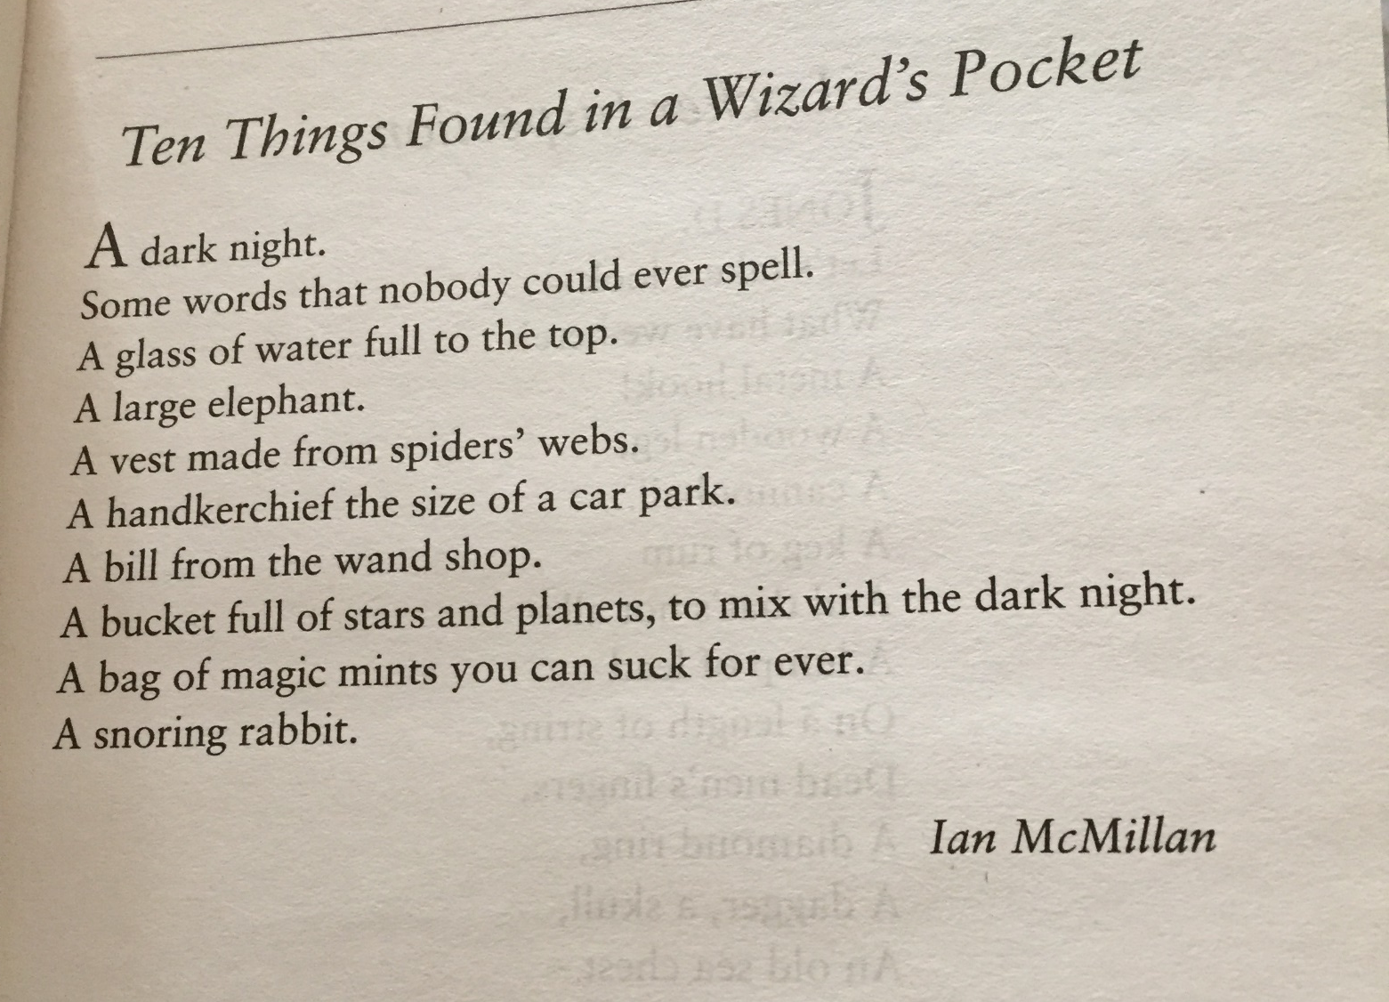

Slide 4
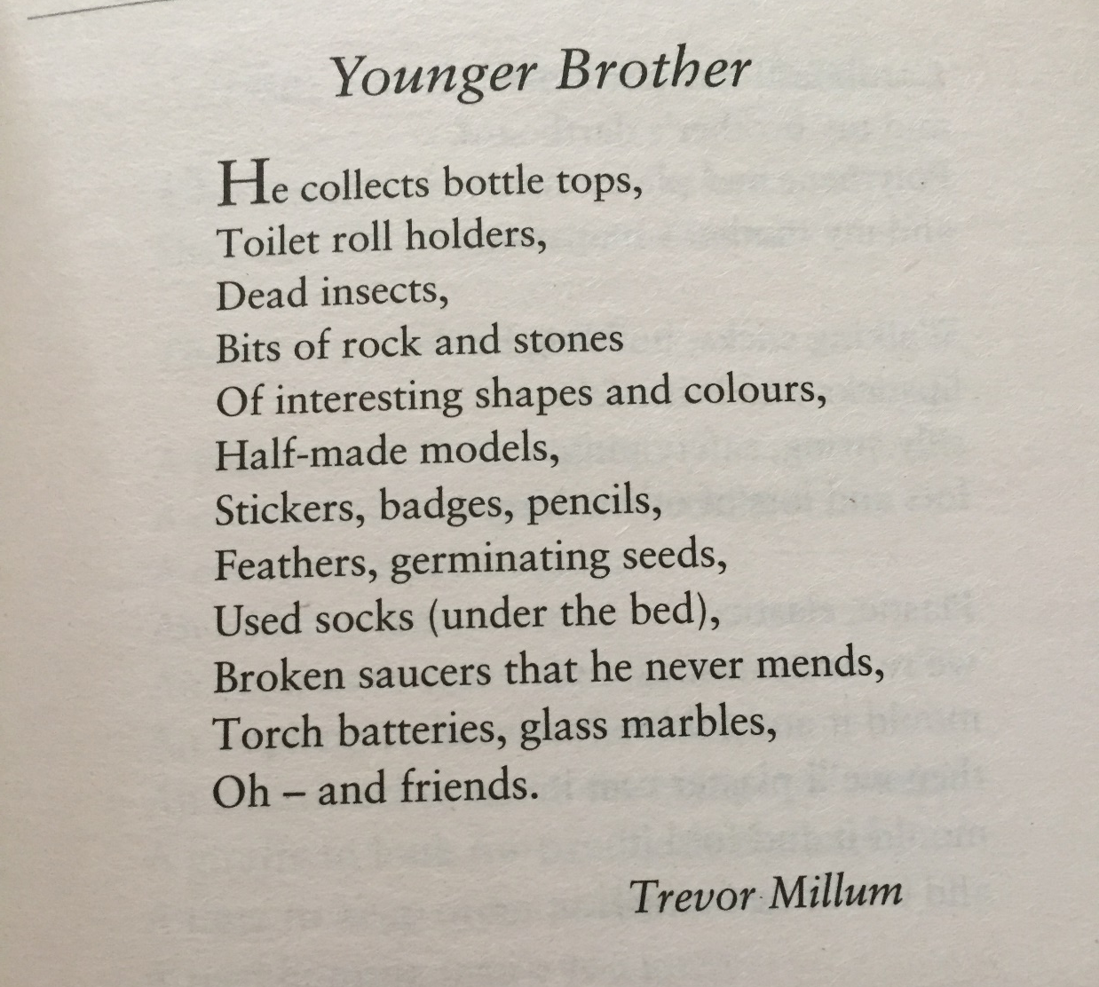

Slide 5
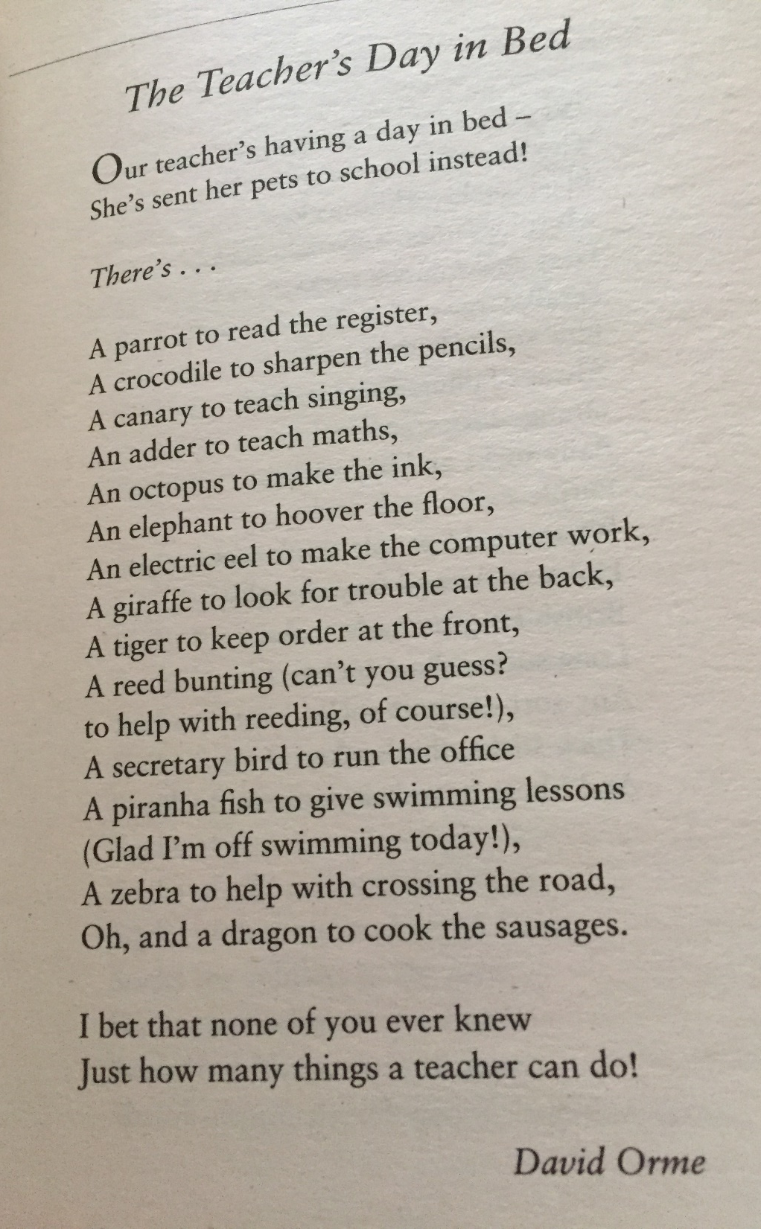
This poem’s a little different because it explains what each of the things in the list is actually for. So you can add a little detail.

Slide 6
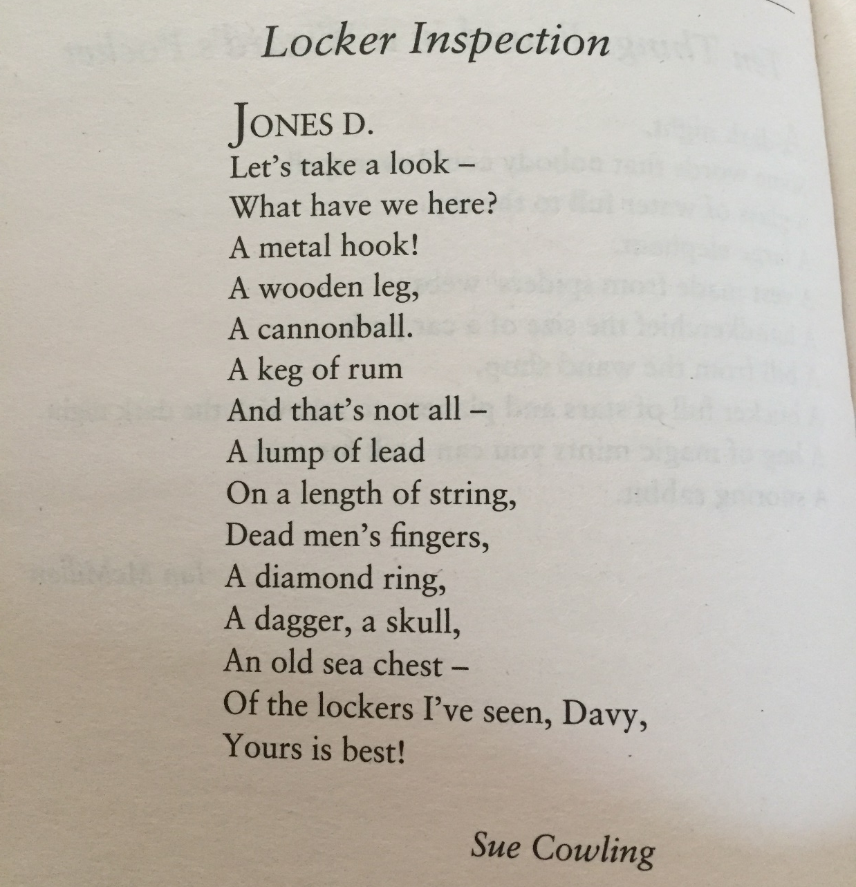

Slide 7
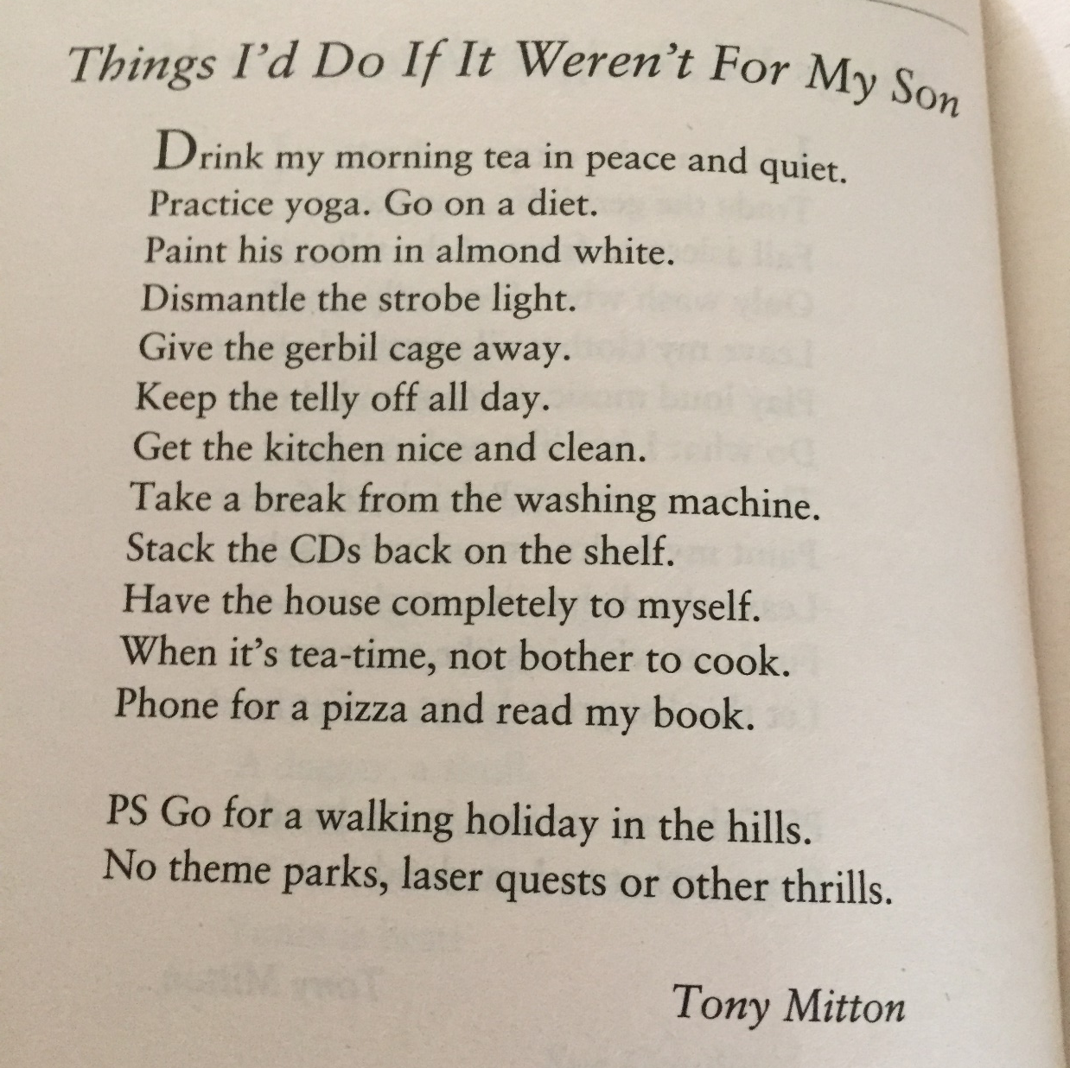

Slide 8
So as you can see, list poems are really just about using your imagination. There aren’t really any rules!
Now try writing your own list poem.
You could write your own version of ‘Things I’d Do if It Weren’t For My Son’ but change it to ‘Things I’d Do if It Weren’t For My Parents’ and include all the (very silly) things you could do if your parents didn’t stop you like ‘Eat sweets for every meal’
Or you could come up with your own ’10 things Found in a Wizard’s Pocket’ Or change ‘Wizard’ for one of your favourite book or film characters.
I’ve put some more possible ideas on the next slide but you’re welcome to come up with your own too.

Slide 9
Things I Saw on My School Trip to Ancient Egypt
Things My Dog Dreams About
10 Things Found in Willy Wonka’s Pocket
10 Things Found in a Princess’s Pocket
What My Toys Do When I’m At School
Things I saw on My School Trip to Atlantis
(Atlantis is a mythical city that is said to be under the sea
somewhere so you might see things like mermaids)
What My Hamster Does at Night

