Slide 2
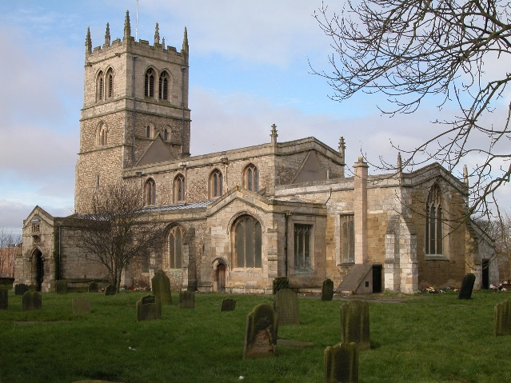
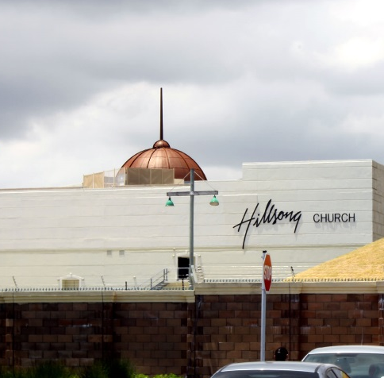
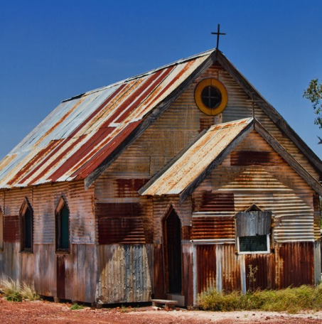
Starter Activity
All of these building look different, but what do they all have in common?
Who might visit them?
What might happen in them?
Photo courtesy of JamesCanby, aussiegall and warrenski (@flickr.com) - granted under creative commons licence – attribution

Slide 3
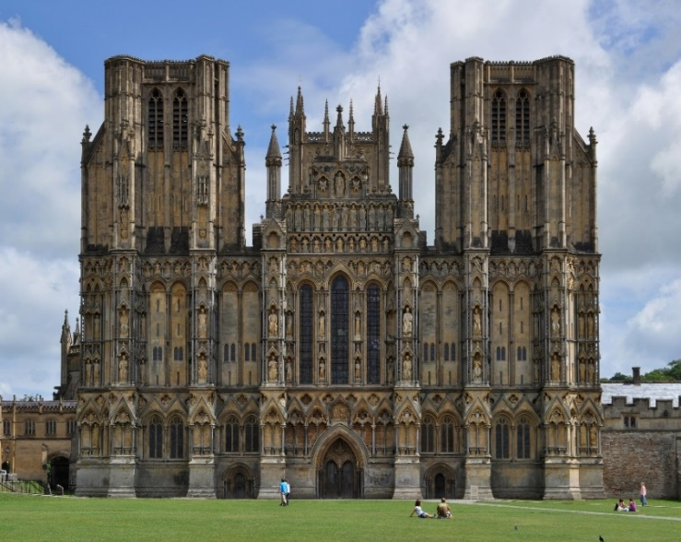
Churches throughout the world.
Church buildings throughout the world vary hugely!
Church buildings reflect the people who built them, when they were built and the needs of the Christians who worship in them.
1
2
Here are two churches in the UK.
How might each church reflect who built them?
How might location have affected how big each church needed to be?
Photo courtesy of seiser+seiser and eamon123 (@flickr.com) - granted under creative commons licence – attribution

Slide 4
Churches throughout the world.
1
Wells Cathedral, Wells
Wells Cathedral was planned by a Bishop in 1175. It was built to be the seat of the Bishop (an important Christian leader).
The church is so grand because it was meant to be the central building for Christianity in its area of the country.
2
Sutton-on-the-Hill Methodist Chapel, Derbyshire
This chapel was built by the Methodist church.
It was built to serve a very small, rural village, so small that it doesn’t have a shop. Therefore the church could be simple and small.
Photo courtesy of seiser+seiser and eamon123 (@flickr.com) - granted under creative commons licence – attribution

Slide 5
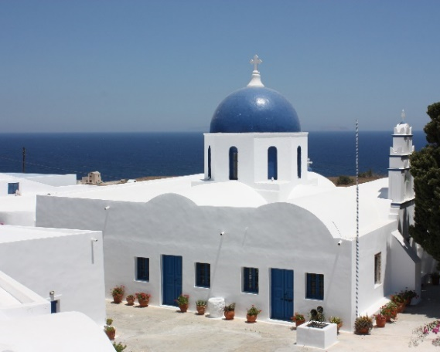
Churches throughout the world.
Here are some more examples of how churches around the word reflect the people who built them and who worships in them.
Hillsong Church in Cape Town, South Africa.
The modern building reflects a modern way of worshipping.
Congregations here worship with rock music and dress casually.
St. Artemios church, Santorini, Greece
This old church building reflects the local architecture of the island.
Many people on Santorini would have felt very connected to the sea, perhaps this is why the church and other buildings are blue and white?
Photo courtesy of warrenski and Arian Zwegers (@flickr.com) - granted under creative commons licence – attribution

Slide 6
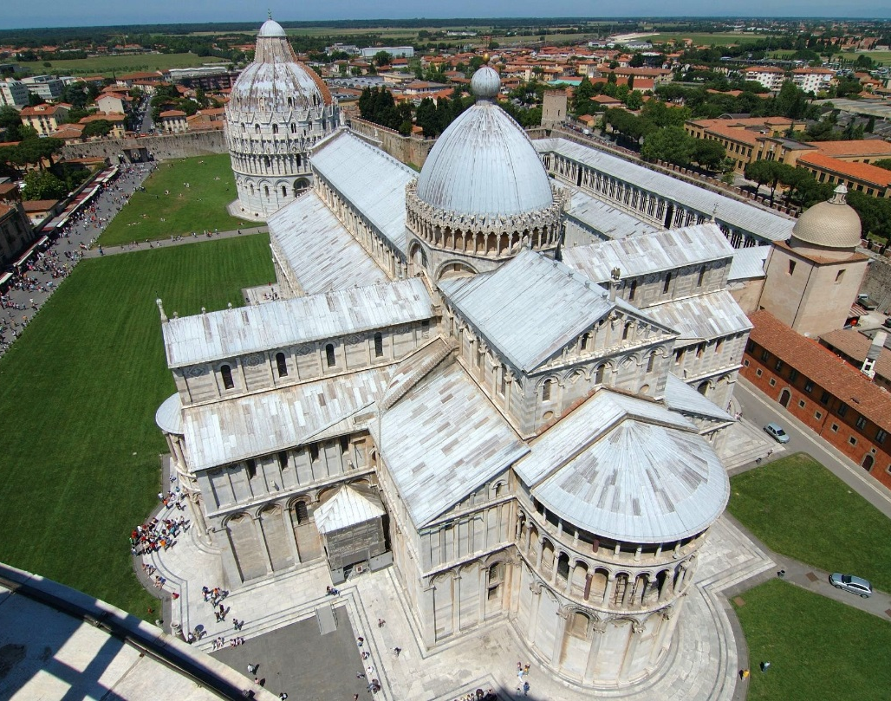
Look out for these other special features!
Some churches or cathedrals are built in the shape of the cross. Why do you think this is?
?
Photo courtesy of gaspa (@flickr.com) - granted under creative commons licence – attribution

Slide 7
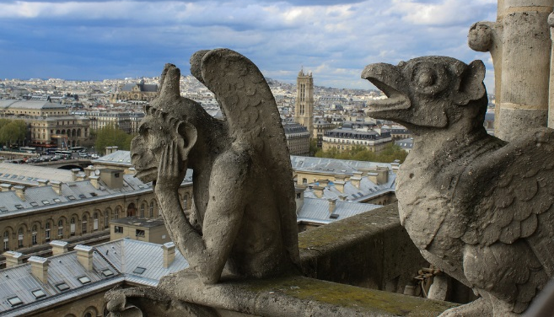
Look out for these other special features!
Many older churches have gargoyles carved into the stone.
Gargoyles are strange looking creatures which were believed to scare away evil spirits.
Many churches also have a bell tower.
This is the home to the bell which is rung before a service to let people know it is time for worship.
Photo courtesy of Andy Hay, LenDog64 and Sharon Mollerus (@flickr.com) - granted under creative commons licence – attribution

Slide 8
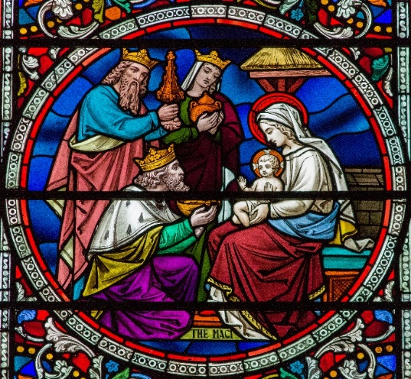
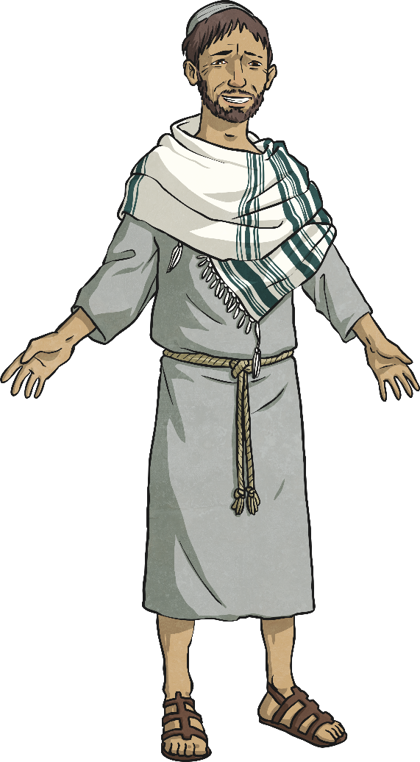
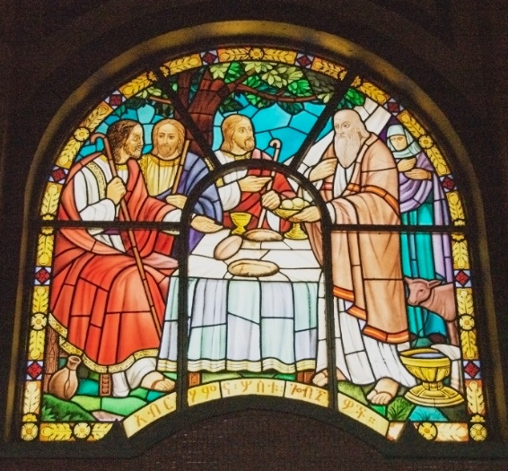
Look out for these other special features!
Stained glass windows often appear in Christian churches depicting the life of Jesus.
Photo courtesy of J.P.Guffogg and A.Davey (@flickr.com) - granted under creative commons licence – attribution

Slide 9
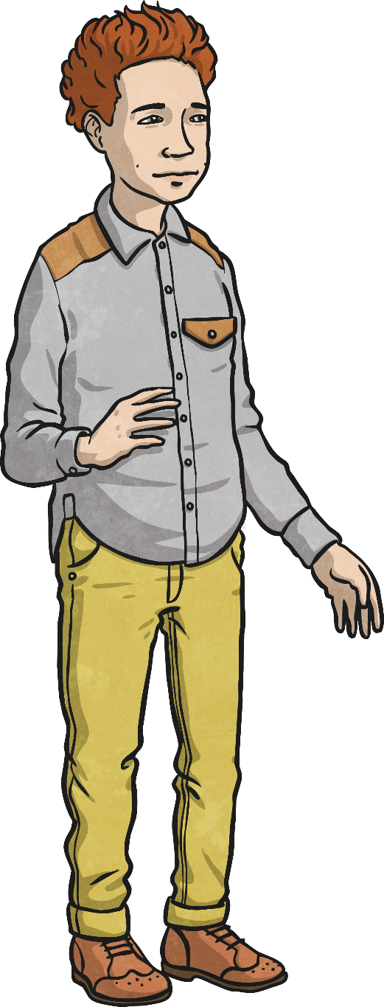
Things you might find in a church.
If you went into a church in this country, talk to your partner about what you might find.

Slide 10
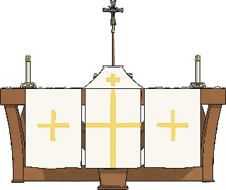
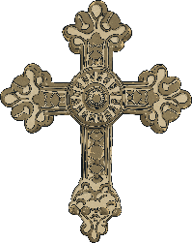
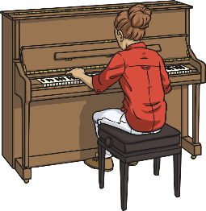
Things you might find in a church.
Altar: The table at the very front of the church which holds the bread and wine.
Cross: This is the symbol of Christianity because Jesus died on a cross.
Candle: Candles are common in churches as they represent Jesus as the light of the world.
Organ: An instrument played to accompany traditional hymns.
Musical Instruments: Christians can worship God using a wide variety of instruments, from guitars to cellos.

Slide 11
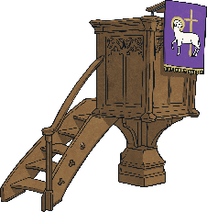
Things you might find in a church.
Font: This is where part of the Baptism service takes place. The font holds Holy water.
Seating Area: The people who come to church services are called the congregation and they sit here. Some churches have long wooden pews or individual chairs.
Lectern: Where the Bible sits. Readings are read from here during a service.
Pulpit: A raised platform from which the church leader can teach from the Bible.

Slide 12
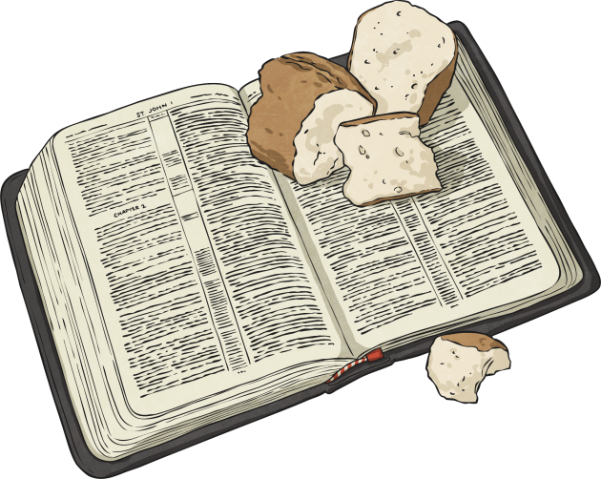
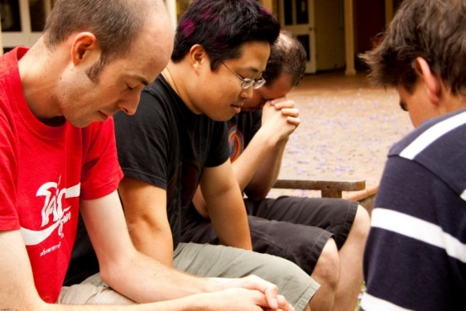
Why do people go to church?
Christian churches hold services of worship every Sunday. There are usually other events happening at churches throughout the week such as bible studies, social events and prayer nights.
Christians go to church to praise God together as a group, and to build friendships with other Christians (called fellowship) and learn from the Bible together.
Photo courtesy of SMBCollege (@flickr.com) - granted under creative commons licence – attribution

Slide 13
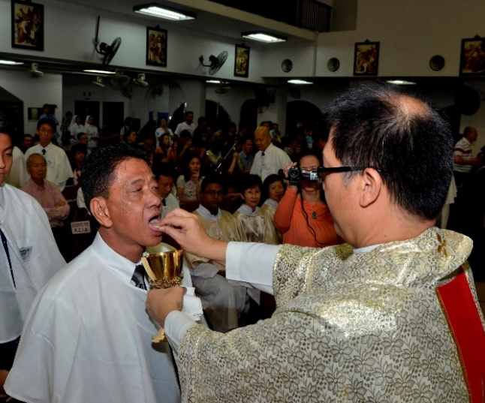
Why do people go to church?
During a Sunday service, the congregation will usually sing hymns and songs together as a way of worshipping God, and listen to Bible teaching and readings together.
Christians also receive ‘Holy communion’ at church. This is where some Christians drink wine and eat bread to remember the events of the last supper. With the wine they remember Jesus’ blood and with the Bread they remember Jesus’ body, when he was crucified on the cross.
Jesus took bread and wine and shared it with his disciples the night before he was killed. This is known as The Last Supper.
Photo courtesy of Simon Chumkat (@flickr.com) - granted under creative commons licence – attribution

Slide 14
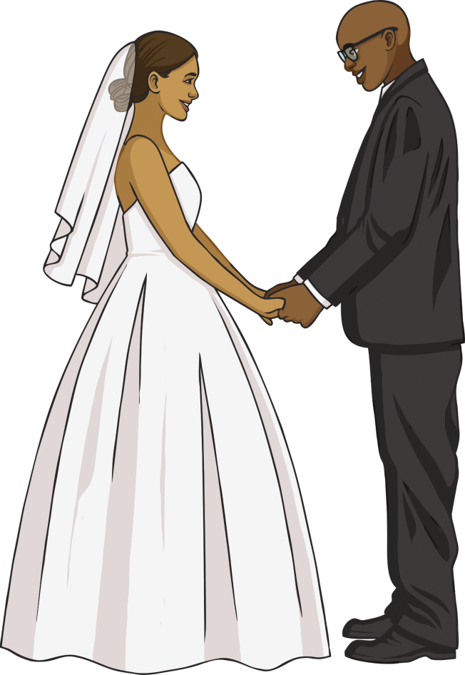
Important Occasions in Church
Weddings
A Christian church wedding is a special ceremony where a bride and groom come together to declare their love and devotion to one another in front of God, family and friends.
The couple make important promises in front of God, and there are Bible readings and worship songs.
The bride usually wears a white gown and rings are exchanged as a symbol of never ending love.

Slide 15
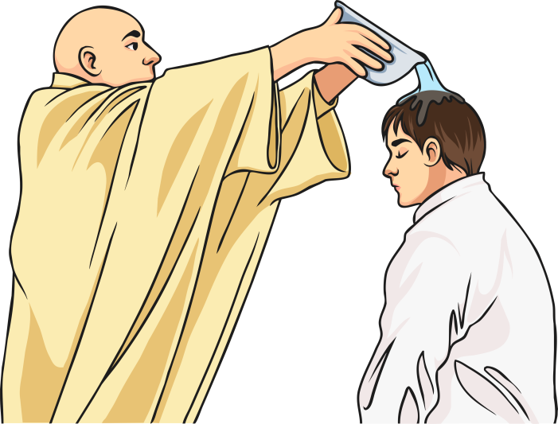
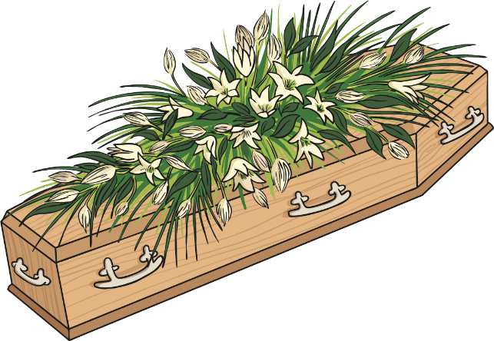
Important Occasions in Church
Baptisms - This is also known as a Christening. At somebody’s baptism, the church officially welcome them into God’s family.
Both babies or adults can be baptised. The vicar can pour Holy water over the person’s head, dunk their head in Holy water or fully immerse the person in Holy water.
This is done because John the Baptist baptised Jesus like this in the Bible.
Funerals - When a Christian dies, a funeral is held for family and friends.
This is a chance for everyone to say goodbye and to thank God for their life.

Slide 16
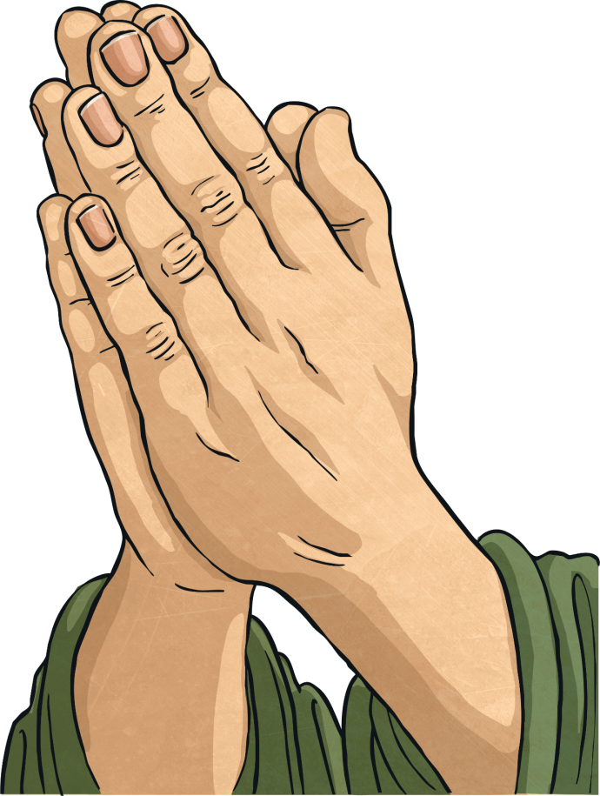
Worship at Home
Many Christians say prayers at home too. They might be prayers asking for help, or saying thank you for something.
At home Christians may pray on their own, with their family or even with groups of other Christians.
Some Christians have their church services in peoples homes. Sometimes this is by choice, but Christians in some parts of the world have to meet secretly in homes because Christianity is banned in their country.

