Slide 1
Adding the suffix -ous to words of more than one syllable

Slide 2
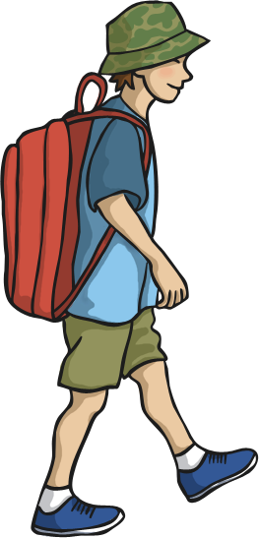
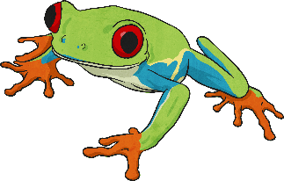
One day Oliver wants to be a fame explorer.
Which of the spellings below is correct, after the suffix has been added?
fameous
famous

Slide 3
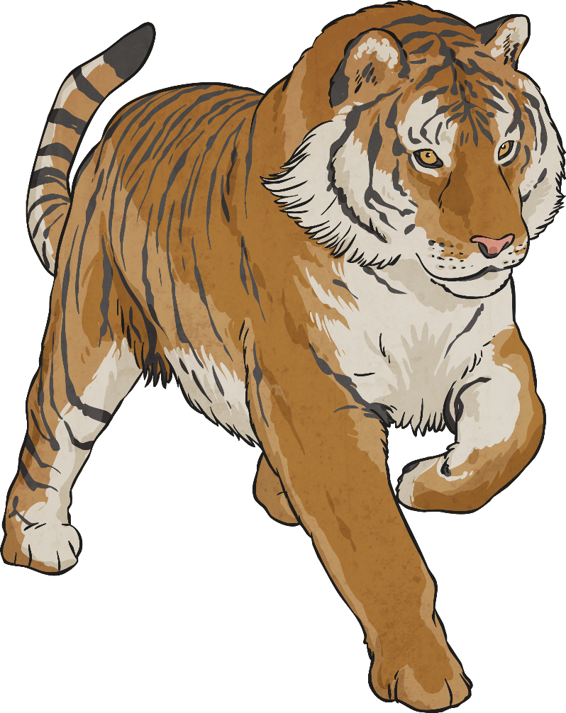
Correct! Well done!

Slide 4
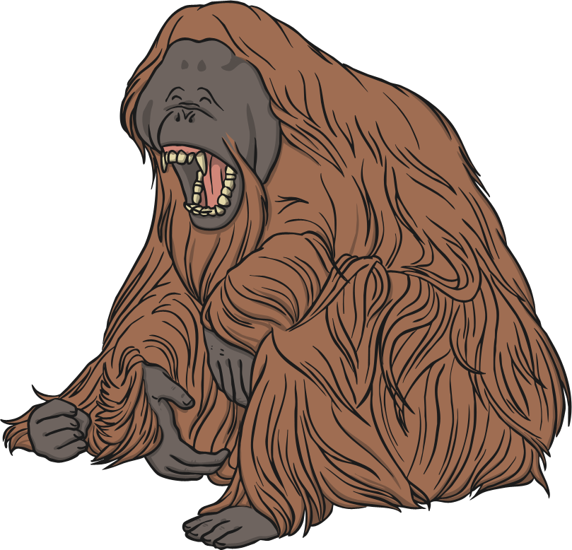
Oh no! Try again!

Slide 5
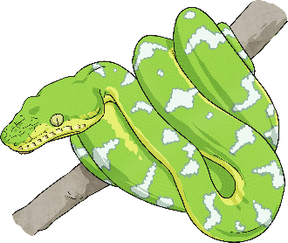
Tigers and bears are both carnivore animals.
Which of the spellings below is correct, after the suffix has been added?
carnivorous
carnivoreous

Slide 6
Correct! Well done!

Slide 7
Oh no! Try again!

Slide 8
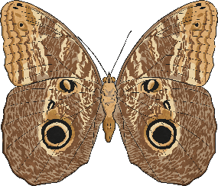
Being an explorer can be very hazard.
Which of the spellings below is correct, after the suffix has been added?
hazardous
hazarous

Slide 9
Correct! Well done!

Slide 10
Oh no! Try again!

Slide 11
Oliver was joy when he found a new species of plant in the rainforest.
Which of the spellings below is correct, after the suffix has been added?
joyous
joyus

Slide 12
Correct! Well done!

Slide 13
Oh no! Try again!

Slide 14
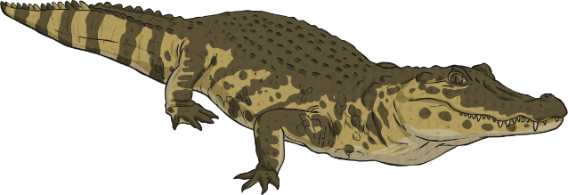
Oliver was an adventure traveller.
Which of the spellings below is correct, after the suffix has been added?
adventurous
adventous

Slide 15
Correct! Well done!

Slide 16
Oh no! Try again!

Slide 17
The hippo is considered Africa’s most danger animal.
Which of the spellings below is correct, after the suffix has been added?
dangrous
dangerous

Slide 18
Correct! Well done!

Slide 19
Oh no! Try again!

