Slide 1
Maths
Statistics
Year One
Maths | Year 3 | Statistics | Questions about Data Presented in Bar Charts, Pictograms and Tables | Lesson 3 of 5: Either, Both or None

Slide 2
Either, Both or None

Slide 3
Aim
I can interpret data in a simple Venn diagram.
Success Criteria
I can create a Venn diagram.
I can answer questions about a Venn diagram.
I can ask questions about a Venn diagram.

Slide 4
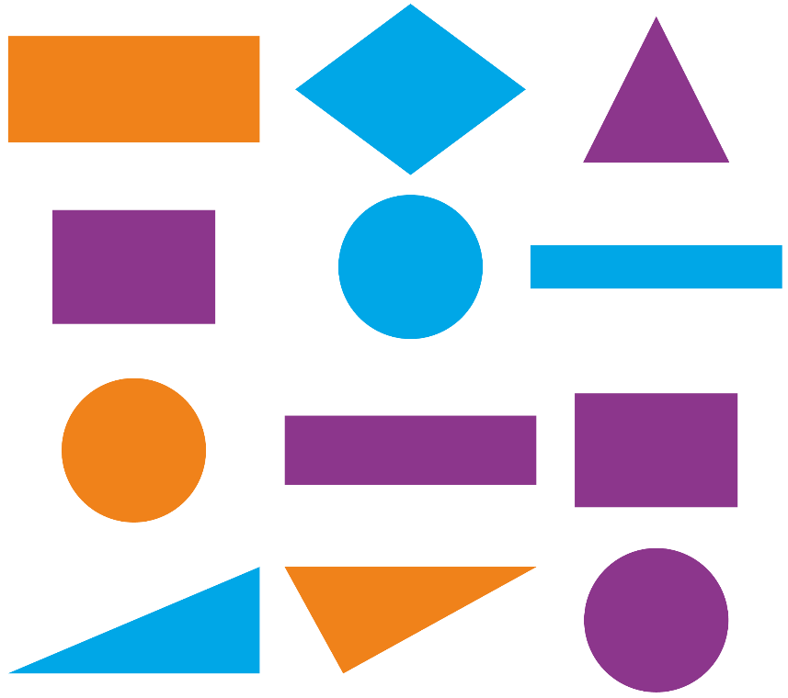
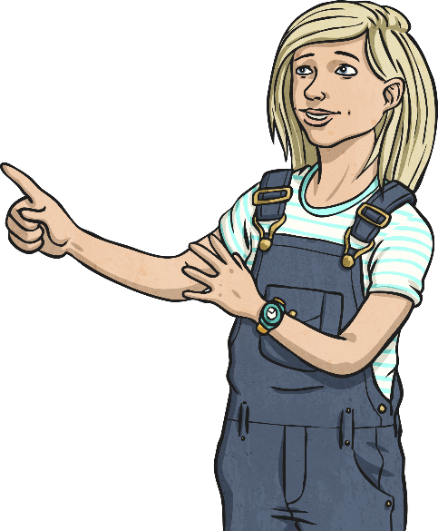
Comparing Objects
Look at the objects below.
Listen carefully to the questions you’re asked.
How many shapes are triangles and blue?
How many shapes are either blue or orange?
How many shapes are neither orange nor purple?
How many shapes are circles and blue?
How many shapes are circles or blue?
How many shapes are neither circles nor triangles?
1
7
4
1
6
6

Slide 5
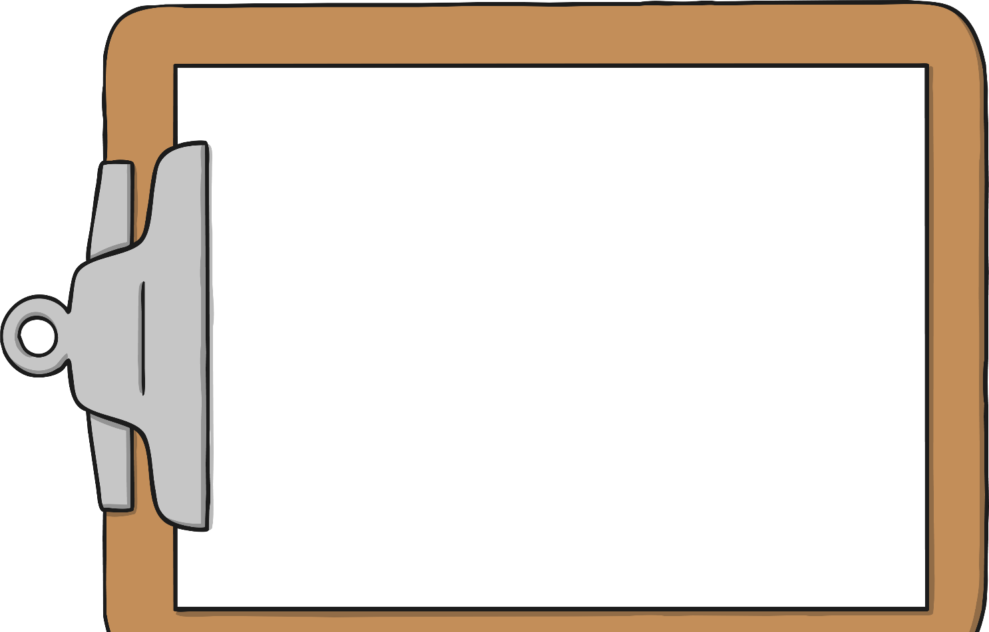
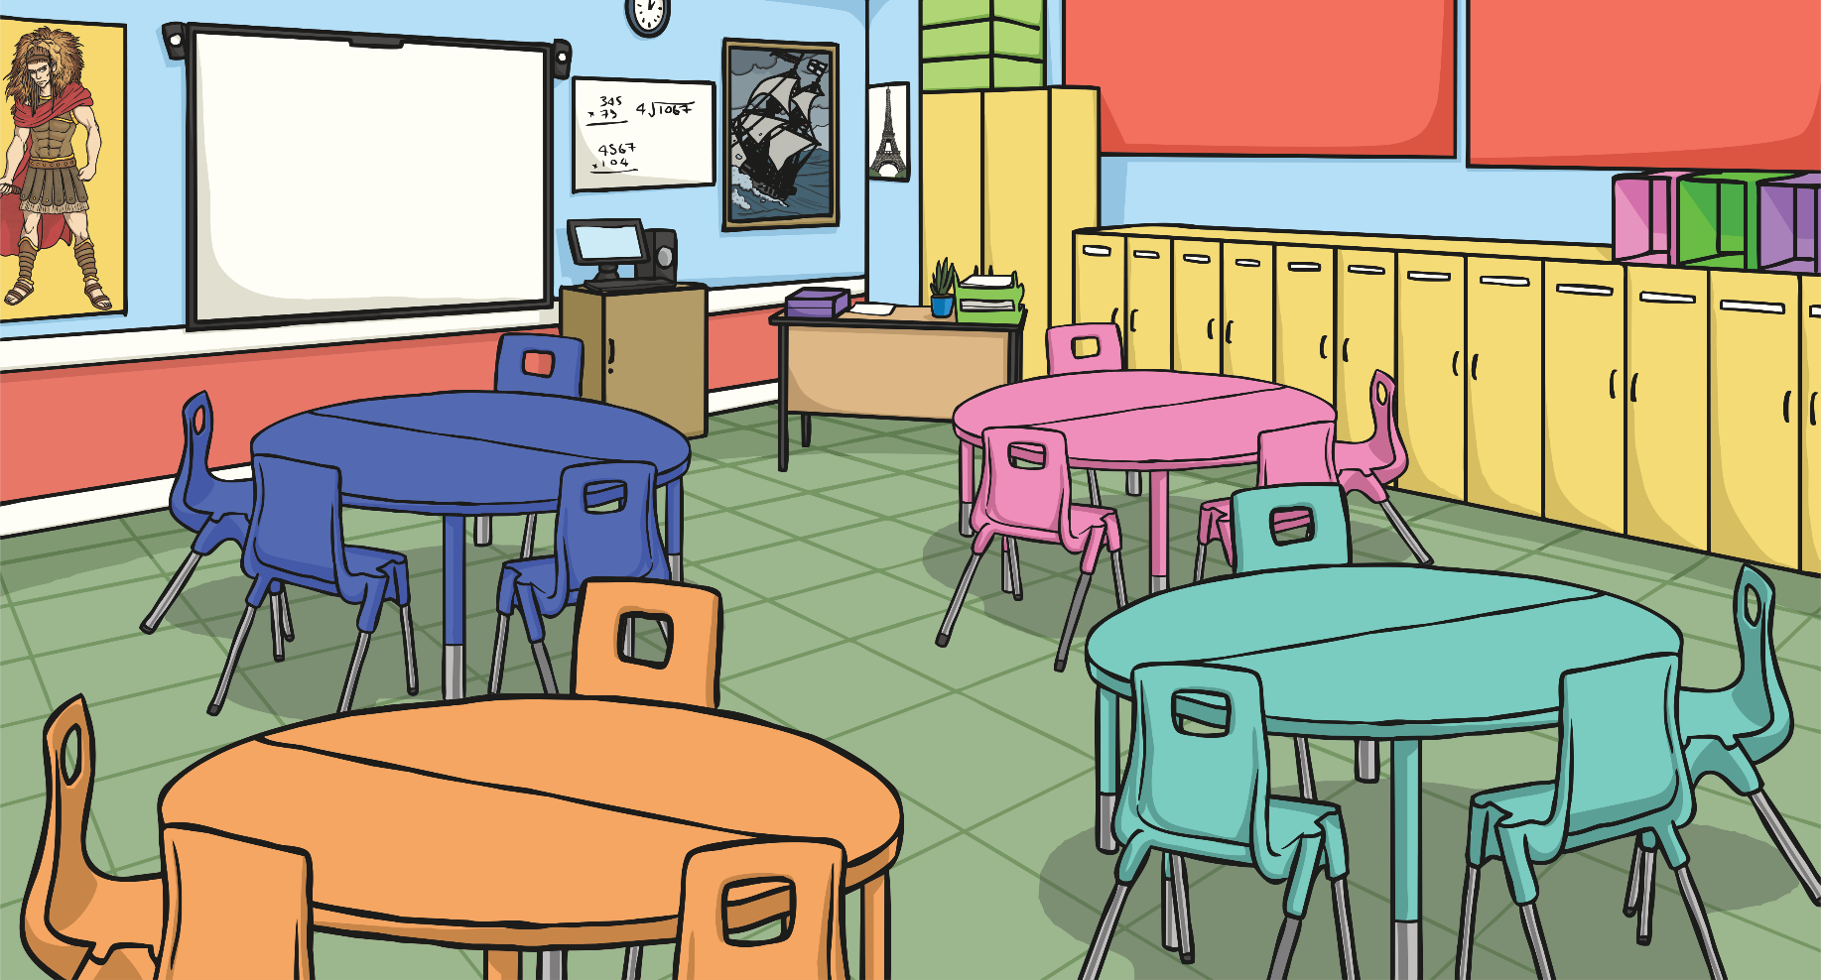
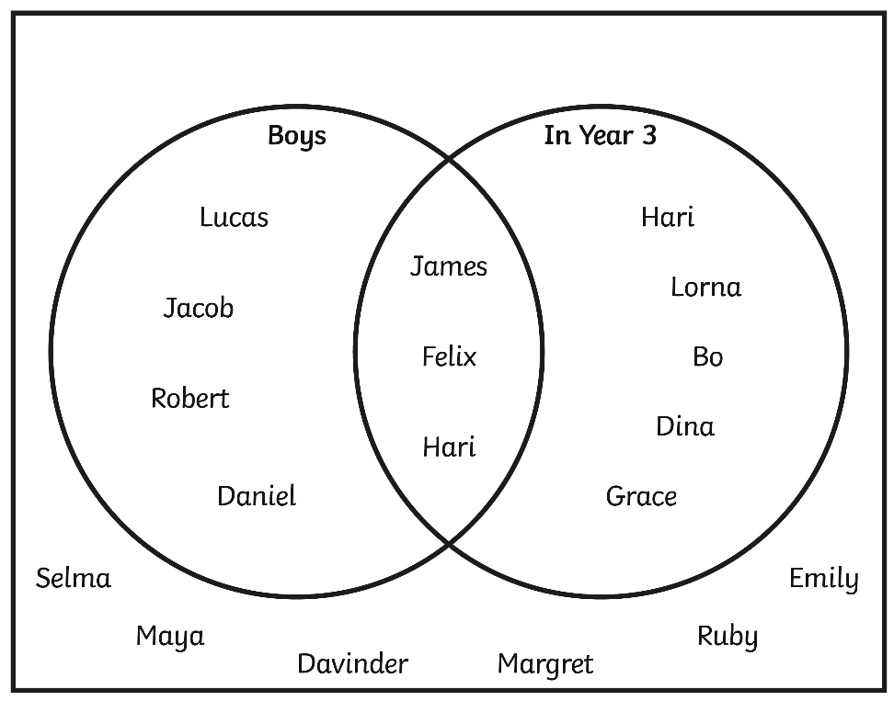
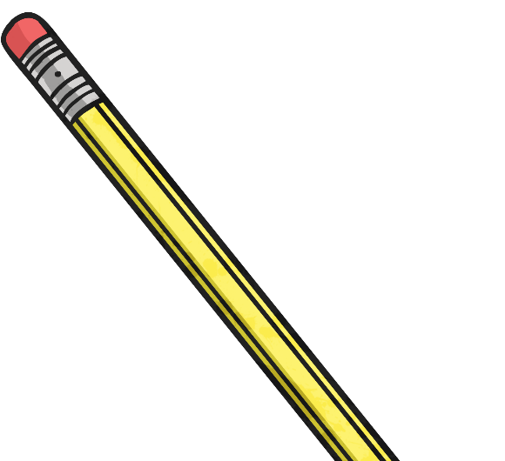
Features of Venn Diagrams
A Venn diagram shows four sets of information.
A set that are in both groups.
A set that are in the first group.
A set that are in the second group.
Hannah
A final set that are in neither group.

Slide 6
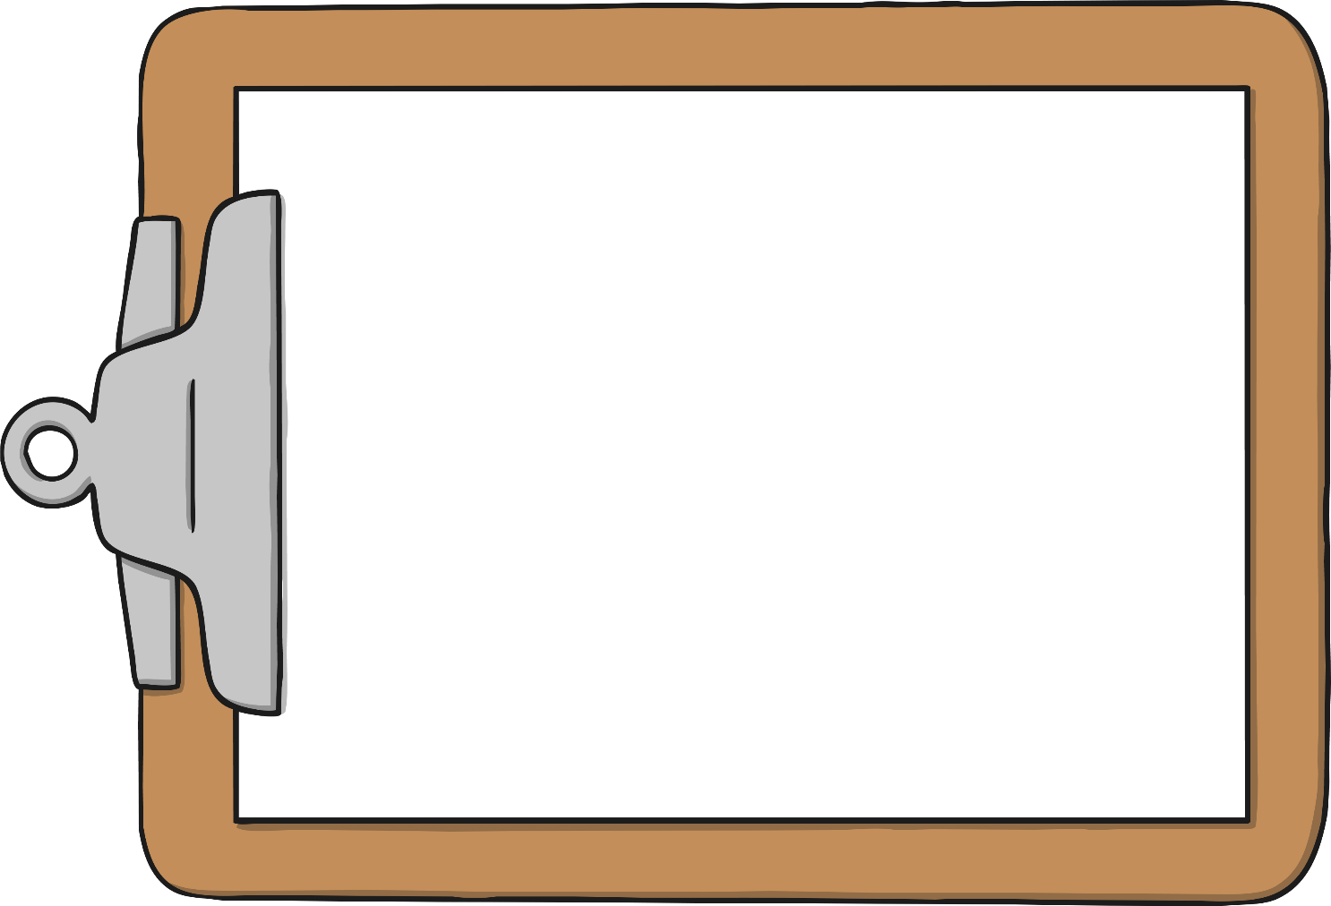
Features of Venn Diagrams
What information does this chart give you?
What can you tell your partner about James? Ruby? Robert?
Where would your name go in the diagram?
Hannah

Slide 7
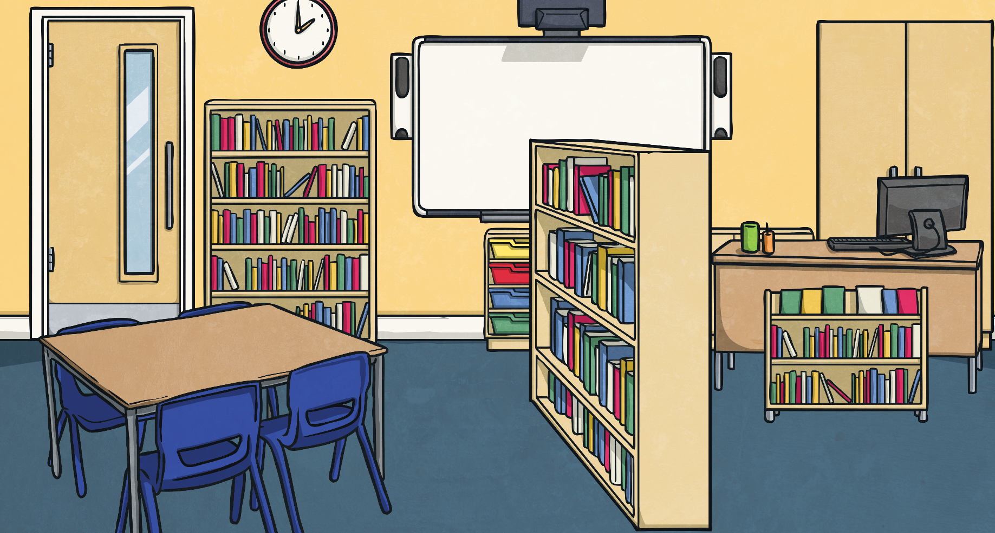
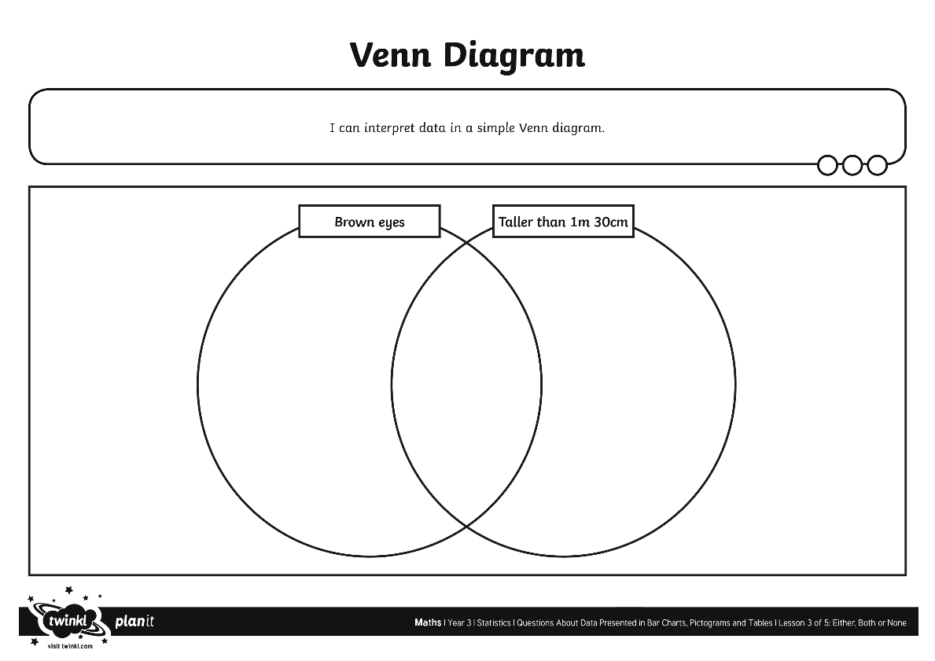
Creating a Venn Diagram
Use the data from the database cards to create a Venn diagram.

Slide 8
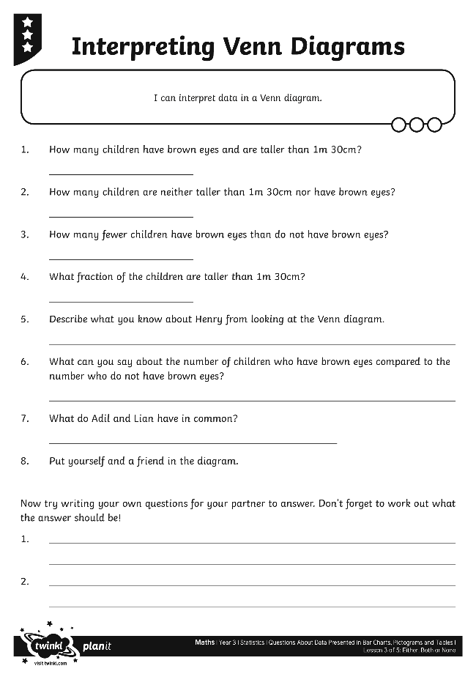
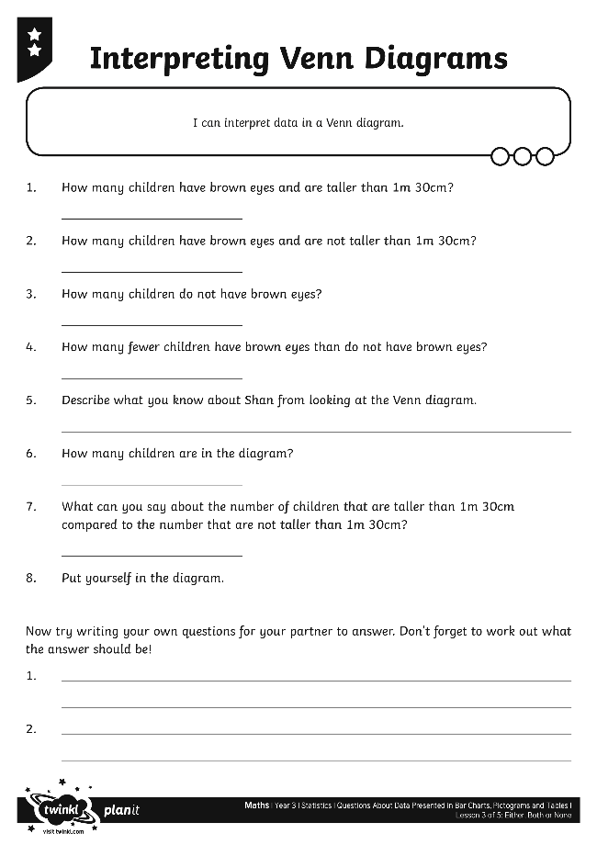
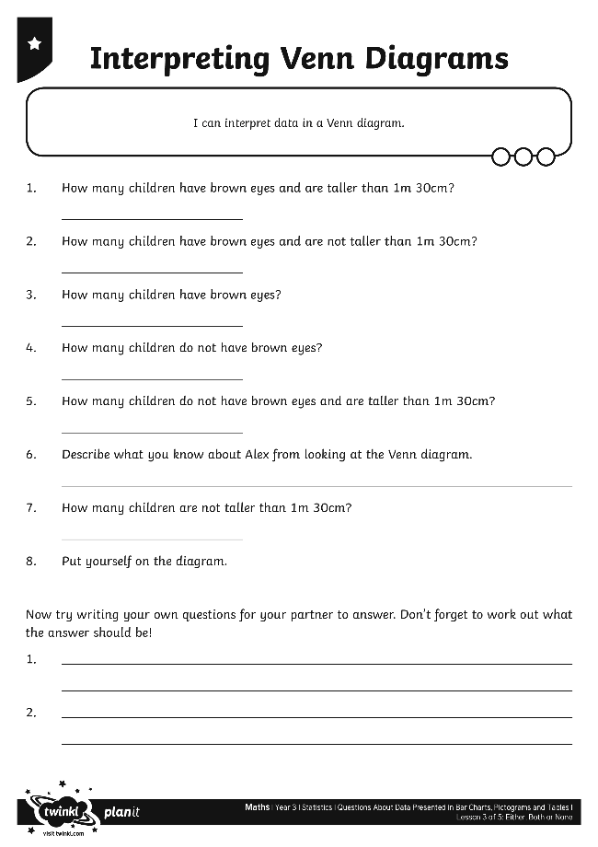
Venn Diagram Questions
Now, we need to look closely at our Venn diagram and the information in it to answer some questions.

Slide 9
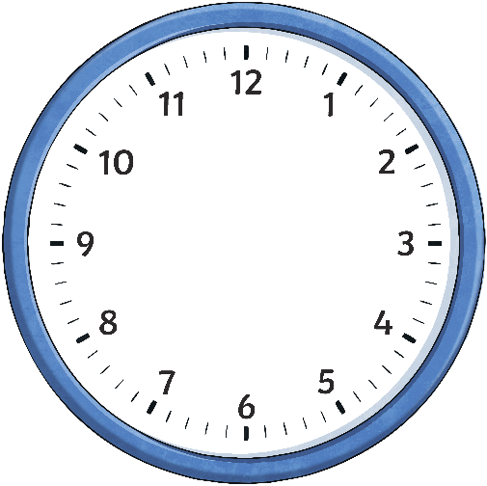
Diagram Dash
You have five minutes to create a Venn diagram using the blank template.
You can use whatever information you like.
You must fill in the labels.
You can draw, write, or use objects.
Times Up!
You must have at least one piece of information in each section of the diagram. Include more if you have time.
Be prepared to tell the class what your diagram shows!
Click the clock for a five minute timer.

Slide 10
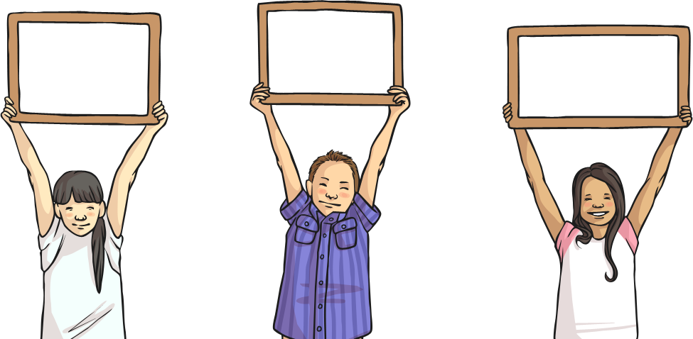
Diagram Dash
What does your Venn diagram show?

Slide 11
Aim
I can interpret data in a simple Venn diagram.
Success Criteria
I can create a Venn diagram.
I can answer questions about a Venn diagram.
I can ask questions about a Venn diagram.

