Slide 1
Maths
Measurement
Year One
Maths | Year 3 | Measurement | Measure, Compare, Add and Subtract Units of Measurement | Lesson 1 of 5: Measuring in Millilitres

Slide 2
Measuring in Millilitres

Slide 3
Aim
I can measure volume in millilitres.
Success Criteria
I can calculate the intervals on a scale.
I can read scales to measure in millilitres.

Slide 4
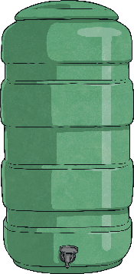
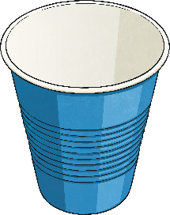
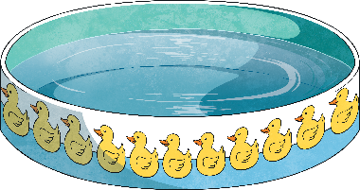
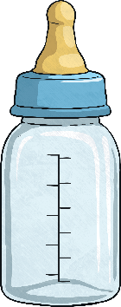
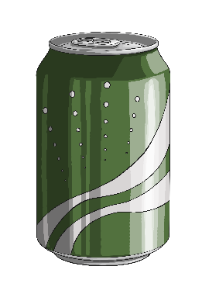
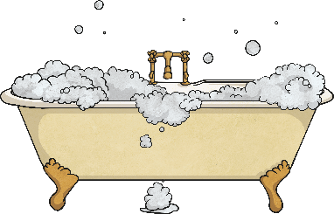
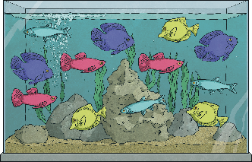
Litres or Millilitres?
Sort these containers into those that hold litres
and those that hold millilitres.
Click the picture to reveal the place.
millilitres
litres

Slide 5
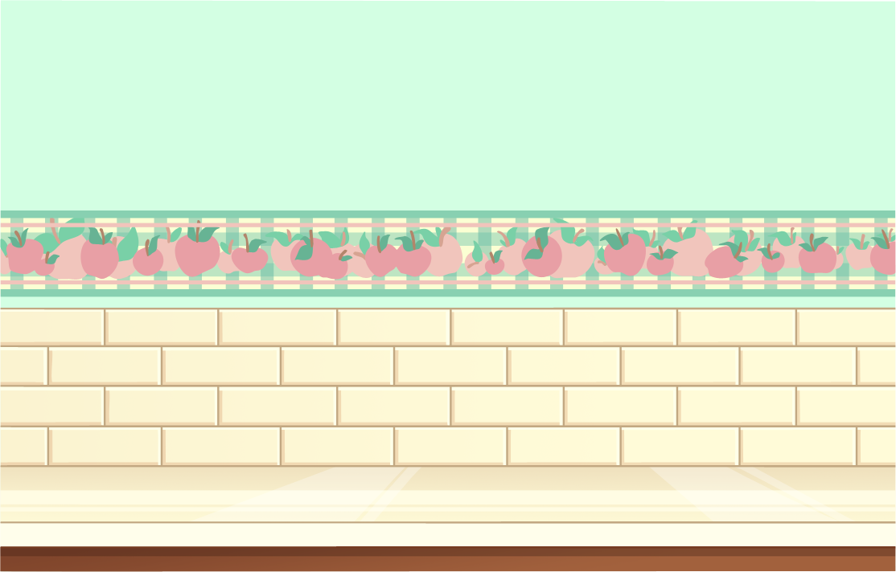
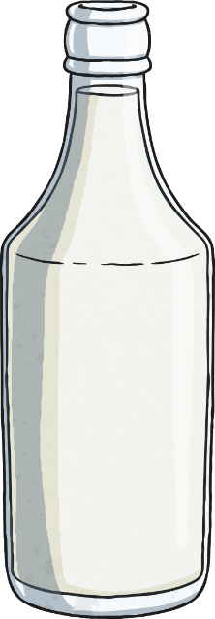
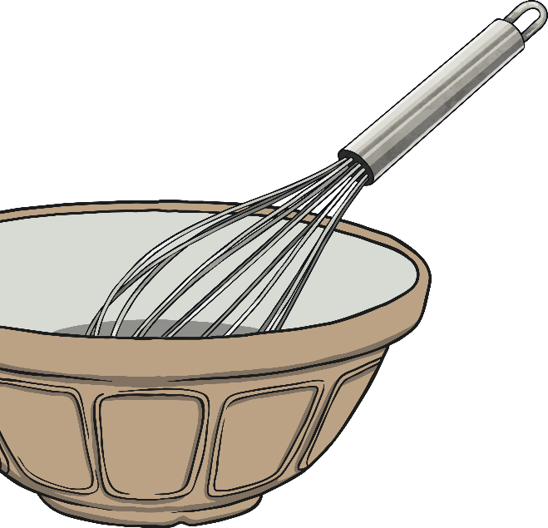
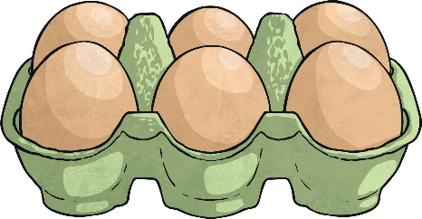
Volume or Capacity?
Before we begin our work on volume and capacity, let’s make sure we understand what these two words mean.
This measuring jug measures up to 500ml. We say that it has a capacity of 500ml.
Capacity is the total amount of liquid that a container can hold.
In this measuring jug, there is 300ml of liquid. The volume is 300ml.
Volume is the amount of liquid that is actually in a container.

Slide 6
Volume or Capacity?
What is the capacity and what is the volume of this jug?
This measuring jug has a capacity of 250ml.
The volume of the liquid
is 200ml.

Slide 7
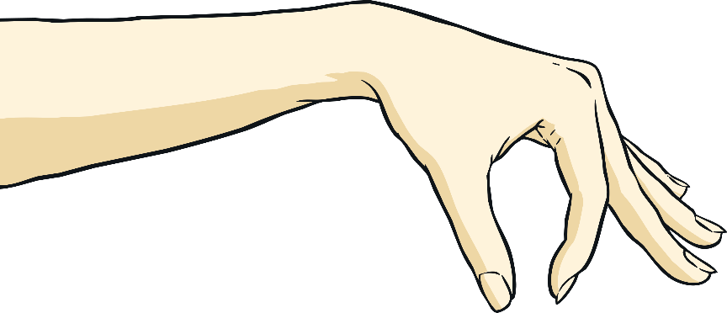
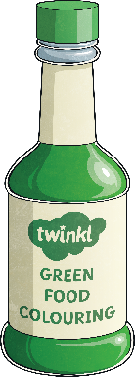
Measuring Volume in Millilitres
A millilitre is a very small amount.
A teaspoon measures 5ml. A small bottle of food colouring measures 50ml.
We can use a measuring cylinder or jug to measure volume.
1ml of liquid is just a tiny drop.

Slide 8
Measuring Cylinders
The first thing that you need to do is to work out what each interval
of the scale on the measuring cylinder represents.
On this scale, there are 10 intervals between 0 and 100ml. To work out what each interval is worth we divide 100 by 10.
100 ÷ 10 = 10, so each interval is worth 10ml.
Look at the level of the liquid. It is at 300ml plus 2 intervals.
300ml + 20ml = 320ml

Slide 9
Measuring Cylinders
This is the same scale.
How much liquid is in the measuring cylinder now?
Look at the level of the liquid. It is at 400ml plus 6 intervals.
400ml + 60ml = 460ml

Slide 10
Measuring Cylinders
The first thing that you need to do is to work out what each interval
of the scale on the measuring cylinder represents.
On this scale, there are 2 intervals between 0 and 100ml. To work out what each interval is worth, we divide 100 by 2.
100 ÷ 2 = 50, so each interval is worth 50ml.
Look at the level of the liquid. It is at 400ml plus 1 interval.
400ml + 50ml = 450ml

Slide 11
Measuring Cylinders
This is the same scale.
How much liquid is in the measuring cylinder now?
Look at the level of the liquid. It is at is 200ml plus 1 interval.
200ml + 50ml = 250ml

Slide 12
Measuring Cylinders
The first thing that you need to do is to work out what each interval
of the scale on the measuring cylinder represents.
On this scale, there are 4 intervals between 0 and 100ml. To work out what each interval is worth, we divide 100 by 4.
100 ÷ 4 = 25, so each interval is worth 25ml.
Look at the level of the liquid. It is at 400ml plus 2 intervals.
400ml + 50ml = 450ml

Slide 13
Measuring Cylinders
This is the same scale.
How much liquid is in the measuring cylinder now?
Look at the level of the liquid. It is at 300ml plus 3 intervals.
300ml + 75ml = 375ml

Slide 14
Measuring Cylinders
The first thing that you need to do is to work out what each interval
of the scale on the measuring cylinder represents.
On this scale, there are 5 intervals between 0 and 100ml. To work out what each interval is worth, we divide 100 by 5.
100 ÷ 5 = 20, so each interval is worth 20ml.
Look at the level of the liquid. It is at 200ml plus 4 intervals.
200ml + 80ml = 280ml

Slide 15
Measuring Cylinders
This is the same scale.
How much liquid is in the measuring cylinder now?
Look at the level of the liquid. It is at 400ml plus 1 interval.
400ml + 20ml = 420ml

Slide 16
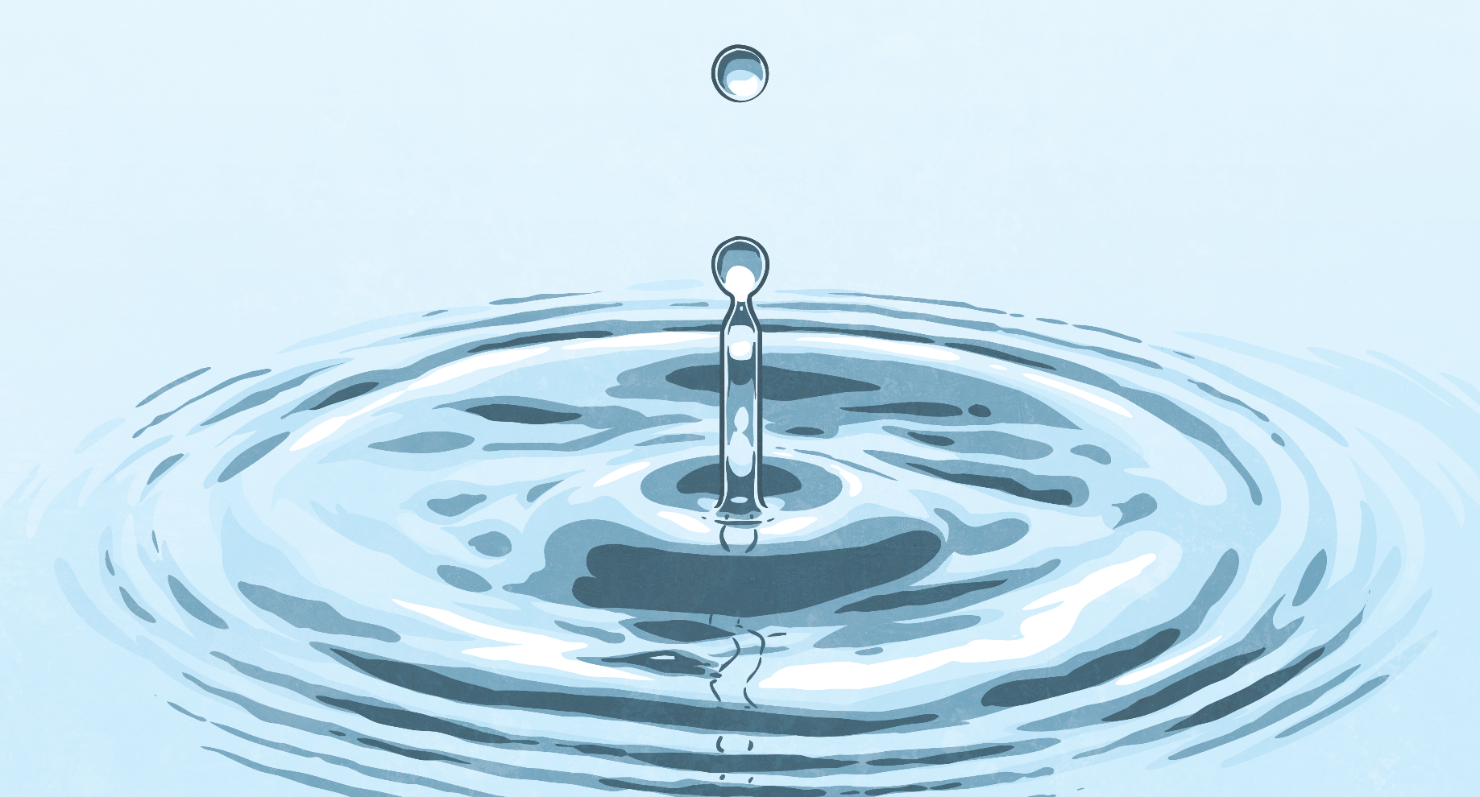
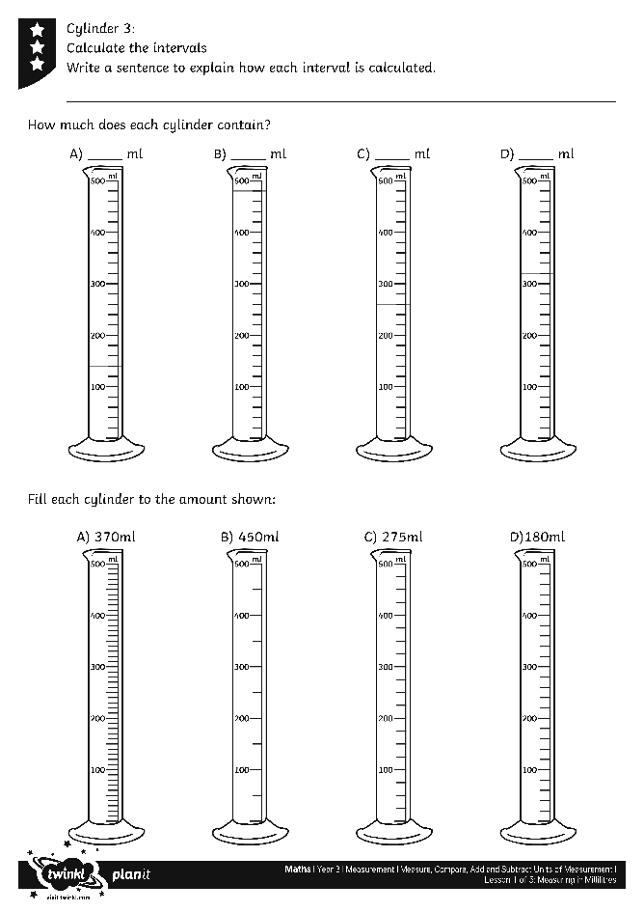
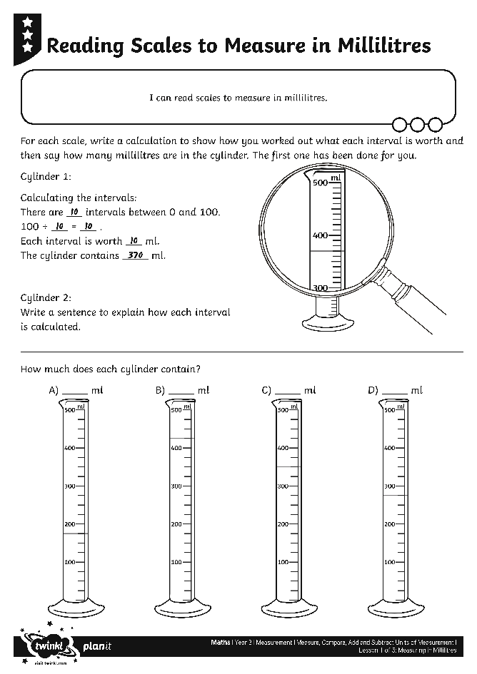
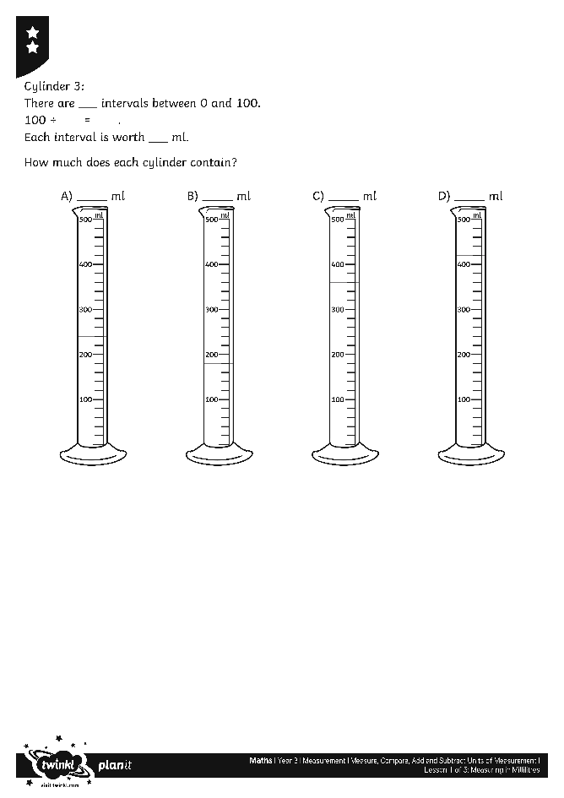
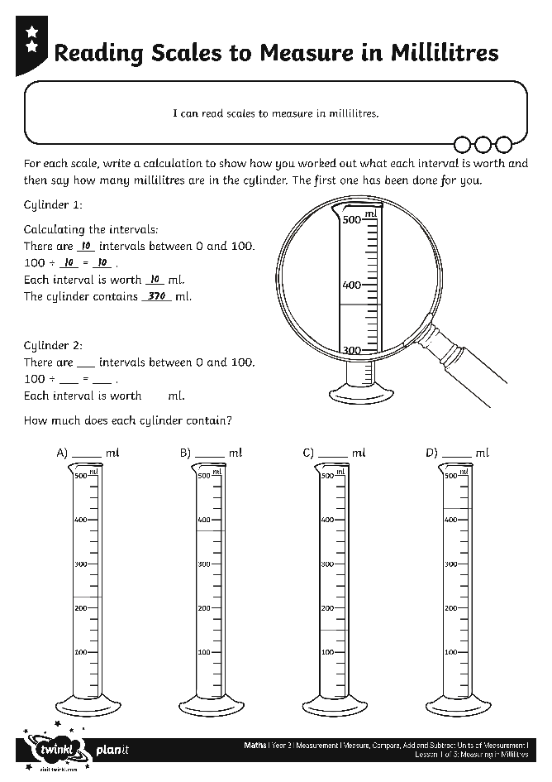
Reading Scales
Use your measuring mastery to compete these activity sheets:

Slide 17
Aim
I can measure volume in millilitres.
Success Criteria
I can calculate the intervals on a scale.
I can read scales to measure in millilitres.

