Slide 1
Maths
Statistics
Year One
Maths | Year 3 | Statistics | Questions about Data Presented in Bar Charts, Pictograms and Tables | Lesson 4 of 5: Measuring Up

Slide 2
Measuring Up

Slide 3
Aim
I can present and interpret data in a Carroll diagram.
Success Criteria
I can create a Carroll diagram.
I can answer questions about a Carroll diagram.
I can ask questions about a Carroll diagram.

Slide 4
Comparing People
Look at these people. Listen carefully to the questions.
Who has blonde hair and is wearing a skirt?
Who has blonde hair and is not wearing a skirt?
Who has brown hair and is not wearing trousers?
Which children are wearing skirts and do not have blonde hair?
Who is not a boy and is wearing trousers?
Who is wearing a red jumper and is wearing a skirt?
Who is not wearing a blue jumper and does not have blonde hair?
Kaylee
Poppy
Lowri and Eli
Klaudia and Lowri
Poppy
Kaylee
Dara and Eli
Kaylee
Klaudia
Dara
Lowri
Poppy
Eli

Slide 5
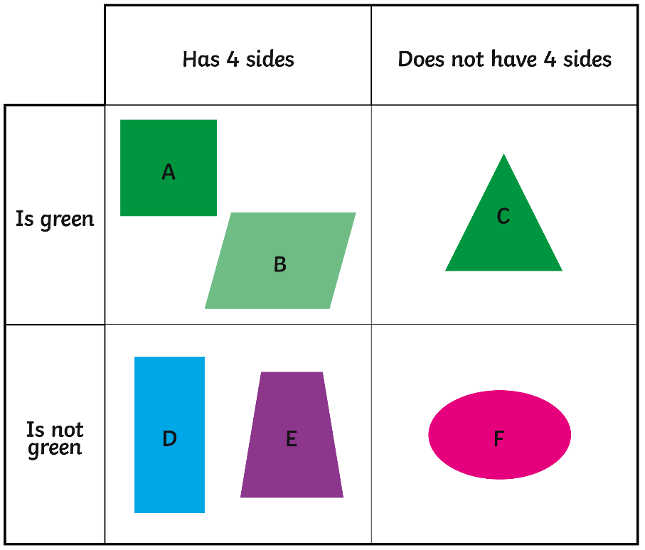
Features of Carroll Diagrams
Carroll diagrams sort things into 4 sets according to two questions or criteria.
Green
Not Green

Slide 6
Features of Carroll Diagrams
What information does this chart give you?
What can you tell your partner about each shape?
Can you draw another shape for each section of the diagram?
Hint: use the headings to help you!
Green
Not Green

Slide 7
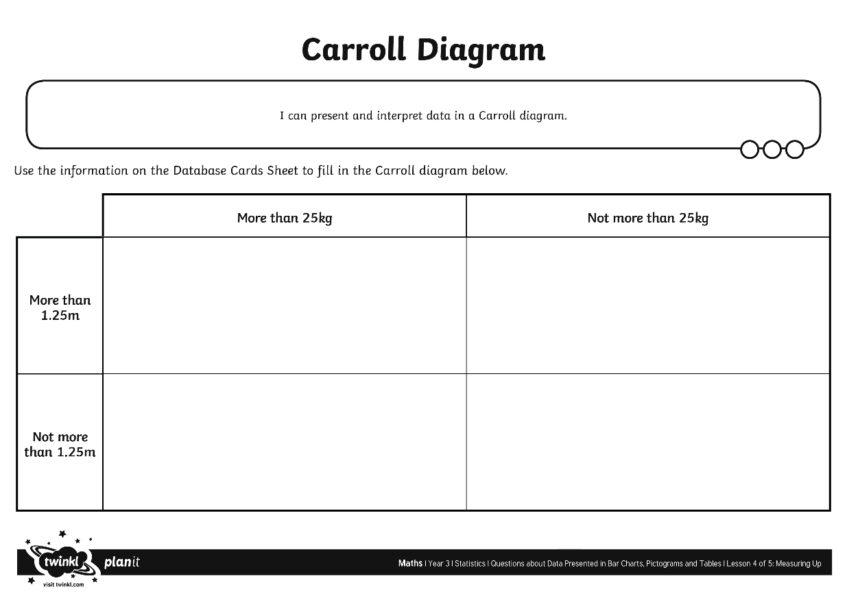
Creating a Carroll Diagram
Use the data from the Database Cards to create a Carroll diagram.

Slide 8
Carroll Diagram Challenge
Now we need to look closely at our Carroll diagram and use the information in it to answer some questions.

Slide 9
Convince Me!
This Venn diagram shows exactly the same information as your Carroll diagrams. Is this true or false? Convince me!
More than 1.25m
More than 25kg
Mert
George
Poppy
Mariam
Lowri
Fatimah
Kamil
Eli
Rhys
Gethin
Shanelle
Pasha
Nikita
Lian
Alex
Navbir
Megan
Maya
Shan
Kaylee
Adil
Aneesha
Madison
Henry
Klaudia
Dara
Uri

Slide 10
Convince Me!
This time I think I made a mistake! How can I correct it?
More than 1.25m
More than 25kg
Mert
George
Poppy
Mariam
Lowri
Fatimah
Kamil
Eli
Rhys
Gethin
Shanelle
Pasha
Nikita
Lian
Alex
Megan
Navbir
Maya
Kaylee
Adil
Shan
Aneesha
Madison
Henry
Klaudia
Dara
Uri

Slide 11
Aim
I can present and interpret data in a Carroll diagram.
Success Criteria
I can create a Carroll diagram.
I can answer questions about a Carroll diagram.
I can ask questions about a Carroll diagram.

