Slide 1
Quadrilaterals Reasoning

Slide 2
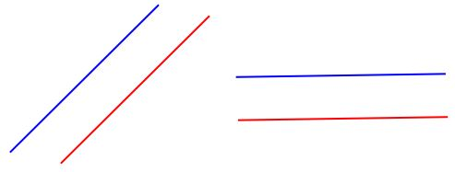
Horizontal, Vertical, Perpendicular and Parallel lines:
You did this in Year 3 but here’s a reminder for you ☺
Vertical lines are straight down.
Horizontal lines are straight across like the horizon ☺
Parallel lines are a pair of lines that can point in any direction. They are the same distance apart the whole way along the line so they would never meet no matter how long the line gets. Like train tracks.
Perpendicular lines meet making an angle of 90 degrees (a right angle)

Slide 3
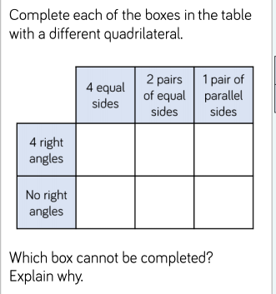
As you can see, the box where the headings are ‘4 right angles’ and ‘1 pair of parallel sides’ can’t be filled in.
This is because the only quadrilaterals with 4 right angles are squares and rectangles and both of those shapes have 2 pairs of parallel sides, not just one ☺

Slide 4
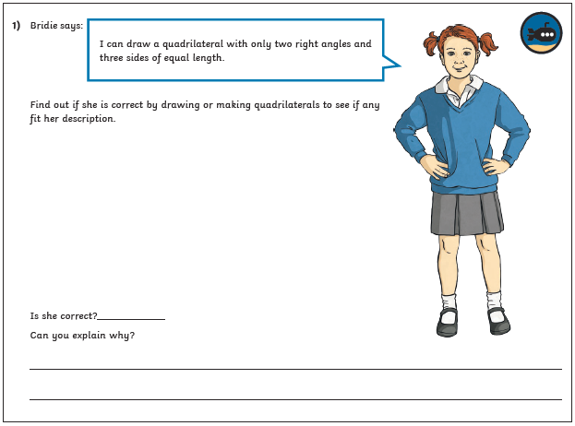
Let’s have a go…

Slide 5
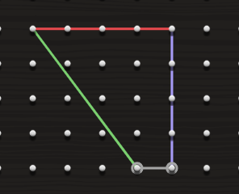
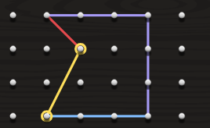
This shape is pretty close! It has 2 right angles but the green side is a little bit longer than the purple and red sides.
This shape has 3 equal sides and only 2 right angles BUT it’s actually an irregular pentagon, not a quadrilateral. It has 5 sides!

Slide 6
The answer is
No, she can’t make a quadrilateral with 3 equal sides and only 2 right angles because if you have only 2 right angles in a quadrilateral, you can only have 2 equal sides not three.

