Slide 2
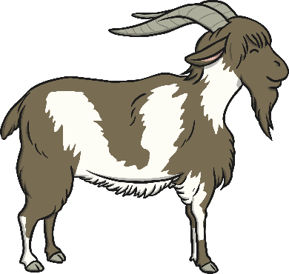
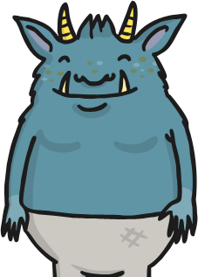
The grumpy troll has stolen all the punctuation in the story. Can you work out where the question marks should be?
One day the three Billy Goats Gruff saw a field of sweet grass on the other side of a bridge How can we get to that lovely grass? asked the smallest Billy Goat
We must go across the bridge said the biggest Billy Goat
Who will be brave enough? wondered the medium sized Billy Goat
The smallest Billy Goat went across the bridge first Who goes trip-trap over my bridge? growled the troll
Who says this is your bridge? asked the smallest Billy Goat Gruff
One day, the three Billy Goats Gruff saw a field of sweet grass on the other side of a bridge. “How can we get to that lovely grass?” asked the smallest Billy Goat.
“We must go across the bridge,” said the biggest Billy Goat.
“Who will be brave enough?” wondered the medium sized Billy Goat.
The smallest Billy Goat went across the bridge first. “Who goes trip-trap over my bridge?” growled the troll.
“Who says this is your bridge?” asked the smallest Billy Goat Gruff.
grass
?
?
enough
?
bridge
bridge
?
Can you write the next part of the story, remembering to use question marks at the end of your questions?
Show all punctuation

Slide 3
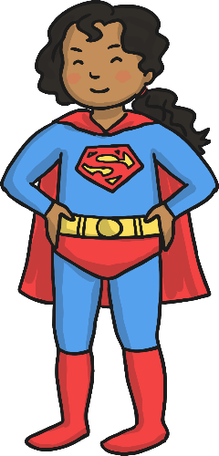
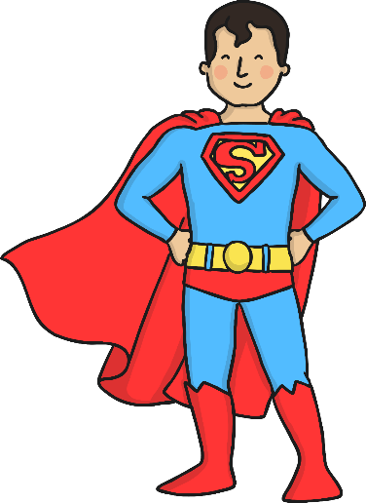
These superheroes are here to help make these sentences super!
If the sentence needs a full stop adding, you need Full Stop Girl!
If the sentence needs a question mark adding, you need Captain Question Mark!
Click on the superhero needed for each sentence.
Where did mum put the cheese
Where did mum put the cheese?
Full Stop Girl
Captain Question Mark
Correct!
Try again!

Slide 4
These superheroes are here to help make these sentences super!
If the sentence needs a full stop adding, you need Full Stop Girl!
If the sentence needs a question mark adding, you need Captain Question Mark!
Click on the superhero needed for each sentence.
I like to play football with my friends
I like to play football with my friends.
Full Stop Girl
Captain Question Mark
Correct!
Try again!

Slide 5
These superheroes are here to help make these sentences super!
If the sentence needs a full stop adding, you need Full Stop Girl!
If the sentence needs a question mark adding, you need Captain Question Mark!
Click on the superhero needed for each sentence.
I can’t decide what to wear
I can’t decide what to wear.
Full Stop Girl
Captain Question Mark
Correct!
Try again!

Slide 6
These superheroes are here to help make these sentences super!
If the sentence needs a full stop adding, you need Full Stop Girl!
If the sentence needs a question mark adding, you need Captain Question Mark!
Click on the superhero needed for each sentence.
Who is going to wash the dishes
Who is going to wash the dishes?
Full Stop Girl
Captain Question Mark
Correct!
Try again!

Slide 7
These superheroes are here to help make these sentences super!
If the sentence needs a full stop adding, you need Full Stop Girl!
If the sentence needs a question mark adding, you need Captain Question Mark!
Click on the superhero needed for each sentence.
Why does it always rain on Saturday
Why does it always rain on Saturday?
Full Stop Girl
Captain Question Mark
Correct!
Try again!

Slide 8
The question marks in these text messages are in the wrong place. Can you put the question marks in the correct place so that they make sense? Click on the message to see the answer.
How many bananas shall I? buy at the shops
How many bananas shall I buy at the shops?
What time are you going to get here?
What? time are you going to get here
When will? my new bunkbed be ready
Who is coming to your birthday party?
When will my new bunkbed be ready?
Who is coming to your birthday? party
Can you write your own text message for a friend with the question mark in the wrong place? Can they correct it?

