Slide 1
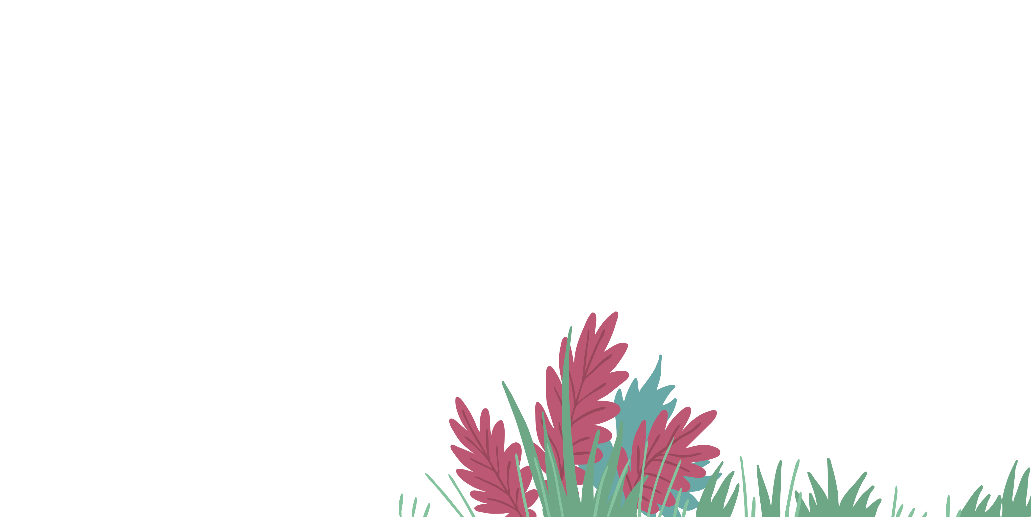
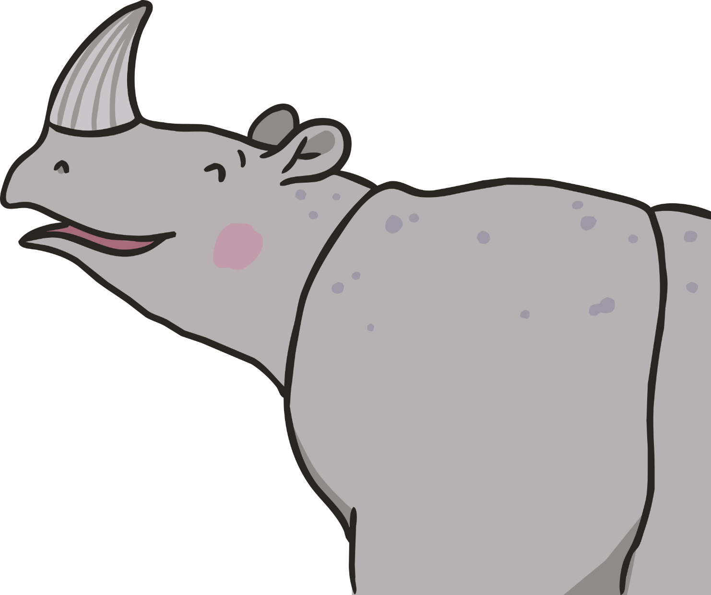

Slide 3
His dusky grey skin is very well worn.
At the front of his head is a beautiful horn.
Ronald the Rhino is so big and strong.
In the Javan forest is where he belongs.

Slide 4
He eats fallen fruits from the damp forest floor,
But Ronald is sad; he longs for much more.
“Why am I special?” he says with a tear.
“I live by myself, I have no friends here.”
“All of the animals have a grand trait,
Something unique that makes them just great.”
“I’ve got it!” he cries, with a smile on his face,
And he wiggles and jiggles all over the place.

Slide 5
“I’ll be a leopard with beautiful spots,
All yellowish fur and dark brownish dots.”
Ronald sets off to hatch out his plan,
And through the dense forest his eyes start to scan.
He soon finds some mud, all sticky and wet.
“Great!” Ronald says, “I’ll have my spots yet!”
He starts right away, painting on patches,
Using his horn to scoop mud up in batches.

Slide 6
As soon as he’s finished, he admires his work,
But high in the trees, Leopard does lurk.
“What are you doing?” Leopard asks with a grin.
“You’ve mud in great patches all over your skin!”
“I want to be like you, with spots on my face,
To sleep in a tree; to run, leap and race!”
“You can’t be a leopard, you’re too big and grey.
You’re a Javan rhino in every way!”

Slide 7
Ronald looks sad, unsure what to do.
He lets out a sigh; he’s feeling so blue.
“Why am I special?” he says with a tear.
“I live by myself, I have no friends here.”
“All of the animals have a grand trait.
Leopard has spots that make him just great.”
“I’ve got it!” he cries, with a smile on his face,
And he wiggles and jiggles all over the place.

Slide 8
“I’ll be a python, my body so strong,
With smooth patterned skin and a tongue nice and long!”
He starts right away and gets down on the ground.
He slides through the mud with a terrible sound.
But as Ronald moves, he lets out a wail;
His body is sore and bent round like a snail.
Out in the bushes, now Python can see
What the young rhino is trying to be.

Slide 9
“Why are you moving around like a snake?
Your back is all bent; I saw your legs shake!”
“You can’t be a python, your skin is too rough,
Your horn is too hard and your feet are too tough.”
Ronald sits down, his head hanging low.
What could he be? He just doesn’t know.
“I want to be like you, on the rough jungle ground,
Slowly and smoothly sliding around.”

Slide 10
Leopard and Python see Ronald so glum,
So they cook up a plan to cheer up their chum.
“We’ve got it!” they say, looking down at his face.
Ronald wiggles and jiggles all over the place.
“Why am I special?” he says with a tear.
“I live by myself, I have no friends here.
All of the animals have a grand trait.
Python slides smoothly, which makes him just great.”

Slide 11
His skin is tough and looks like great armour.
His eyes sparkle brightly – he’s a real charmer!
“I want to be like him!” Ronald cries out,
His eyes shining bright as his feet dance about.
So into the forest they set off to find
This mystery animal that might change his mind.
His legs are so strong and his horn is the best.
The animals love him, as you may have guessed.

Slide 12
They come to a clearing, with few trees around,
With a beautiful stream; no one to be found.
Leopard says with a smile, “He lives just down there.”
Across the wet ground, he approaches with care.
Ronald moves closer to look at this beast,
His heart all aflutter, his brow lined and creased.
He looks hard for a moment, his eyes flashing fast.
The water is silty with mud flowing past.

Slide 13
He grins at the animal that he can see,
“By golly,
It’s amazing,
It’s wonderfully…
He stops as he sees it and then gasps out loud.
Leopard and Python could cry, they’re so proud.

Slide 14
…Me!”

