Slide 2
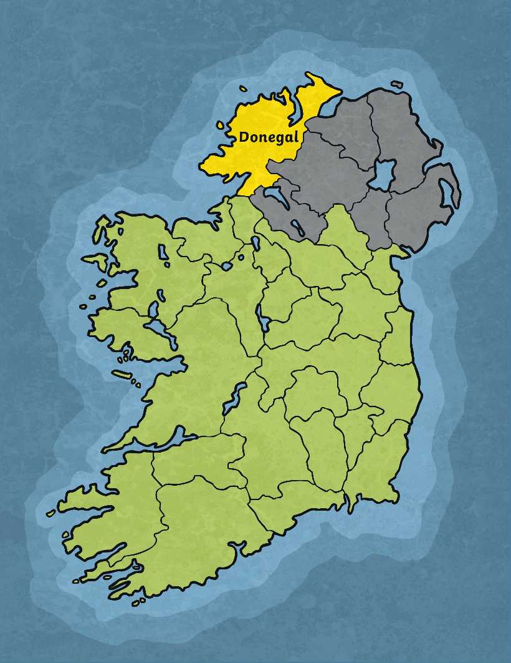
The Early Years
Saint Columba was born in Gartan, Co. Donegal in AD521.
He was christened Crimhthann, but was known as Columba later in his life.
His mother was Princess Eithne of Leinster.
His father, Fedelmidh, was the great grandson of King Niall of the Nine Hostages.

Slide 3
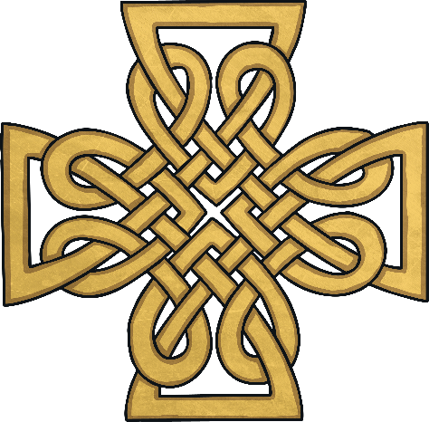
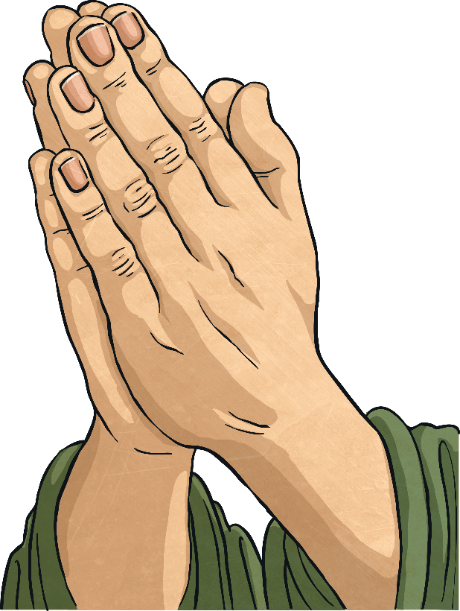
The Early Years
Columba was sent to be fostered by another family when he was young. This was normal for princes back in this time.
He was sent to the house of Cruithnechan, a holy man.
Columba spent a lot of his time in church, praying and meditating.

Slide 4
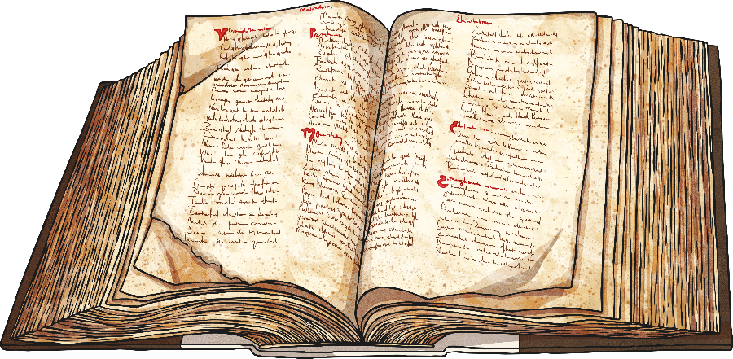
Education
Columba was a well-educated scholar. He attended many different schools around Ireland.
He first attended St. Finnian’s monastic school in Derry.
After this, he travelled down to Clonard Monastery, Co. Meath.
His last place of study was St. Mobhi’s, Glasnevin, Co. Dublin.
He only stayed a short time in Dublin because there was a breakout of the plague. He returned to Donegal at this point.

Slide 5
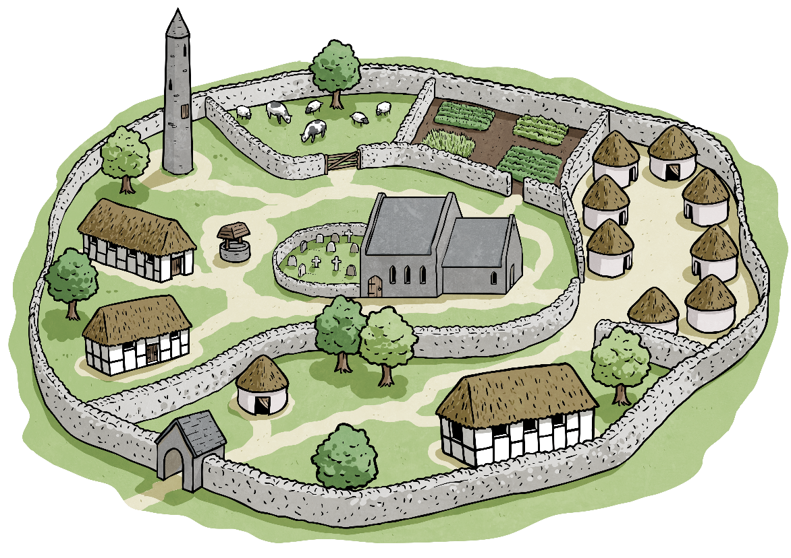
Monasteries
In AD545, he founded his first monastery in Co. Derry.
He went on to found over 60 monasteries and churches in Ireland, including ones in Swords, Co. Dublin and in the Burren, Co. Clare

Slide 6
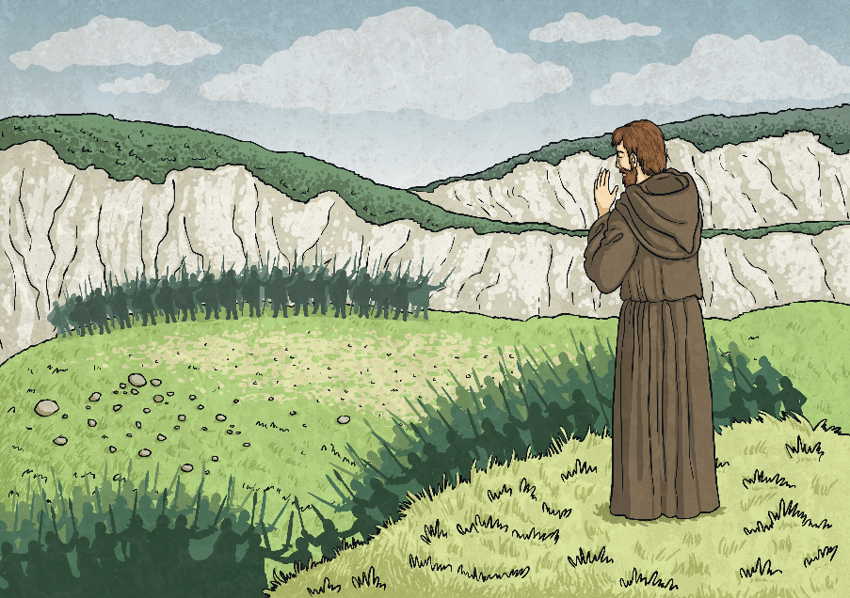
Pilgrimage to Iona
In AD563, Saint Columba travelled to the island of Iona off the western coast of Scotland.
He went into exile. The pilgrimage was a kind of repentance for his involvement in the Battle of Cúl Dreimhne, where 3,000 warriors died.

Slide 7
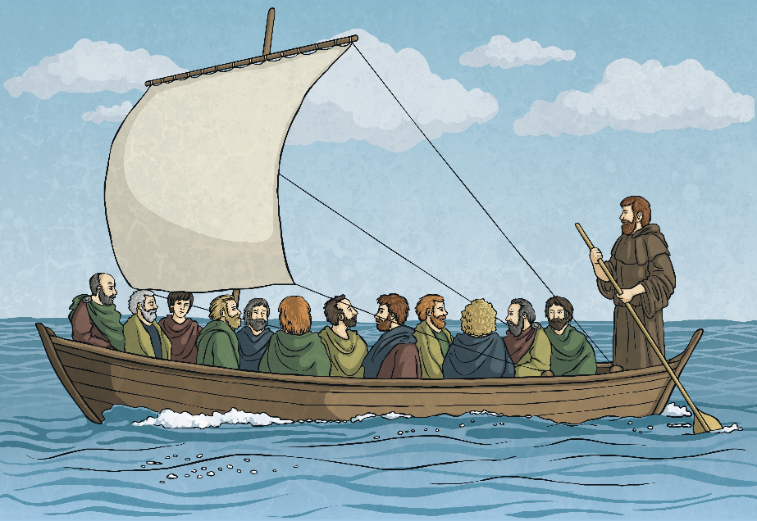
Pilgrimage to Iona
He set sail with 12 clansmen and sailed to Iona.
He founded a monastery here and spread the word of God to local people and to the people of the Picts tribe.

Slide 8
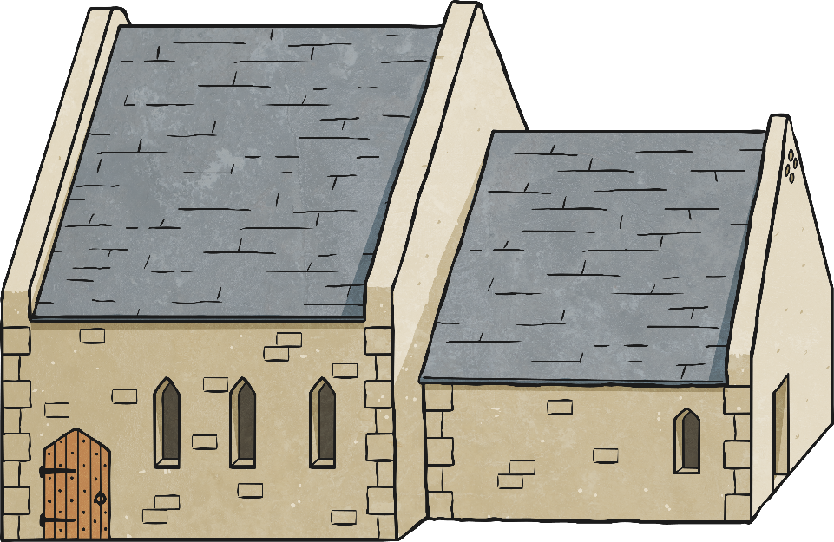
Iona
The monastery at Iona was originally very small and built in timber.
It soon began to thrive. The land was very fertile and there was plenty of timber available to build a large community.
Over time, the monastery was rebuilt in stone and in AD1200, it was taken over by the Augustinian monks.
High Kings of Scotland are buried in Iona.
Many people today go to Iona on a pilgrimage.

Slide 9
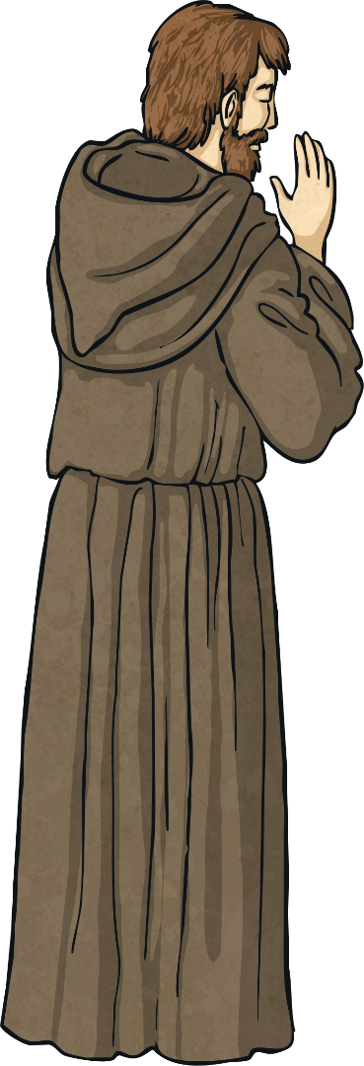
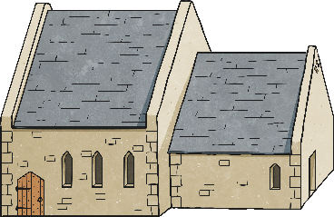
Later Years
Saint Columba died in AD597 at the age of 76.
Saint Columba died in the church, on the altar, in Iona.
His monks buried him in the grounds of his monastery on Iona and many years later, his bones were disinterred and are thought to be buried in Downpatrick, County Down, with Saint Patrick and Saint Brigid.

Slide 10
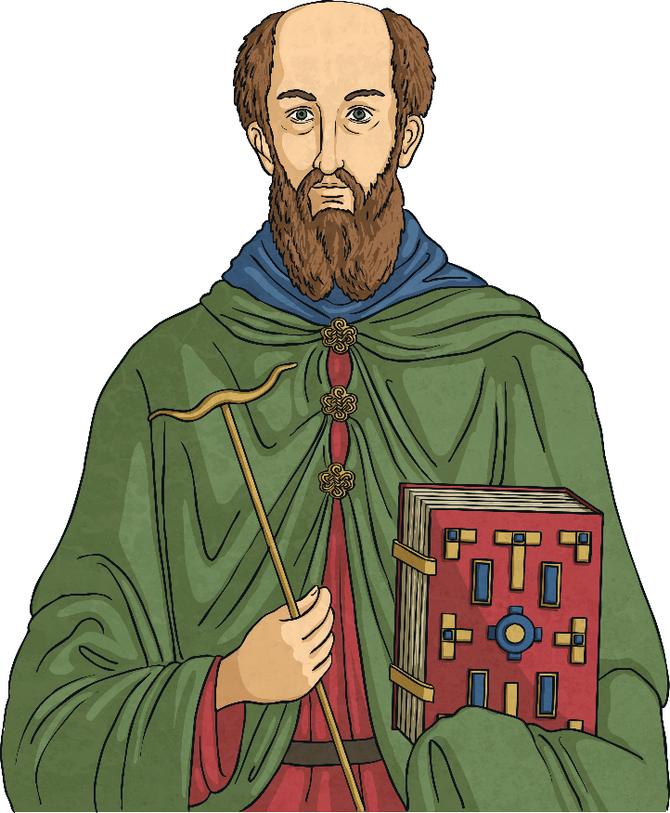
Patron Saint of Ireland
Saint Columba is one of Ireland’s patron saints, along with Saint Patrick and Saint Brigid.

Slide 11
Iona
The island of Iona is a small island with an area of almost 9km². Iona is off the coast of Mull in the Inner Hebrides. It has a population of only around 120 permanent residents, however around 130,000 visitors come to the island each year!
Bird watchers can spot many different species on Iona. Oyster catchers, sandpipers, redshanks, plovers, curlews and greylag geese may be spotted on the shoreline. The endangered corncrake also lives on the island.
The main village in Iona is Baile Mor. Work on Iona is divided between crofting, farming and tourism.

Slide 12
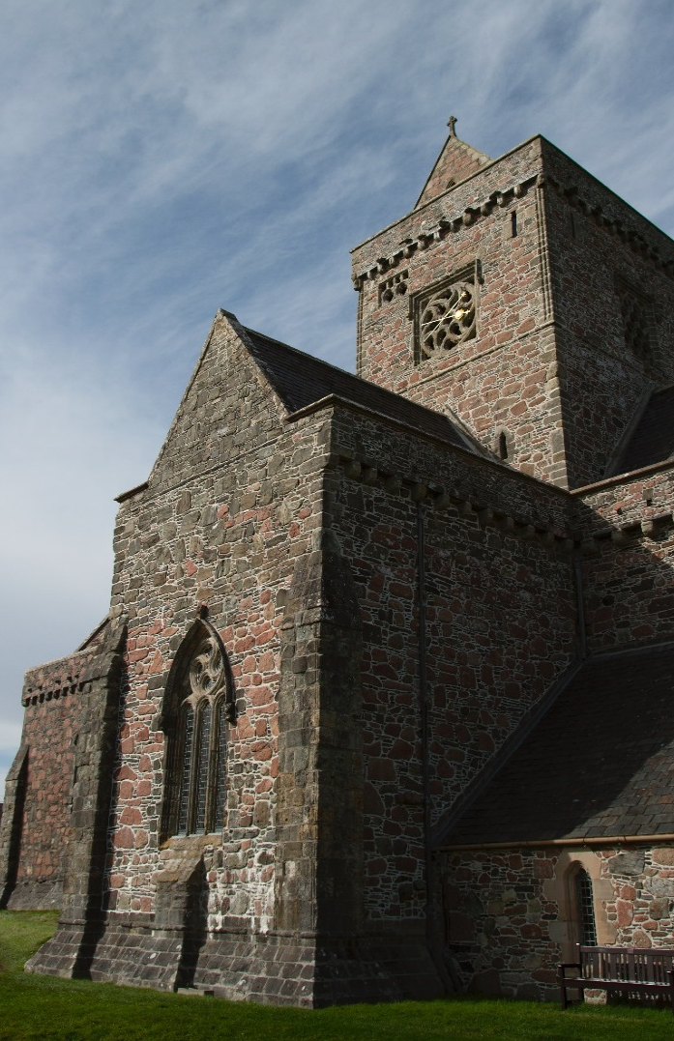
Iona
Evidence that humans have been here for thousands of years include flint tools, Bronze Age burial sites and an Iron Age dun or hill fort. The island is probably most famous for Saint Columba and his works.
In AD563, Columba and his 12 disciples arrived from Ireland and founded a monastery. They then went on to spread Christianity in Scotland and Northern England. Since then, Iona has been a place of pilgrimage for Christians.
Iona Abbey is one of Scotland’s most historic and sacred sites. A small cemetery next to the Abbey is said to be the burial place of 48 kings of Scotland, including Macbeth.
Photo courtesy of Paul Albertella (@flickr.com) - granted under creative commons licence – attribution

