Slide 1
Understanding Scaled
Pictograms

Slide 2
10
Favourite Fruit
9
8
7
Here is a bar chart showing the favourite fruit for a class of children.
The scale counts up in 1’s.
6
5
4
3
2
1
0
Banana
Grapes
Apples
Pears

Slide 3
10
Favourite Fruit
9
8
7
6
Here is the same pictogram with 1 picture representing 2 children’s choices.
5
4
3
2
1
0
Banana
Grapes
Apples
Pears

Slide 4
10
Favourite Fruit
8
6
Here is the same pictogram with the number scale changed to only show the even numbers.
4
2
0
Banana
Grapes
Apples
Pears

Slide 5
10
Favourite Colour
9
8
7
6
Here is a pictogram showing children’s favourite colours.
Each circle represents 1 child’s choice.
5
4
3
2
1
0
Pink
Red
Blue
Green
Yellow

Slide 6
10
Favourite Colour
9
8
7
Here is the same pictogram with 1 circle representing 2 children’s choices.
If there is an odd number, we use half a circle to mean 1 child.
6
5
4
3
2
1
0
Red
Blue
Green
Yellow
Pink

Slide 7
10
Favourite Colour
8
6
Here is the same pictogram with the number scale changed to only show the even numbers.
4
2
0
Red
Blue
Green
Yellow
Pink

Slide 8
10
Class Pets
9
8
7
6
Here is a pictogram showing children’s pets.
Each picture represents 1 pet.
5
4
3
2
1
0
Dog
Cat
Fish
Rabbit
Hamster

Slide 9
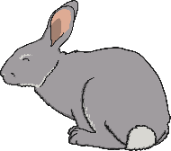
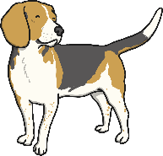
10
Class Pets
9
8
7
Here is the same pictogram with 1 picture representing 2 pets.
For odd numbers we can use half a picture to mean 1 pet.
6
5
4
3
2
1
0
Dog
Cat
Fish
Rabbit
Hamster

Slide 10
10
Class Pets
8
6
Here is the same pictogram with the number scale changed to only show the even numbers.
4
2
0
Dog
Cat
Fish
Rabbit
Hamster

