Slide 2
Can you match the sentence with the correct sentence type?
Sentence
Type of Sentence
It is a beautiful day.
statement
question
Where should we have our picnic?
command
question
Take the sandwiches out of the lunch box.
exclamation
command
What a mess we have made!
statement
exclamation
show answer

Slide 3
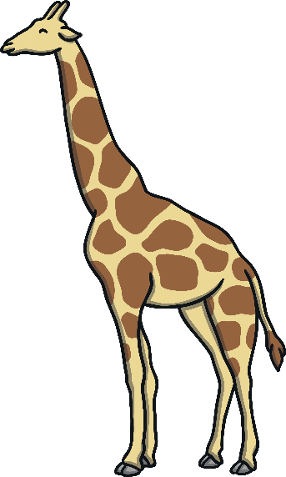

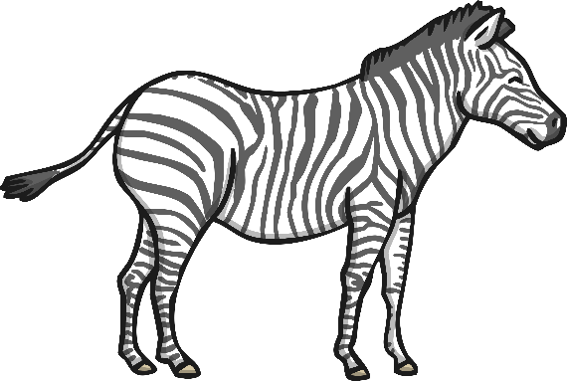
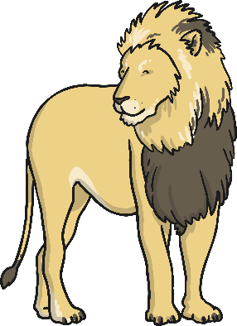
Can you write one statement sentence that describes each of these animals?
Any sentence is correct as long as it tells you something about the animal and ends in a full stop. For example: The giraffe has a long neck. The elephant is huge. The zebra has stripes. The lion is fierce.
show answer

Slide 4


Can you rearrange the words in each sentence to make five statements that tell a story?
The lion is hungry.
The zebra is scared.
The elephant is clever.
The elephant trips up the lion.
The zebra runs away.
is The hungry. lion
scared. The is zebra
elephant clever. The is
up The elephant the lion. trips
away. zebra runs The
show answer

Slide 5
Can you turn these statement sentences into question sentences by adding punctuation, rearranging words or adding new words?
For example: The lion is vicious.
  Is the lion vicious?
Giraffes have long necks so that they can reach tall trees.
  Do giraffes have long necks so that they can reach tall trees?
Zebras have stripes to help them to camouflage.
  Do zebras have stripes to help them camouflage?
African elephants have ears shaped like Africa.
  Do African elephants have ears shaped like Africa?
show answer

Slide 6



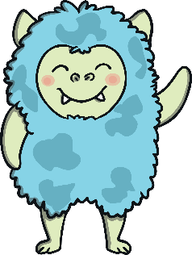




Oh no, these aliens have got lost in space! Can you help them to get back to their home planets? Each planet is a different sentence type. Read the alien’s sentences to work out where they live.
show answer
Bow down before me, weak humans!
Will I be home in time for tea?
My eye is huge.
What pointy ears I have!
Planet Command
Planet Question
Planet Statement
Planet Exclamation

Slide 7
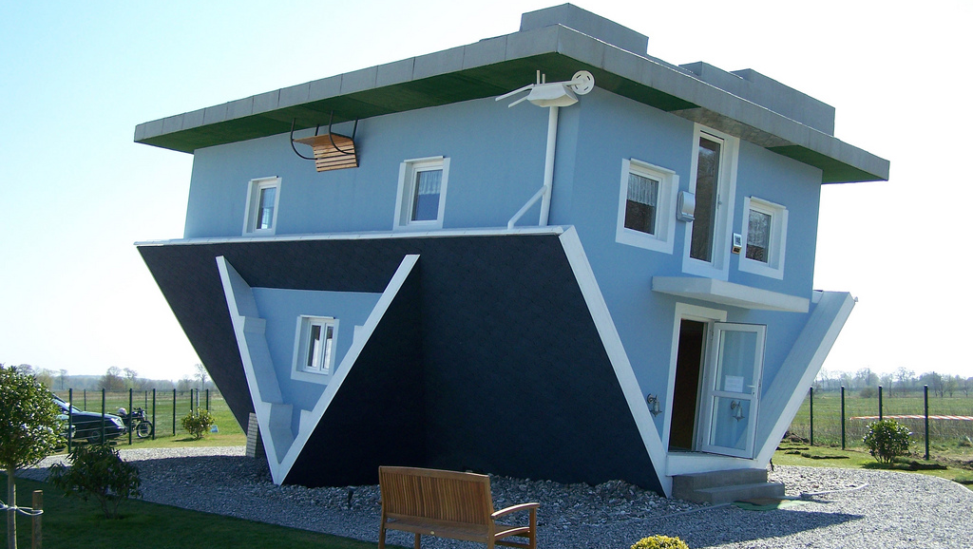
This is a very strange house! Write a list of all the questions you have about what it would be like to live there. For example: How do you sleep upside down?
Challenge: Swap your questions with a partner and see if they can answer them.
Challenge!

Slide 8

Can you choose the correct word from the question word hand to begin these question sentences?
Where
_____ have all the chocolate biscuits gone?
w
h
a
t
w
h
e
r
e
w
h
o
Why
___ is the sky blue?
w
h
y
What
____ should I dress up as for Halloween?
?
Who
___ is coming to the party?
when
When
____ will I be allowed to walk home on my own?
show answer

Slide 9

Challenge: Come up with the answers that would make you want the interviewee to work at your school.
Working with a partner, come up with a list of questions that you would ask if you were interviewing for a new teacher at your school.
Challenge!

Slide 10

If your sentence is a statement, it must tell you something and end in a full stop. If your sentence is a command, it must tell you to do something. If your sentence is a question, it must ask something and should end in a question mark. If your sentence is an exclamation, it must end in an exclamation mark, start with ‘how’ or ‘what’ and contain a verb.
Throw the darts! Write a sentence using the topic that one dart lands on and the type of sentence the other dart lands one.
Statement
Chocolate
Command
Under the Sea
Question
Dinosaurs
Exclamation
Pets
show answer
Throw!

Slide 11

Can you choose the correct imperative (bossy) verbs to complete the commands in this recipe?
heat
put
First, ____ the oven to 180 C. Secondly, ___ the butter and sugar in a bowl and ____ with a fork until fluffy. Next, ____ the flour into the bowl. After that, _____ the eggs and then ___ to the bowl. Finally, _____ the mixture into paper cases and ____ for twenty minutes in the oven.
beat
sift
whisk
add
spoon
bake
beat
add
spoon
sift
bake
heat
put
whisk
Challenge: Can you write your own recipe using lots of commands and imperative verbs?
show answer
Challenge!

Slide 12
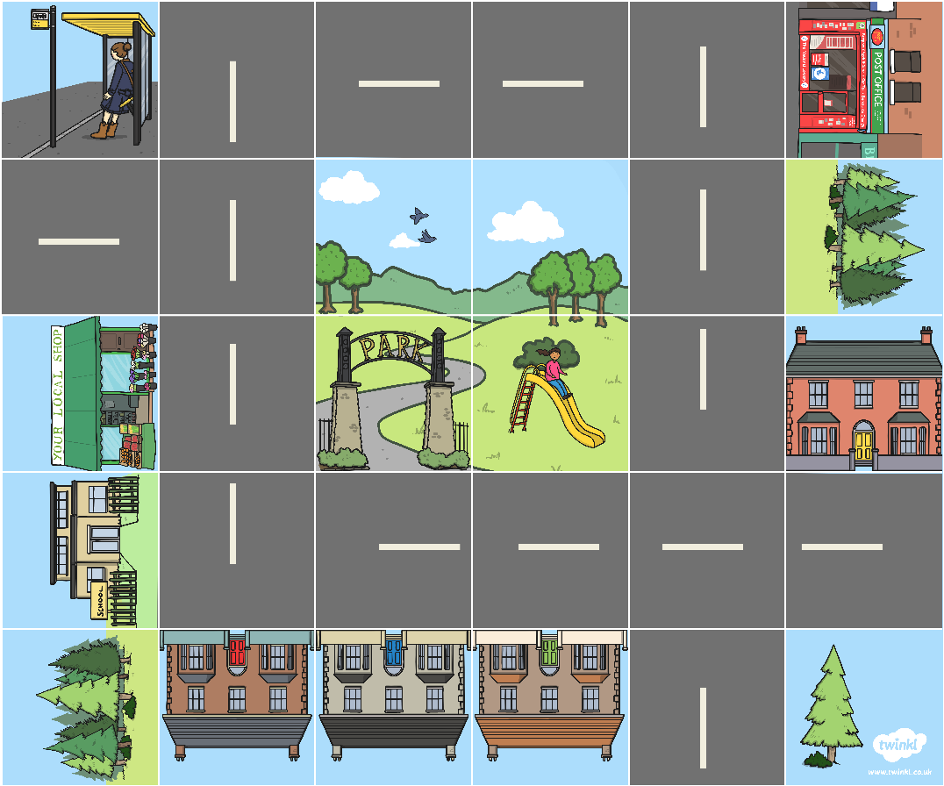

Challenge: Can you write your own directions to somewhere else on the map, using command sentences?
Can you write the command sentences needed to tell the Bee-Bot how to get from the school to the forest?
Go forward three squares. Turn left. Go forward 2 squares. Turn right. Go forward one square.
show answer
Challenge!

Slide 13
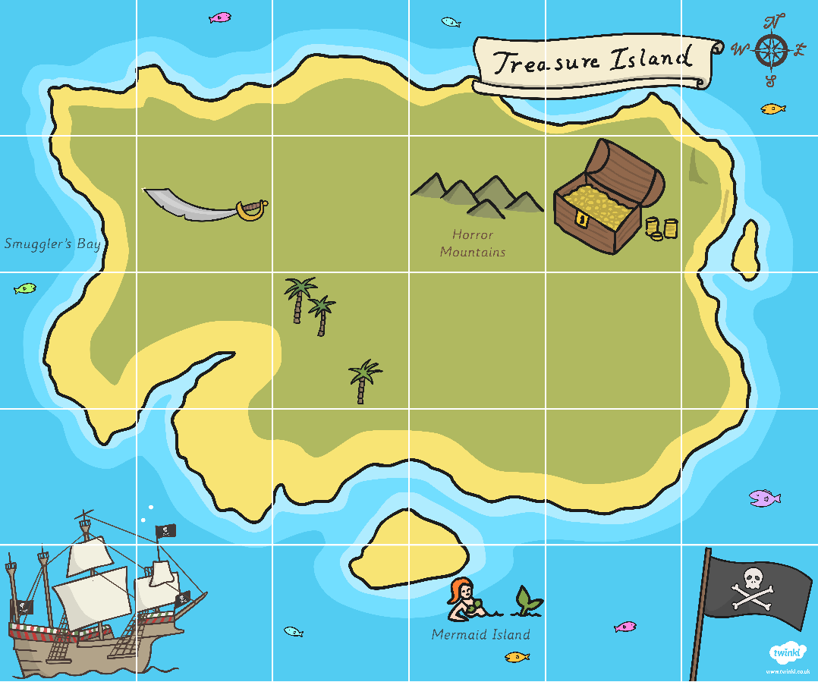

Challenge: Can you write your own directions to somewhere else on the map, using command sentences?
Can you write the command sentences needed to tell the parrot how to get to the treasure?
Go forwards four squares. Turn right. Go forwards one square.
show answer
Challenge!

Slide 14
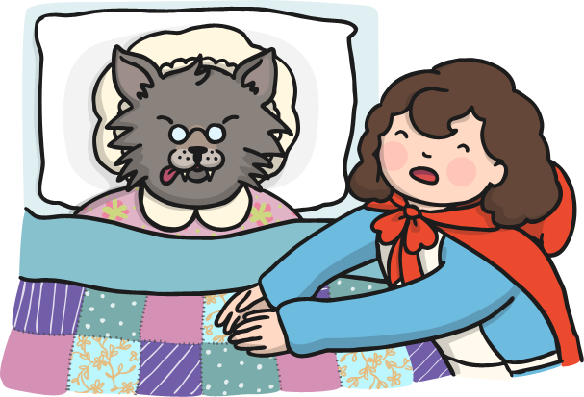
Can you fill in the missing verbs and nouns in the exclamation sentences that Little Red Riding Hood says to her grandma? Use the wolf’s replies to help you.
Oh grandma, what big ____ you _____!
All the better to see you with my dear.
eyes
have
Oh grandma, what big ____ you _____!
All the better to hear you with my dear.
ears
have
Oh grandma, what a big ____ you _____!
All the better to smell you with my dear.
nose
have
Oh grandma, what big _____ you _____!
All the better to eat you with my dear!
teeth
have
show answer

Slide 15

In two minutes, see how many compliments you can write to other children in your class as exclamations.
For example:
To: Henry
From: Aishah
What neat handwriting you have!
For example:
To: Eva
From: Ibrahmin
How good at football you are!
Any compliment will be an exclamation sentence as long as it starts with ‘how’ or ‘what’, contains a verb and ends in an exclamation mark.
show answer

Slide 16


Can you add the correct punctuation to these sentences? Think carefully about whether these sentences need a question mark or an exclamation mark!
What a way to say you’re sorry
!
?
What are you going to have for lunch today
How ridiculous to walk to school in the rain
!
show answer

Slide 17
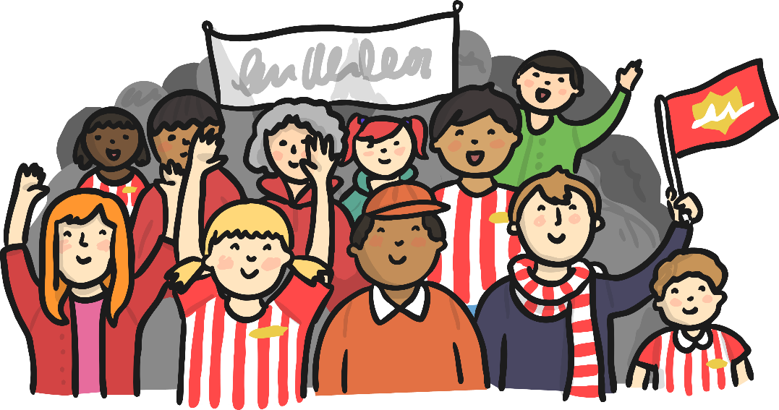
Can you write speech bubbles to imagine what each of the people at this football match is saying? One must be a command, one must be a statement, one must be a question and one must be an exclamation.
If your sentence is a statement, it must tell you something and end in a full stop.
If your sentence is a command, it must tell you to do something.
If your sentence is a question, it must ask something and should end in a question mark.
If your sentence is an exclamation, it must start with ‘how’ or ‘what’ and contain a verb.
show answer

Slide 18

Can you write speech bubbles to imagine what each of the children working in the group is saying? One must be a command, one must be a statement, one must be a question and one must be an exclamation.
If your sentence is a statement, it must tell you something and end in a full stop.
If your sentence is a command, it must tell you to do something.
If your sentence is an exclamation, it must start with ‘how’ or ‘what’ and contain a verb.
If your sentence is a question, it must ask something and should end in a question mark.
show answer

Slide 19
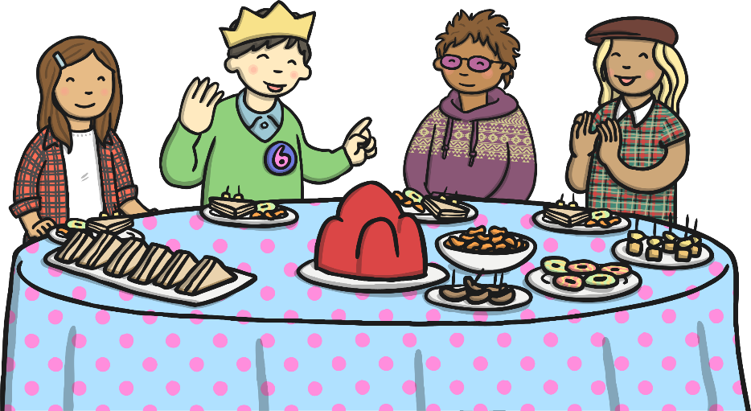
Can you write speech bubbles to imagine what each of the children at the party is saying? One must be a command, one must be a statement, one must be a question and one must be an exclamation.
If your sentence is a statement, it must tell you something and end in a full stop.
If your sentence is a command, it must tell you to do something.
If your sentence is an exclamation, it must start with ‘how’ or ‘what’ and contain a verb.
If your sentence is a question, it must ask something and should end in a question mark.
show answer

