Slide 1


Maths
Properties of Shapes
Year One
Maths | Year 4 | Properties of Shapes | Symmetry | Lesson 1 of 1: Symmetrical Patterns

Slide 2

Symmetrical Patterns

Slide 3
Aim
I can complete a symmetrical pattern or drawing.
Success Criteria
I can complete a symmetrical drawing along a vertical or horizontal mirror line.
I can complete a symmetrical pattern along a vertical or horizontal mirror line.
I can complete symmetrical patterns where the mirror line is on a diagonal.

Slide 4









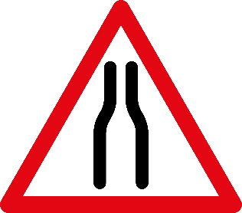







Road Signs Symmetry
Can you identify any lines of symmetry in these road signs?

Slide 5
Reflecting Symmetrical Patterns 1
Symmetrical patterns are reflected along a line of symmetry. Sometimes this is called a mirror line.
Horizontal line of symmetry
Vertical line of symmetry

Slide 6
Reflecting Symmetrical Patterns 1
Every part of a reflected image is the same distance from the line of symmetry as the original, and the same size.
This triangle is 3 squares from the line of symmetry on this side…
…so it must be 3 squares from the line of symmetry on this side.

Slide 7
Reflecting Symmetrical Patterns 1
Every part of a reflected image is the same distance from the line of symmetry as the original, and the same size.
This circle is 4 squares from the line of symmetry on this side…
…so it must be 4 squares from the line of symmetry on this side.

Slide 8
Reflecting Symmetrical Patterns 1
Every part of a reflected image is the same distance from the line of symmetry as the original, and the same size.
This pentagon is 1 square from the line of symmetry on this side…
…so it must be 1 square from the line of symmetry on this side.

Slide 9
Reflecting Symmetrical Patterns 1
Every part of a reflected image is the same distance from the line of symmetry as the original, and the same size.
The horizontal line of the triangle is closest to the line of symmetry…
…so the triangle needs to be flipped to keep its symmetry!

Slide 10
Reflecting Symmetrical Patterns 1
Every part of a reflected image is the same distance from the line of symmetry as the original, and the same size.
The horizontal line of the pentagon is closest to the line of symmetry…
…so the pentagon needs to be flipped to keep its symmetry!

Slide 11
True or False Symmetry?
True Symmetry
False Symmetry

Slide 12
True or False Symmetry?
True Symmetry
False Symmetry

Slide 13
True or False Symmetry?
True Symmetry
False Symmetry

Slide 14
True or False Symmetry?
True Symmetry
False Symmetry

Slide 15
True or False Symmetry?
True Symmetry
False Symmetry

Slide 16
True or False Symmetry?
True Symmetry
False Symmetry

Slide 17
Reflecting Symmetrical Patterns 2
Every part of a reflected image is the same distance from the line of symmetry as the original, and the same size.
Lines of symmetry are not just horizontal and vertical, they can also be diagonal.

Slide 18
Reflecting Symmetrical Patterns 2
Every part of a reflected image is the same distance from the line of symmetry as the original, and the same size.
Lines of symmetry are not just horizontal and vertical, they can also be diagonal.

Slide 19

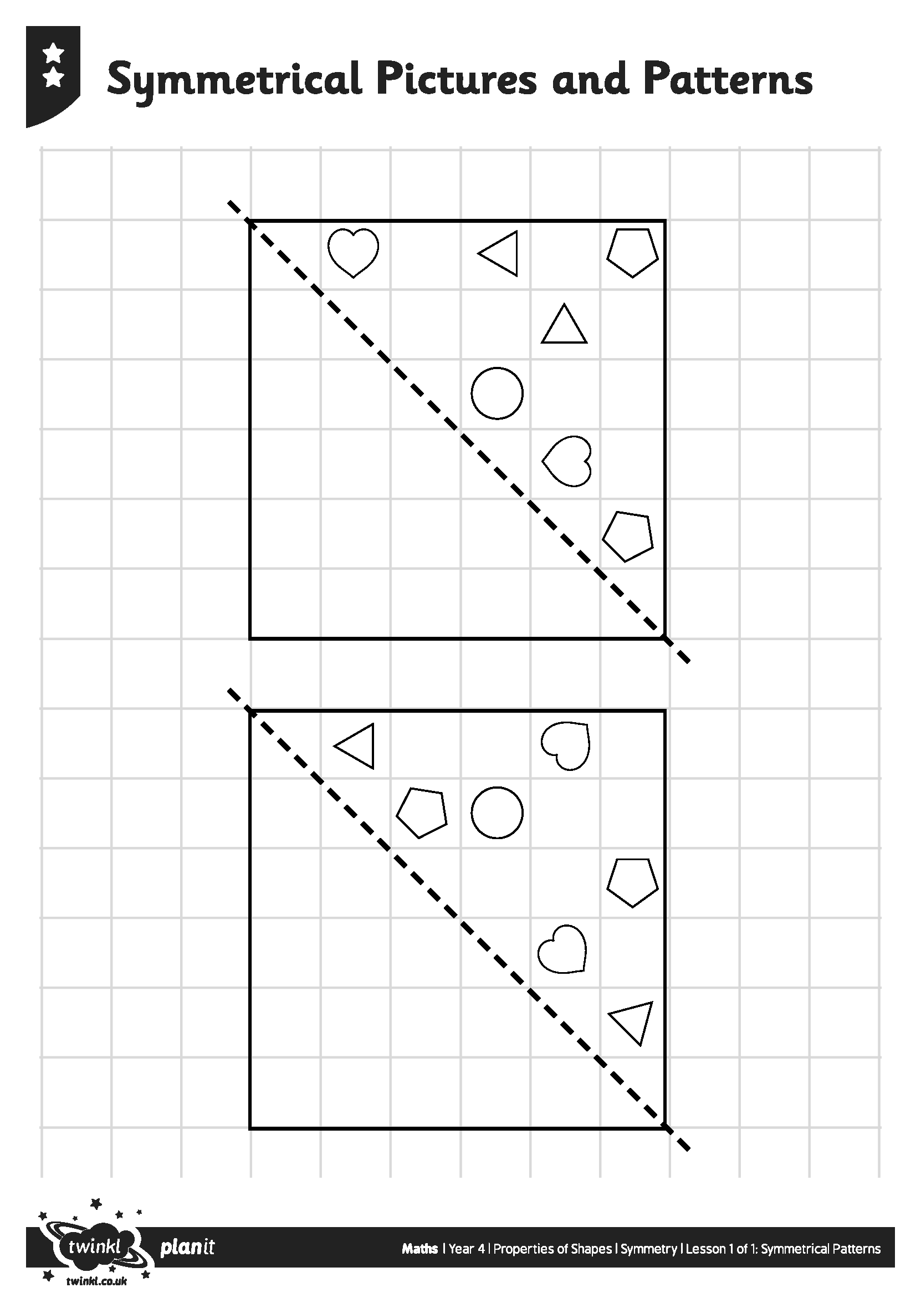
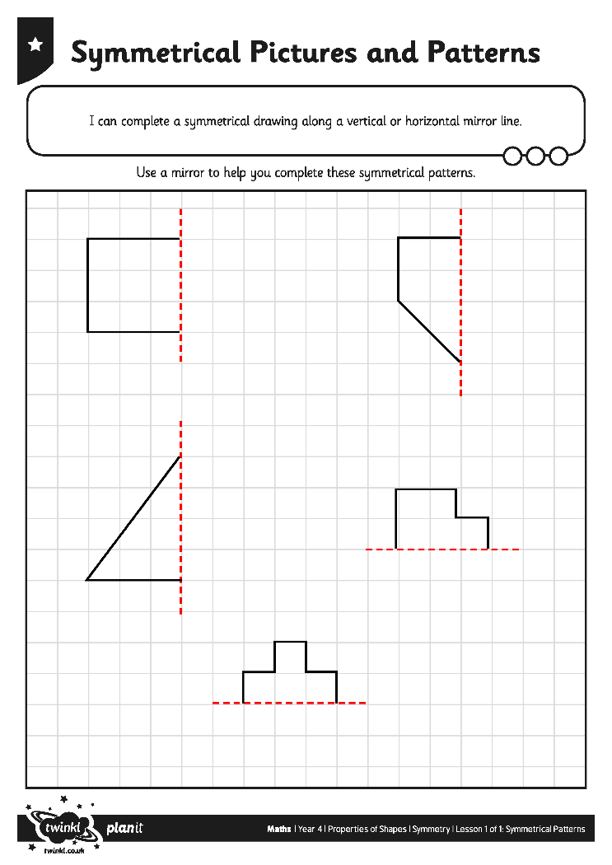
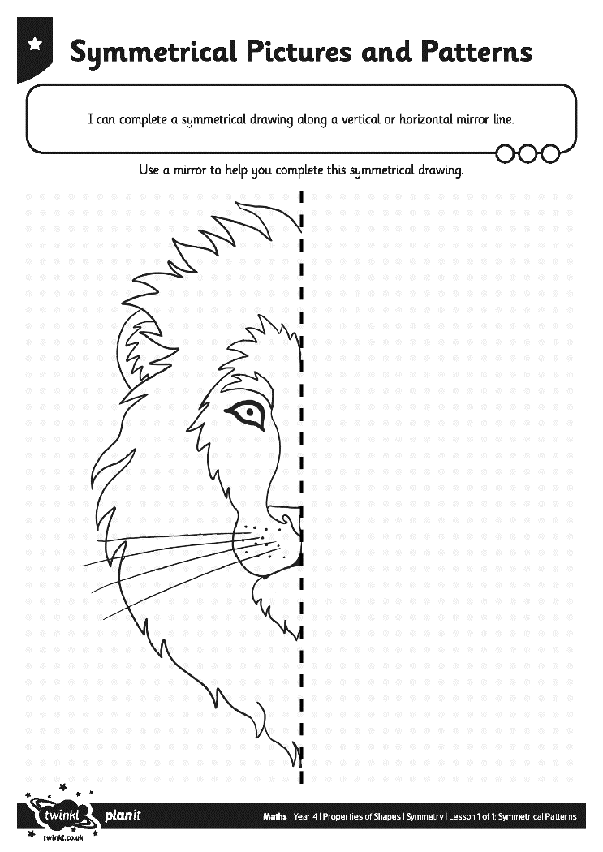
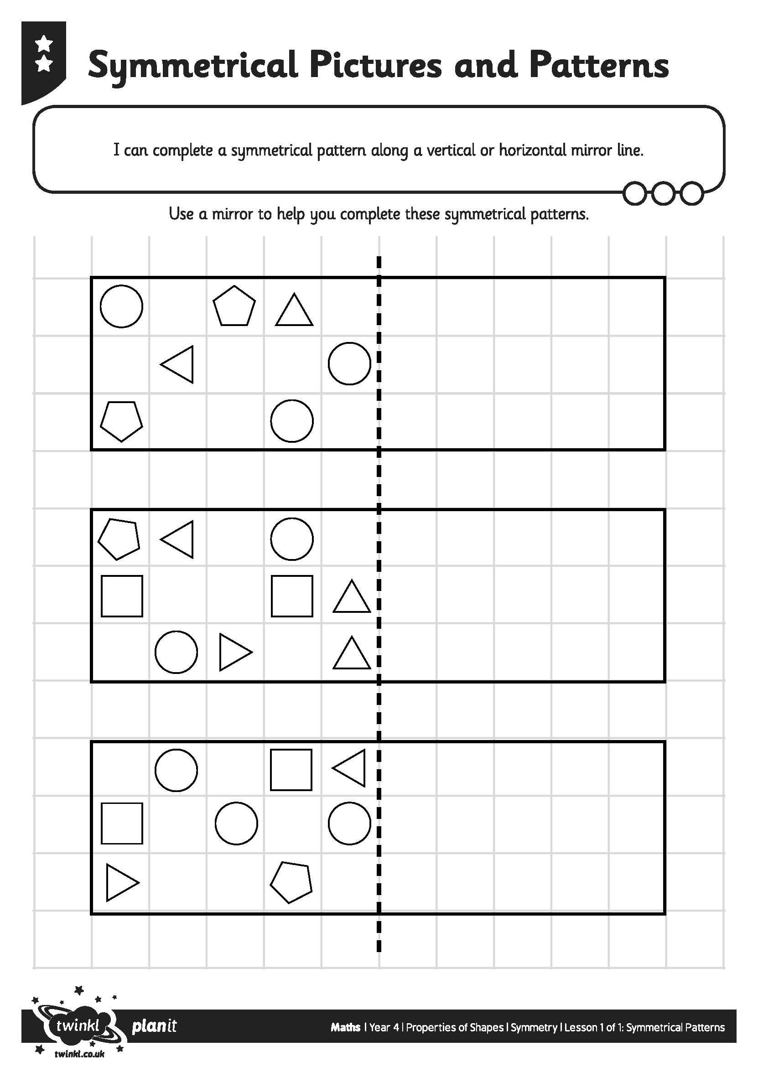
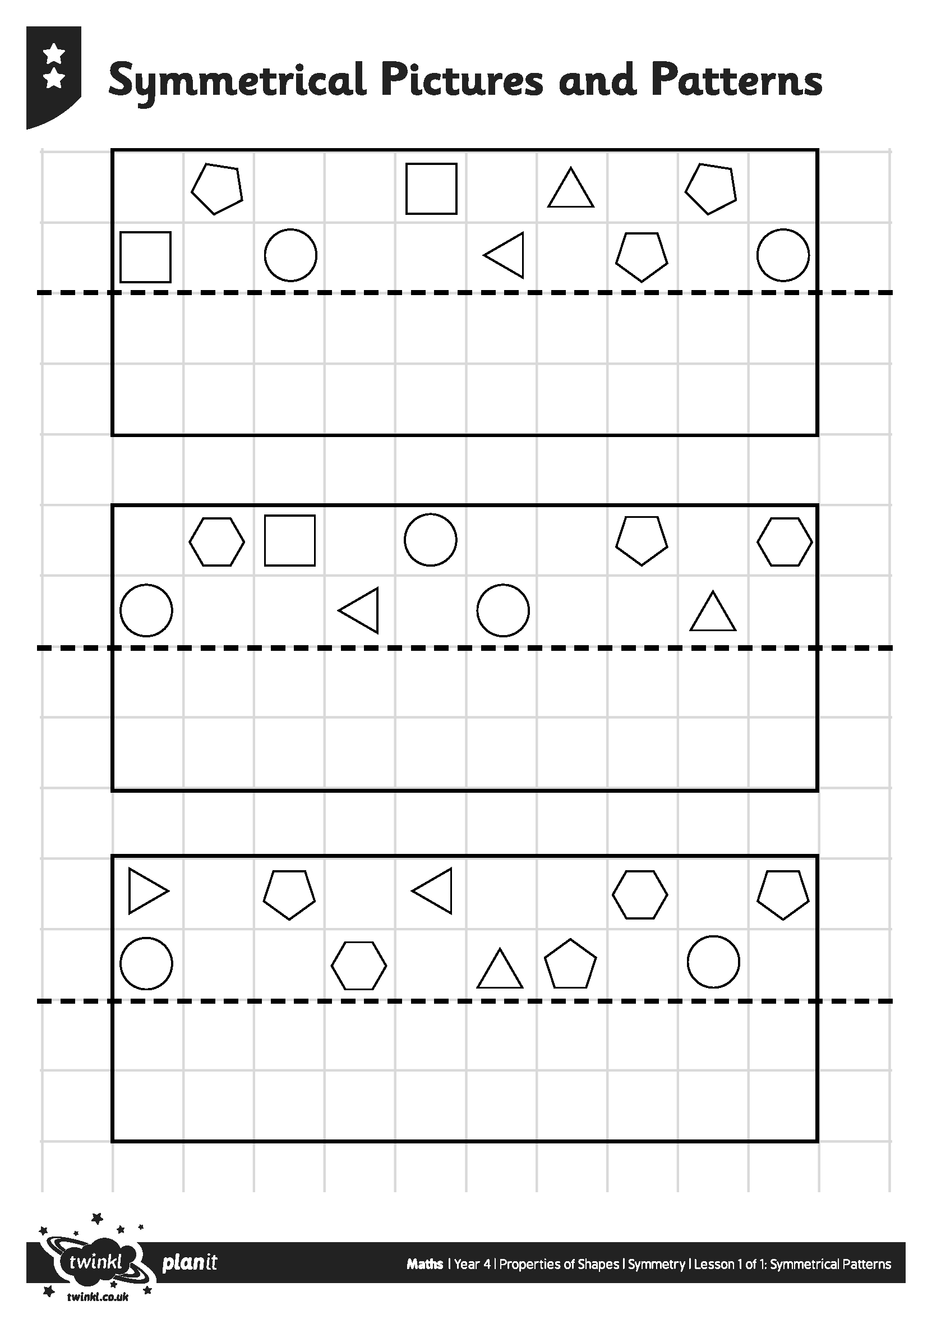
Symmetrical Pictures and Patterns

Slide 20
Capital Letter Symmetry
Identify the lines of symmetry in these capital letters.
A | B | C | D | E | F | G
H | I | J | K | L | M | N
O | P | Q | R | S | T | U
V | W | X | Y | Z

Slide 21

Aim
I can complete a symmetrical pattern or drawing.
Success Criteria
I can complete a symmetrical drawing along a vertical or horizontal mirror line.
I can complete a symmetrical pattern along a vertical or horizontal mirror line.
I can complete symmetrical patterns where the mirror line is on a diagonal.

