Slide 1
Maths
Measurement
Year One
Maths | Year 3 | Measurement | Telling the Time | Lesson 1 of 7: Telling the Time in Five-Minute Intervals

Slide 2
Telling the Time in Five-Minute Intervals

Slide 3
Aim
I can tell and write the time in 5-minute intervals.
Success Criteria
I can tell the time in 5-minute intervals.
I can write the time in 5-minute intervals.

Slide 4
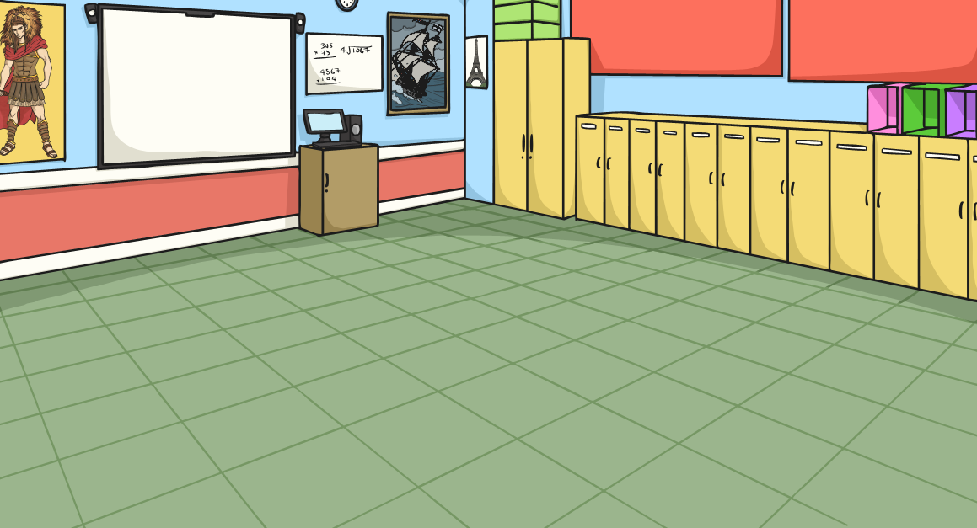
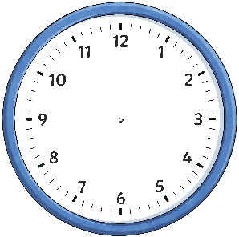
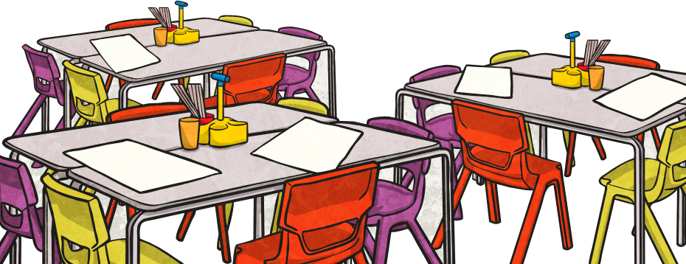
O’Clock, Half Past,
Quarter Past, Quarter To
Click on the times to reveal the answers.
5 o’clock
Half Past
7
Quarter Past 1
Quarter
To 11
Half Past 10
Quarter
To 3
Quarter Past 10
6 o’clock
Quarter Past 7
Half Past 11
Quarter
To 2
3 o’clock

Slide 5
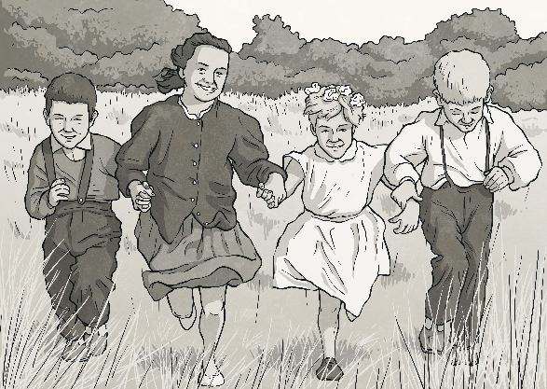
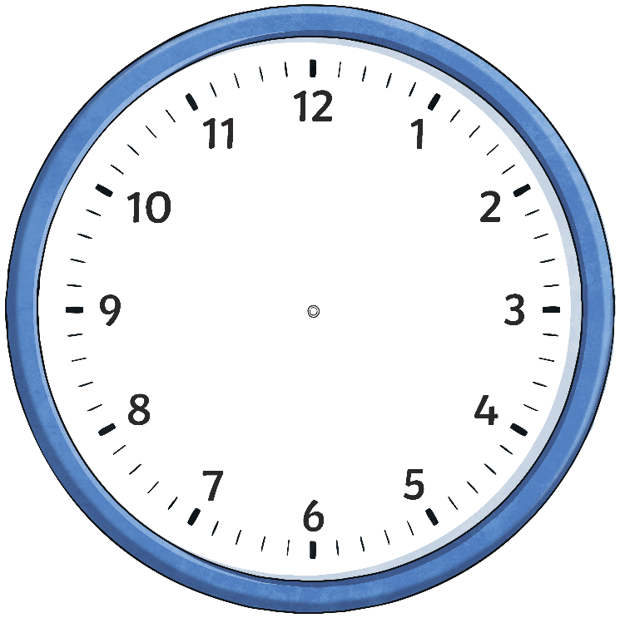
Telling the Time Past the Hour
Starting at 12, we count clockwise round the clock to tell us
minutes past the hour.
5 past
10 past
15 minutes past
(quarter past)
20 past
25 past
30 minutes past
(half past)

Slide 6
Telling the Time Past the Hour
What time is it?
5 past
hide hint
hint
10 past
15 minutes past
(quarter past)
20 past
25 past
5 past 5
30 minutes past
(half past)

Slide 7
Telling the Time Past the Hour
What time is it?
5 past
hide hint
hint
10 past
15 minutes past
(quarter past)
20 past
25 past
10 past 9
30 minutes past
(half past)

Slide 8
Telling the Time Past the Hour
What time is it?
5 past
hide hint
hint
10 past
15 minutes past
(quarter past)
20 past
15 minutes past 11
(quarter
past 11)
25 past
30 minutes past
(half past)

Slide 9
Telling the Time Past the Hour
What time is it?
5 past
hide hint
hint
10 past
15 minutes past
(quarter past)
20 past
25 past
20 past 2
30 minutes past
(half past)

Slide 10
Telling the Time Past the Hour
What time is it?
5 past
hide hint
hint
10 past
15 minutes past
(quarter past)
20 past
25 past 12
25 past
30 minutes past
(half past)

Slide 11
Telling the Time Past the Hour
What time is it?
5 past
hide hint
hint
10 past
15 minutes past
(quarter past)
20 past
30 minutes past 9
(half past 9)
25 past
30 minutes past
(half past)

Slide 12
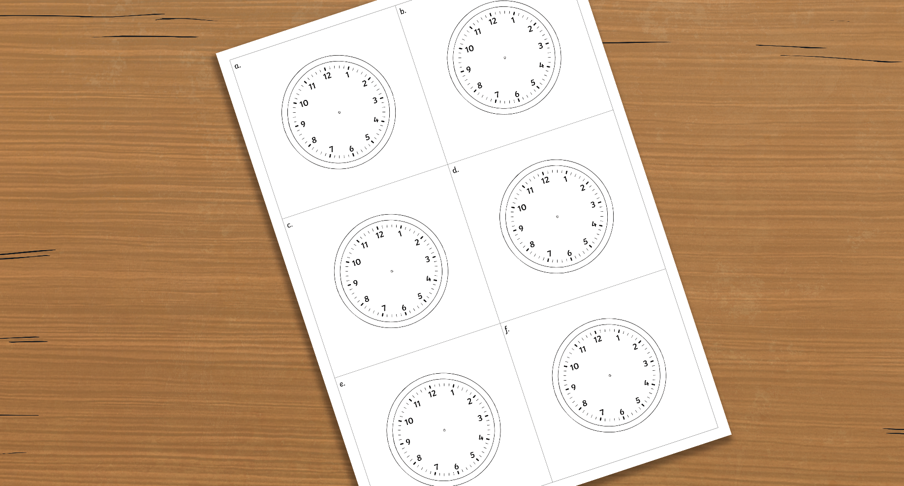
Draw the Clock Hands - Past the Hour
Use the Blank Clock Face Sheet.
Draw hands on the clocks to show these times:
c.
quarter past 5
a.
5 past 8
b.
25 past 11
d.
20 past 7
e.
10 past 6
f.
quarter past 1

Slide 13
Draw the Clock Hands - Past the Hour
a) 5 past 8
The big hand points to the 1, the small hand points just after the 8.

Slide 14
Draw the Clock Hands - Past the Hour
b) 25 past 11
The big hand
points to the 5, the small hand points almost halfway between the
11 and 12.

Slide 15
Draw the Clock Hands - Past the Hour
c) quarter past 5
The big hand points to the 3, the small hand points a quarter of the way between the
5 and 6.

Slide 16
Draw the Clock Hands - Past the Hour
d) 20 past 7
The big hand points to the 4, the small hand points just before halfway between the
7 and 8.

Slide 17
Draw the Clock Hands - Past the Hour
e) 10 past 6
The big hand points to the 2, the small hand points just
past 6.

Slide 18
Draw the Clock Hands - Past the Hour
f) quarter past 1
The big hand
points to the 3, the small hand points a quarter of the way between the 1 and the 2.

Slide 19
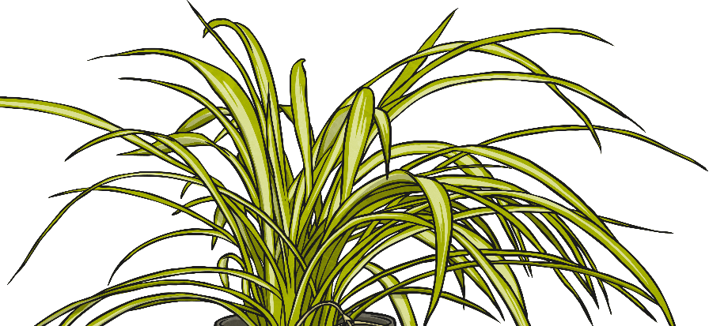
Telling the Time to the Hour
Starting at 12, we count anticlockwise round the clock to tell us
minutes to the hour.
5 to
10 to
15 minutes to
(quarter to)
20 to
25 to

Slide 20
Telling the Time to the Hour
What time is it?
hide hint
5 to
hint
10 to
15 minutes to
(quarter to)
20 to
5 to 6
25 to

Slide 21
Telling the Time to the Hour
What time is it?
hide hint
5 to
hint
10 to
15 minutes to
(quarter to)
20 to
10 to 8
25 to

Slide 22
Telling the Time to the Hour
What time is it?
hide hint
5 to
hint
10 to
15 minutes to
(quarter to)
20 to
15 minutes to 2
(quarter to 2)
25 to

Slide 23
Telling the Time to the Hour
What time is it?
hide hint
5 to
hint
10 to
15 minutes to
(quarter to)
20 to
20 to 12
25 to

Slide 24
Telling the Time to the Hour
What time is it?
hide hint
5 to
hint
10 to
15 minutes to
(quarter to)
20 to
25 to 3
25 to

Slide 25
Draw the Clock Hands - To the Hour
Use the Blank Clock Face Sheet.
Draw hands on the clocks to show these times:
c.
quarter to 10
a.
5 to 9
b.
25 to 3
d.
20 to 11
e.
10 to 2
f.
20 to 8

Slide 26
Draw the Clock Hands - To the Hour
a) 5 to 9
The big hand points to the 11, the small hand points almost to the 9.

Slide 27
Draw the Clock Hands - To the Hour
b) 25 to 3
The big hand
points to the 7, the small hand points just after halfway between the 2 and the 3.

Slide 28
Draw the Clock Hands - To the Hour
c) quarter to 10
The big hand
points to the 9, the small hand points three quarters of the way between the 9 and the 10.

Slide 29
Draw the Clock Hands - To the Hour
d) 20 to 11
The big hand
points to the 8, the small hand just after halfway between the 10 and the 11.

Slide 30
Draw the Clock Hands - To the Hour
e) 10 to 2
The big hand points to the 10, the small hand points just before the 2.

Slide 31
Draw the Clock Hands - To the Hour
f) 20 to 8
The big hand
points to the 8, the small hand just after halfway between
the 7 and the 8.

Slide 32
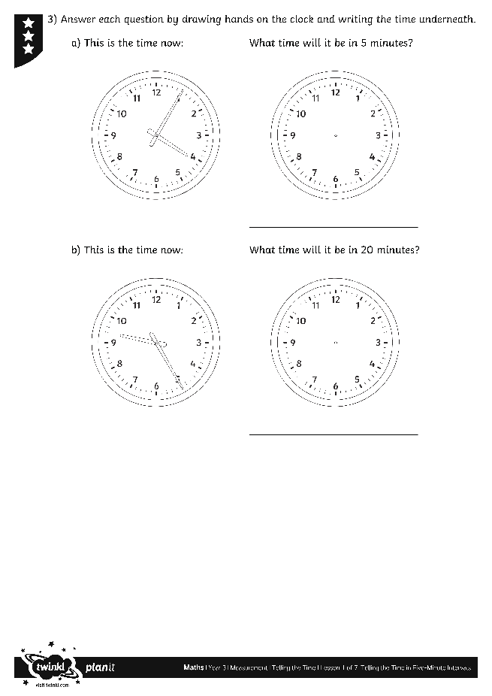
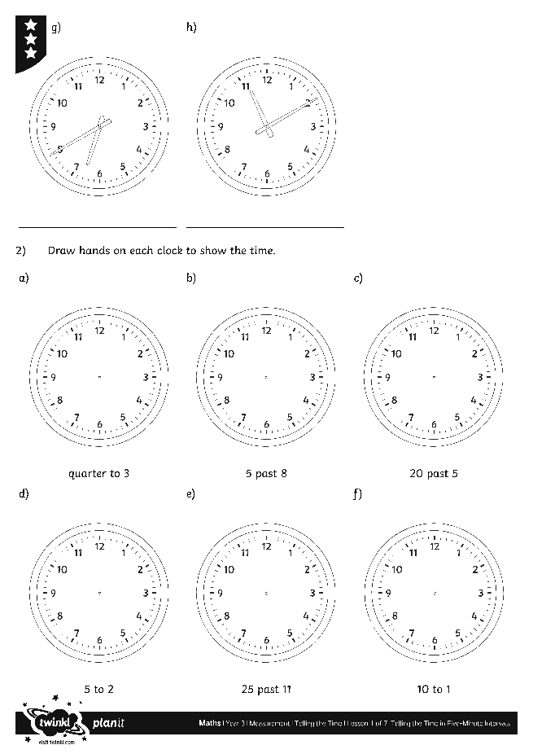
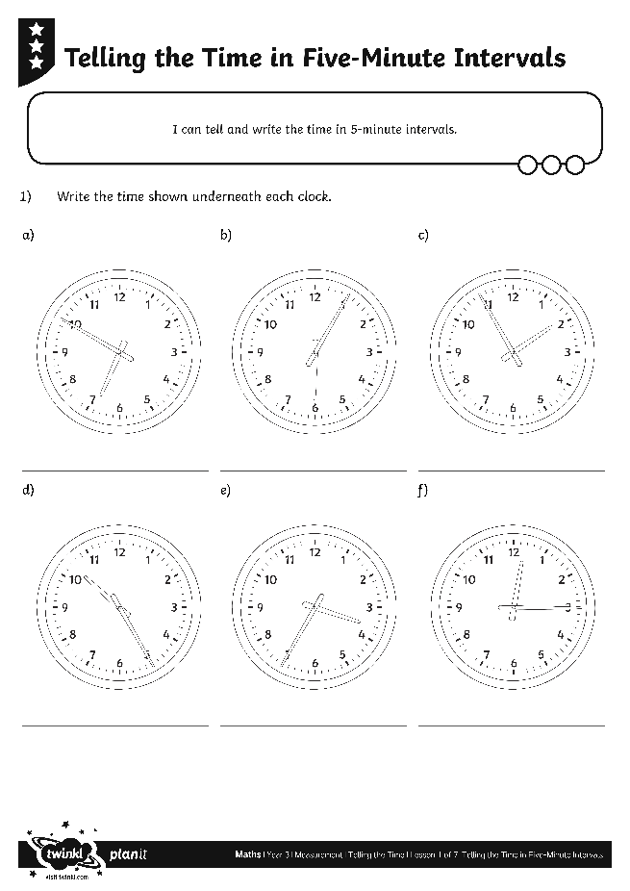
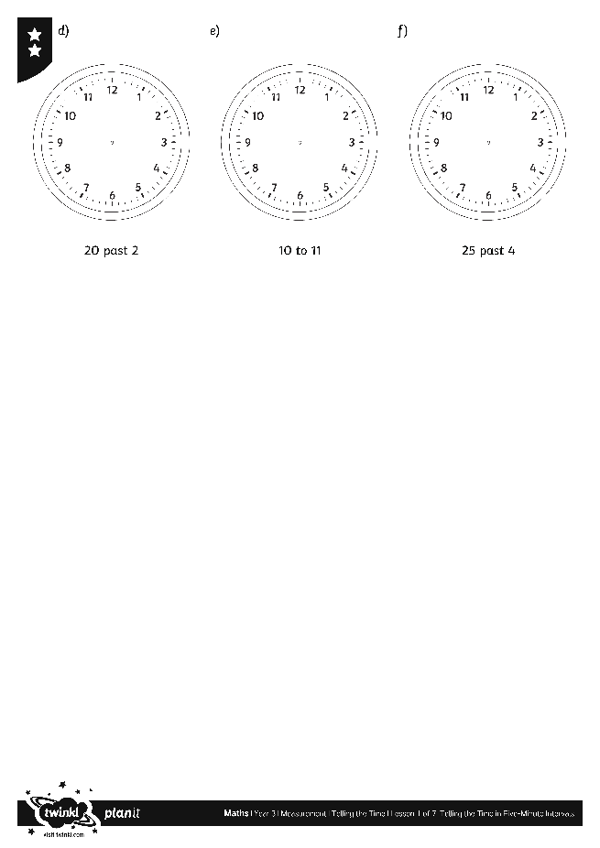
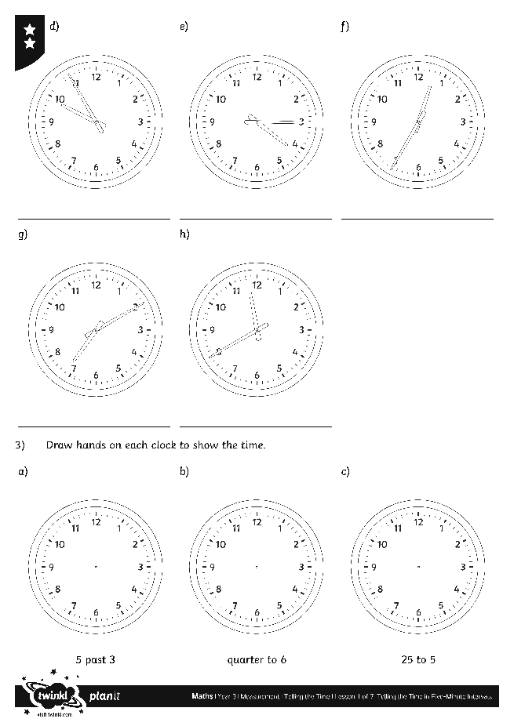
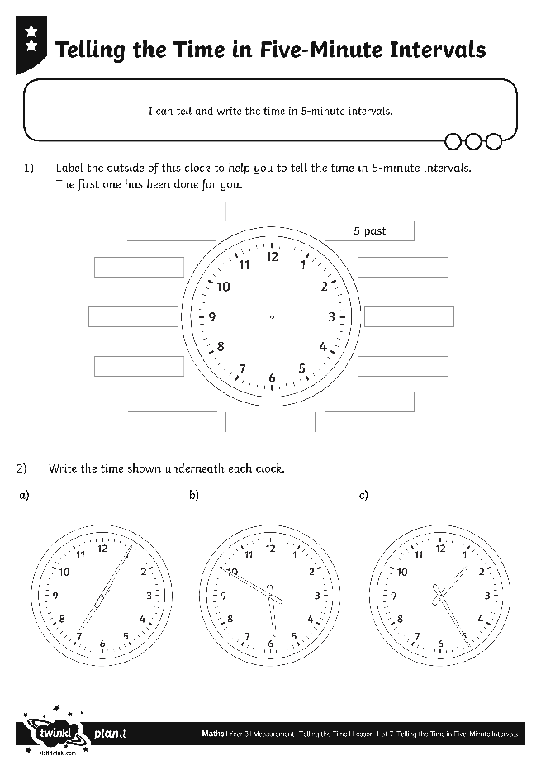
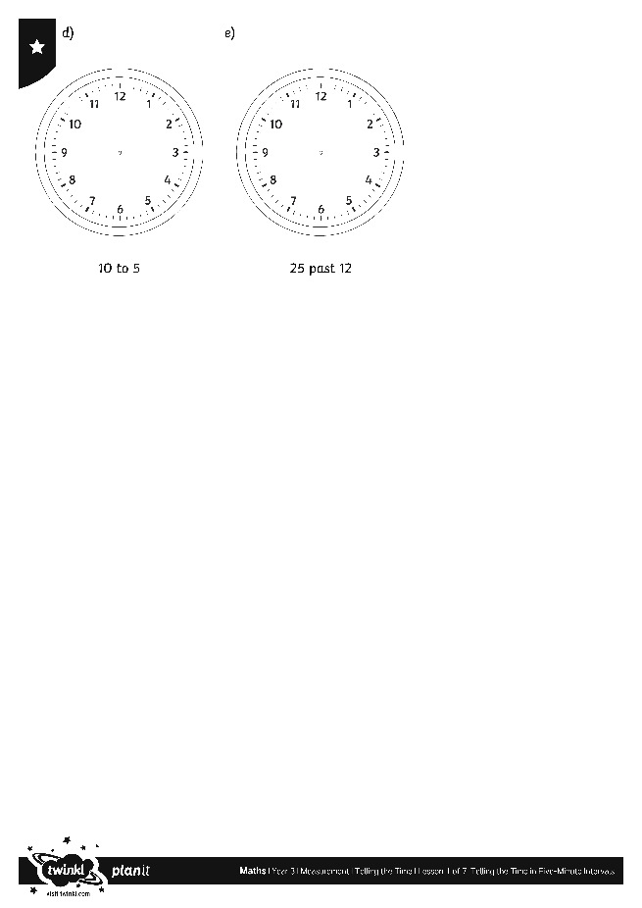
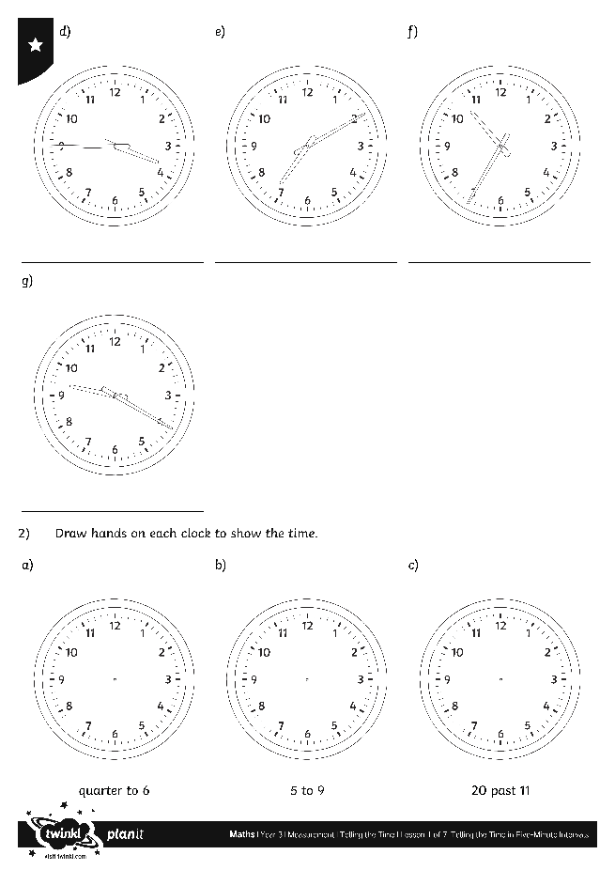
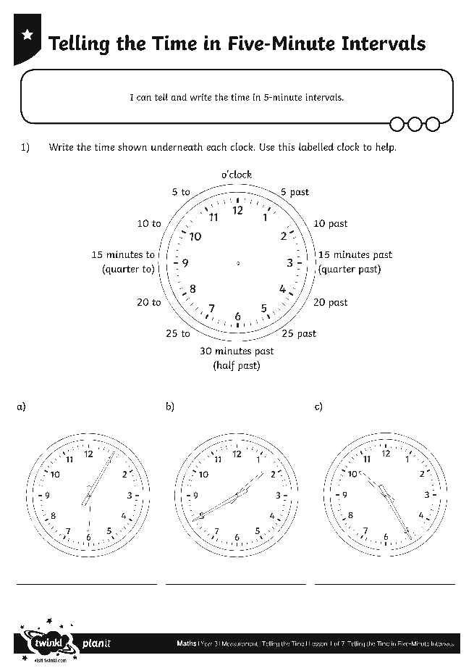
Telling the Time in
Five-Minute Intervals

Slide 33
What’s the Time If…?
What’s the time if...
The big hand points to the 3 and the small hand past the 4?
15 minutes
past 4
(quarter
past 4)

Slide 34
What’s the Time If…?
What’s the time if...
The big hand points to the 7 and the small hand between the 11 and 12?
25 to 12

Slide 35
What’s the Time If…?
What’s the time if...
The big hand points to the 11 and the small hand just before the 7?
5 to 7

Slide 36
What’s the Time If…?
What’s the time if...
The big hand points to the 5 and the small hand between the 8 and 9?
25 past 8

Slide 37
What’s the Time If…?
What’s the time if...
The big hand points to the 4 and the small hand between the 1 and 2?
20 past 1

Slide 38
What’s the Time If…?
What’s the time if...
The big hand points to the 8 and the small hand between the 5 and 6?
20 to 6

Slide 39
Aim
I can tell and write the time in 5-minute intervals.
Success Criteria
I can tell the time in 5-minute intervals.
I can write the time in 5-minute intervals.

