Slide 1
Maths
Measurement
Year One
Maths | Year 3 | Measurement | Telling the Time | Lesson 2 of 7: Minutes Past the Hour

Slide 2
Minutes Past the Hour

Slide 3
Aim
I can tell and write the time in minutes past the hour.
Success Criteria
I can tell the time in minutes past the hour.
I can write the time in minutes past the hour.

Slide 4
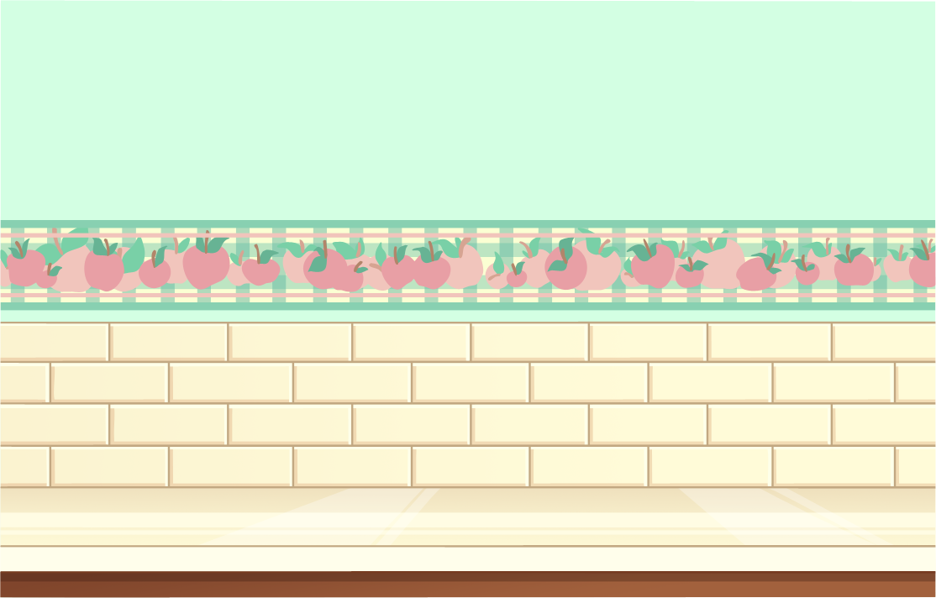
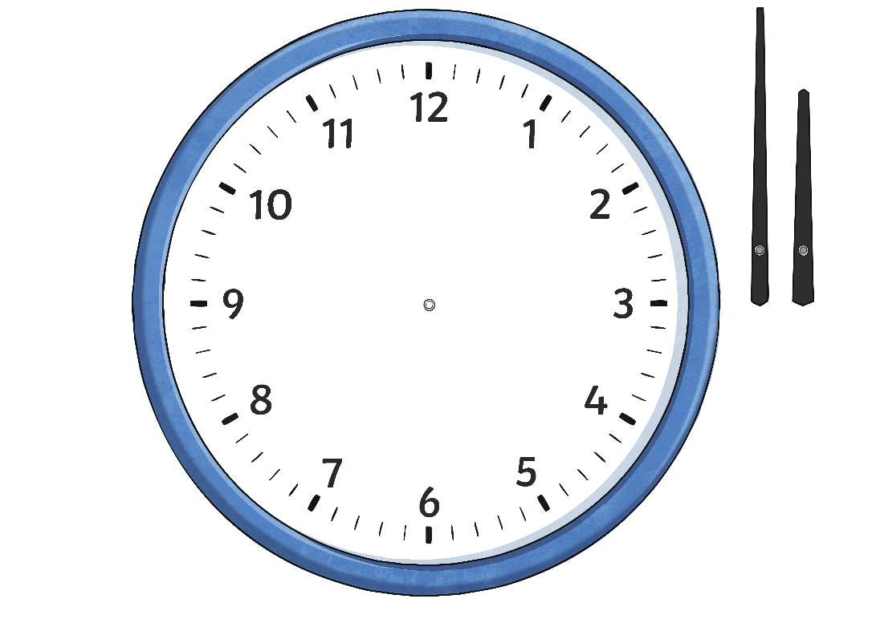
Minute Past the Hour
We already know how to tell the time in five-minute intervals.
5 past
10 past
15 minutes past
(quarter past)
We can tell the time to the nearest minute by counting clockwise round the clock in fives, then counting on in single minutes until we reach the exact time.
20 past
25 past
30 minutes past
(half past)

Slide 5
Minute Past the Hour
Count clockwise in multiples of five, then count on in single minutes.
The big hand is
at 2 minutes after the 2. 10 minutes plus 2 minutes = 12 minutes past the hour.
12 minutes past 6

Slide 6
Minute Past the Hour
Count clockwise in multiples of five, then count on in single minutes.
The big hand is
at 3 minutes after the 4. 20 minutes plus 3 minutes = 23 minutes past the hour.
23 minutes past 10

Slide 7
Minute Past the Hour
Count clockwise in multiples of five, then count on in single minutes.
The big hand is
at 4 minutes after the 1. 5 minutes plus 4 minutes = 9 minutes past the hour.
9 minutes past 9

Slide 8
Minute Past the Hour
Count clockwise in multiples of five, then count on in single minutes.
The big hand is
at 4 minutes after the 5. 25 minutes plus 4 minutes = 29 minutes past the hour.
29 minutes past 12

Slide 9
Minute Past the Hour
Count clockwise in multiples of five, then count on in single minutes.
The big hand is
at 2 minutes after the 2. 10 minutes plus 2 minutes = 12 minutes past the hour.
12 minutes past 6

Slide 10
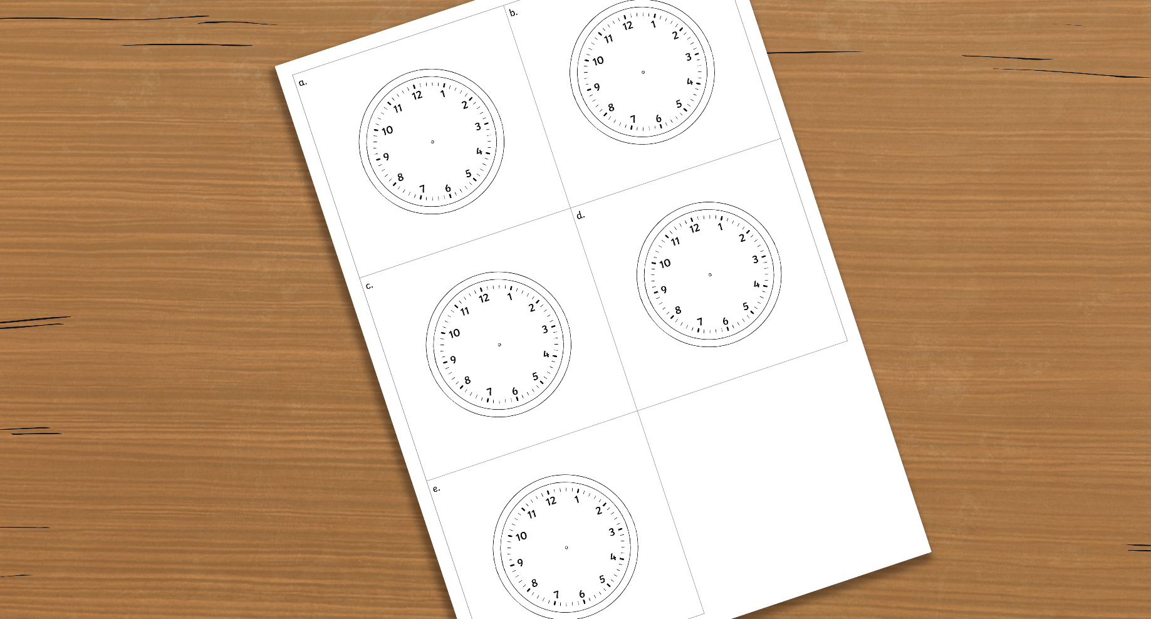
Clock Hands
Use the Blank Clock Face Sheet.
Draw hands on the clocks to show these times:
a.
16 minutes past 3
b.
22 minutes past 11
c.
6 minutes past 4
d.
28 minutes past 7
e.
13 minutes past 5
Be sure to use a ruler!
Remember – the big hand points to the minutes, and the small hand points to the hour.

Slide 11
Clock Hands
a) 16 minutes past 3
The big hand points 1 minute after the 3. The small hand points just after the 3.

Slide 12
Clock Hands
b) 22 minutes past 11
The big hand points 2 minutes after the 4.
The small hand points between
the 11 and 12.

Slide 13
Clock Hands
c) 6 minutes past 4
The big hand points 1 minute after the 1. The small hand points just past the 4.

Slide 14
Clock Hands
d) 28 minutes past 7
The big hand points 3 minutes after the 5.
The small hand points between the 7 and the 8.

Slide 15
Clock Hands
e) 13 minutes past 5
The big hand points 3 minutes after the 2. The small hand points after the 5.

Slide 16
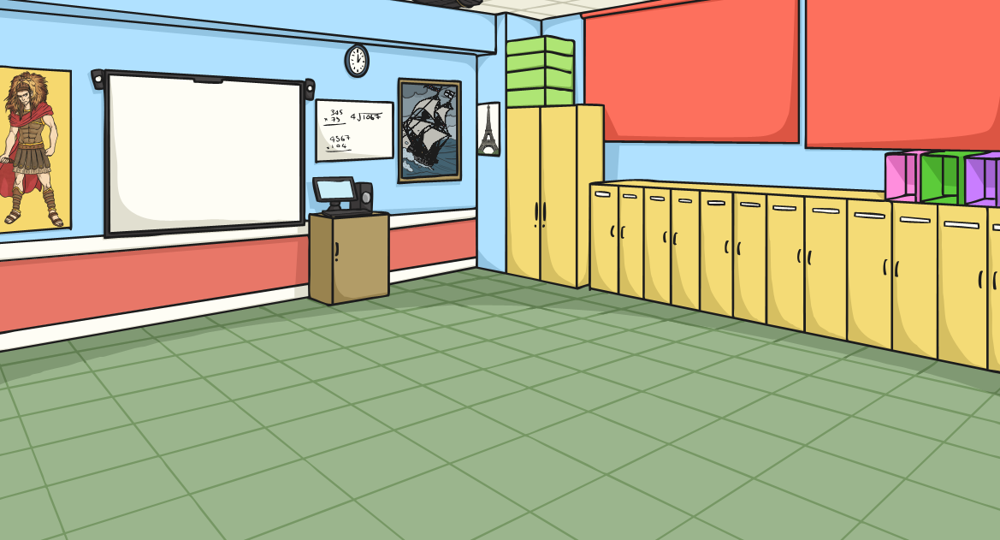
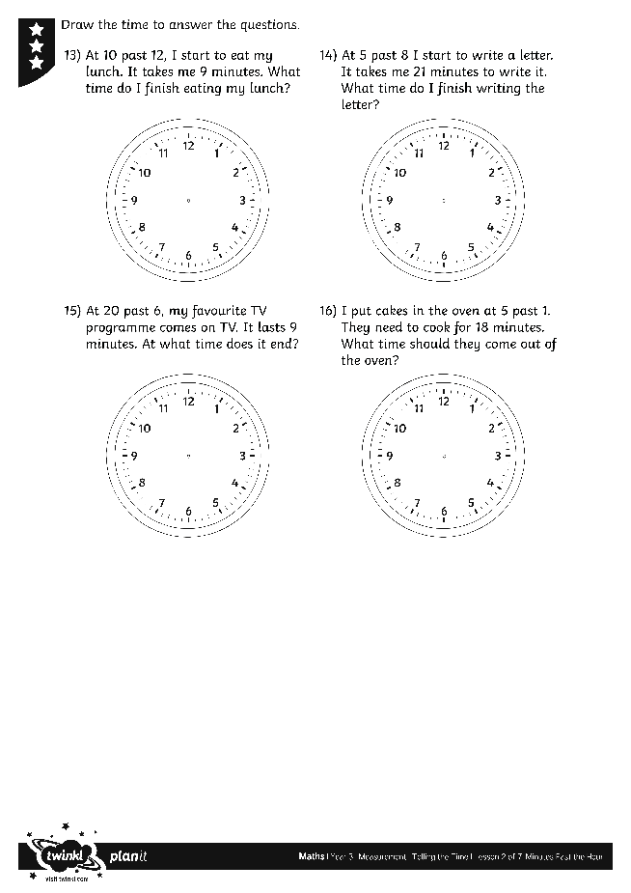
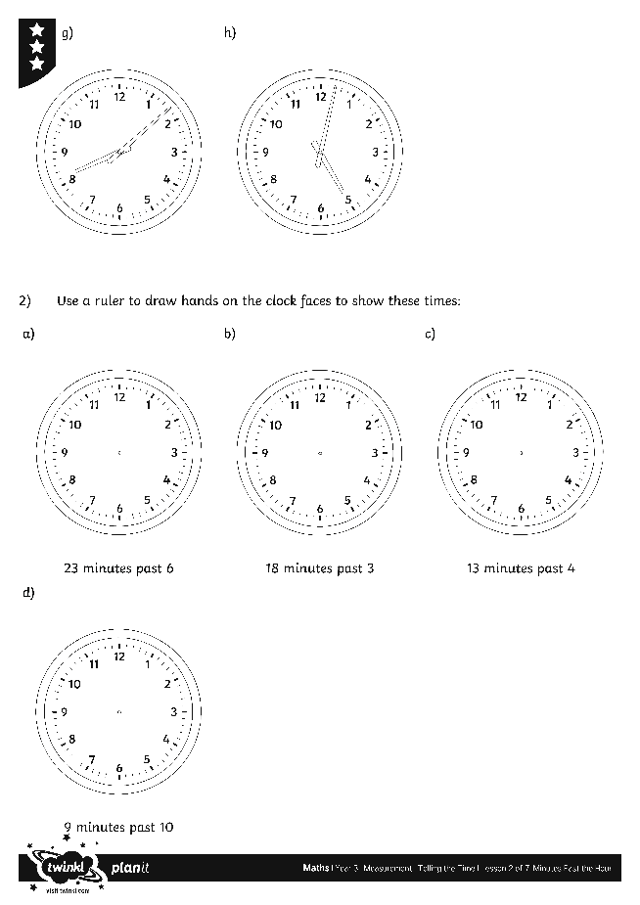
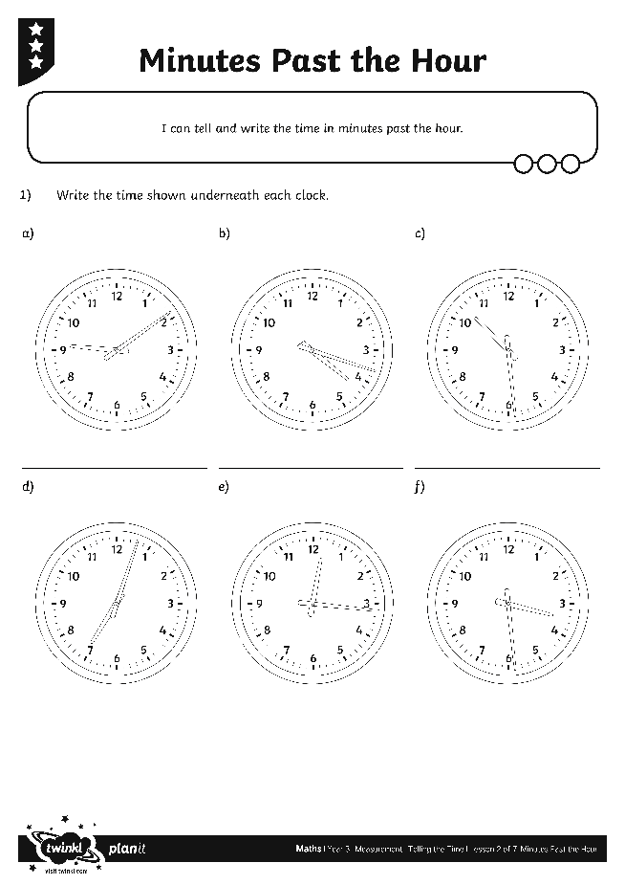
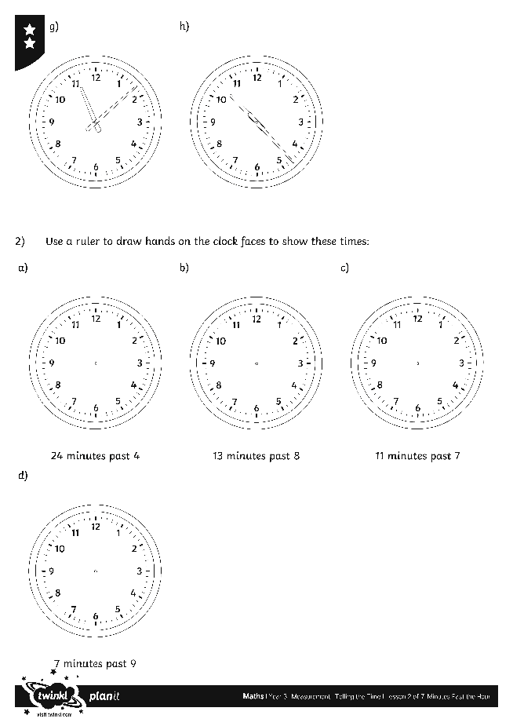
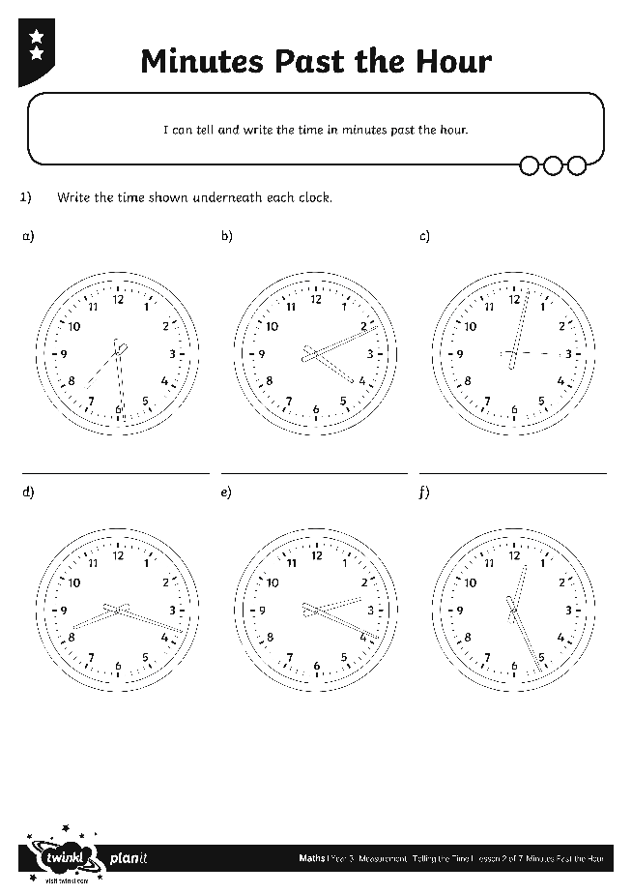
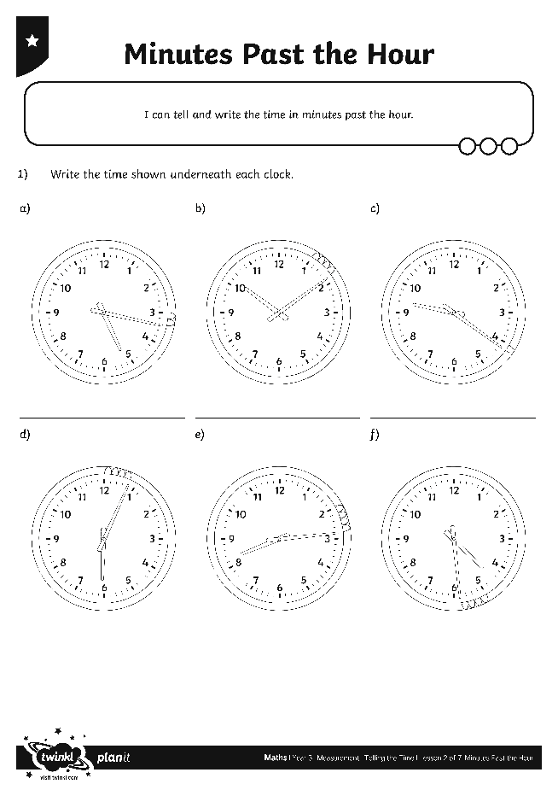
Minutes Past the Hour
Use your terrific time skills to complete these activity sheets:

Slide 17
What Will the Time Be?
What time will it be 12 minutes after the time shown?
12 minutes
past 10

Slide 18
What Will the Time Be?
What time will it be 8 minutes after the time shown?
18 minutes
past 7

Slide 19
What Will the Time Be?
What time will it be 8 minutes after the time shown?
13 minutes
past 9

Slide 20
What Will the Time Be?
What time will it be 6 minutes after the time shown?
26 minutes
past 1

Slide 21
What Will the Time Be?
What time will it be 14 minutes after the time shown?
29 minutes
past 11

Slide 22
What Will the Time Be?
What time will it be 11 minutes after the time shown?
16 minutes
past 6

Slide 23
Aim
I can tell and write the time in minutes past the hour.
Success Criteria
I can tell the time in minutes past the hour.
I can write the time in minutes past the hour.

