Slide 1
Maths
Measurement
Year One
Maths | Year 3 | Measurement | Telling the Time | Lesson 3 of 7: Minutes to the Hour

Slide 2
Minutes to the Hour

Slide 3
Aim
I can tell and write the time in minutes to the hour.
Success Criteria
I can tell the time in minutes to the hour.
I can write the time in minutes to the hour.

Slide 4
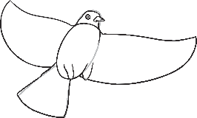
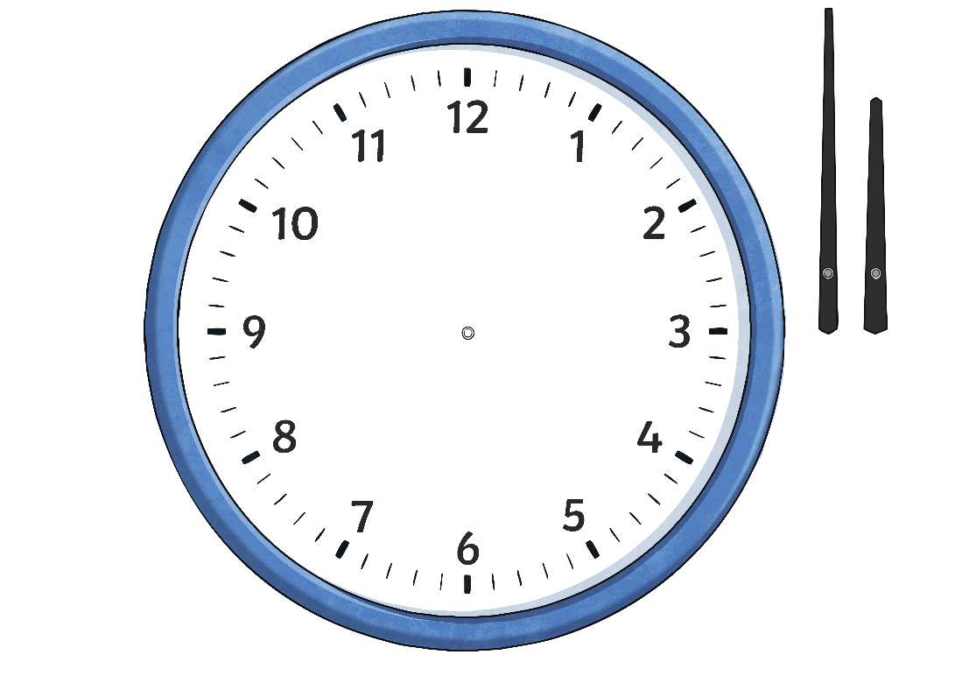
Minutes to the Hour
Count in multiples of five, anticlockwise, then count on in single minutes.
time flies
The big hand is
2 minutes before the 11. 5 plus 2 =
7 minutes to the hour.
7 minutes to 6

Slide 5
Minutes to the Hour
Count in multiples of five, anticlockwise, then count on in single minutes.
time flies
The big hand is
4 minutes before the 9. 15 plus 4 = 19 minutes to the hour.
19 minutes to 11

Slide 6
Minutes to the Hour
Count in multiples of five, anticlockwise, then count on in single minutes.
time flies
The big hand is
1 minute before the 7. 25 plus 1 =
26 minutes to the hour.
26 minutes to 2

Slide 7
Minutes to the Hour
Count in multiples of five, anticlockwise, then count on in single minutes.
time flies
The big hand is 3 minutes before the 12. 3 minutes to the hour.
3 minutes to 8

Slide 8
Minutes to the Hour
Count in multiples of five, anticlockwise, then count on in single minutes.
time flies
The big hand is 3 minutes before the 10. 10 plus 3 =
13 minutes to the hour.
13 minutes to 12

Slide 9
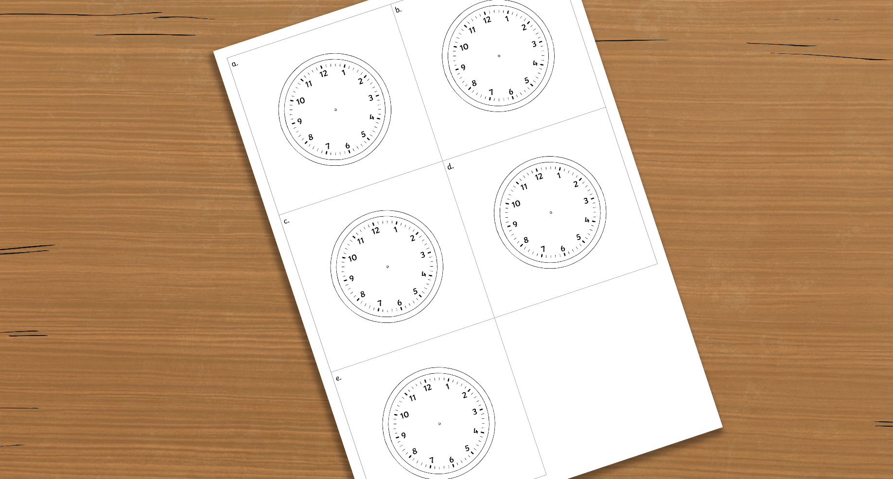
Clock Face
Use the Blank Clock Face Sheet.
Draw hands on the clocks to show these times:
a.
16 minutes to 3
b.
2 minutes
to 9
c.
23 minutes to 6
d.
19 minutes past 5
e.
8 minutes
to 10
Be sure to use a ruler!
Remember – the big hand points to the minutes, and the small hand points to the hour.

Slide 10
Clock Face
a) 16 minutes to 3
time flies
The big hand points 1 minute before the 9. The small hand points between the 2
and the 3.

Slide 11
Clock Face
b) 2 minutes to 9
time flies
The big hand points 2 minutes before the 12. The small hand points almost on the 9.

Slide 12
Clock Face
c) 23 minutes to 6
time flies
The big hand points 3 minutes before the 8. The small hand points between the 5
and 6.

Slide 13
Clock Face
d) 19 minutes to 5
time flies
The big hand points 4 minutes before the 9. The small hand points between the 4
and 5.

Slide 14
Clock Face
e) 8 minutes to 10
time flies
The big hand points 3 minutes before the 11. The small hand points between the 9
and 10.

Slide 15
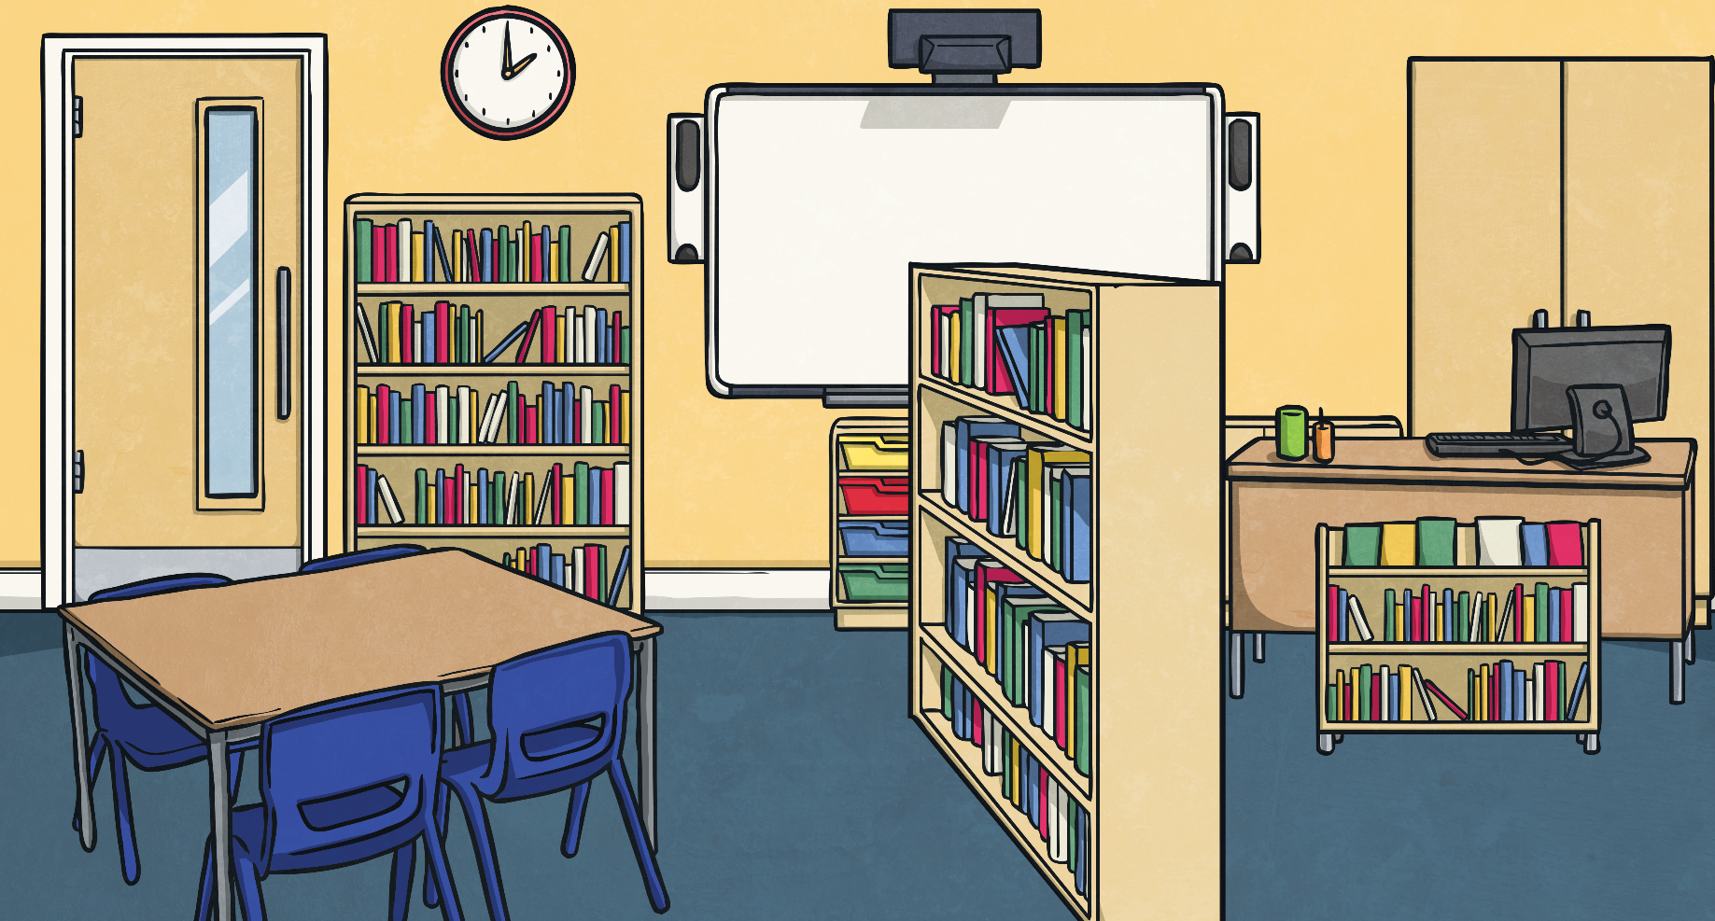
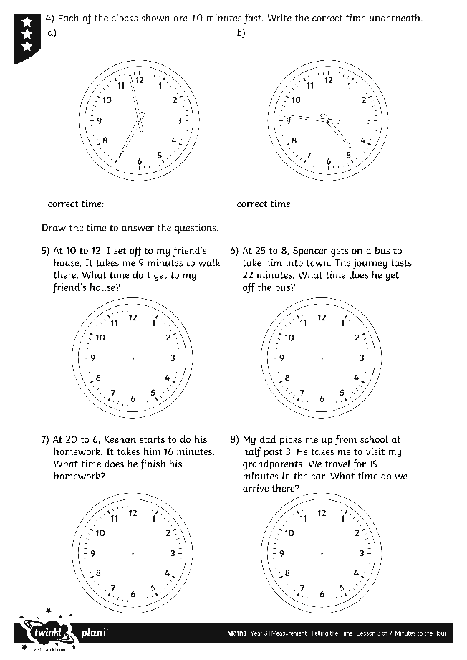
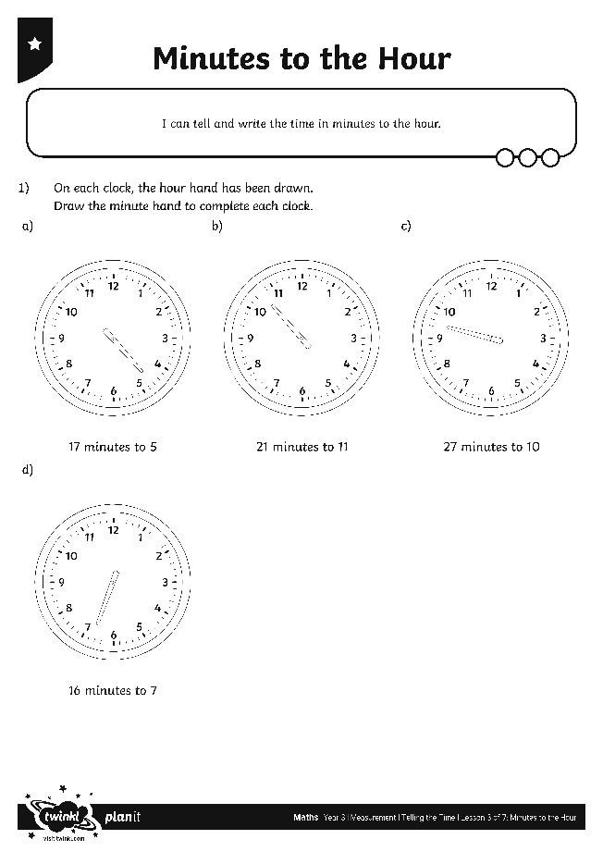
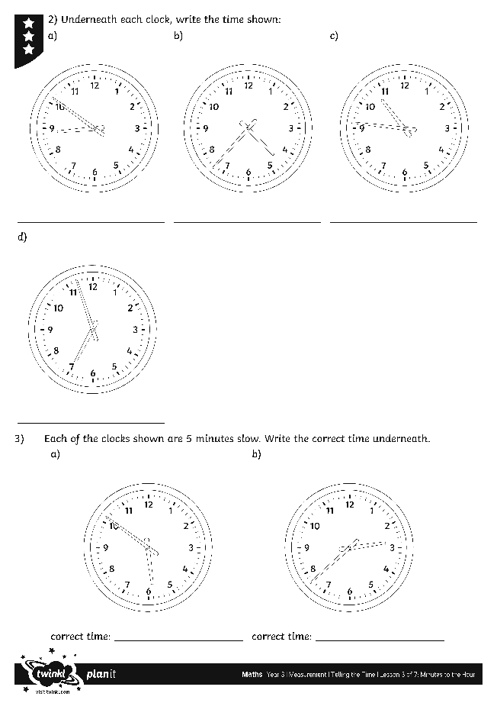
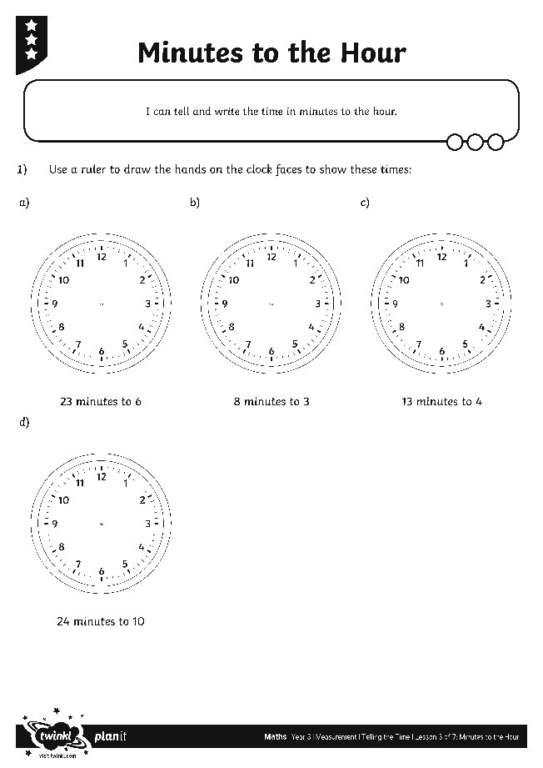
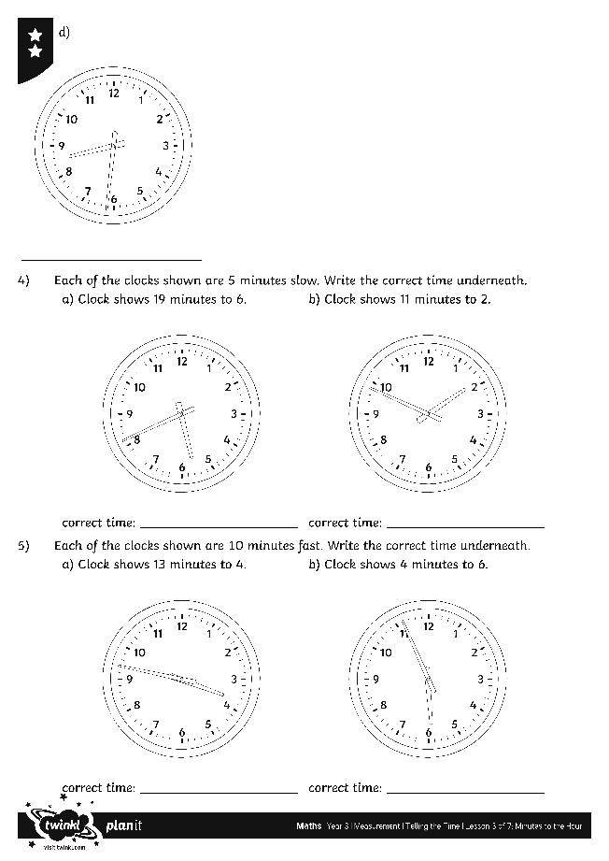
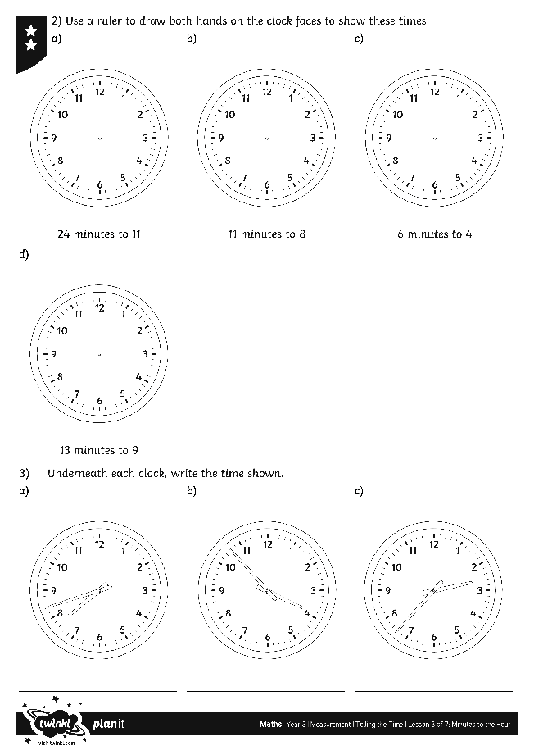
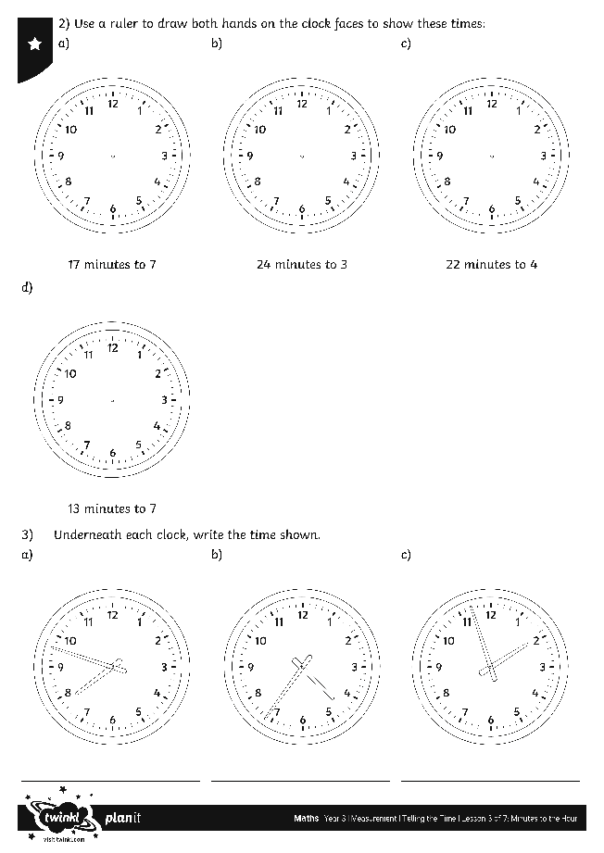
Minutes to the Hour
Use your terrific time skills to complete these activity sheets:

Slide 16
What Time Is It?
Jagdeep is looking in a mirror. He can see this reflection of a clock face. What is the actual time shown by the clock?
seilf emit
5 to
10 to
15 minutes to
(quarter to)
20 to
25 to
hide hint
hint
7 minutes to 8

Slide 17
What Time Is It?
Jagdeep is looking in a mirror. He can see this reflection of a clock face. What is the actual time shown by the clock?
seilf emit
5 to
10 to
15 minutes to
(quarter to)
20 to
25 to
hide hint
hint
26 minutes to 2

Slide 18
What Time Is It?
Jagdeep is looking in a mirror. He can see this reflection of a clock face. What is the actual time shown by the clock?
seilf emit
5 to
10 to
15 minutes to
(quarter to)
20 to
25 to
hide hint
hint
21 minutes to 5

Slide 19
What Time Is It?
Jagdeep is looking in a mirror. He can see this reflection of a clock face. What is the actual time shown by the clock?
seilf emit
5 to
10 to
15 minutes to
(quarter to)
20 to
25 to
hide hint
hint
3 minutes to 9

Slide 20
Aim
I can tell and write the time in minutes to the hour.
Success Criteria
I can tell the time in minutes to the hour.
I can write the time in minutes to the hour.

