Slide 1
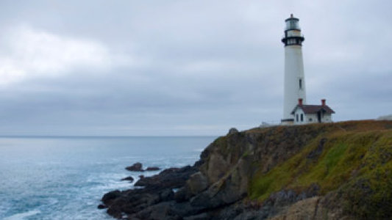
The Lighthouse Keeper
Creating Suspense and Showing How a Character feels

Slide 2
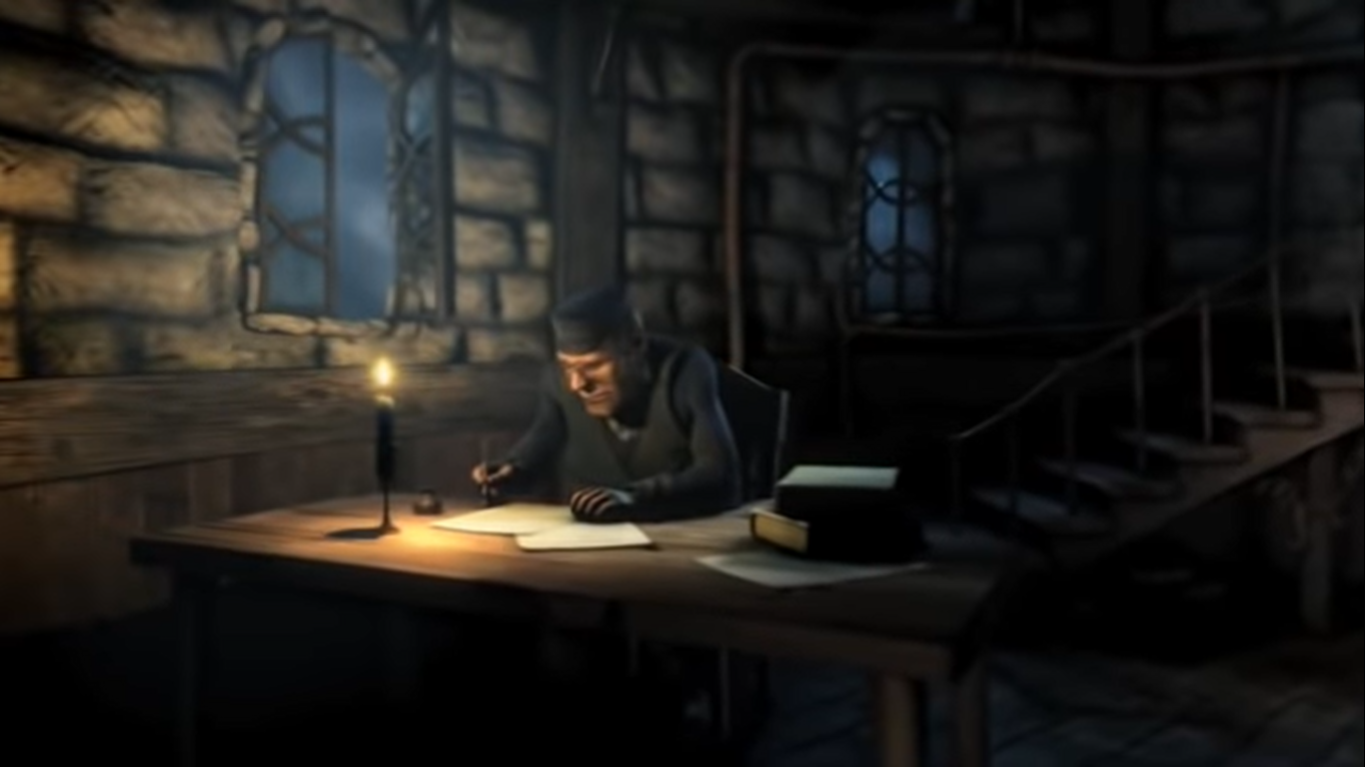
Watch the film until the lighthouse keeper closes the window. Think about these questions:
What sort of mood is the lighthouse keeper in?
Why do you think he’s in this mood?
What do you think he’s writing?
Could it be letters? If so, who to and what is he saying?
Or could it a be a diary? What could he be writing in it?
Why does he shut the window?
Record your ideas in your book so you can look at them another time. (you don’t need to write out a full letter or diary entry just ideas for what he could be writing)

Slide 3
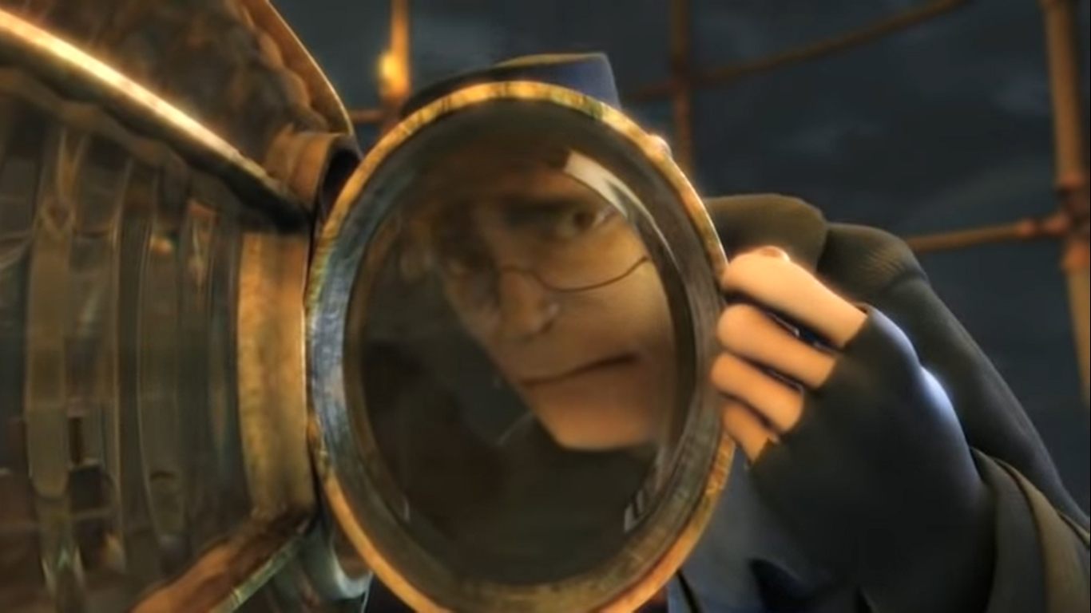
Watch the next part of it up to the bit where the lighthouse keeper starts to rush downstairs.
How do you think the lighthouse keeper feels when he hears the ship coming? How do you know?
If you were to write how he feels using ‘show not tell’ you might write;
In the distance, a foghorn sounded. The lighthouse keeper gasped in horror. A boat was approaching!
Fronted adverbial
I did not say ‘The lighthouse keeper felt scared’ or ‘The lighthouse keeper was terrified.’ I also used short sentences to increase the level of suspense and drama.
As you know, it is usually more effective when an author shows how their character is feeling through the way they act rather than simply describing their feelings.

Slide 4
Now let’s have a look at the same part of the film again. We’re going to write 4 sentences to show how the lighthouse keeper feels until he decides to go downstairs.
So that’s when he first hears the ship approaching; when he lifts the lamp off the stand; when he breaks the lamp and when he hears the ship’s horn for a second time.
First, let’s think of some fronted adverbials (or other exciting openers) that we could use to open our sentences. I’ll start you off and then I’d like you to time yourself for two minutes by playing the video in the corner of the screen. See how many you can write in that time.
In the distance,
Out at sea,

Slide 5
What did you come up with?
Here’s a few more to help if you couldn’t think of too many…
In a panic,
His chest tightening,
Stumbling backwards,
Approaching from the West,
Looming out of the fog,

Slide 6
Now, let’s have a think about the rest of the sentences.
What vocabulary/exciting phrases could we use? If you have a thesaurus, use it to find some good words for example, if you were going to write ‘loud’ you could look it up in your thesaurus and find a more exciting word like ‘deafening’ instead.
Spend a few minutes (no more than 5) thinking of possible vocabulary or exciting phrases that you could use. You could talk to an adult or older sibling if anyone is free.
For example:
deafening roar
panic-stricken
an overwhelming sense of dread
Stumbling backwards
If you do come up with some exciting vocabulary, it would be great if you could share it with me on Tapestry so I can make a list to share with everyone.
Try to think about what happens to people when they feel scared.

Slide 7
Now try writing your 4 sentences (or groups of short sentences) . Watch the film again and remember the 4 sentences you’re writing are;
When he first hears the ship approaching
When he lifts the lamp off the stand
When he breaks the lamp
When he hears the ship’s horn for a second time.
Don’t forget to try using different openers like fronted adverbials or verbs like ‘Stumbling backwards over his tool box,’
Try to use some exciting conjunctions
whilst, because, so that, even though, as

