Slide 1
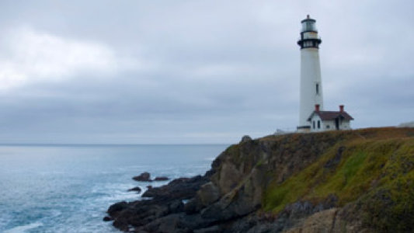
The Lighthouse Keeper
Writing the opening to the story.

Slide 2
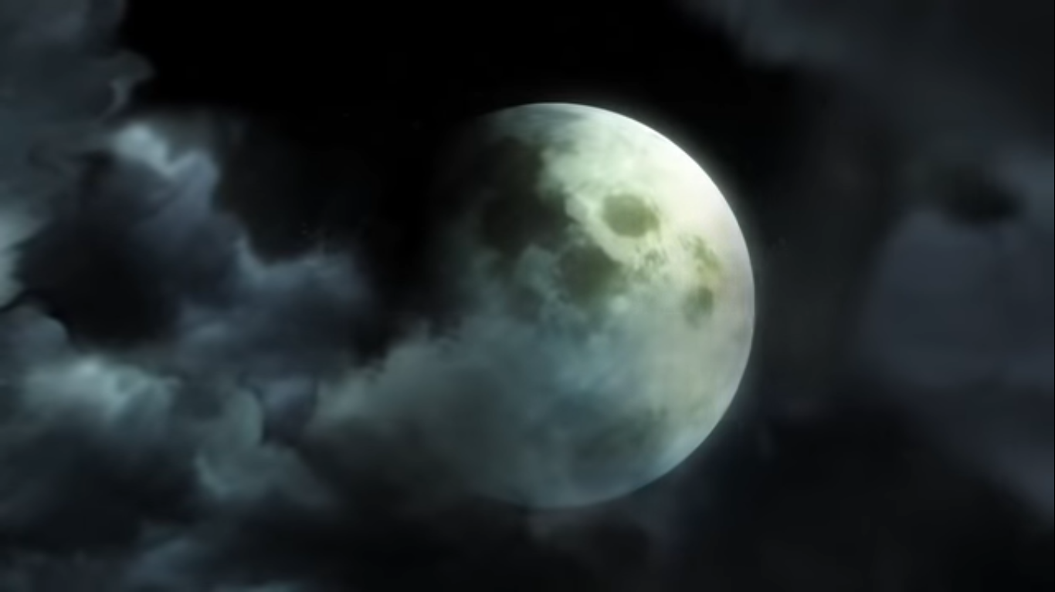
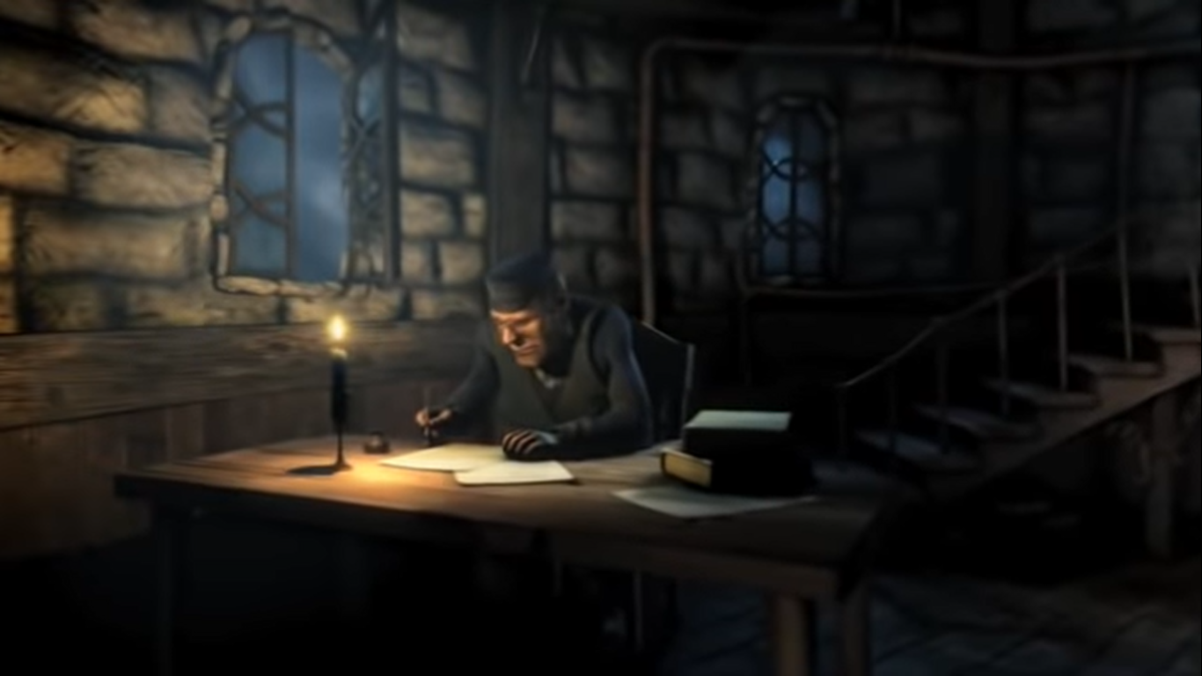
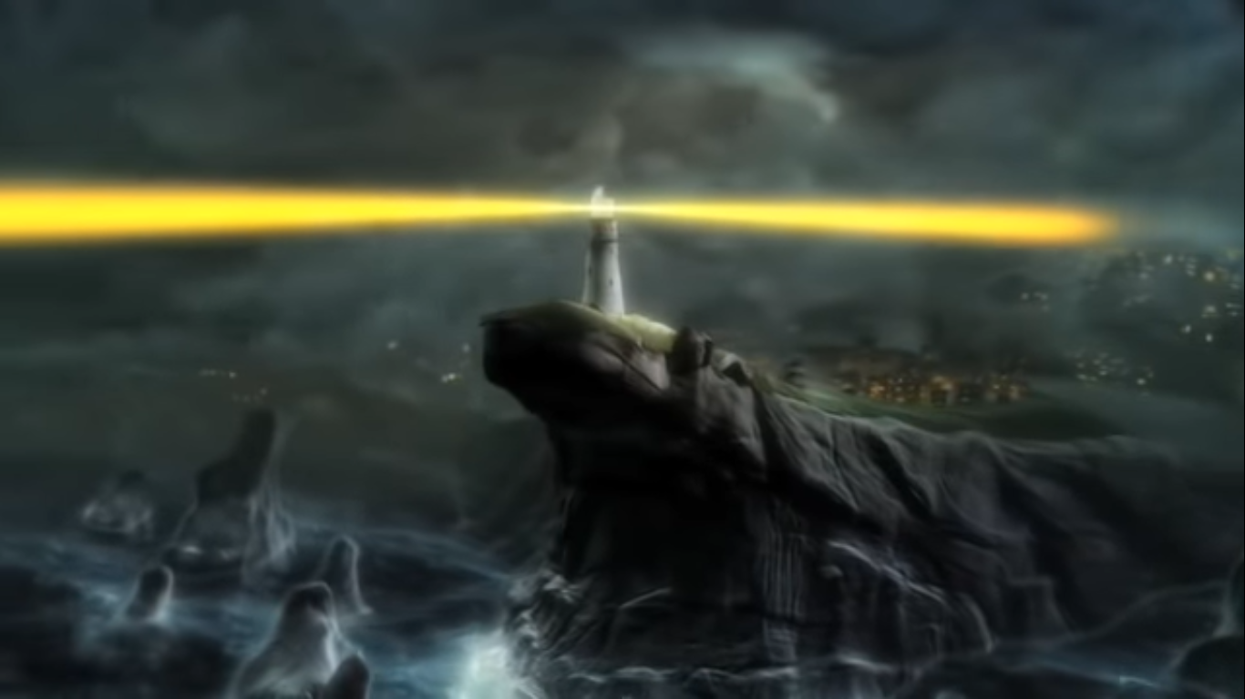
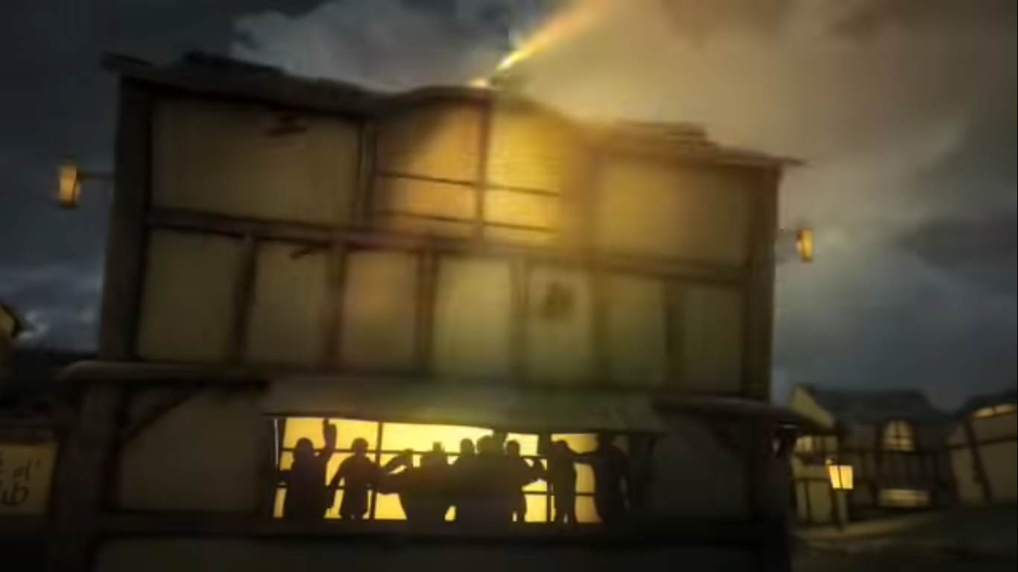
Watch the film until the lighthouse keeper closes the window. We’re just focussing on the beginning of the story today.

Slide 3
Your task today is to write the beginning of the story up until the part where the lighthouse keeper shuts the window. Look back at the notes you made yesterday about the questions about the lighthouse keeper from the first slide and then at the vocabulary you generated and the sentences you wrote, just to get you back into the feeling of the film.
Now let’s have a look at the opening shot of the film where the moon is in the middle of the screen…

Slide 4
How could we open our story? We need an interesting sentence to describe the moon. Spend 2 minutes thinking of vocabulary and phrases to describe the moon, the sky and the clouds (don’t forget to write it down).
Play the video to start the timer
Here’s a few ideas:
pearly-white
billowing clouds

Slide 5
What did you come up with? I’d love to see some of your ideas so I can add them to our collection of vocabulary.
Now let’s think about how we’re going to open the story…
You might start with the time of day or a description of the moon or you might even mention that it is beside the sea.
Here’s an example; you don’t always have to start with fronted adverbials…
Waves crashed furiously against the base of the cliffs, illuminated by the pearly-white glow of the moon.

Slide 6
Let’s look at that sentence.
This tells us how dangerous the waves are
Waves crashed furiously against the base of the
cliffs, illuminated by the pearly-white glow of the
moon.
Tells us that it is night time.

Slide 7
Now try writing the rest of the story opener. Here are the 4 main things that you will need to focus on.
The lighthouse (don’t forget to mention the light).
The moon
People partying in the pub.
The lighthouse keeper alone writing something.

