Slide 1
Maths SolveIt
Position and Direction
Year One
Maths | Year 4 | Position and Direction | SolveIt | Traffic Trouble

Slide 2
Traffic Trouble

Slide 3
Aim
I can describe translating using coordinates.
Success Criteria
I can read, write and plot coordinates on a 2D grid.
I can describe a translation of a coordinate using the vocabulary left/right and up/down.

Slide 4
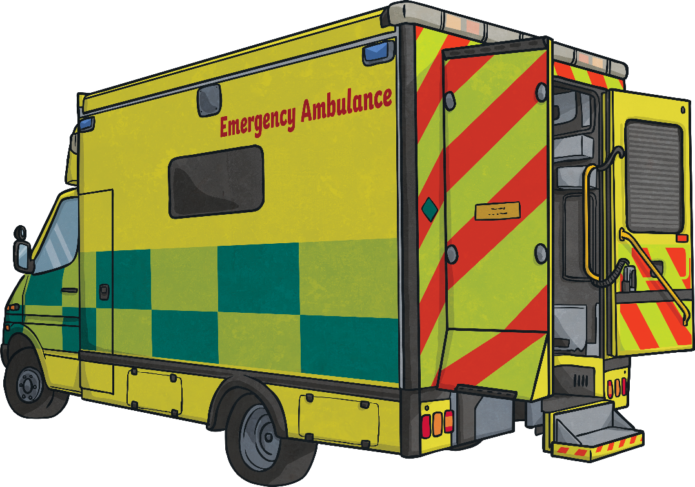
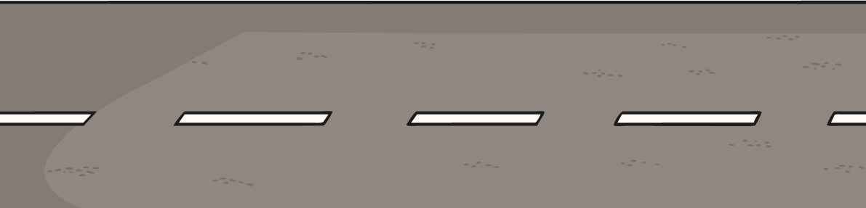
The Big Question
What is the shortest route for the ambulance to reach the doctor?

Slide 5
Contents
Beginning
Preparing
Exploring
Reviewing
The Big Question

Slide 6
Beginning

Slide 7
Coordinates and Translations
6
Look carefully at the numbers across the bottom of the grid and down the side of the grid.
5
4
We can use these numbers to give the position of an object on the grid.
3
2
1
0
1
2
3
4
5
6

Slide 8
Coordinates and Translations
6
The numbers across the bottom of the grid are on the x-axis.
5
4
We always read the number on the x-axis first.
3
2
1
0
1
2
3
4
5
6
x-axis

Slide 9
Coordinates and Translations
6
The numbers up the side of the grid are on the y-axis.
5
4
We always read the number on the y-axis after the x-axis.
3
y-axis
2
1
0
1
2
3
4
5
6

Slide 10
Coordinates and Translations
6
There is a special way we write coordinates:
5
A
(1,3)
4
3
B
x-axis
y-axis
2
Have a go at writing the coordinates of the letters on the grid.
1
C
0
1
2
3
4
5
6

Slide 11
Coordinates and Translations
6
(1
,5)
5
A
A =
B =
C =
4
(5
,3)
3
B
2
(2
,1)
1
C
0
1
2
3
4
5
6

Slide 12
Coordinates and Translations
6
In maths, translation means moving an object on a grid.
5
A
4
The object is moved without changing the size, turning or reflecting it.
3
B
2
When translating an object on a grid, it can slide up or down, left or right.
1
C
0
1
2
3
4
5
6

Slide 13
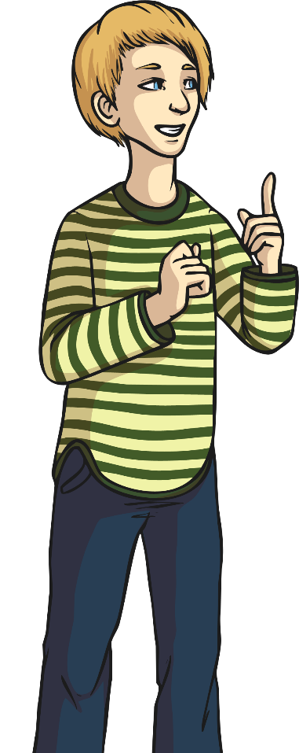
Coordinates and Translations
6
Have a go at translating the letters on the grid. What is the finishing coordinate of each letter?
5
A
B
C
4
3
B
Translate A
Right 1, Down 3
2
A
Translate B
Left 2, Up 2
1
C
Translate C Right 4, Up 4
0
1
2
3
4
5
6

Slide 14
Preparing

Slide 15
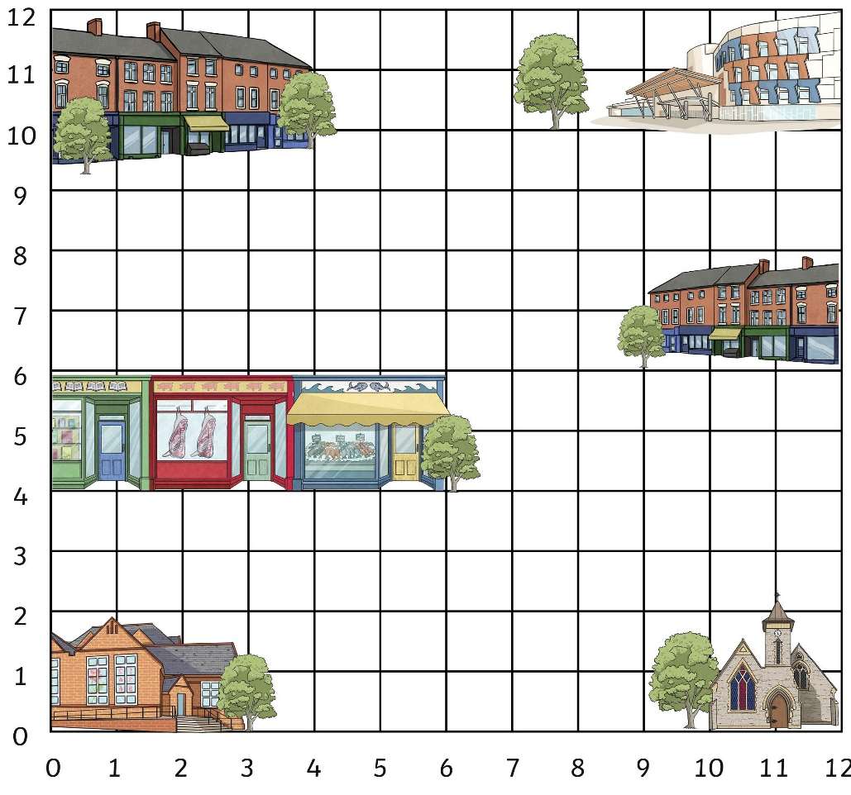
Ambulance Emergency
Here is a coordinate map of Twinkl Town:
What is the coordinate of the ambulance?
(3
,3)

Slide 16
Ambulance Emergency
Here is a coordinate map of Twinkl Town:
What is the
coordinate of the doctor?
(7
,9)

Slide 17
Ambulance Emergency
Here is a coordinate map of Twinkl Town:
The ambulance needs to drive the patient to the doctor.
Translating the ambulance around the grid using left and right, and up and down, write down a route for the ambulance to take.
You can only move along visible grid lines.

Slide 18
Ambulance Emergency
Here is a coordinate map of Twinkl Town:
Compare your translations with someone else.
How are they similar or different?
The ambulance always needs to transport the patient in the shortest route possible, did you find the shortest translation?

Slide 19
Ambulance Emergency
Here is a coordinate map of Twinkl Town:
This was the shortest route for the ambulance to take:
(3
Start:
,3)
Translation:
Right 4
Up 6
(7
Finish:
,9)
The route measured 10 square sides.

Slide 20
Ambulance Emergency
Here is a coordinate map of Twinkl Town:
Unfortunately, there is traffic trouble today in Twinkl Town and the ambulance is having to avoid different obstacles in order to transport patients to the hospital.
What is the shortest route for the ambulance to take now, avoiding the traffic cones?
Remember to use the vocabulary of left and right and up and down, and to only move along visible grid lines.

Slide 21
Ambulance Emergency
Here is a coordinate map of Twinkl Town:
This was the shortest route for the ambulance to take:
(7
(3
,9)
,3)
Start:
Finish:
Translation:
Right 1
Down 1
Right 2
Up 1
Right 2
Up 4
Left 1
Up 2
The route measured 14 square sides.

Slide 22
Exploring

Slide 23
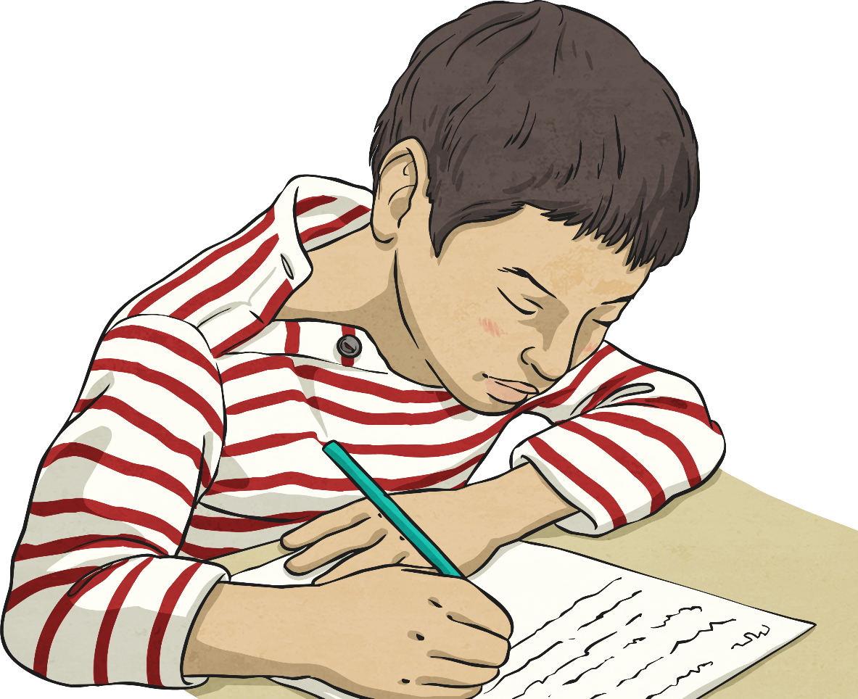
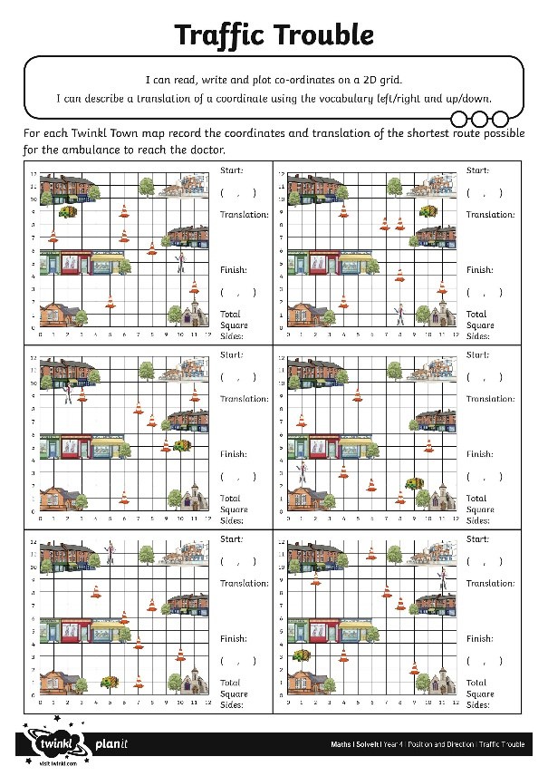
Traffic Trouble
For each Twinkl Town map record the coordinates and translation of the shortest route possible for the ambulance to reach the doctor.

Slide 24
Reviewing

Slide 25
The Big Question
What is the shortest route for the ambulance to reach the doctor?

Slide 26
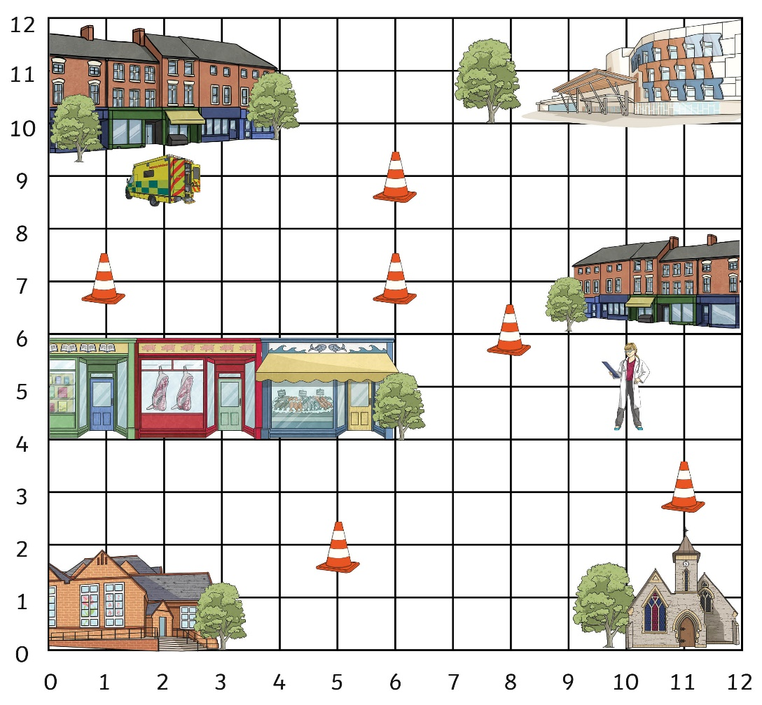
Emergency Over!
The shortest route from the ambulance to the doctor is 12 square sides.

Slide 27
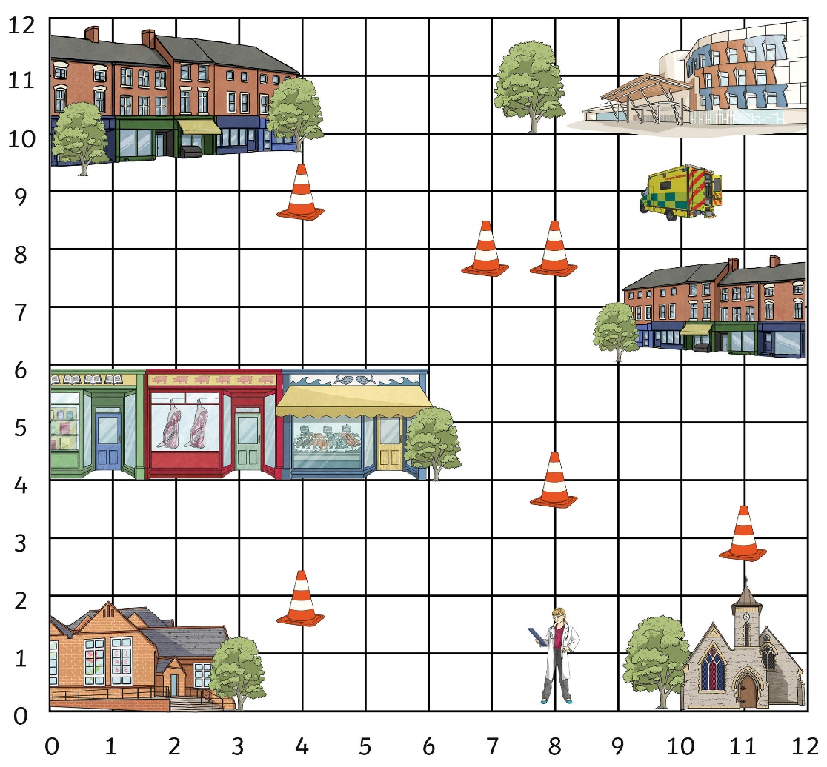
Emergency Over!
The shortest route from the ambulance to the doctor is 14 square sides.

Slide 28
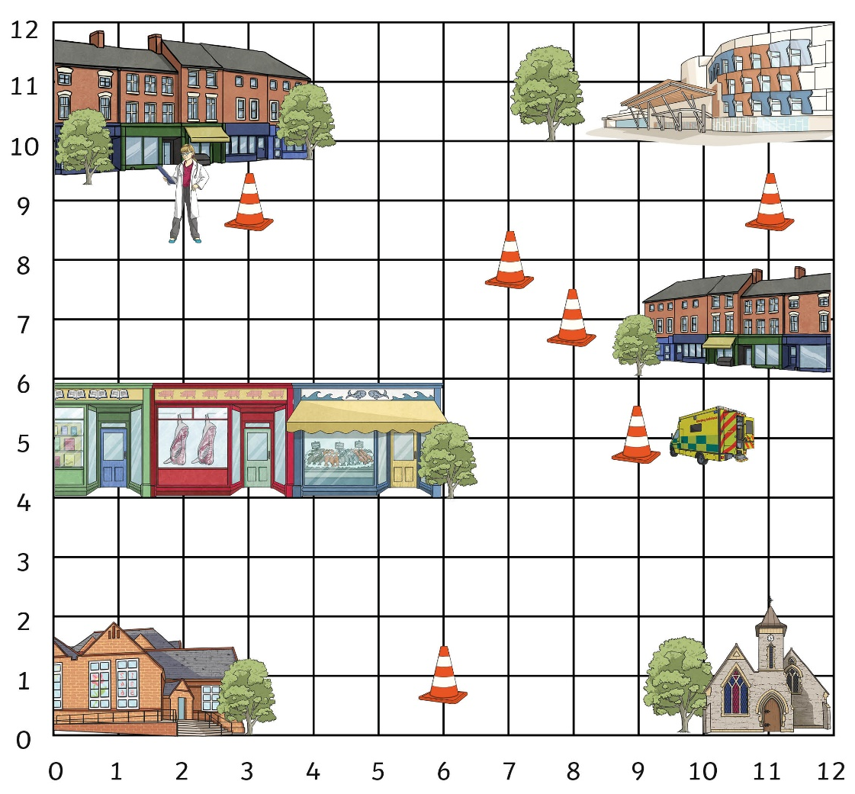
Emergency Over!
The shortest route from the ambulance to the doctor is 14 square sides.

Slide 29
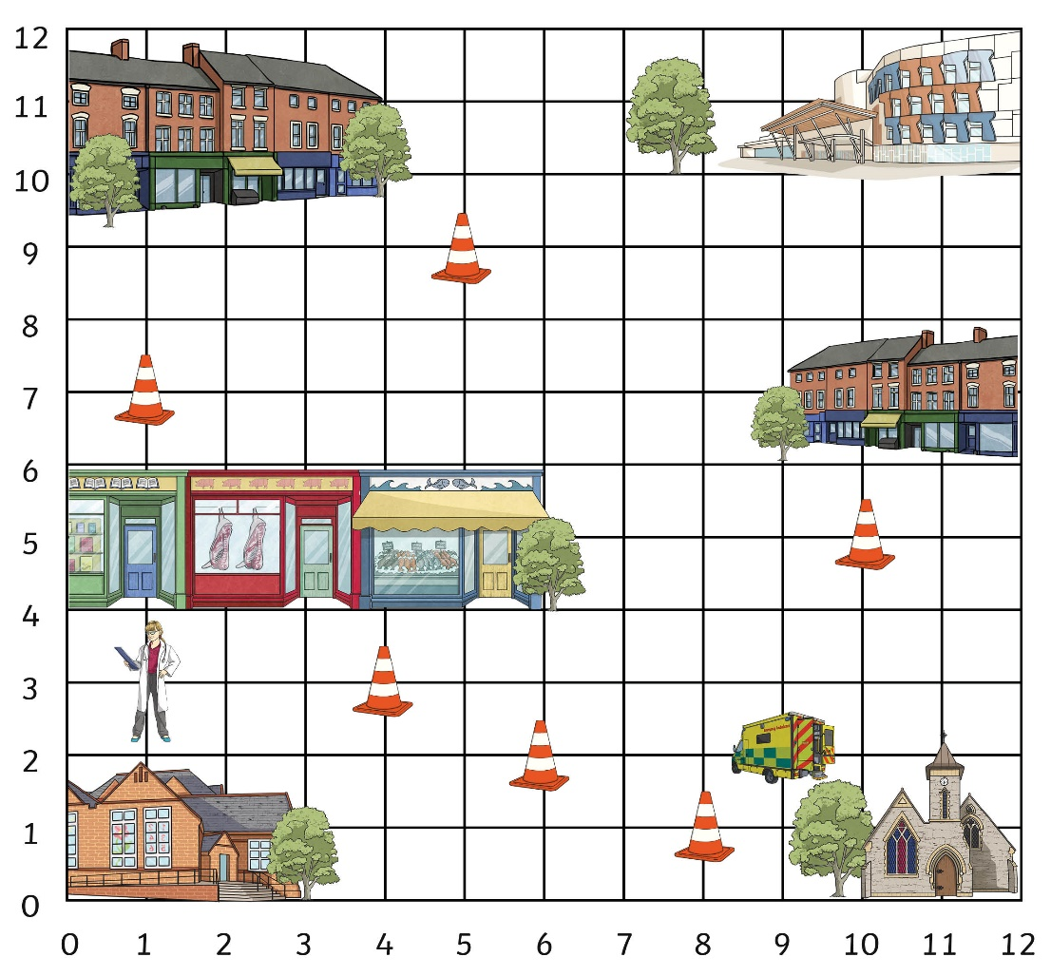
Emergency Over!
The shortest route from the ambulance to the doctor is 11 square sides.

Slide 30
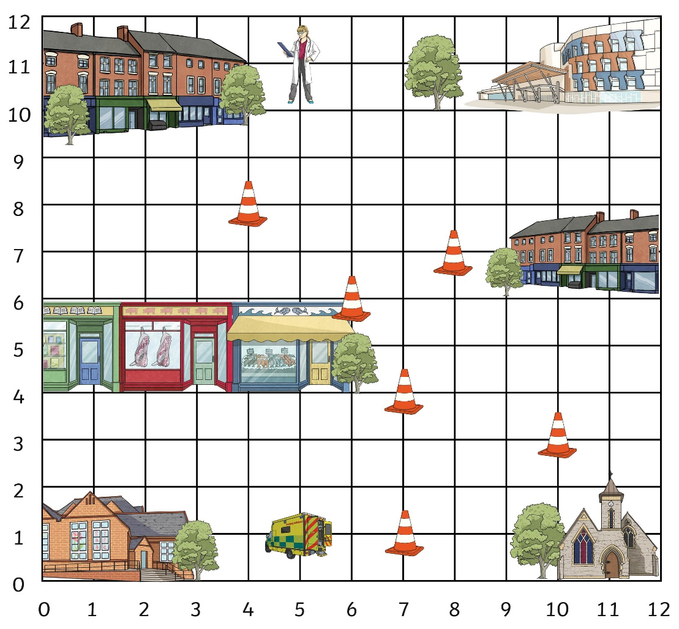
Emergency Over!
The shortest route from the ambulance to the doctor is 16 square sides.

Slide 31
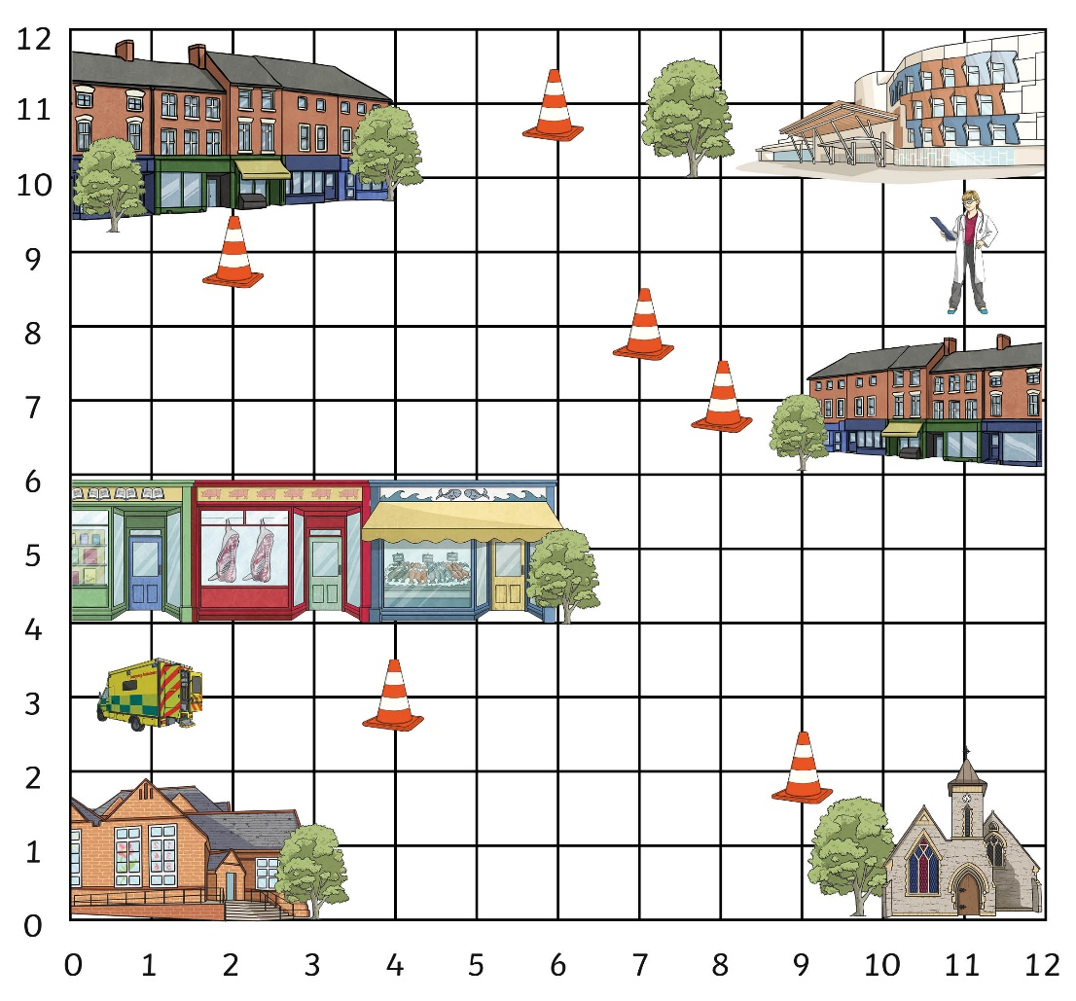
Emergency Over!
The shortest route from the ambulance to the doctor is 20 square sides.

Slide 32
Aim
I can describe translating using coordinates.
Success Criteria
I can read, write and plot coordinates on a 2D grid.
I can describe a translation of a coordinate using the vocabulary left/right and up/down.

