Slide 1
Triangles Reasoning

Slide 2
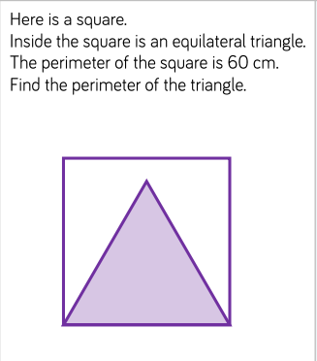
Here’s the first question…
So firstly, you know that perimeter means
‘the length of all the sides of the shape added together.
You also know that a SQUARE has 4 EQUAL sides
You know that an EQUILATERAL TRIANGLE has 3 equal sides
You can see that one side of the triangle is the same length as one side of the square.
So what do you need to do?

Slide 3
Here’s the first question…
The square has 4 equal sides and the question says that all the sides added together are 60cm
So to find out the length of one side, you need to divide 60 by 4.
(you can do this in your head – you know 40 divided by 4 is 10
Then 20 divided by 4 is 5
So 60 divided by 4 is 15)
So one side of the triangle is 15cm.
This means that all the sides of the triangle added together is 15 + 15 + 15 or 15 x 3
So the perimeter of the triangle is 45cm
Well done if you figured it out ☺

Slide 4
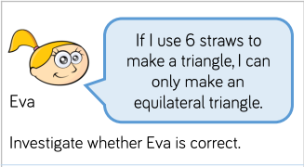
Here’s the second question…
So, for this question you will need 6 straws/matchsticks(used ones please!!!!)/pencils/pens whatever as long as all 6 are the same length.
If matches are the only think you have, please ask an ADULT to make them safe for you to use. DO NOT light them yourself!

Slide 5
Here’s the second question…
Let’s first make an equilateral triangle…
The sides are 2, 2 and 2 sticks long ☺

Slide 6
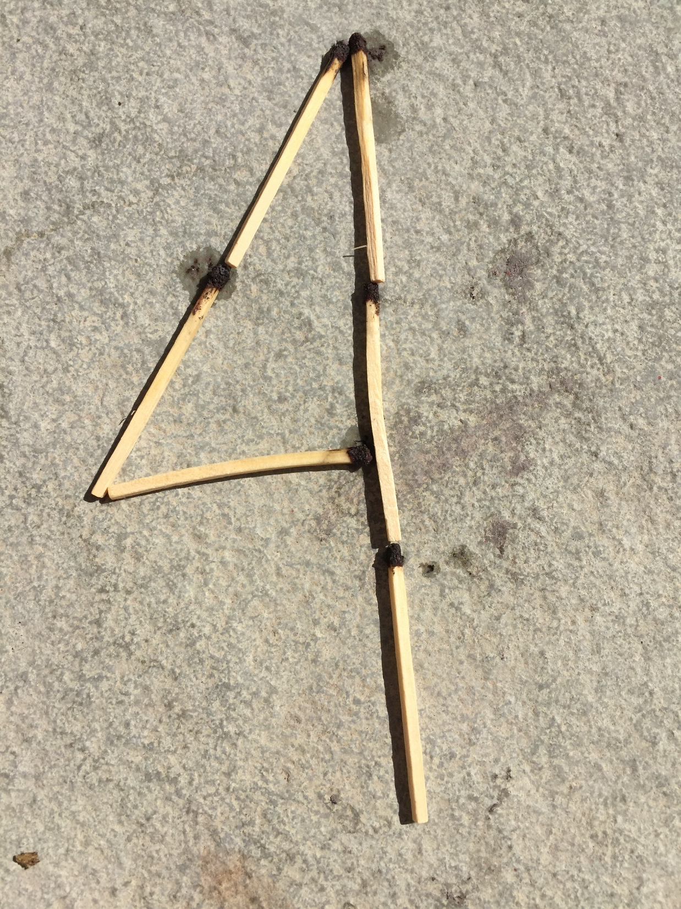
What happens if we try and make a different triangle where the sides are not all the same length?
Here’s my attempt at a scalene triangle. I tried to do 1 side that is 2 sticks long, 1 side that is 3 sticks long and 1 that is 1 stick long.
As you can see, it does not work.

Slide 7
What happens if we try and make a different triangle where the sides are not all the same length?
Here’s my attempt at a scalene triangle. I tried to do 1 side that is 2 sticks long, 1 side that is 3 sticks long and 1 that is 1 stick long.
As you can see, it does not work.

Slide 8
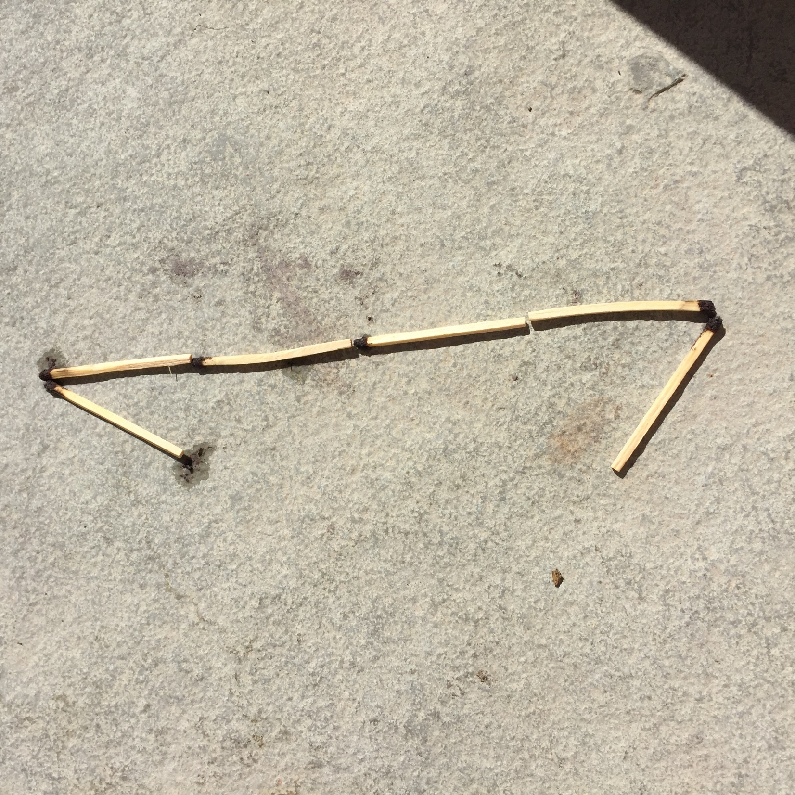
What happens if we try and make a different triangle where the sides are not all the same length?
I tried to make an isosceles triangle with 1 side that was 4 sticks long and the others 1 stick long but that didn’t work either.
So Eva is correct.

Slide 9
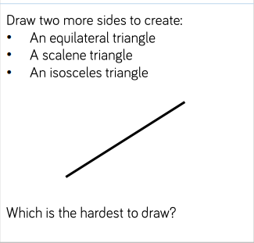
Here is the 3rd Question…
First, you need to remember the properties of the different types of triangle.
Equilateral: All sides and internal angles are equal
Scalene: All sides and internal angles are different
Isoceles: 2 sides and angles are the same and 1 is different.

Slide 10
Here is the 3rd Question…
First, you need a ruler.
Start by drawing a line that is 4.5cm long
4.5cm

Slide 11
Here is the 3rd Question…
Next try adding in the other two lines to make the types of triangles. I decided to start with a scalene triangle so I need to draw 2 more sides that are different to 4.5cm
4.5cm
Scalene was pretty easy to draw.

Slide 12
Here is the 3rd Question…
Now try another triangle. This time I went for equilateral so I needed to add 2 more sides that were 4.5cm.
4.5cm

Slide 13
Here is the 3rd Question…
Lastly, I went for an isosceles triangle. I decided to add in two sides that were 6cm long.
4.5cm
The trickiest triangles for me were the isosceles and the equilateral triangle because you have to be very accurate about measuring. What did you think?

