Slide 1
Maths
Properties of Shapes
Year One
Maths | Year 4 | Properties of Shapes | Geometric Shapes | Lesson 2 of 2: Quadrilaterals

Slide 2
Quadrilaterals

Slide 3
Comparing Quadrilaterals
How are these quadrilaterals different?
How are they the same?

Slide 4
Quadrilaterals
These shapes are all quadrilaterals.
All quadrilaterals have 4 straight sides and 4 vertices.

Slide 5
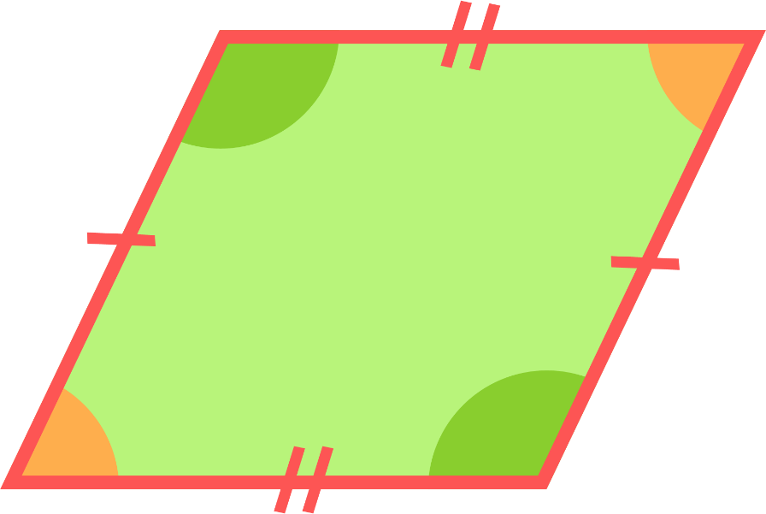
Quadrilaterals
This is a parallelogram.
It has 2 pairs of equal parallel sides and diagonally opposite angles are equal.
2 pairs of equal parallel sides
Diagonally opposite angles are equal

Slide 6
Quadrilaterals
This is a trapezium.
It has 1 pair of parallel sides.
1 pair of sides are parallel

Slide 7
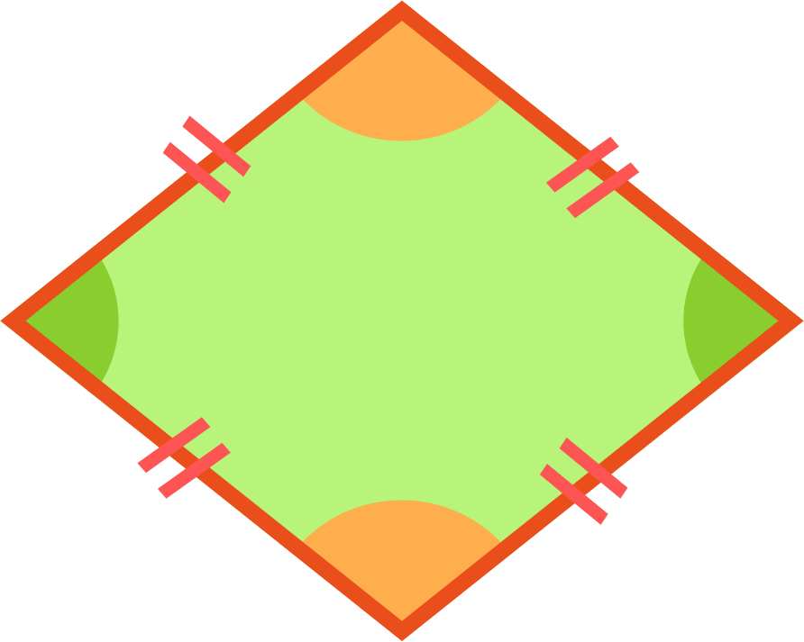
Quadrilaterals
This is a rhombus.
It is a parallelogram where all four sides are equal.
All 4 sides are equal and diagonally opposite angles are equal.
All sides are equal
Diagonally opposite angles are equal

Slide 8
Quadrilaterals
This is a rectangle.
It is a parallelogram where all four angles are equal.
It has 2 pairs of equal parallel sides and 4 right angles.
2 pairs of equal parallel sides
4 right angles (90°)

Slide 9
Quadrilaterals
This is a kite.
It has 2 pairs of equal sides and the horizontally opposite angles are equal.
Horizontally opposite angles are equal
2 pairs of equal sides

Slide 10
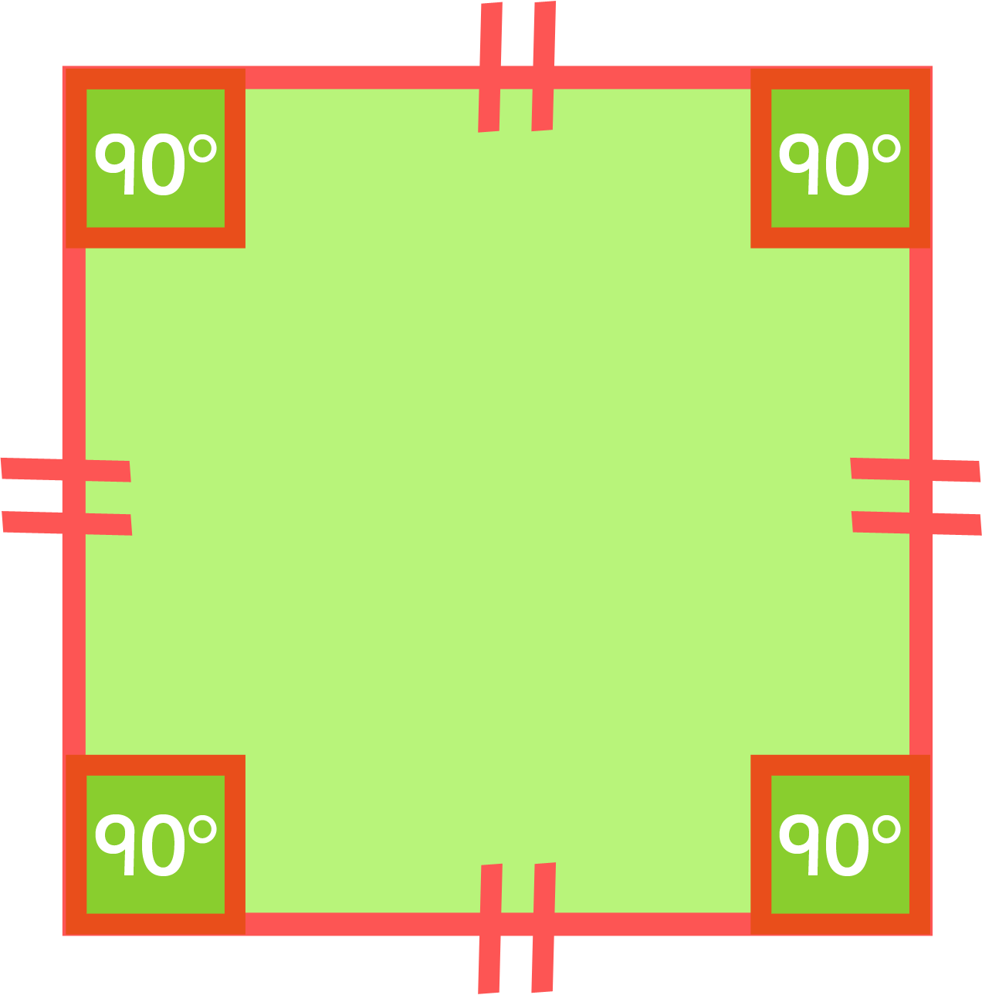
Quirky Quadrilaterals
This is a square.
A square is a regular quadrilateral.
It has 4 equal parallel sides and 4 right angles.
4 equal parallel sides
4 right angles (90°)

