Slide 2
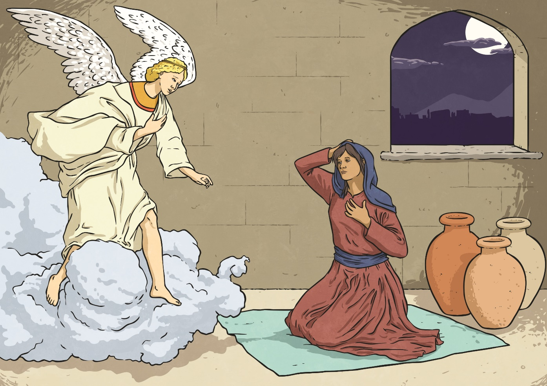
What Can You See?
Look at this scene. Talk to your partner and tell them what you can see.

Slide 3
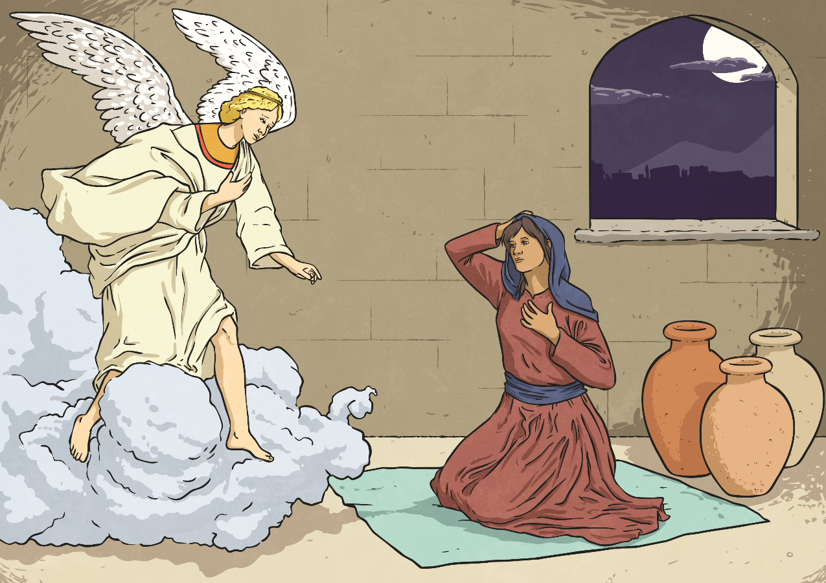
What Can You See?
Whilst you have been speaking, you have been using determiners before your nouns. Determiners come before nouns (or noun phrases) to introduce the noun and give the reader important information about them.
3
×
the moon
1
×
an angel
4
×
a window
2
×
some clouds
×
5
three vases
5
×
a lady

Slide 4
Determiners
How many different determiners can you think of? Don’t forget to include simple articles, quantifiers and possessive determiners.
many
five
any
some
the
a / an
these
Determiners
those
your
that
their
his
our
this
my
her

Slide 5
Determiner Or Not?
Keeping in mind that ‘a determiner is a word which comes before a noun (or modifier) to introduce it’, sort the following words into the correct circles.
Determiners
Not Determiners
ugly
twelve
the
socks
your
my
dog
an
pancake
few

Slide 6
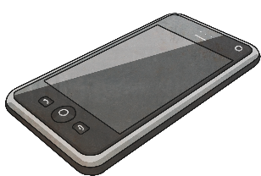
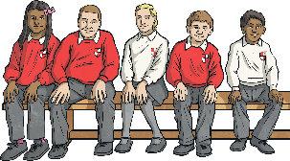
Spot the Determiners
Read the sentences below and spot the determiners which introduce the nouns. There could be more than one.
All mobile phones must be switched off inside the cinema.
A sandy beach is just beyond those trees.
Five towers stood on top of an amazing sandcastle.
Some children are sitting on that bench.

Slide 7
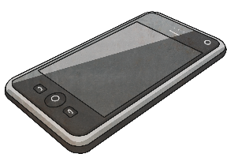
Spot the Determiners
Read the sentences below and spot the determiners which introduce the nouns. There could be more than one.
All mobile phones must be switched off inside the cinema.
A sandy beach is just beyond those trees.
Five towers stood on top of an amazing sandcastle.
Some children are sitting on that bench.

Slide 8
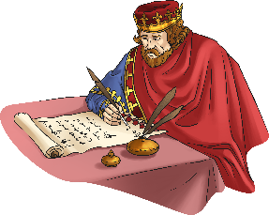
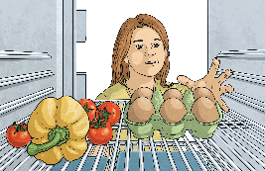
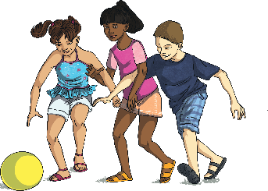
Add a Determiner
Read the sentences below and add a determiner which introduces the noun and gives the reader some important information about it.
king signed important papers.
fridge held eggs and vegetables.
mother and daughters sat together.
children threw ball around circle.
Is there more than one determiner which makes sense?

Slide 9
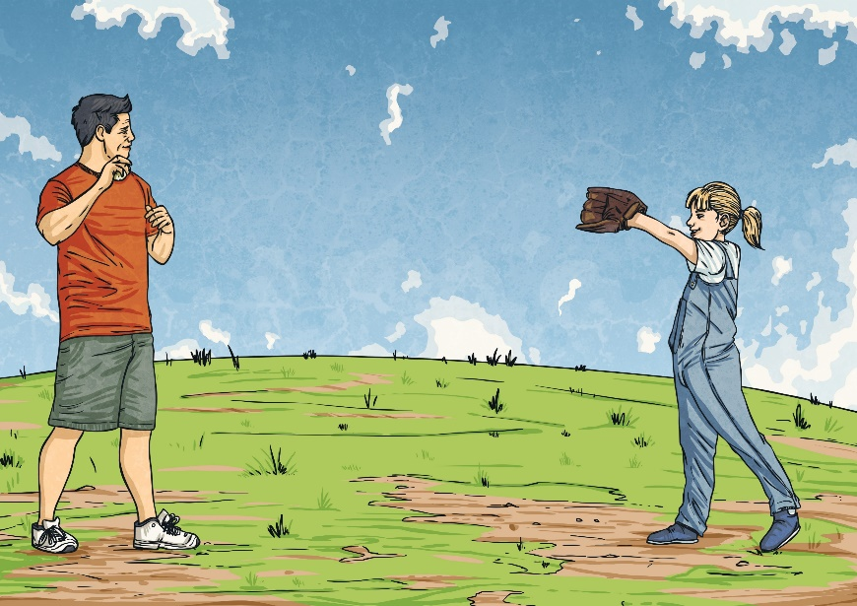
Determine the Determiner!
Look at the sentence below. How many different determiners can you use in two minutes to complete the sentence so that it still makes sense? Write your answers on a whiteboard.
father threw ball to daughter.

Slide 10
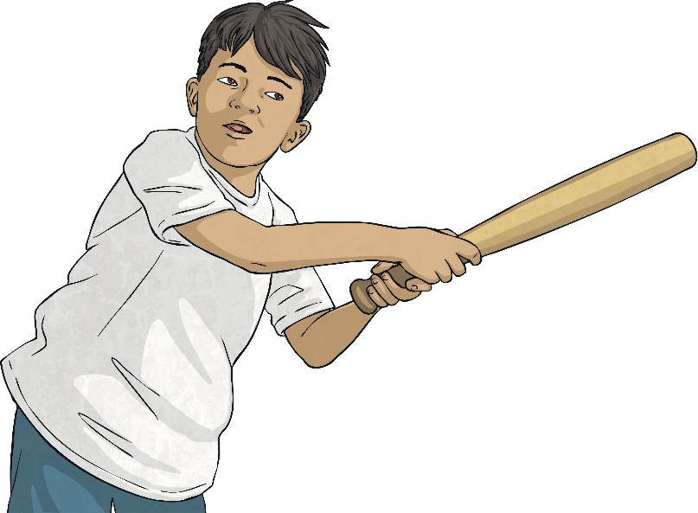
Determine the Determiner!
Look at the sentence below. How many different determiners can you use in two minutes to complete the sentence so that it still makes sense? Write your answers on a whiteboard.
Jeremy hit ball with cricket bat.

Slide 11
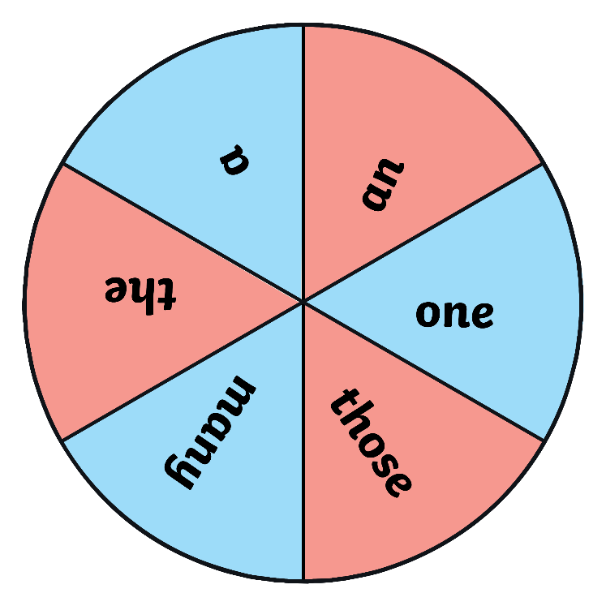
Determine the Determiner!
Spin the spinner to choose a determiner. On your whiteboards, write your own sentence about this picture which includes that determiner.
Spin

Slide 12
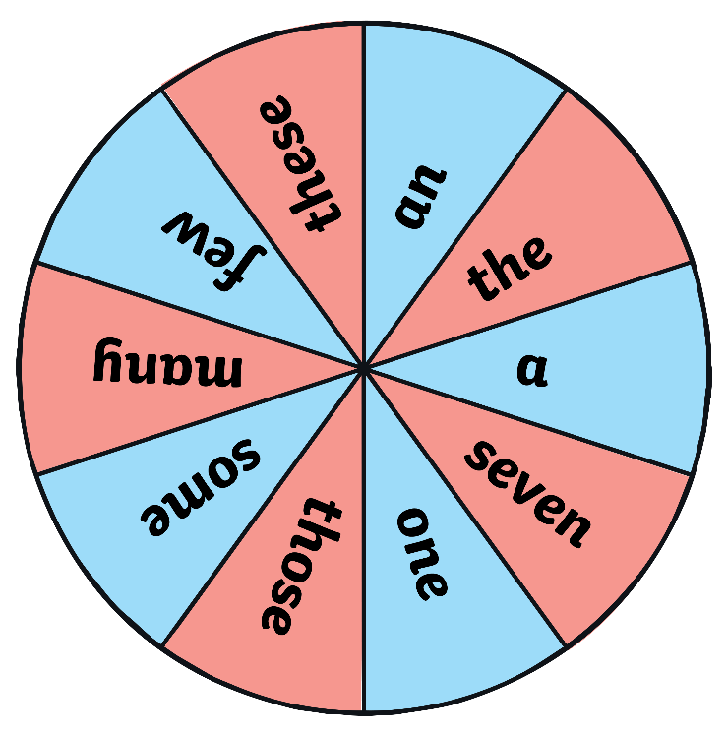
Determine the Determiner!
Spin the spinner to choose a determiner. On your whiteboards, write your own sentence about this picture which includes that determiner.
Spin

Slide 13
The Determiner Detectives
Read the following passage of text. How many determiners can you see? Write them on your whiteboard.
Detective Dwight awoke one night to some shrieks and shouts outside his house. “That is not right,” thought Dwight, so he spied out of his bedroom window. Eek! Dwight had a fright when he saw something white hiding beneath the slide in his back garden. “I think that it is time to put on a light after such a terrible sight,” thought Dwight, but the more he thought, the more he realised what that fright might have been. Dwight crept outside and peered behind the slide. Two wide eyes... one big, fluffy smile... He had found a tiny cat, covered in many scratches. It must have been in a fight. “This will never do,” thought Dwight, so he took the cat inside for a bath and a nice, warm bowl of milk.
Detective Dwight awoke one night to some shrieks and shouts outside his house. “That is not right,” thought Dwight, so he spied out of his bedroom window. Eek! Dwight had a fright when he saw something white hiding beneath the slide in his back garden. “I think that it is time to put on a light after such a terrible sight,” thought Dwight, but the more he thought, the more he realised what that fright might have been. Dwight crept outside and peered behind the slide. Two wide eyes... one big, fluffy smile... He had found a tiny cat, covered in many scratches. It must have been in a fight. “This will never do,” thought Dwight, so he took the cat inside for a bath and a nice, warm bowl of milk.
Could you change any of the determiners to a different determiner and still have the sentence make sense?

Slide 14
Determiners Quick Quiz
Take a quiz to see if you are an expert!
Is the word which is underlined in this sentence a determiner?
The bridge is not wide enough to let lorries pass.
Yes
No
Bridge is a noun. What is the determiner in this sentence?

Slide 15
Determiners Quick Quiz
Take a quiz to see if you are an expert!
Is the word which is underlined in this sentence a determiner?
Mum burned our tea last night because the oven was too hot.
Yes
No
Well done... but what is the other determiner in this sentence?

Slide 16
Determiners Quick Quiz
Take a quiz to see if you are an expert!
Is the word which is underlined in this sentence a determiner?
There are many museums and art galleries in Manchester.
Yes
No
Well done. What is the determiner in this sentence?

Slide 17
Determiners Quick Quiz
Take a quiz to see if you are an expert!
Is the word which is underlined in this sentence a determiner?
“I need some new shoes,” explained Jake.
Yes
No
New is an adjective. What is the determiner?

Slide 18
Determiners Quick Quiz
Take a quiz to see if you are an expert!
Is the word which is underlined in this sentence a determiner?
All morning, three dogs barked in the back garden.
Yes
No
Well done! Which other word is a determiner in this sentence?

