Slide 1
Shape Symmetry

Slide 2
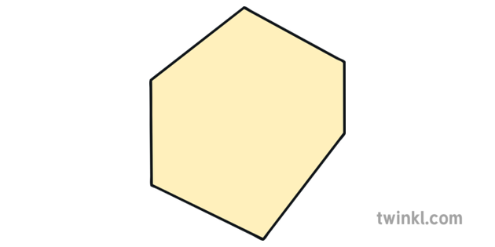
Remember – a regular shape is one where all of the sides and angles are equal.
A square is a regular shape but a rectangle is not
An equilateral triangle is regular but an isosceles is not.
This is a regular hexagon
This is an irregular hexagon

Slide 3
True or False Symmetry?

Slide 4
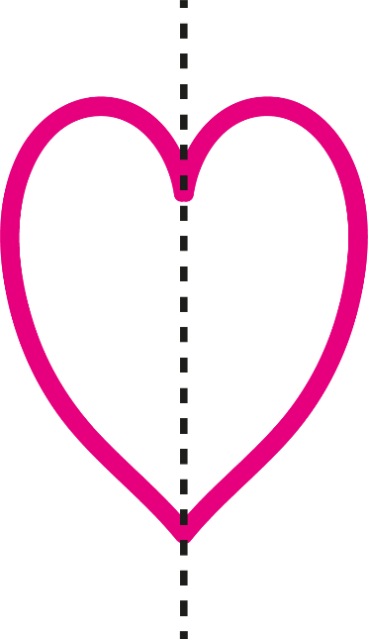
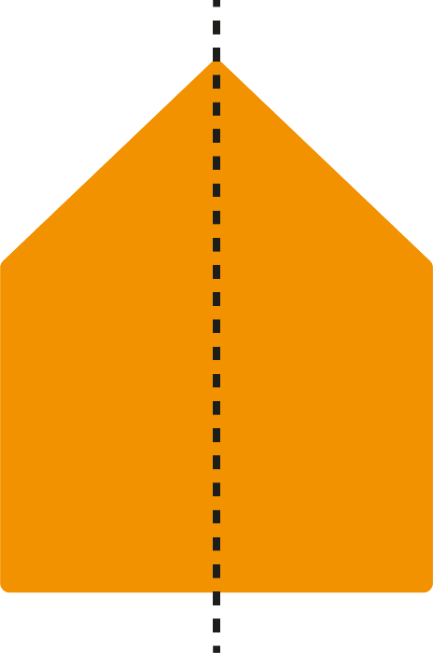
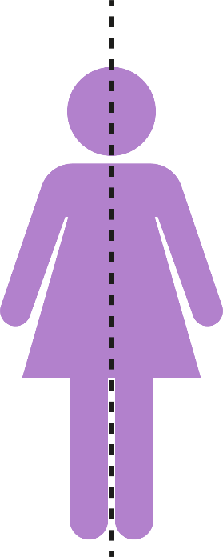
Symmetry
Reflective Symmetry (1 line of symmetry)
Reflection symmetry is where one half of the image is the reflection of the other half. You could fold the image and have both halves match exactly.

Slide 5
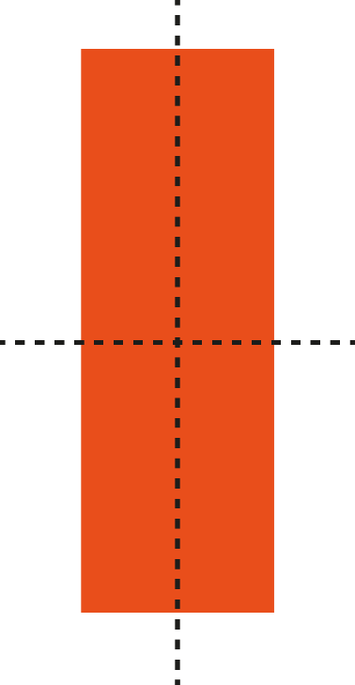
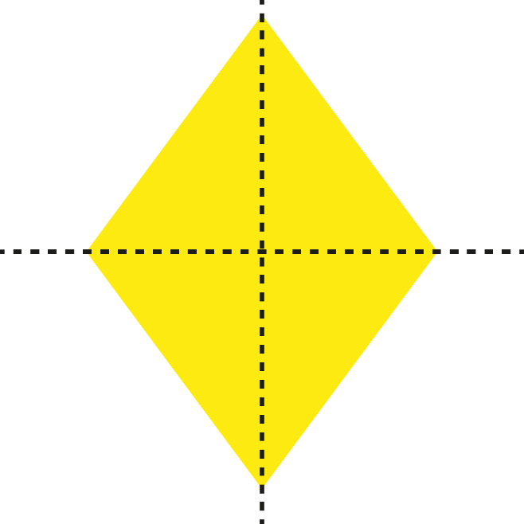
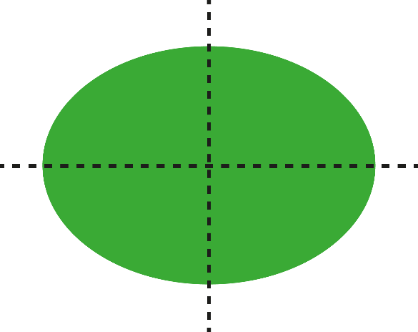
Symmetry
2 Lines of Symmetry
The line showing the reflection is called the line of symmetry.

Slide 6
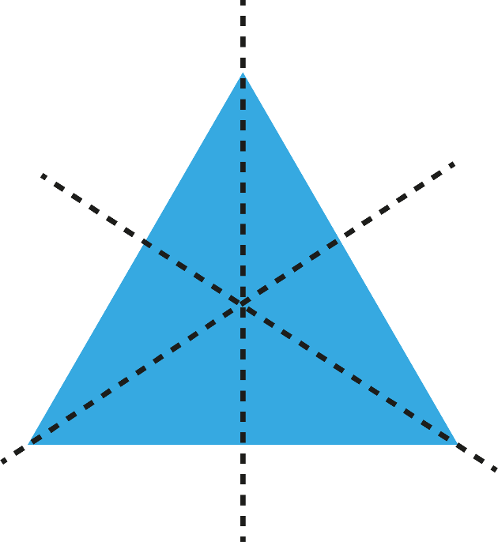
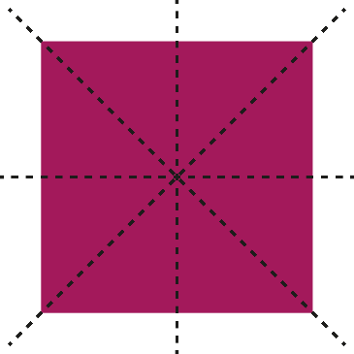
Symmetry
3 or More Lines of Symmetry
The line showing the reflection is called the line of symmetry.

Slide 7
Symmetry in 2D Shapes
Investigate lines of symmetry in 2D shapes by folding the shapes to find the lines of symmetry.

Slide 8
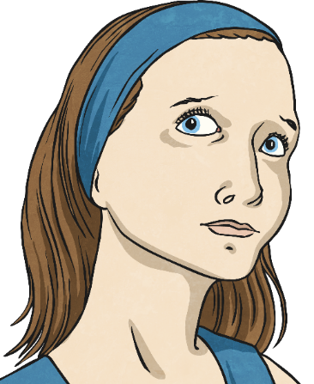
Symmetry Prove It!
Do all regular 2D shapes have the same number of lines of symmetry as they do number of sides?
?
?

Slide 9
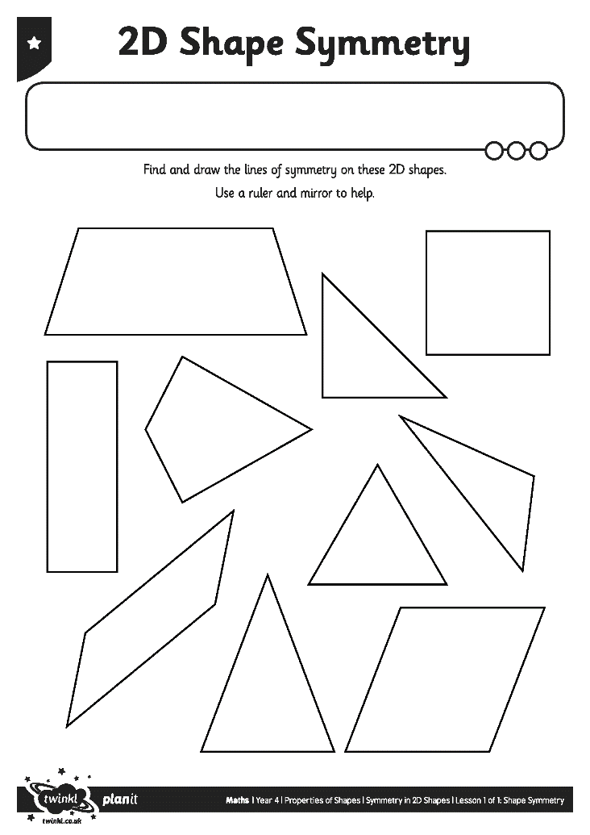
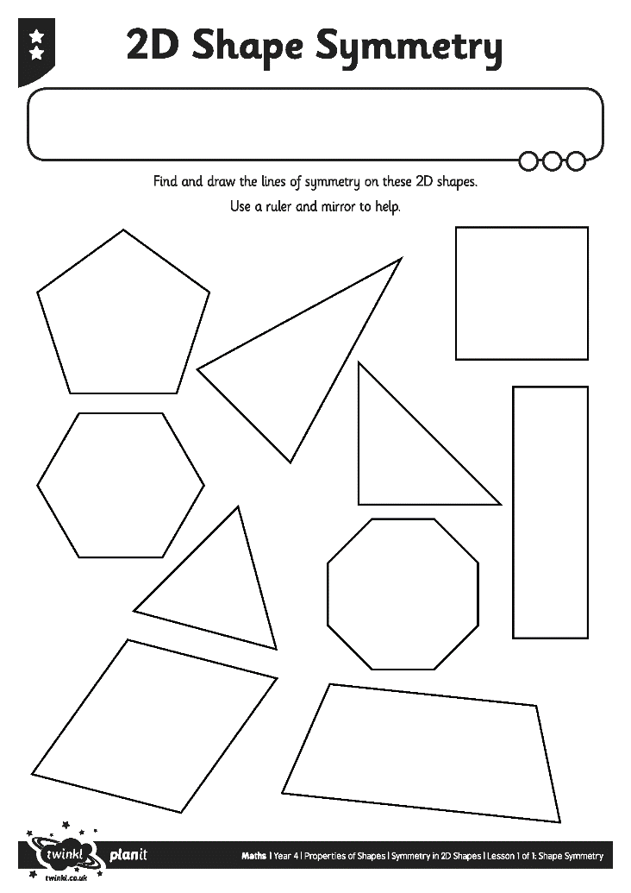
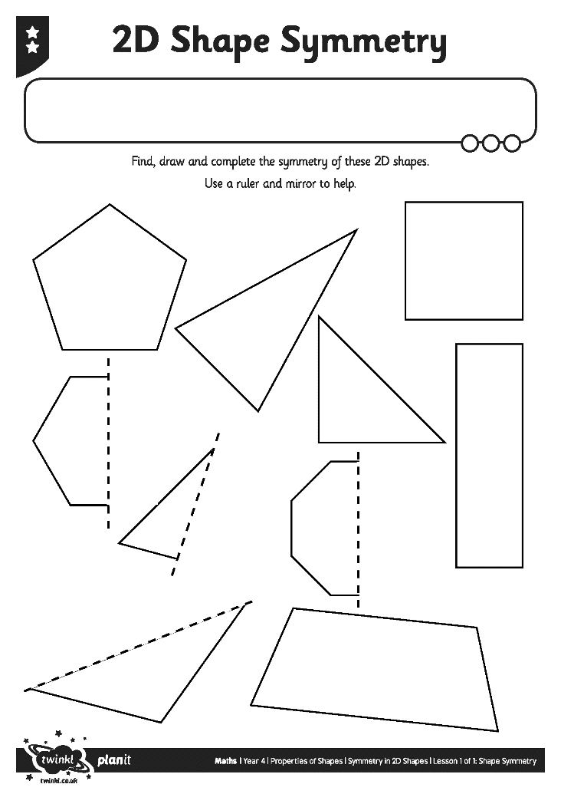
Symmetry in 2D Shapes Activity

Slide 10
Symmetry Quiz
What is a line of symmetry?
A
A line that divides a shape into quarters
B
A line drawn through a shape so that both sides look the same
C
A line that outlines the edge of a shape

Slide 11
Symmetry Quiz
Which types of shapes have lines of symmetry?
A
2D shapes
B
3D shapes
C
Both 2D and 3D shapes

Slide 12
Symmetry Quiz
Which shape has 4 lines of symmetry?
A
A square
B
A rectangle
C
A parallelogram

Slide 13
Symmetry Quiz
Which shape has 2 lines of symmetry?
A
An equilateral triangle
B
A circle
C
A rectangle

Slide 14
Symmetry Quiz
Which shape has 3 lines of symmetry?
A
A scalene triangle
B
An equilateral triangle
C
An isosceles triangle

Slide 15
Symmetry Quiz
Which shape only has 1 line of symmetry?
A
A circle
B
A parallelogram
C
An isosceles triangle

Slide 16
Symmetry Quiz
Which shape has no lines of symmetry?
A
A circle
B
A parallelogram
C
An isosceles triangle

Slide 17
Symmetry Quiz
Which of these statements is false?
A
A rectangle has 4 lines of symmetry
B
An isosceles triangle has one line of symmetry
C
A square has 4 lines of symmetry

Slide 18
Symmetry Quiz
Which of these statements is true?
A
An equilateral triangle has 2 lines of symmetry
B
A scalene triangle has 2 lines of symmetry
C
A rectangle has 2 lines of symmetry

Slide 19
Symmetry Quiz
Which shape has an infinite number of lines of symmetry?
A
A circle
B
A rectangle
C
A scalene triangle

Slide 20
Aim
I can find and draw lines of symmetry in a range of 2D shapes.
Success Criteria
I can find reflective symmetry by folding 2D shapes.
I can draw lines of symmetry on 2D shapes.
I can recognise lines of symmetry in 2D shapes presented in different positions.

