Slide 1
Identifying Types of Angles

Slide 2
What is an angle?
You will have done some work on angles when you were in Year 3, especially when you were talking about properties of shapes. Can you remember what an angle is?

Slide 3
Angles are a way of measuring how much something has turned around. Have a look at the hedgehog in the next few slides.
Angles are measured using a special unit of measurement called degrees.

Slide 4
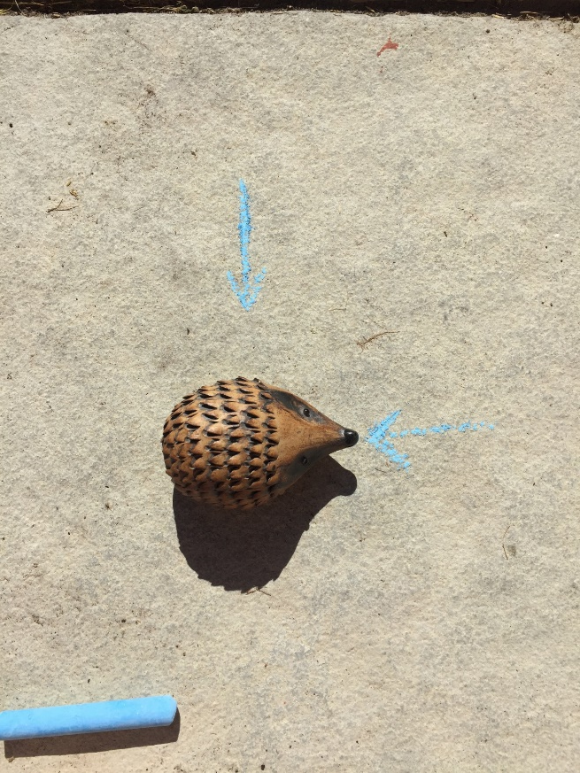
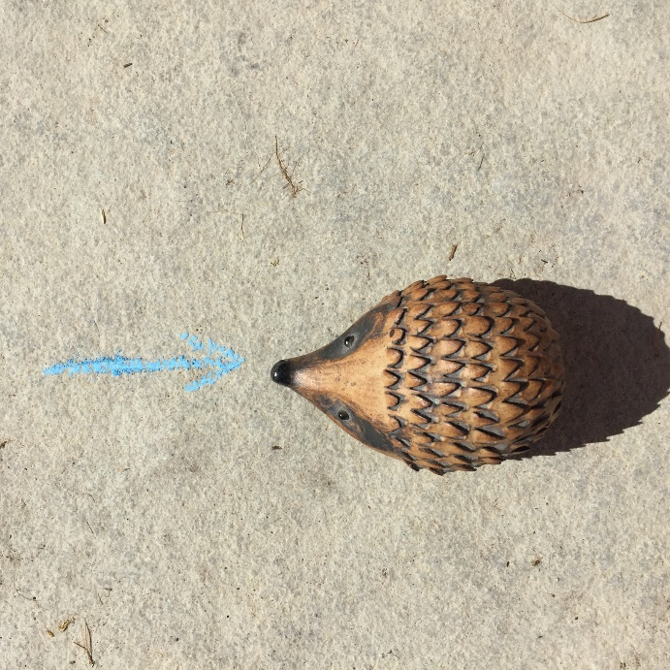
Horace the hedgehog is going to demonstrate for you…
Horace starts off like this.
Then he turns around.
(Click to watch the video)
He ends up like this.

Slide 5
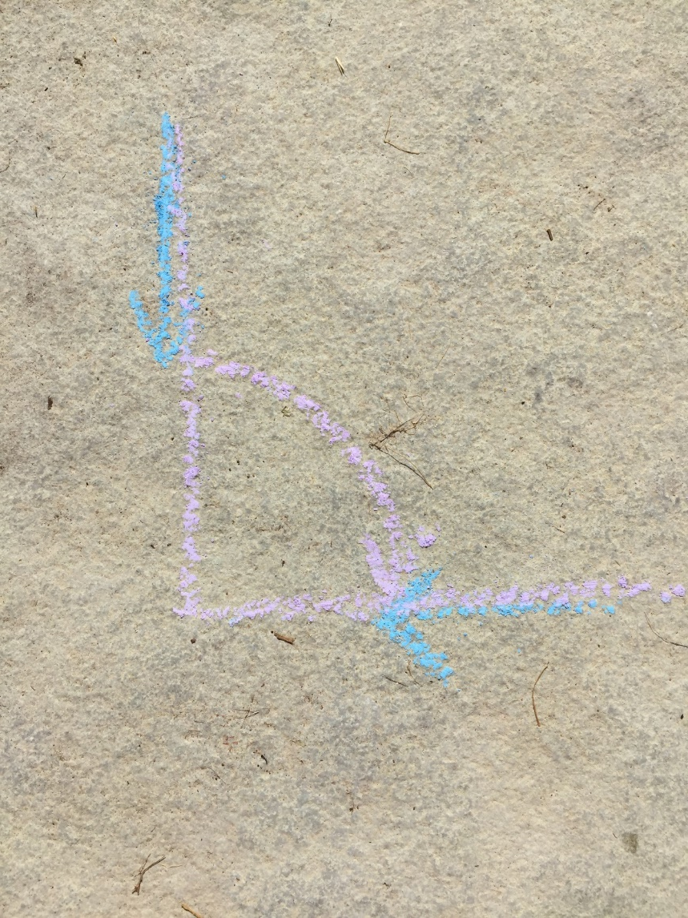
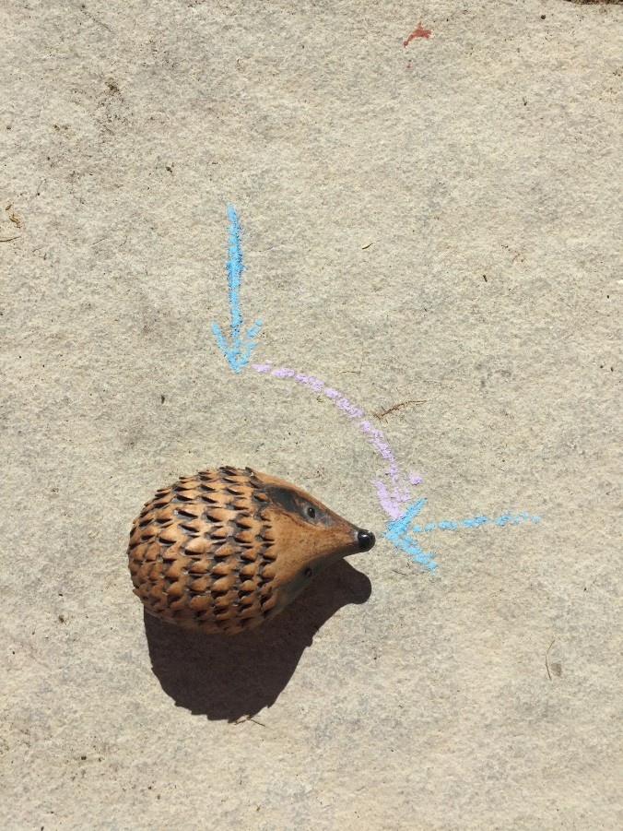
And here’s what it looks like when I take Horace away.
The pink arrow shows how much turning he’s done.

Slide 6
Horace just turned a quarter of a circle. That is called a right angle. You will have heard of right angles before when you have talked about the angles in 2D shapes. In oblongs (rectangles) and squares, the insides of the corners (vertices) are always right angles.
A right angle measures 90 degrees which in maths we would write as 90֯
I’m going to use the corner of a sticky note to help me find more right angles around my house…

Slide 7
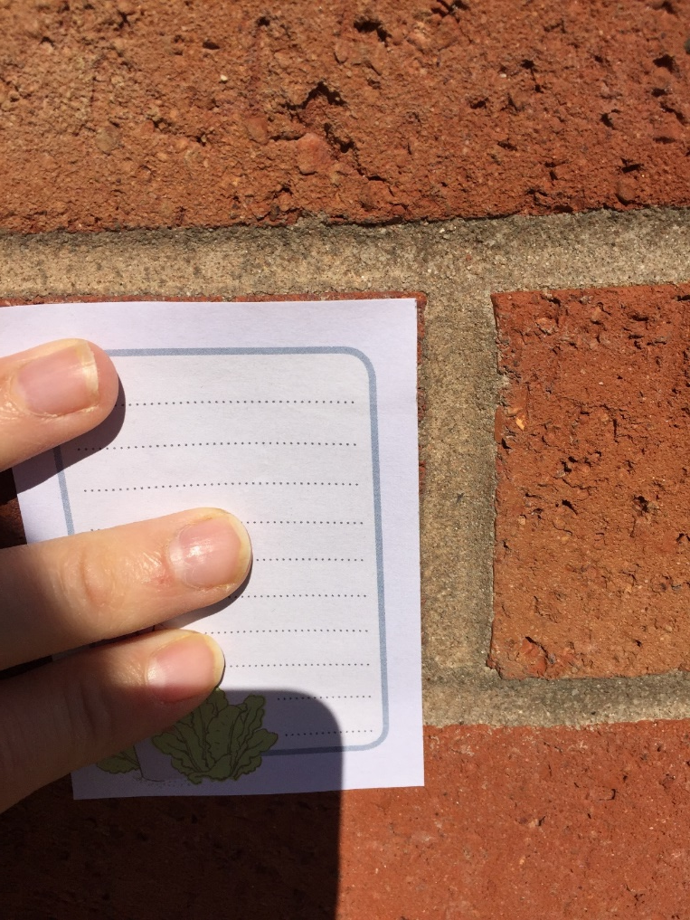
You can see that the corner of the sticky note exactly fits into the corner of the brick. This means that this is a right angle. It measures 90֯.

Slide 8
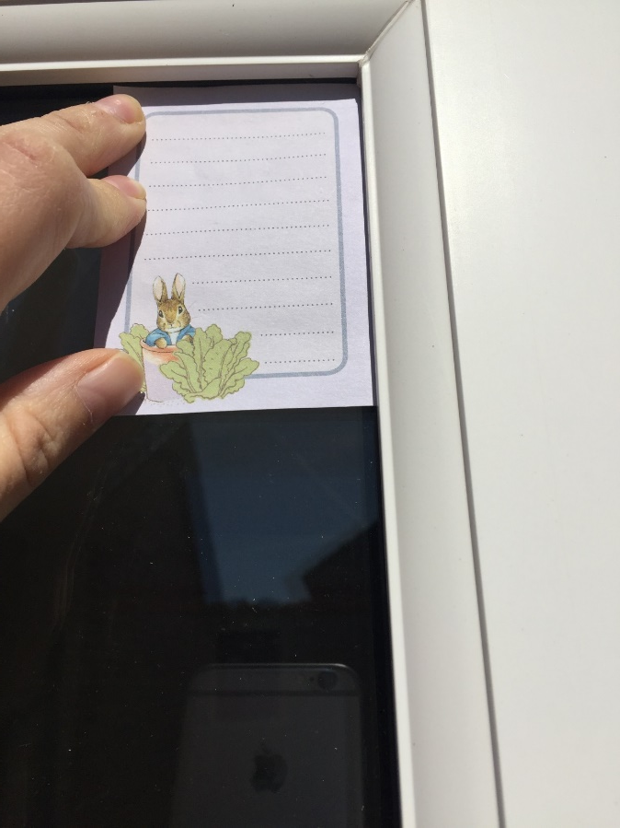
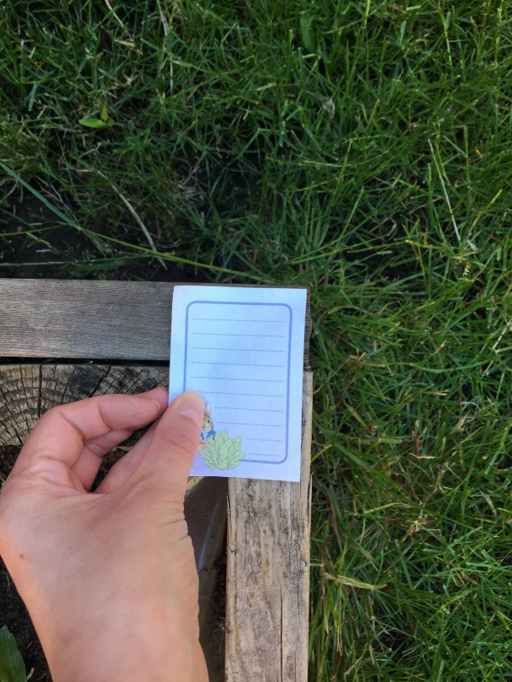
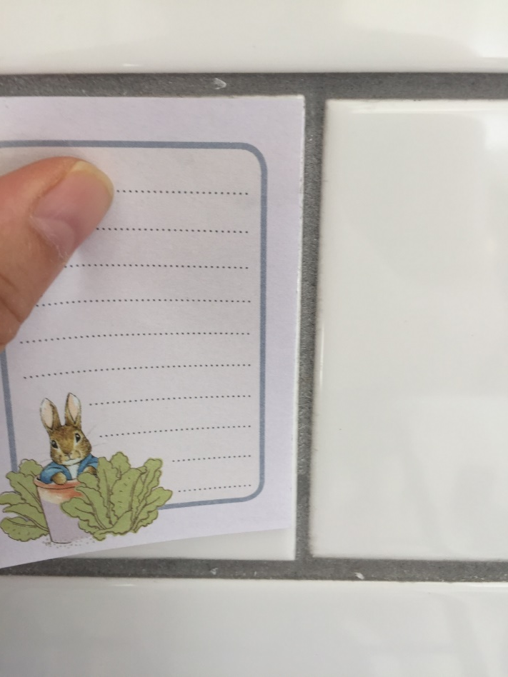
Here are some more right angles that I found. Can you find any in your own house?

Slide 9
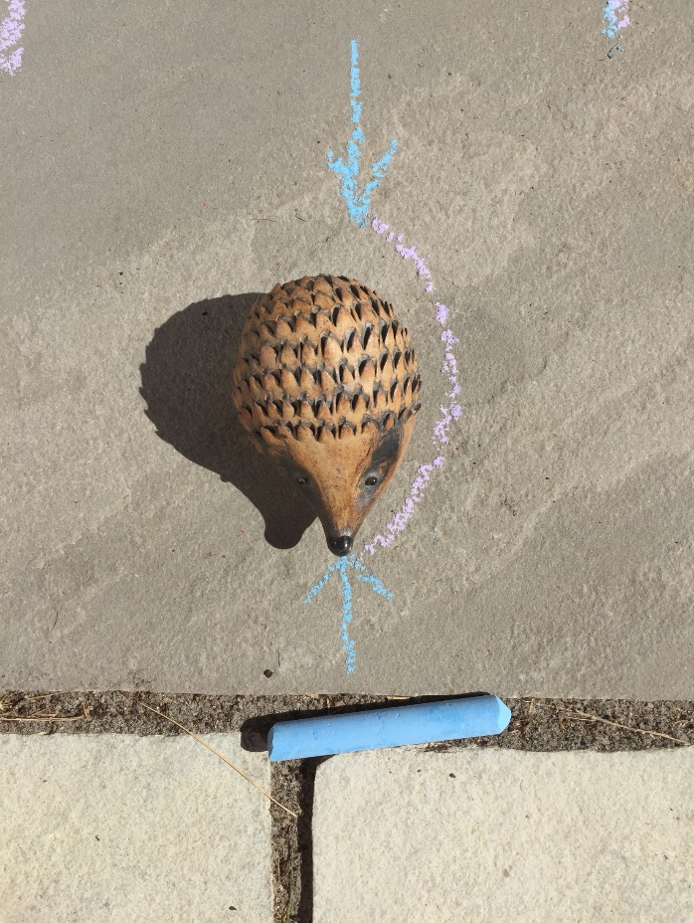
So, a right angle is a quarter turn and it measures 90֯.
Have a look at this angle:
This time, Horace started off pointing this way.
This is a half turn. A half turn measures 180֯.
And ended up facing this way.

Slide 10
So far we have learnt that a quarter turn is called a right angle and it measures 90֯.
A half turn measures 180֯.
There are other types of angles as well as these two. Lets have a look at some more.

Slide 11
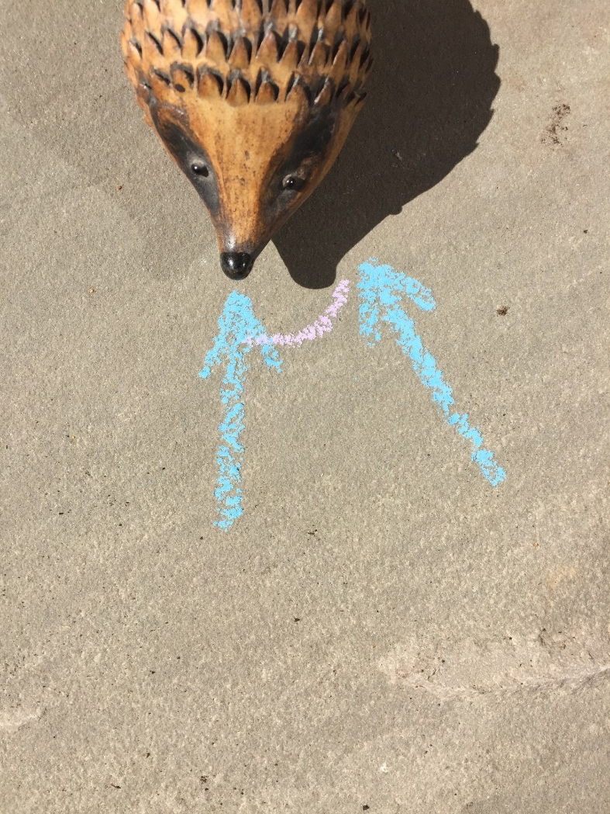
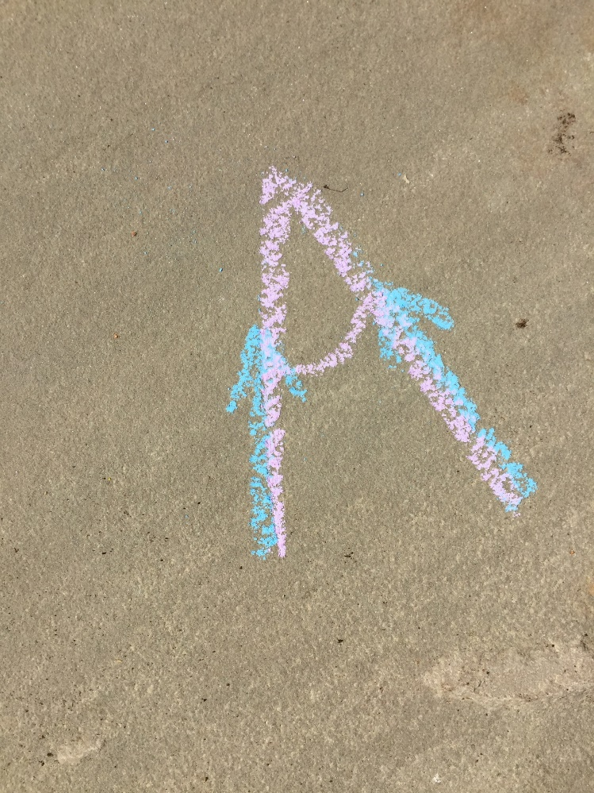
This time, Horace started off pointing this way. Then he turned and…
Ended up facing this way.
This is what the angle looks like without Horace.
As you can see, Horace has not turned enough for it to be a right angle.
The type of angle that he has made is called an acute angle.
Any angle less than 90֯ is an acute angle.

Slide 12
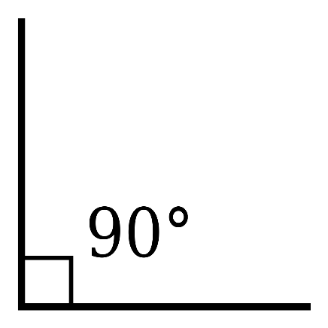
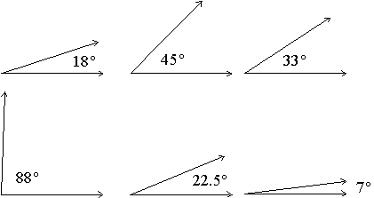
Let’s recap.
A quarter turn is called a right angle and it measures 90֯.
A half turn measures 180֯
Any angle that measures less than 90֯ is called an acute angle. They tend to look sharp and pointy ☺.
You can remember the name because they are small and ‘cute’.

Slide 13
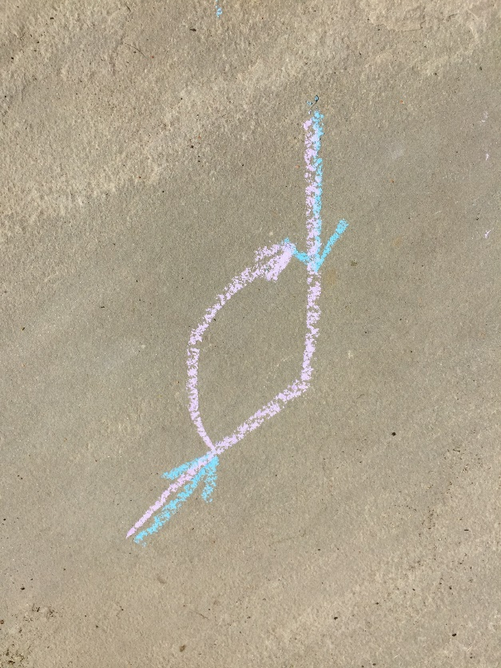
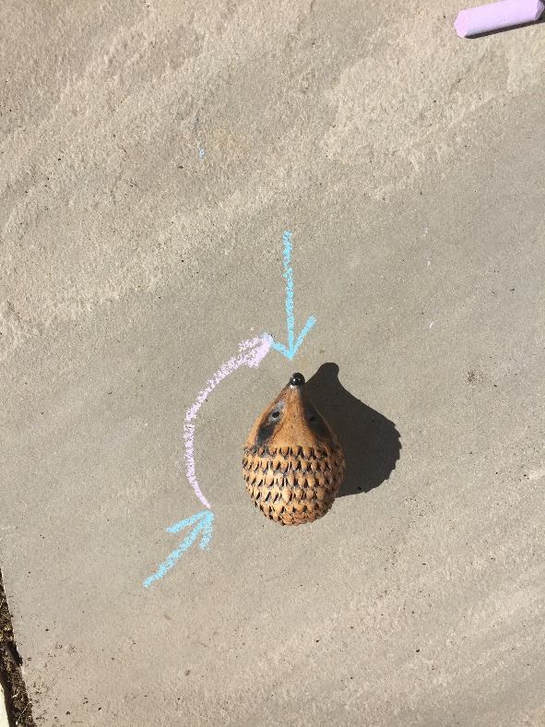
There is one more type of angle that we learn about in Year 4. Here’s Horace again…
He started off here.
Then he turned until he ended up here.
Here’s the angle without Horace.
Now this time, you can see that he turned more than a quarter turn BUT LESS than a half turn.
An angle that is more than 90֯ and less than 180֯ is called an obtuse angle.

Slide 14
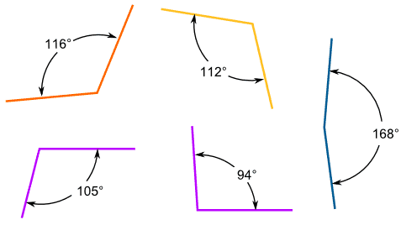
Here are some examples of obtuse angles. Have a good look at them.

Slide 15
If you’re struggling to see the difference between obtuse, acute and right angles it might help you to use the corner of a piece of paper.
The corner of a piece of paper is always a right angle so you can use it to check. Look at the next slide to see how…

Slide 16
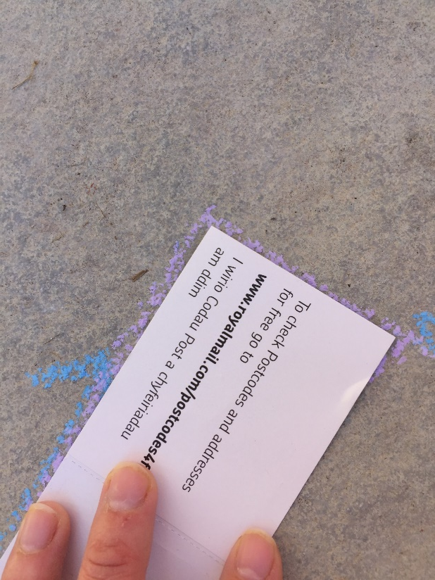
The paper fits exactly into the angle so this must be a right angle.

Slide 17
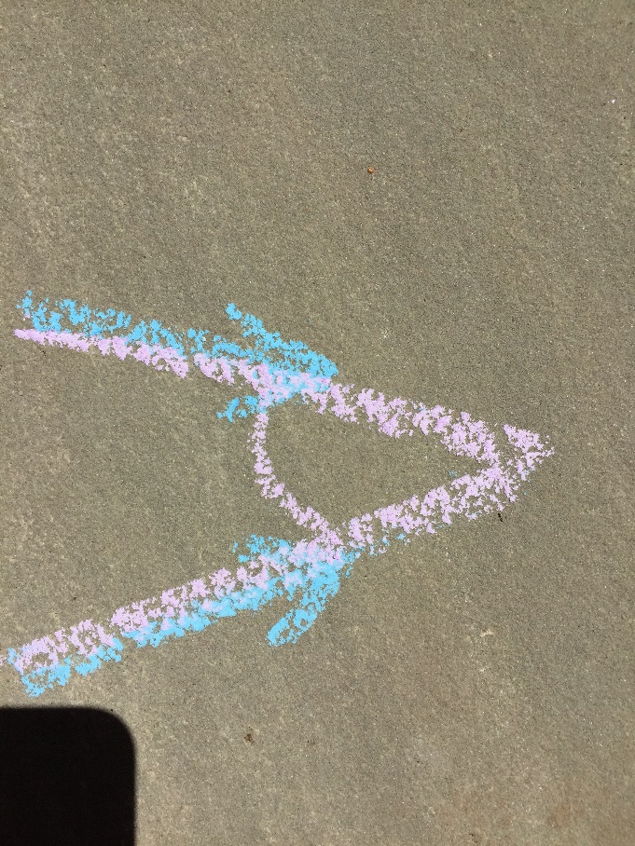
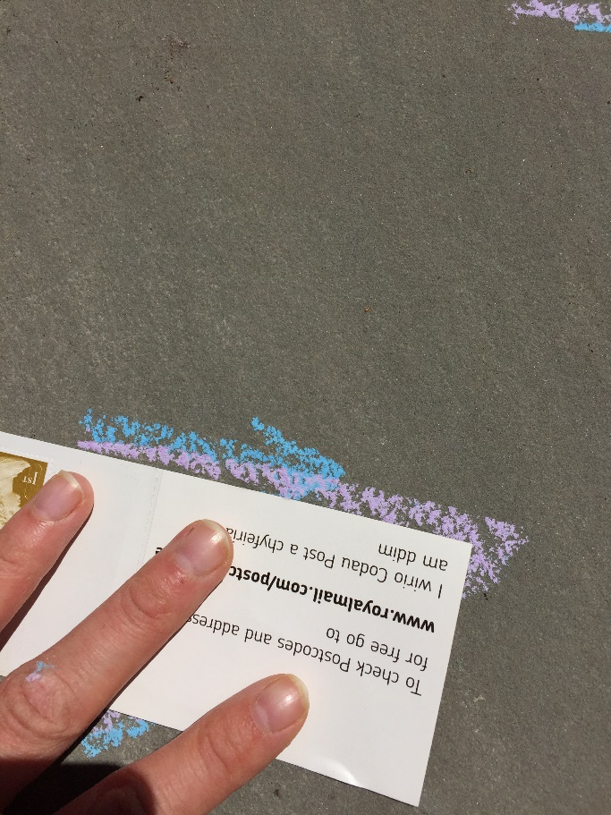
This time it doesn’t fit! The edge of my paper is overlapping the angle. The angle is smaller than a right angle.
This is an acute angle.

Slide 18
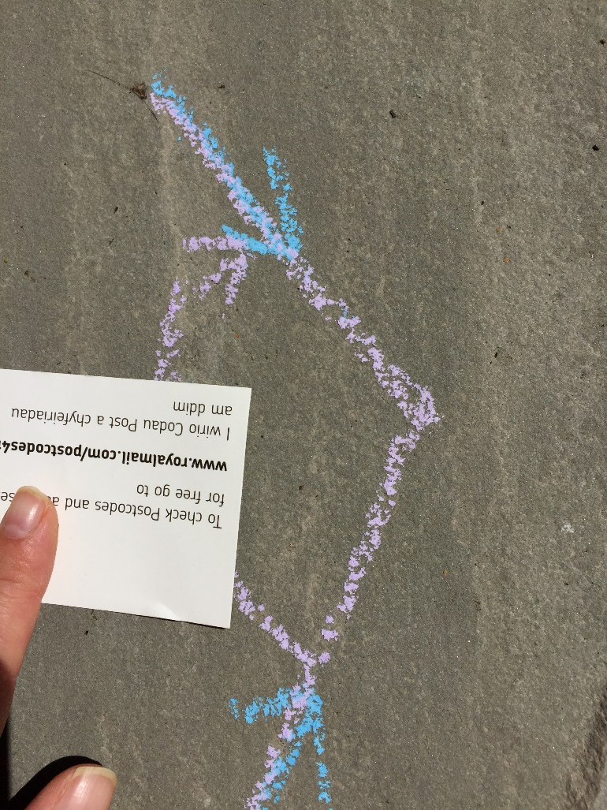
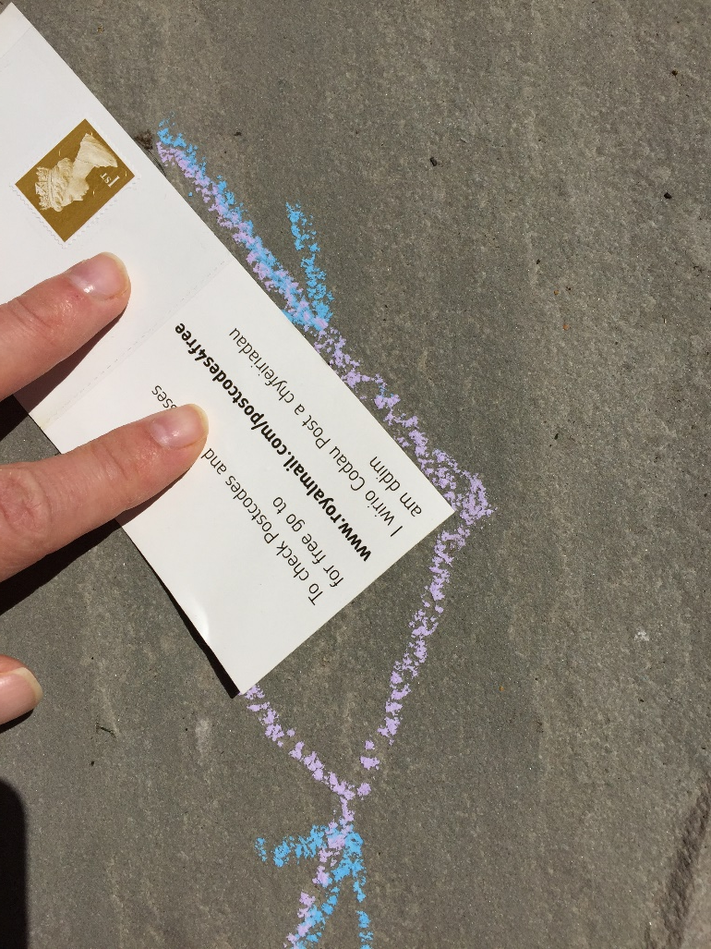
This time, you can see that the corner of the paper is smaller than the angle. The angle is bigger than a right angle.
This angle is obtuse.

Slide 19
See if you can tell whether these are obtuse, acute or right angles. Click to see the answers.
Acute
Acute
Obtuse
Right angle
Acute

