Slide 1
Maths
Addition and Subtraction
Year One
Maths | Year 2 | Addition and Subtraction | Addition and Subtraction Strategies | Lesson 4 of 8: Backflips

Slide 3
Aim
I can subtract a 1-digit number from a 2-digit number.
Success Criteria
I can apply number bonds to higher numbers.
I can spot a pattern.
I can explain the pattern and use it to help me.

Slide 4
Sharp Eyes!
Subtract the number indicated on the slide from all the other numbers.
Discuss what you notice with your partner.
Explain to each other why this happens and think of some other examples to fit the pattern.

Slide 5
Sharp Eyes!
-1
90
80
70
60
50
40

Slide 6
Sharp Eyes!
-7
67
27
17
97
47

Slide 7
Sharp Eyes!
-2
11
21
31
41
51

Slide 8
Sharp Eyes!
-8
38
68
98
48
78
58

Slide 9
Sharp Eyes!
Can you make up your own for a friend to solve?

Slide 10
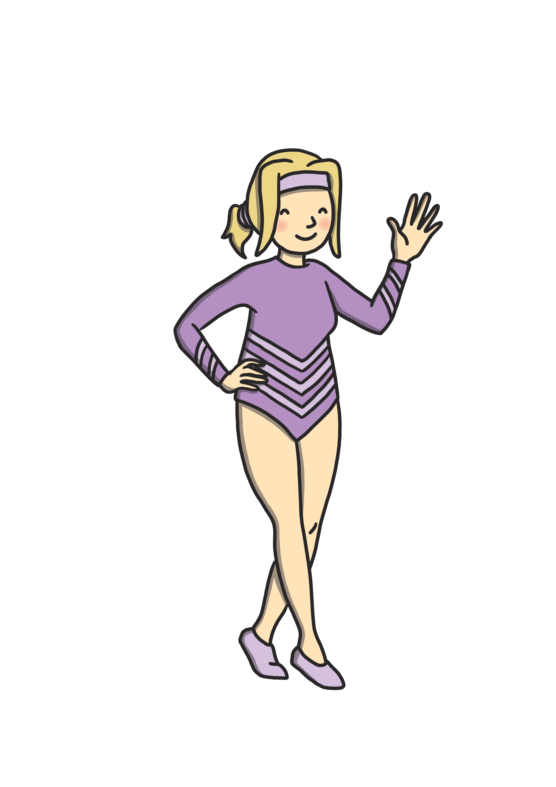
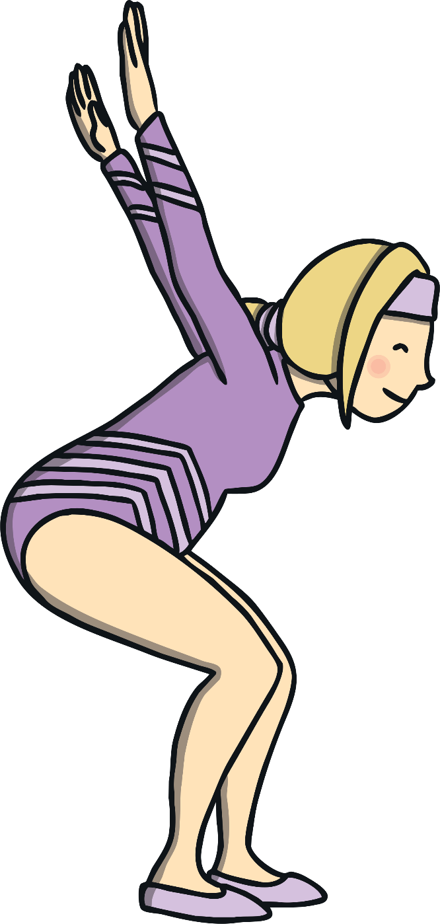
Jump Back Jill
This is Jump Back Jill.
She does amazing backflips along the number line!
She is going to help us to subtract!

Slide 11
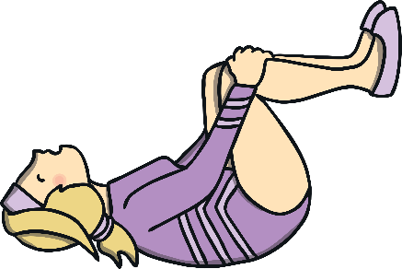
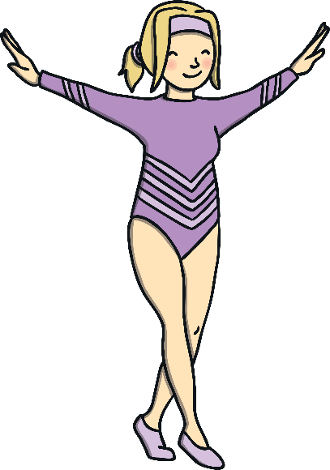
Jump Back Jill
Jill always lands on a multiple of 10 as she knows it’s not wobbly!
Watch her work out 14 – 4.
1
3
2
4
7
5
8
12
13
6
11
9
10
14
14 – 4 = 10

Slide 12
Jumping Further
Help Jill work out 33 - 5.
Jump back to thirty first
If she jumps back 3, she will land on 30.
33 – 5 = 28
I know 5 is a 3 and a 2.
So she now needs to jump back 2 more. She will land on 28.
27
26
28
32
29
31
33
30
34
35
20
21
22
23
24
25
26
27
28
29
30
31
32
33
34
35

Slide 13
Jumping Further
Help Jill work out 45-8.
45 – 8 = 37
If she jumps back 5, she will land on 40.
So she now needs to jump back 3 more. She will land on 37.
I know 8 is a 5 and a 3.
42
39
41
43
36
38
40
44
37
45
46
30
31
32
33
34
35
36
37
38
39
40
41
42
43
44
45

Slide 14
Jumping Further
Help Jill work out 94 - 6.
94 – 6 = 88
If she jumps back 4, she will land on 90.
So she now needs to jump back 2 more. She will land on 88.
I know 6 is a 4 and a 2.
91
88
90
92
85
87
89
93
86
94
95
80
81
82
83
84
85
86
87
88
89
90
91
92
93
94
95

Slide 15
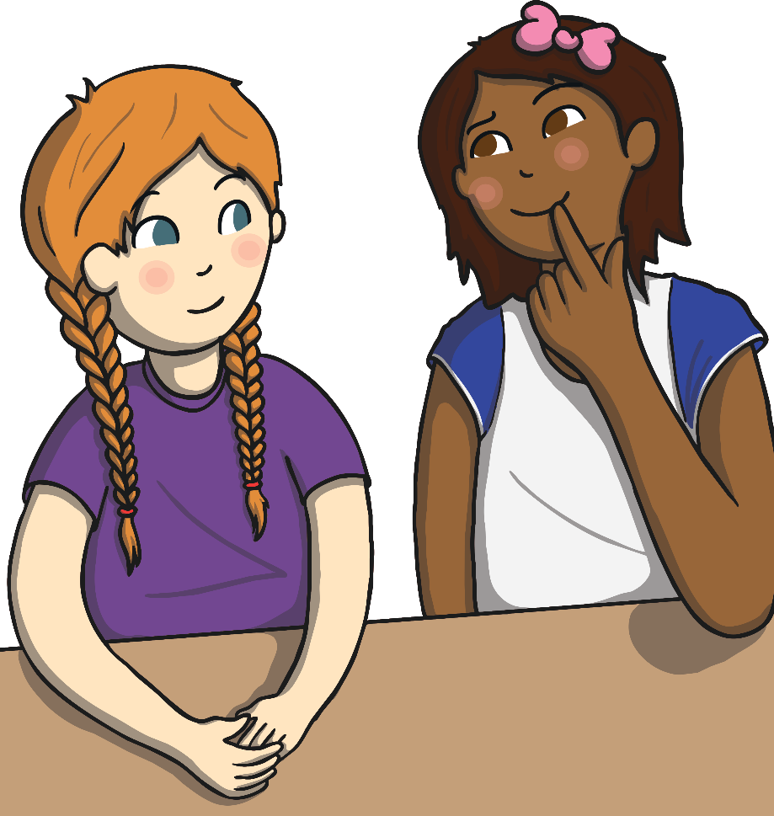
Diving into Mastery
Dive in by completing your own activity!

Slide 16
Aim
I can subtract a 1-digit number from a 2-digit number.
Success Criteria
I can apply number bonds to higher numbers.
I can spot a pattern.
I can explain the pattern and use it to help me.

