Slide 1
Maths
Addition and Subtraction
Year One
Maths | Year 2 | Addition and Subtraction | Difference | Lesson 1 of 2: Comparing

Slide 3
Aim
I can find the difference between 2 numbers.
Success Criteria
I can count between numbers.
I can use efficient jumps.
I can use ‘difference’ in a context.

Slide 4
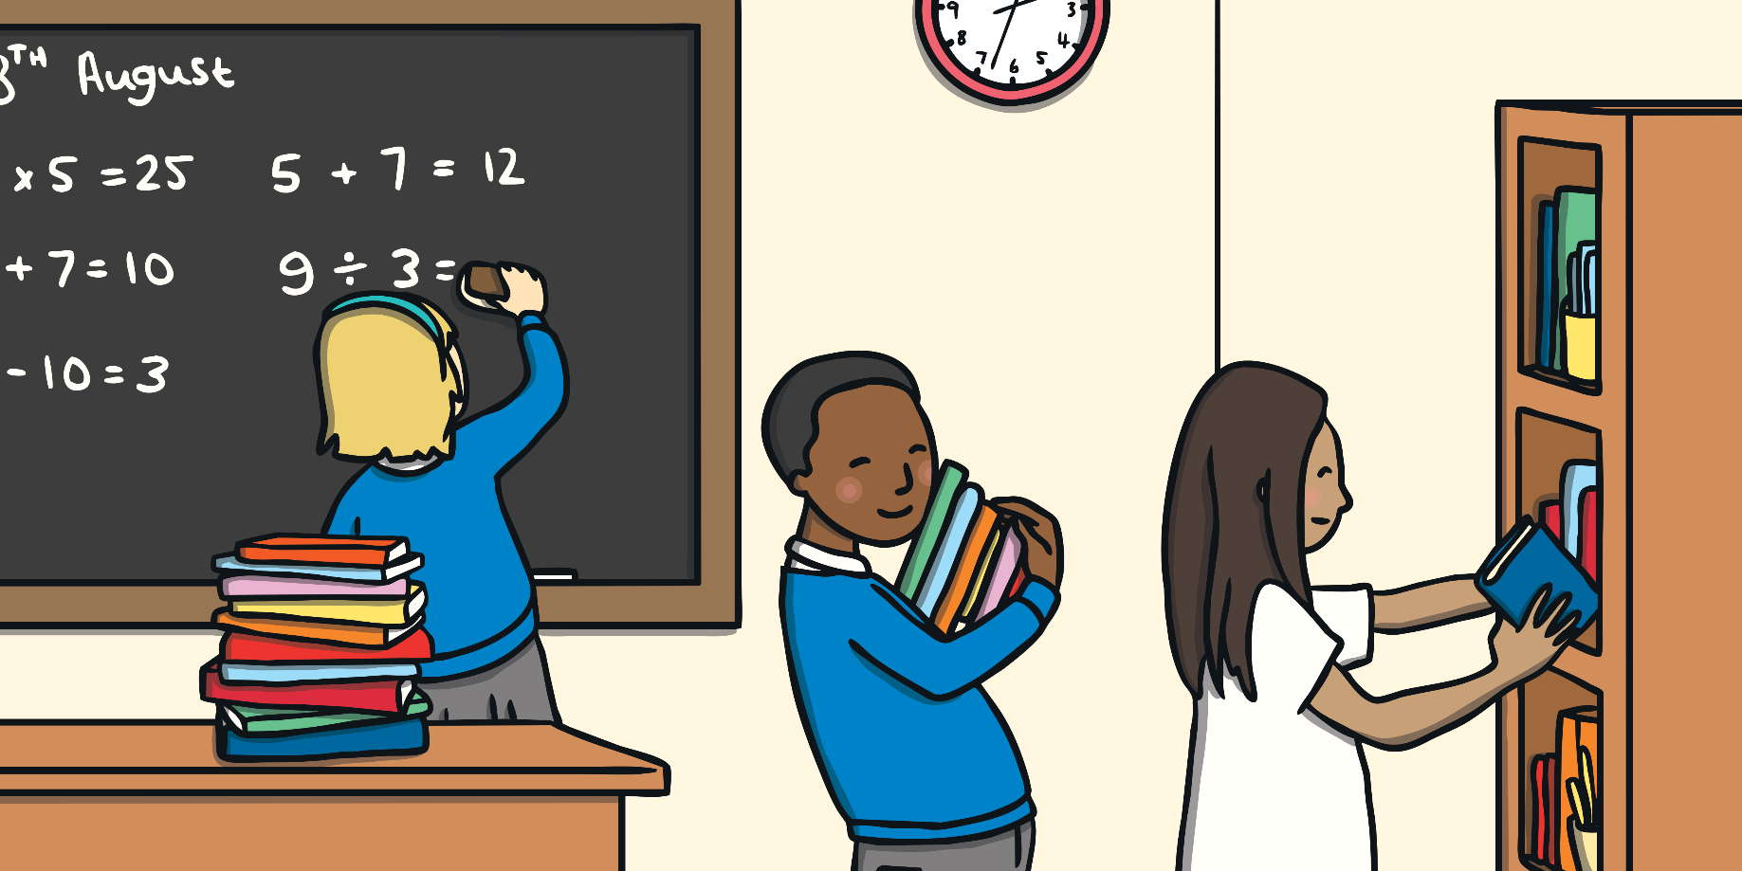
Tick-Tock
How many examples can you find to fit the clue?
The clock is ticking!

Slide 5
Tick-Tock
Think of pairs of numbers where one is…
5
more than the other
0:59
0:58
0:57
0:56
0:55
0:54
0:53
0:52
0:51
0:50
0:49
0:48
0:47
0:46
0:45
0:44
0:43
0:42
0:41
0:40
0:39
0:38
0:37
0:36
0:35
0:34
0:33
0:32
0:31
0:30
0:29
0:28
0:27
0:26
0:25
0:24
0:23
0:22
0:21
0:20
0:19
0:18
0:17
0:16
0:15
0:14
0:13
0:12
0:11
0:10
0:09
0:08
0:07
0:06
0:05
0:04
0:03
0:02
0:01
Time’s up!
8
9
0
1
10
11
2
3
12
13
4
5
Start

Slide 6
Tick-Tock
Think of pairs of numbers where one is…
9
less than the other
0:59
0:58
0:57
0:56
0:55
0:54
0:53
0:52
0:51
0:50
0:49
0:48
0:47
0:46
0:45
0:44
0:43
0:42
0:41
0:40
0:39
0:38
0:37
0:36
0:35
0:34
0:33
0:32
0:31
0:30
0:29
0:28
0:27
0:26
0:25
0:24
0:23
0:22
0:21
0:20
0:19
0:18
0:17
0:16
0:15
0:14
0:13
0:12
0:11
0:10
0:09
0:08
0:07
0:06
0:05
0:04
0:03
0:02
0:01
Time’s up!
9
10
11
12
13
14
15
16
17
18
Start

Slide 7
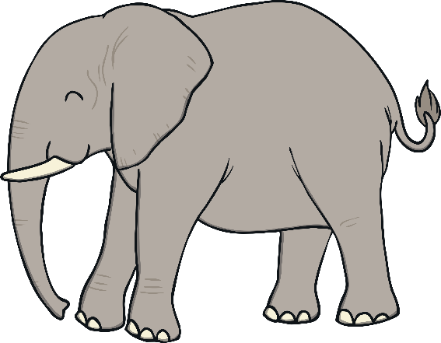
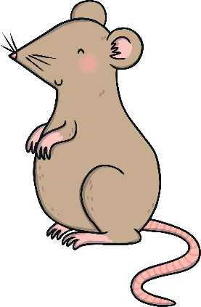
Find the Difference
In maths, we use the word ‘difference’ to compare numbers.
It means:
How much bigger one number is than another.
How much smaller one number is than another.
10
or
1

Slide 8
Find the Difference
5 is the same as 5!
There is no difference in their value.
There are 3 more bricks in this tower.
There are 3 fewer bricks in this tower.
The difference between 5 and 8 is 3.
0
1
2
3
4
5
6
7
8
9

Slide 9
Find the Difference
What is the difference between 37 and 53?
You may need to do bigger jumps!
+10
+3
+3
37
38
39
40
41
42
43
44
45
46
47
48
49
50
51
52
53
10 + 3 + 3 = 16
The difference between 37 and 53 is 16.

Slide 10
Jump On, Jump Back
Can you find the difference between 49 and 64?
Can you do efficient jumps on a number line?
I wonder if it makes a difference to the answer if we jump forwards or backwards.

Slide 11
Jump On, Jump Back
+1
+10
+4
49
50
51
52
53
54
55
56
57
58
59
60
61
62
63
64
65
- 1
- 10
- 4
49
50
51
52
53
54
55
56
57
58
59
60
61
62
63
64
65
What do you think?
Does it make a difference to the answer if we jump forwards or backwards? Which do you think is easier?

Slide 12
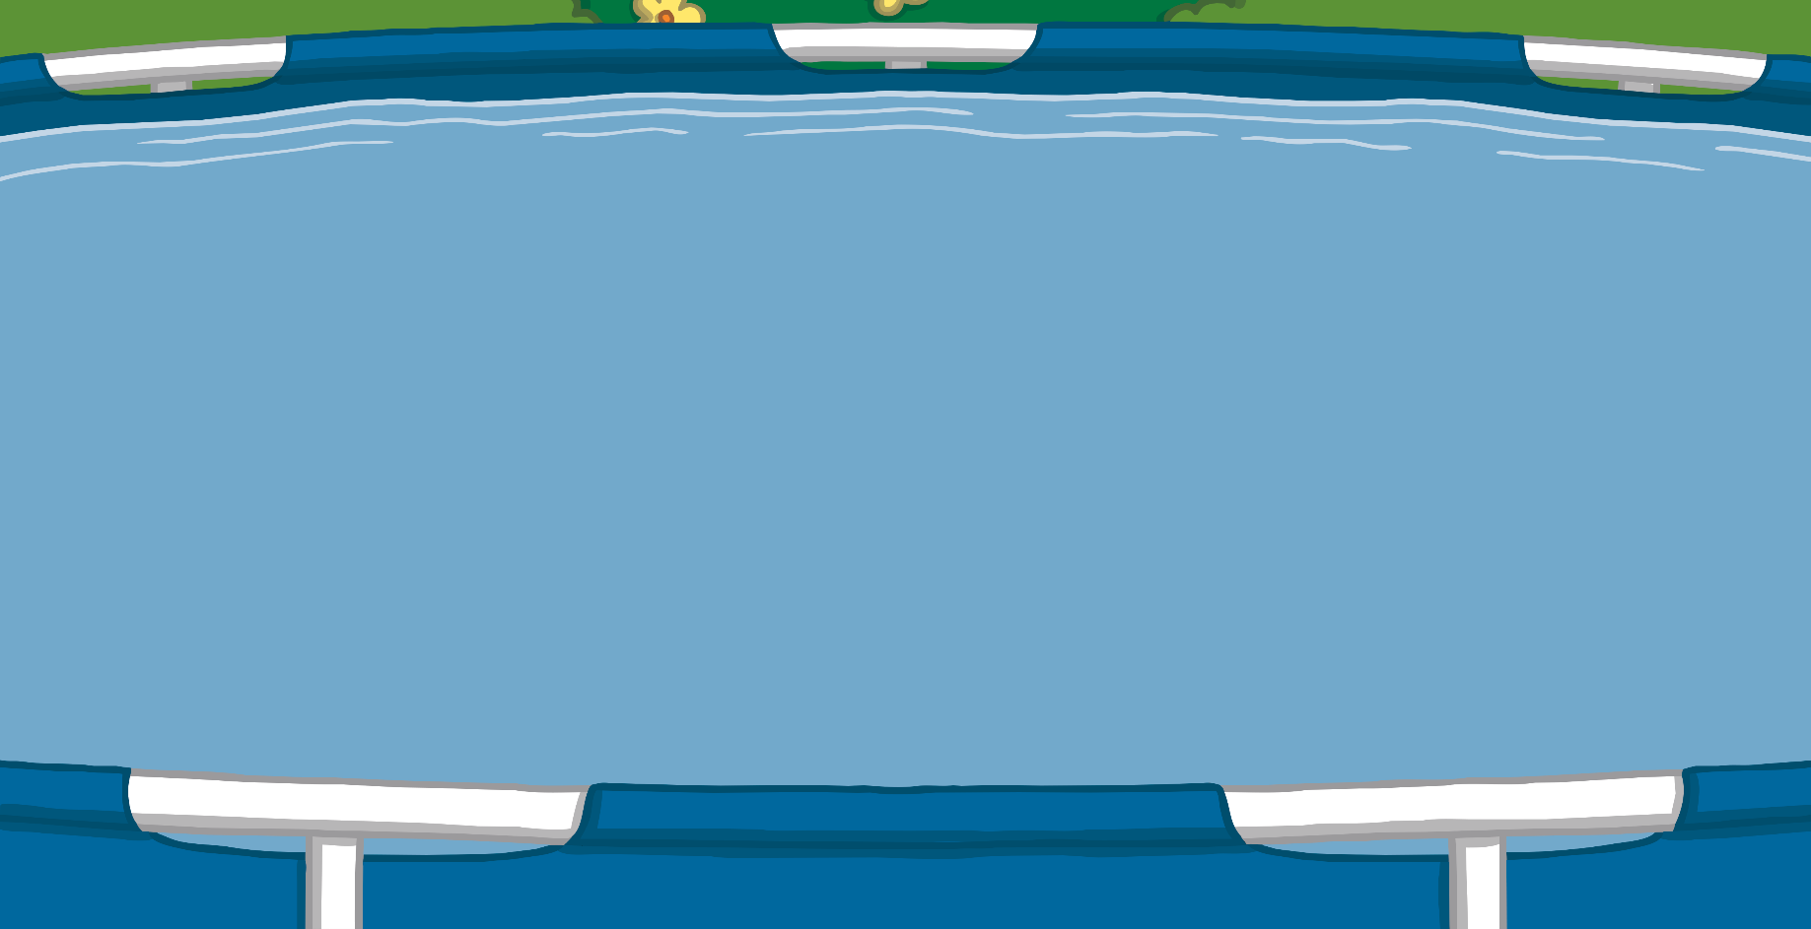
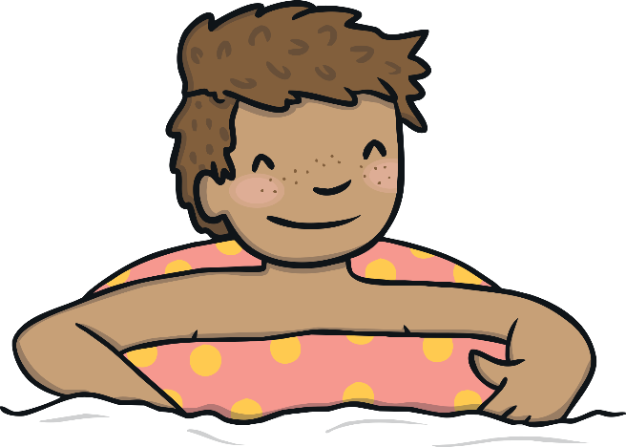
Comparing
We use lots of words in our every day speech to measure ‘difference’.
How much farther did I swim than Ben?

Slide 13
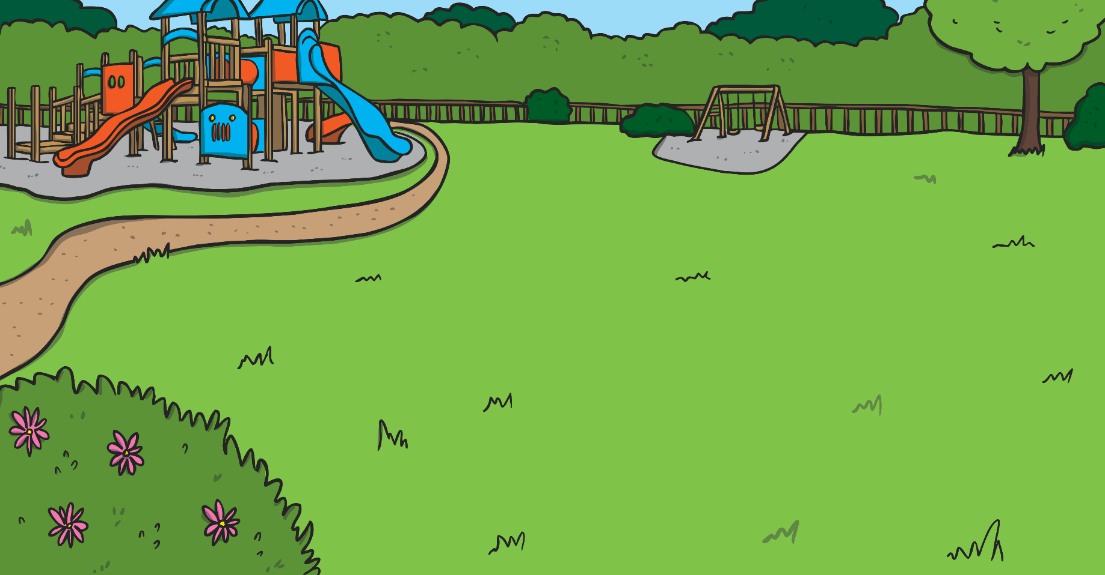
Comparing
We use lots of words in our every day speech to measure ‘difference’.
How much taller am I than my brother?

Slide 14
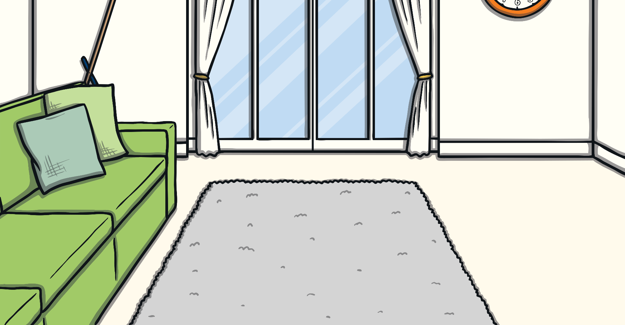
Comparing
We use lots of words in our every day speech to measure ‘difference’.
How much younger am I than my sister?

Slide 15
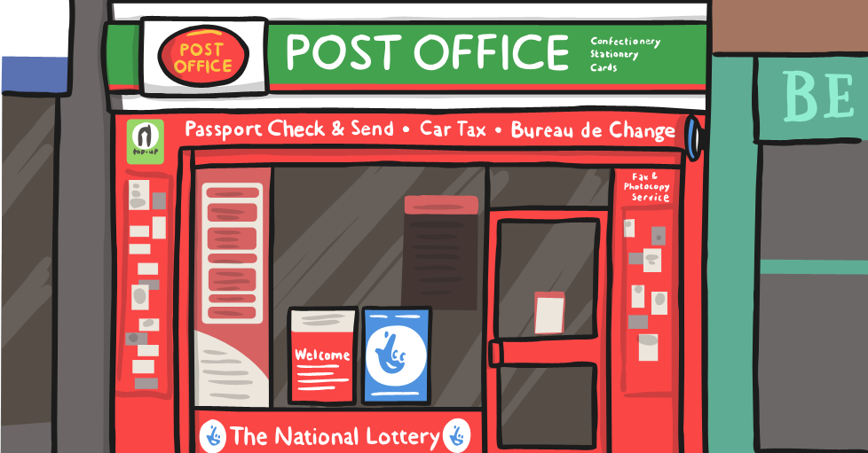
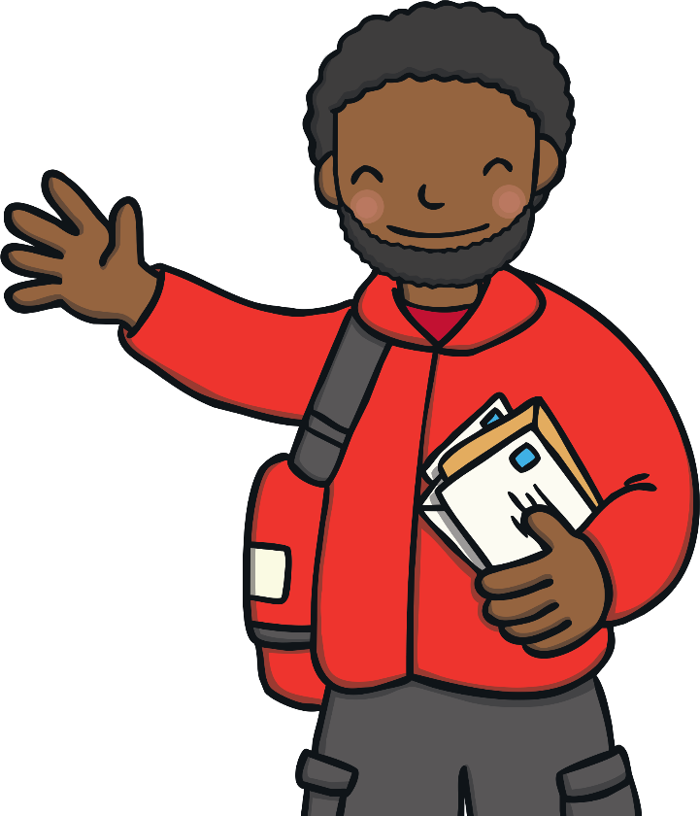
Comparing
We use lots of words in our every day speech to measure ‘difference’.
How much heavier is my parcel than yours?

Slide 16
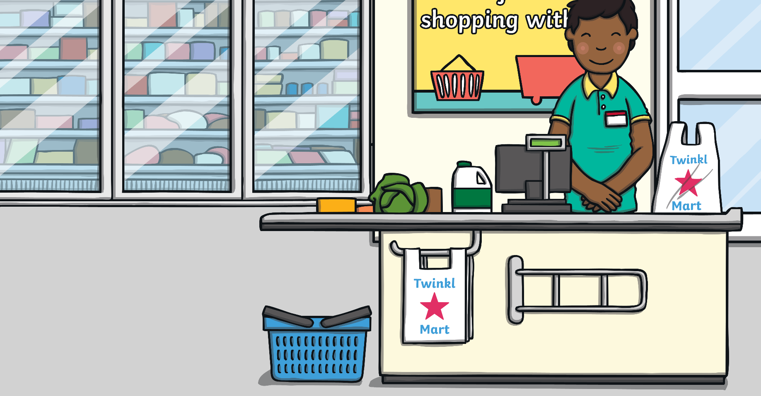
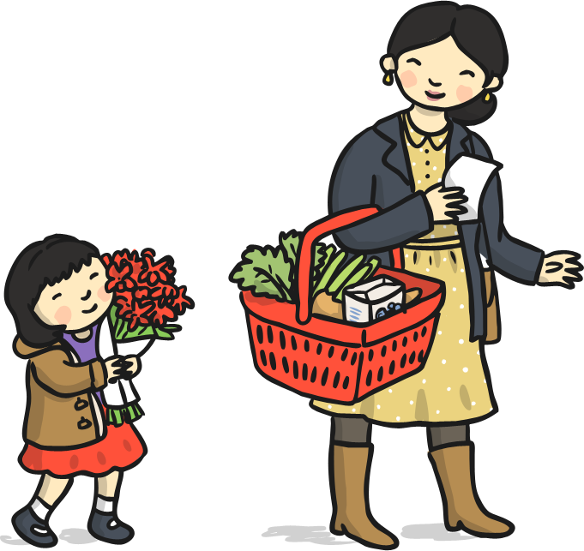
Comparing
We use lots of words in our every day speech to measure ‘difference’.
How much cheaper was my shopping than yours?

Slide 17
Comparing
We use lots of words in our every day speech to measure ‘difference’.
How much faster did I run than you?

Slide 18
Comparing
Can you think of any more examples of comparing words?

Slide 19
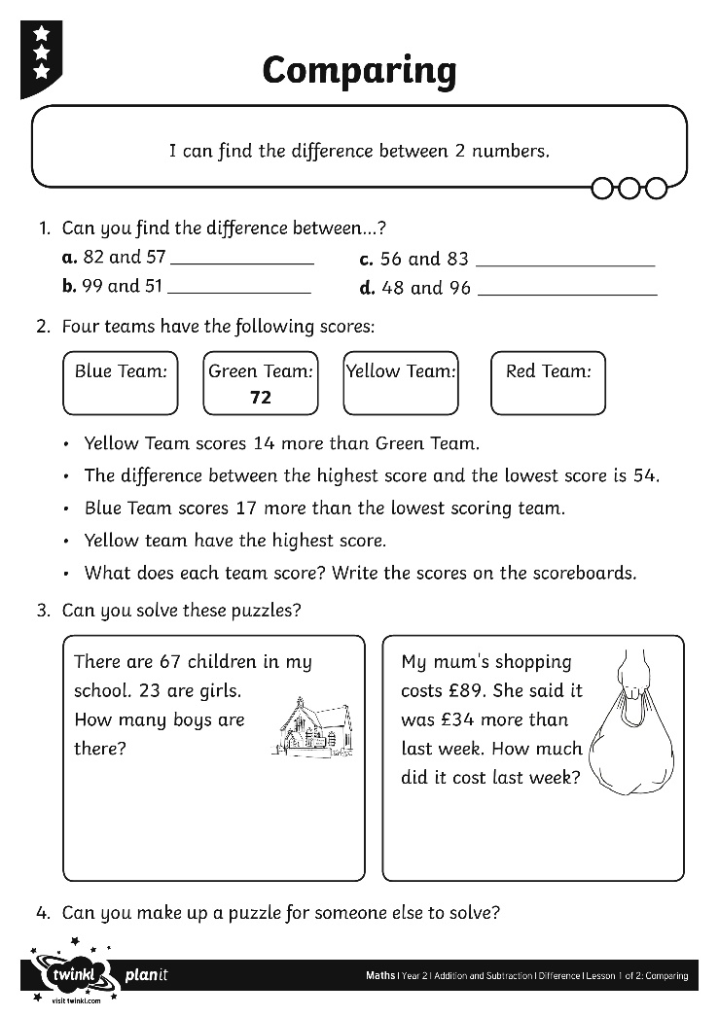
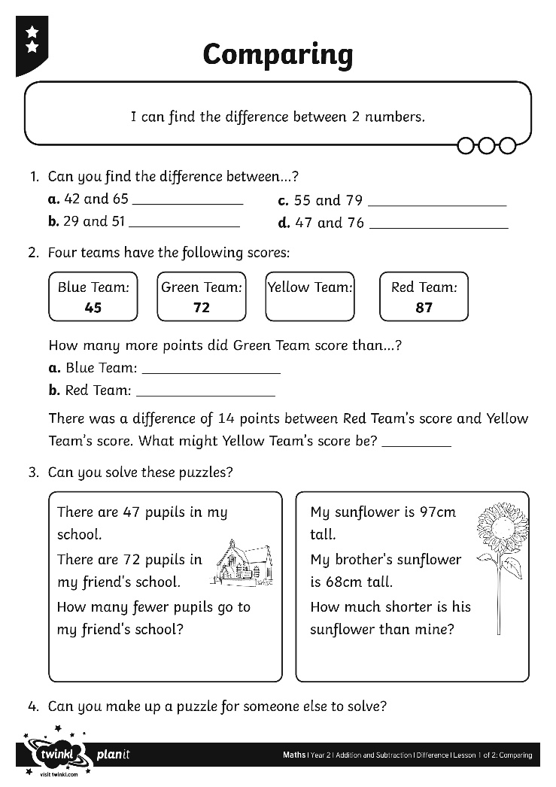
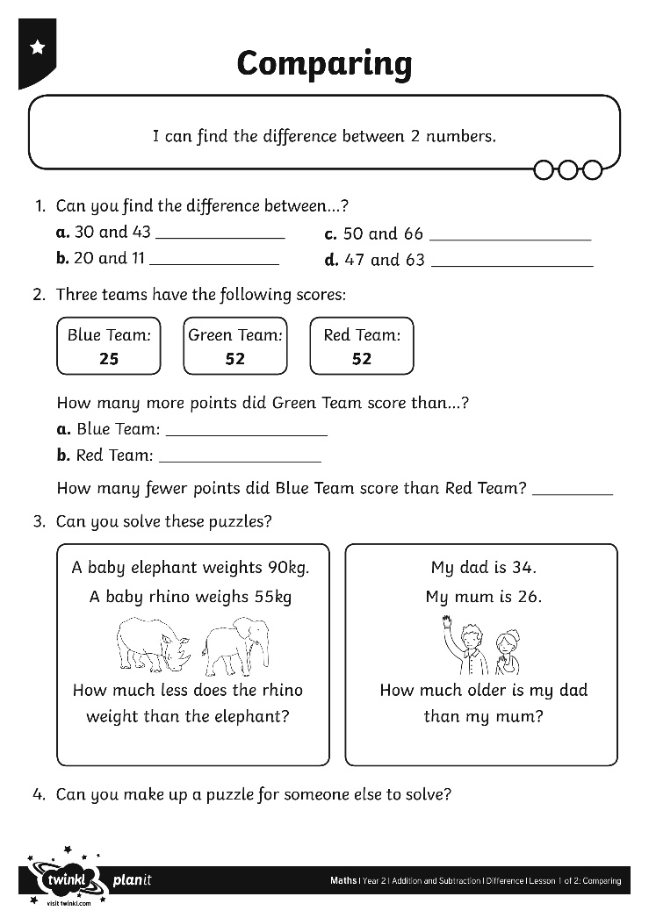
Activity

Slide 20
Thoughts
Ben says finding the difference is the same as subtracting.
Do you agree? Explain your thinking.

Slide 21
Aim
I can find the difference between 2 numbers.
Success Criteria
I can count between numbers.
I can use efficient jumps.
I can use ‘difference’ in a context.

