Slide 1
Maths
Addition and Subtraction
Year One
Maths | Year 2 | Addition and Subtraction | Addition and Subtraction Strategies | Lesson 1 of 8: Follow That Pattern

Slide 3
Aim
I can add a 1-digit number to a multiple of 10 and perform the inverse.
Success Criteria
I can add a 1-digit number to a multiple of 10.
I can subtract a 1-digit number from a multiple of 10.
I can spot a pattern.
I can continue a pattern.

Slide 4
Pattern Builders
Click to change the cards on the following slides.
Follow the instruction on the slide.
Write a number sentence for your calculation.

Slide 5
Pattern Builders
10
5
6
1
2
3
4
Can you add the two numbers together?
10 + 1 = 11
10 + 2 = 12
10 + 3 = 13
10 + 4 = 14
10 + 5 = 15
10 + 6 = 16
What do you notice?
Can you continue the pattern?

Slide 6
Pattern Builders
13
5
4
11
3
1
12
2
16
14
15
6
Subtract the smaller number from the larger one.
11 – 1 = 10
12 – 2 = 10
13 – 3 = 10
14 – 4 = 10
15 – 5 = 10
16 – 6 = 10
What do you notice?
Can you continue the pattern?

Slide 7
What Happens to Zero?
20 + 3 =
Tens
Ones
0
2
3
What happened to zero? Why does this happen?

Slide 8
What Happens to Zero?
40 + 7 =
Tens
Ones
0
4
7
What happened to zero? How do you know?

Slide 9
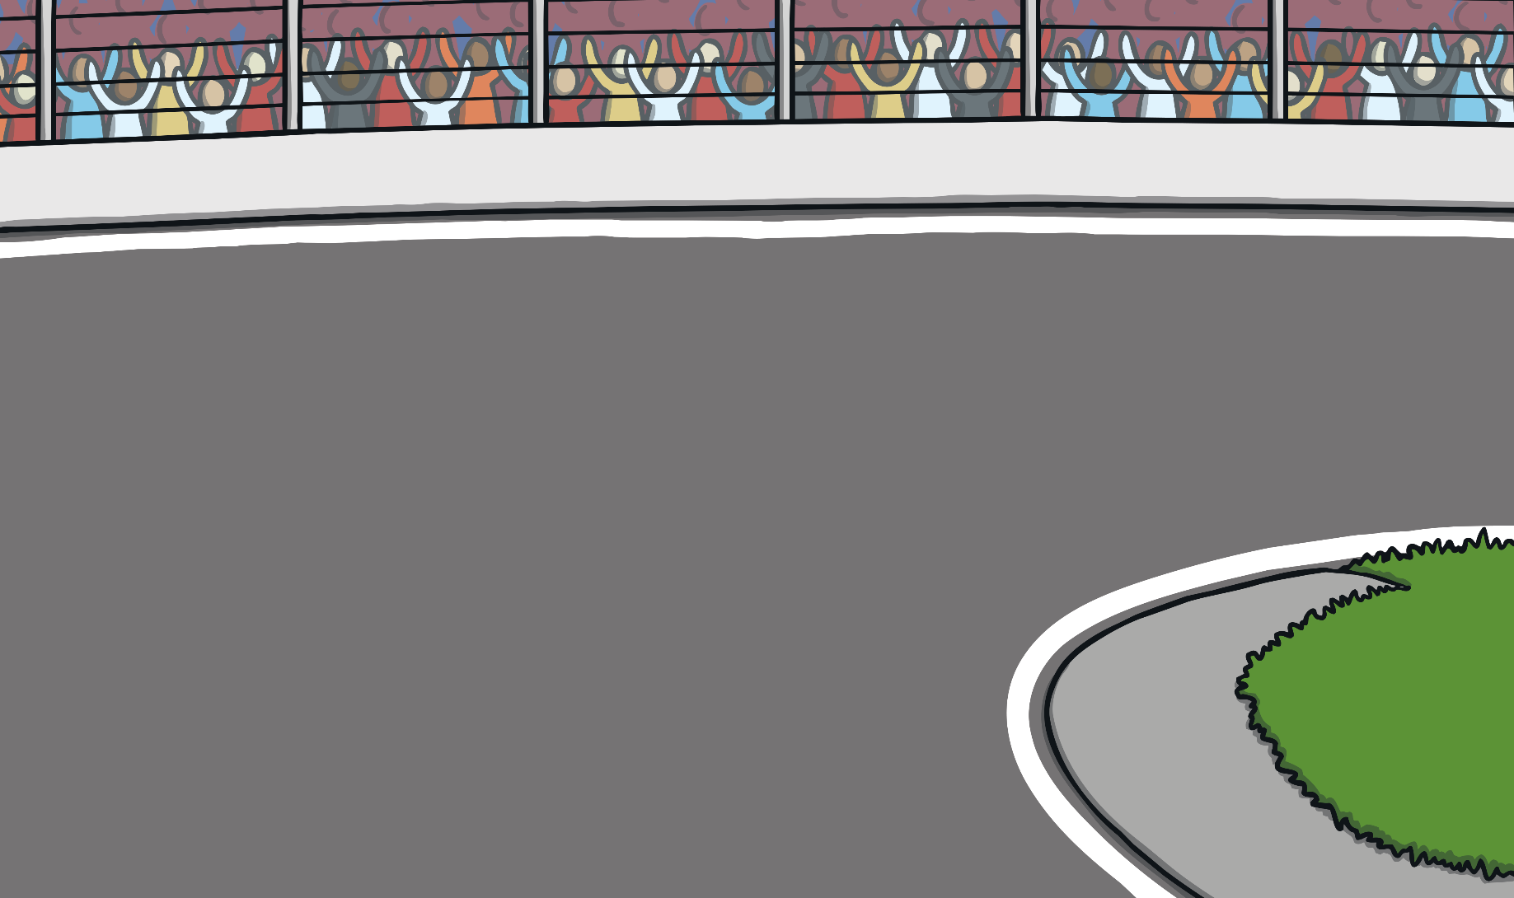
Fast and Furious
30 + 6 =
36
50 + 5 =
55
90 + 7 =
97
10 + 9 =
19
70 + 1 =
71
40 + 8 =
48
60 + 2 =
62
80 + 8 =
88
90 + 5 =
95
20 + 4 =
24
70 + 3 =
73
80 + 6 =
86

Slide 10
Finding Zero
37 – 7 =
Tens
Ones
7
3
0
What has happened? Why does this happen?

Slide 11
Finding Zero
54 – 4 =
Tens
Ones
4
5
0
What has happened? Why does this happen?

Slide 12
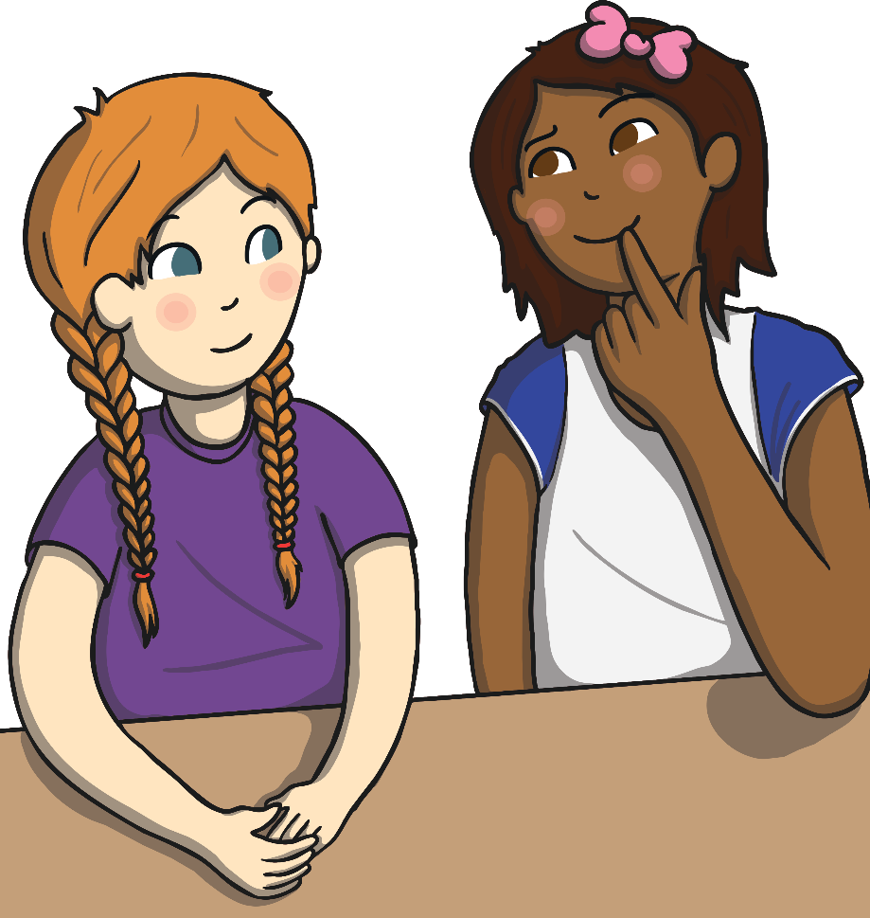
Diving into Mastery
Dive in by completing your own activity!

Slide 13
Aim
I can add a 1-digit number to a multiple of 10 and perform the inverse.
Success Criteria
I can add a 1-digit number to a multiple of 10.
I can subtract a 1-digit number from a multiple of 10.
I can spot a pattern.
I can continue a pattern.

