Slide 1
Maths
Addition and Subtraction
Year One
Maths | Year 2 | Addition and Subtraction | Addition and Subtraction Strategies | Lesson 2 of 8: Nimble Nines

Slide 3
Aim
I can add and subtract 9 from any 2-digit number.
Success Criteria
I can add 9.
I can subtract 9.
I can spot a pattern.
I can explain the pattern and use it to help me.

Slide 4
All the Tens
Turn over 2 cards and make a 2-digit number.
Add 10 to your number. Subtract 10 from your number.
Write a number sentence each time.
Repeat a few times.
I made 74.
4
7
74 + 10 = 84
74 – 10 = 64

Slide 5
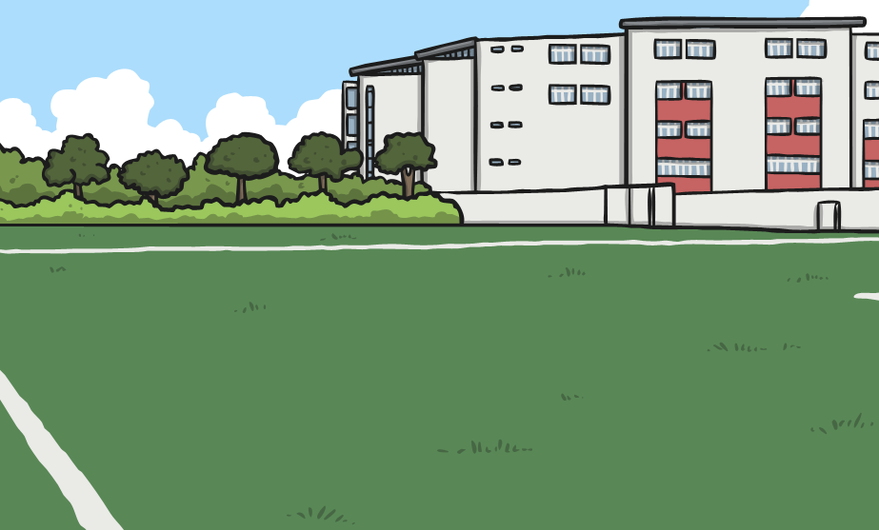
All the Tens
What did you notice?
Can you use equipment and a tens and ones frame to explain what happens and why this happens?
Can you make a rule using ‘always’, ‘sometimes’ or ‘never’?

Slide 6
Adding Ten
21 + 10 =
Tens
Ones
3
2
1
What happened to the tens column? What happened to the ones column? Why did this happen?

Slide 7
Adding Nine
What do you think will happen when we add 9?
Compare 9 to 10.
What do you notice?
I can see that 9 is one less than 10, but how will that help me add 9?

Slide 8
Adding Nine
I need to add 9 so first I add 10.
23 + 9 =
9 is one less than 10 so now I need to take 1 away.
Tens
Ones
3
2
2
3
What happened in the tens column? What happened in the ones column? Why did this happen?

Slide 9
Adding Nine
I need to add 9 so first I add 10.
35 + 9 =
9 is one less than 10 so now I need to take 1 away.
Tens
Ones
3
4
5
4
What happened in the tens column? What happened in the ones column? Why did this happen?

Slide 10
Practise
Choose a colour and complete each calculation.
24 + 9 =
33
22 + 9 =
31
9 + 9 =
18
34 + 9 =
43
23 + 9 =
32
18 + 9 =
27
44 + 9 =
53
24 + 9 =
33
27 + 9 =
36
54 + 9 =
63
25 + 9 =
34
36 + 9 =
45
64 + 9 =
73
26 + 9 =
35
45 + 9 =
54
What did you notice? Why does this happen?

Slide 11
Subtracting Ten
40 – 10 =
Tens
Ones
4
3
0
What happened to the tens column? What happened to the ones column? Why did this happen?

Slide 12
Subtracting Nine
I need to subtract 9 so first I subtract 10.
45 – 9 =
I have taken away 1 too many so now I need to add one back on.
Tens
Ones
3
4
5
6
What happened in the tens column? What happened in the ones column? Why did this happen?

Slide 13
Subtracting Nine
I need to subtract 9 so first I subtract 10.
74 – 9 =
I have taken away 1 too many so now I need to add one back on.
Tens
Ones
6
7
4
5
What happened in the tens column? What happened in the ones column? Why did this happen?

Slide 14
Space Spotting
Do the numbers differ by 9?
Explain how you know.
11
20

Slide 15
Space Spotting
Do the numbers differ by 9?
Explain how you know.
14
21

Slide 16
Space Spotting
Do the numbers differ by 9?
Explain how you know.
26
35

Slide 17
Space Spotting
Do the numbers differ by 9?
Explain how you know.
32
43

Slide 18
Space Spotting
Do the numbers differ by 9?
Explain how you know.
67
81

Slide 19
Space Spotting
Do the numbers differ by 9?
Explain how you know.
58
49

Slide 20
Space Spotting
Do the numbers differ by 9?
Explain how you know.
55
64
73

Slide 21
Aim
I can add and subtract 9 from any 2-digit number.
Success Criteria
I can add 9.
I can subtract 9.
I can spot a pattern.
I can explain the pattern and use it to help me.

